Slide 1
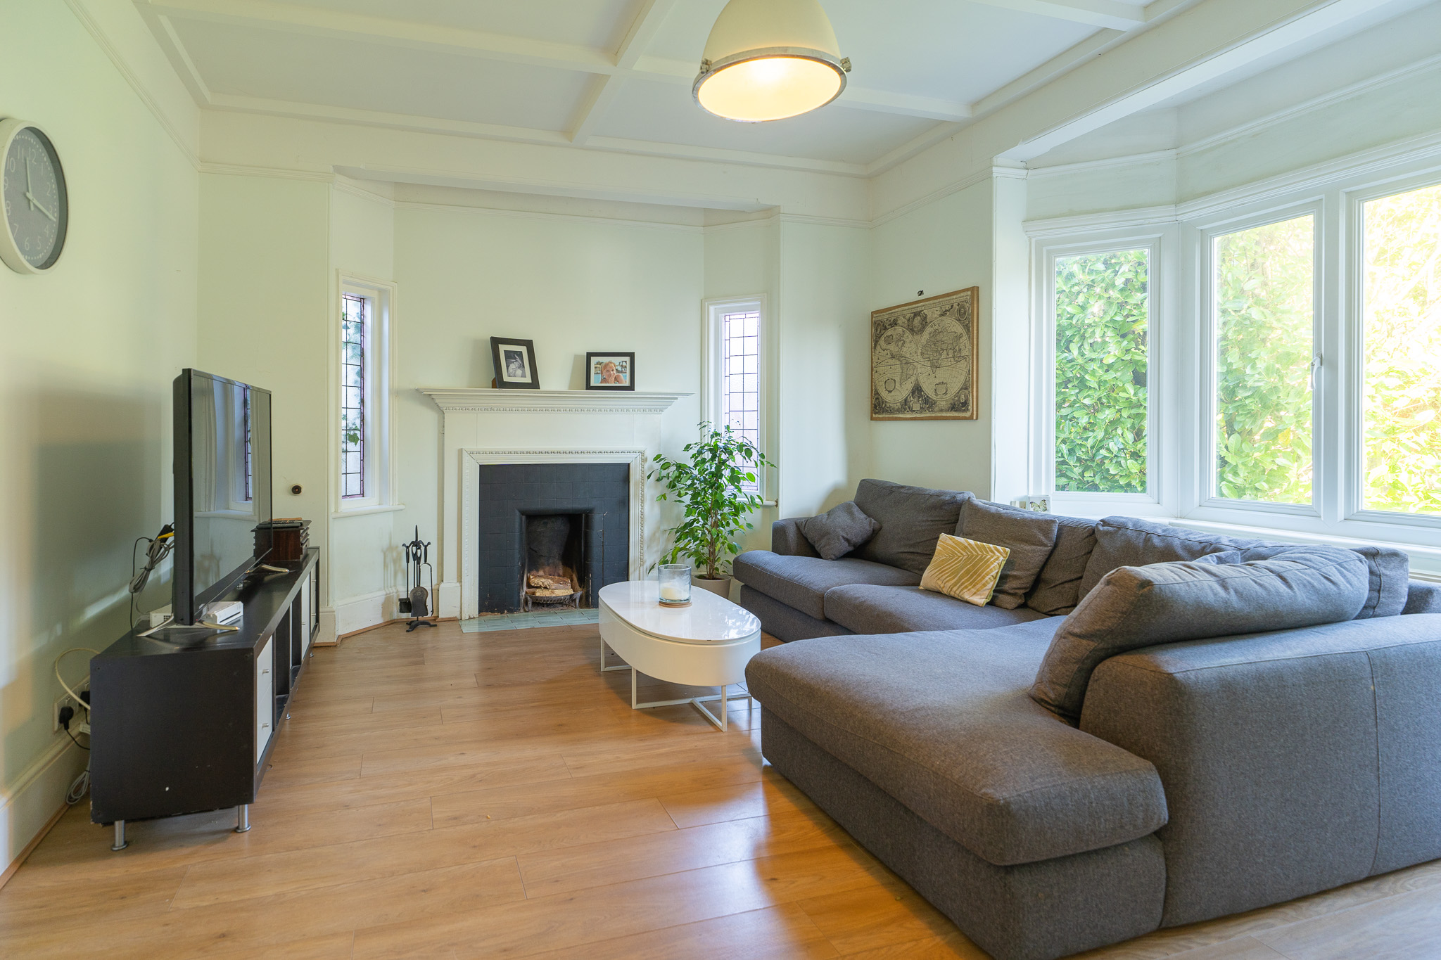
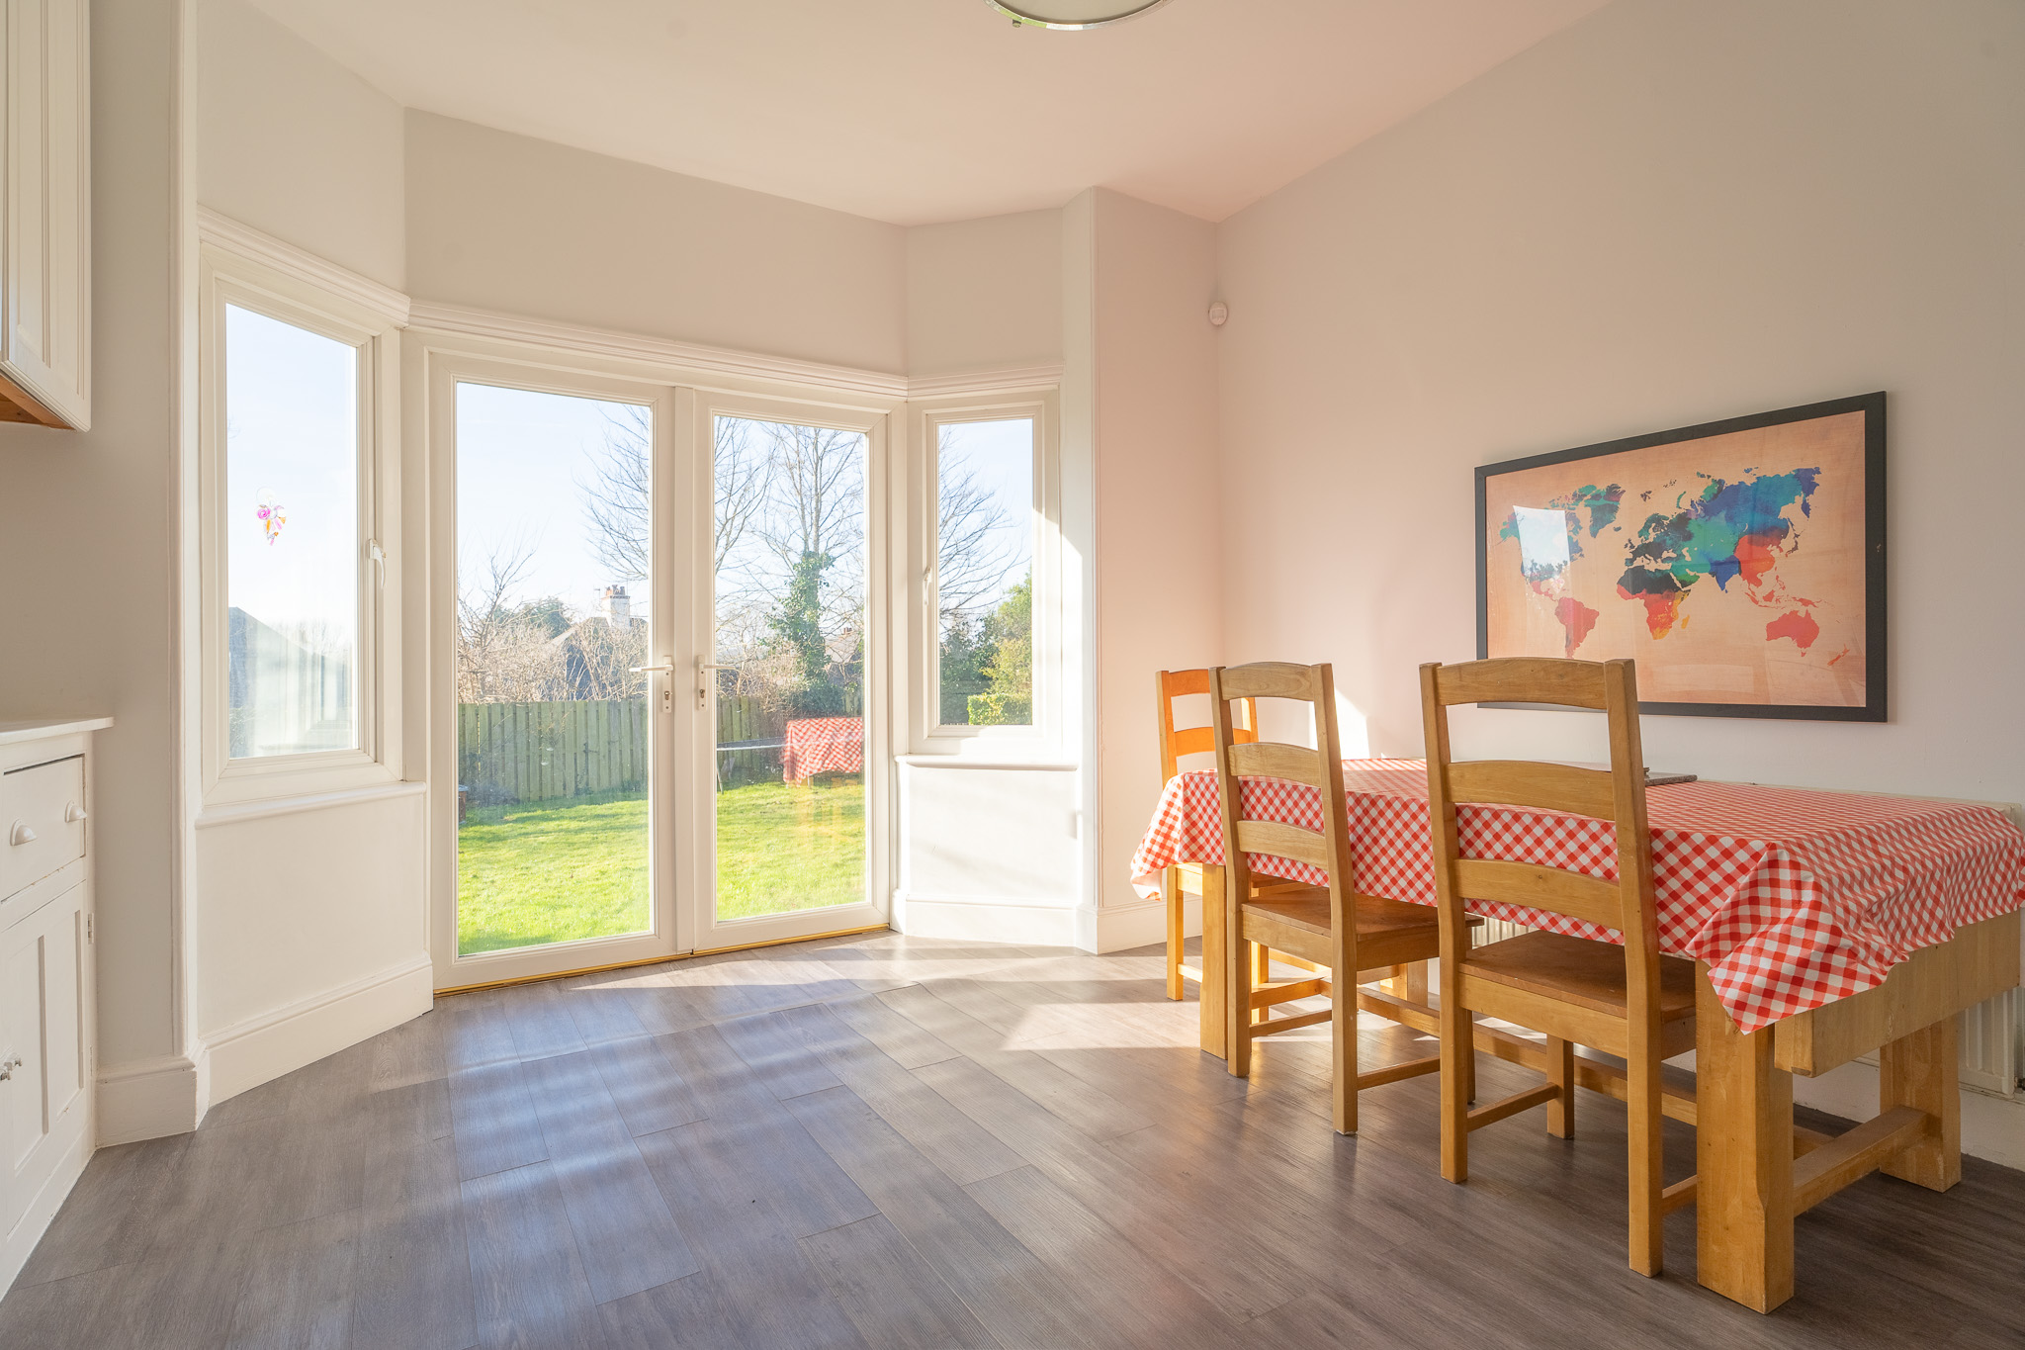
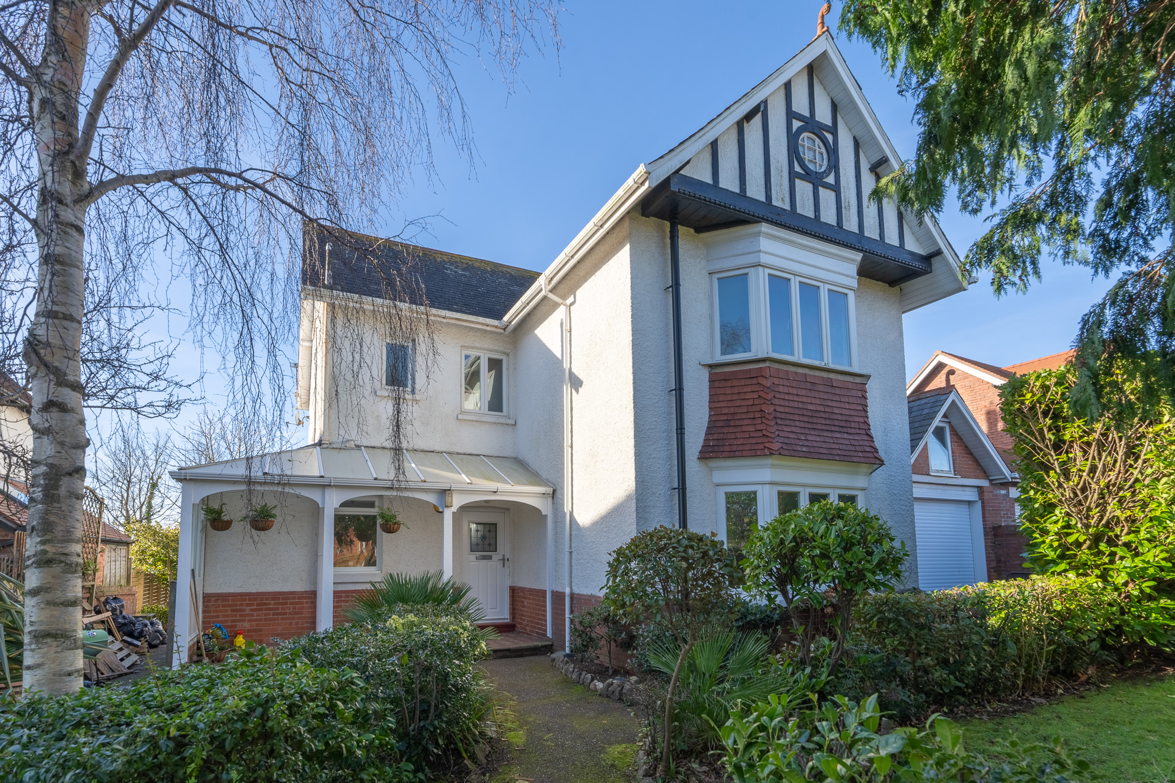
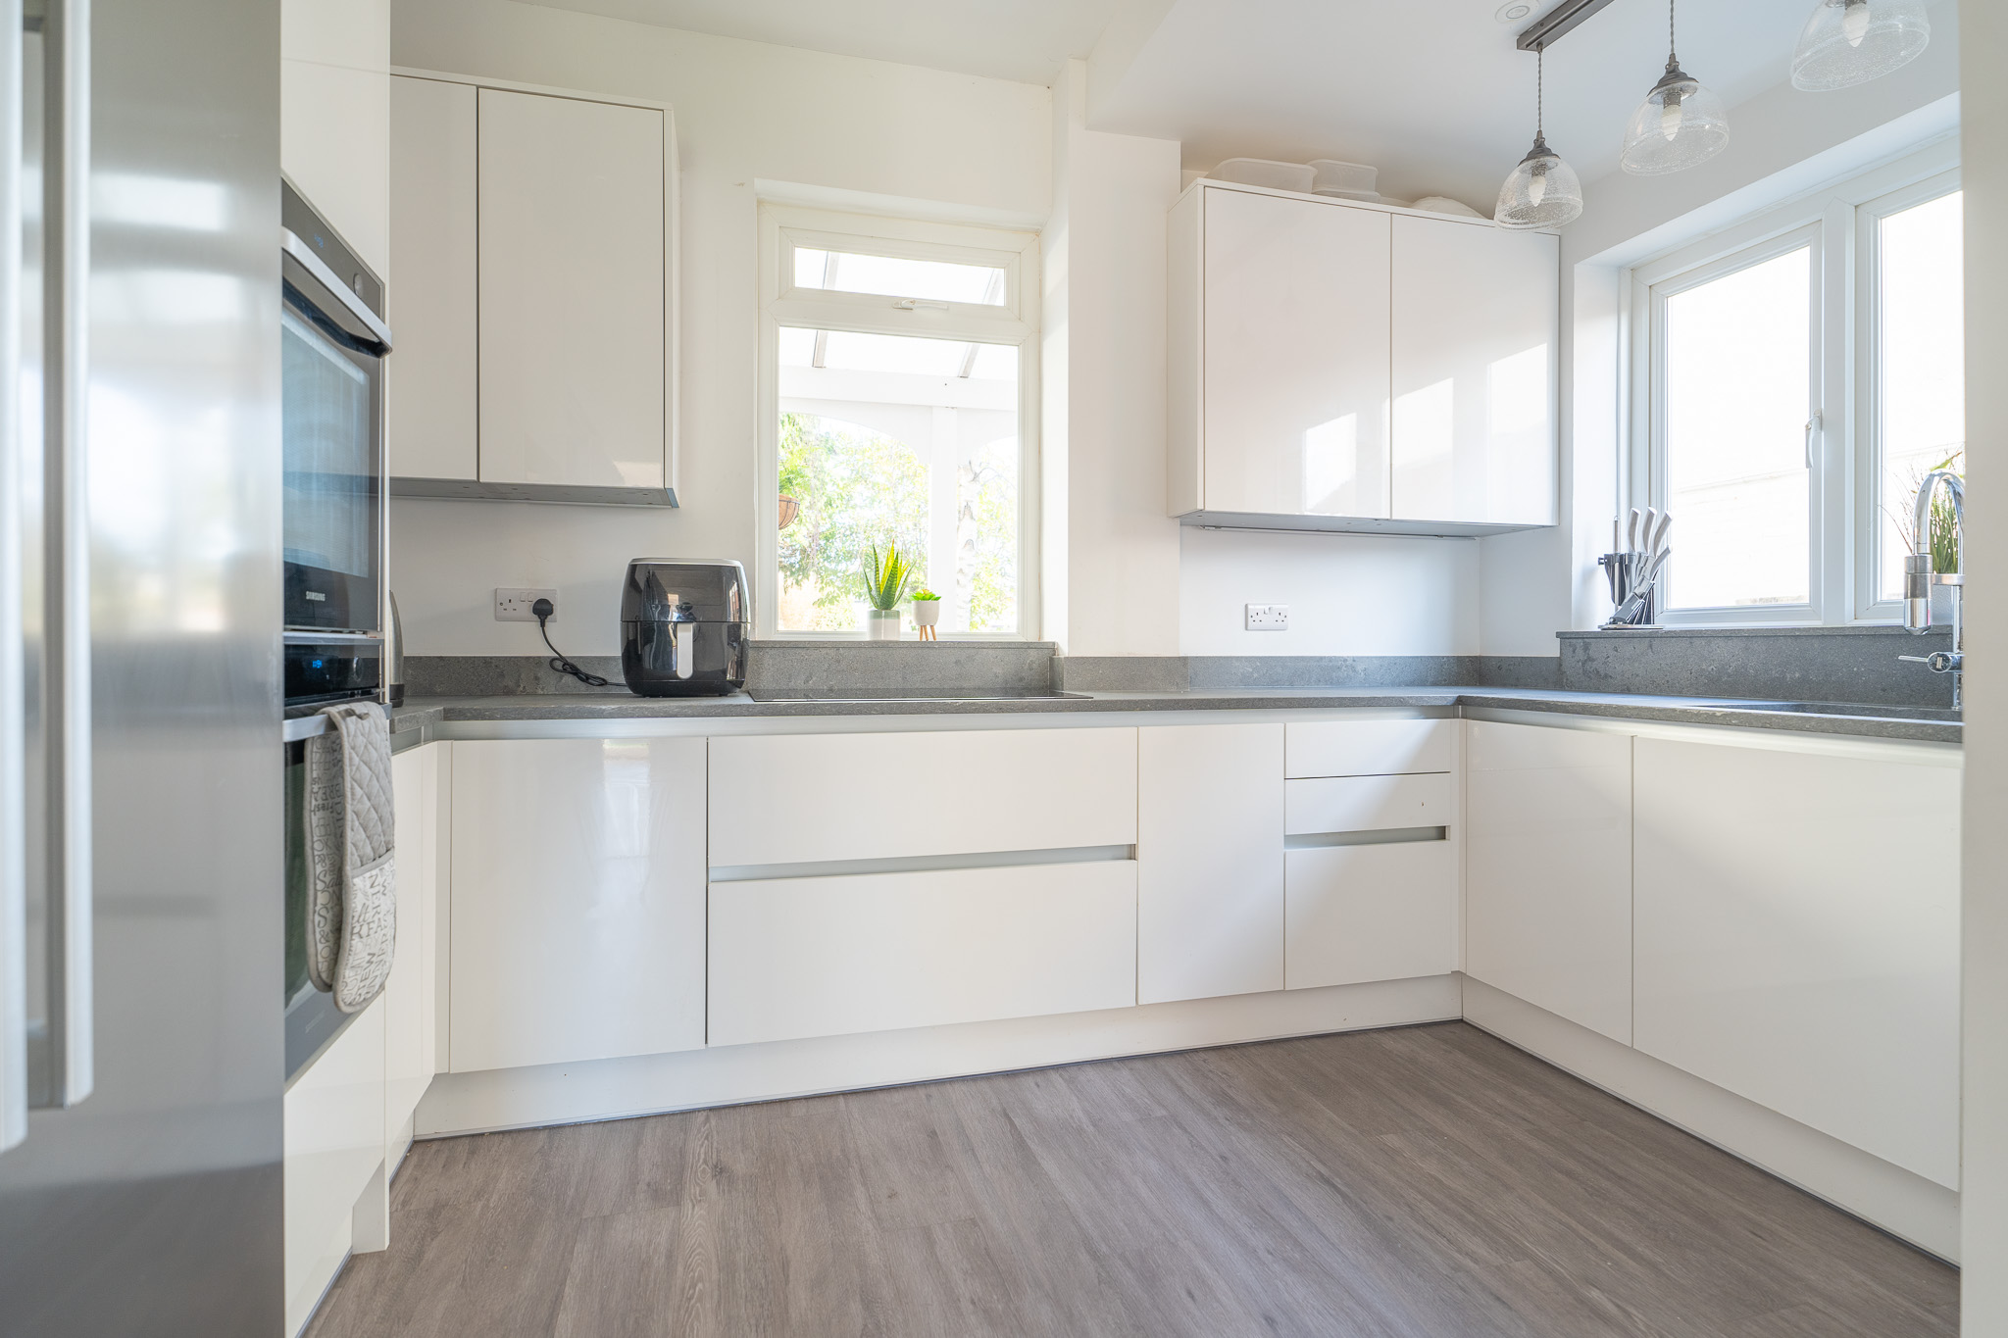
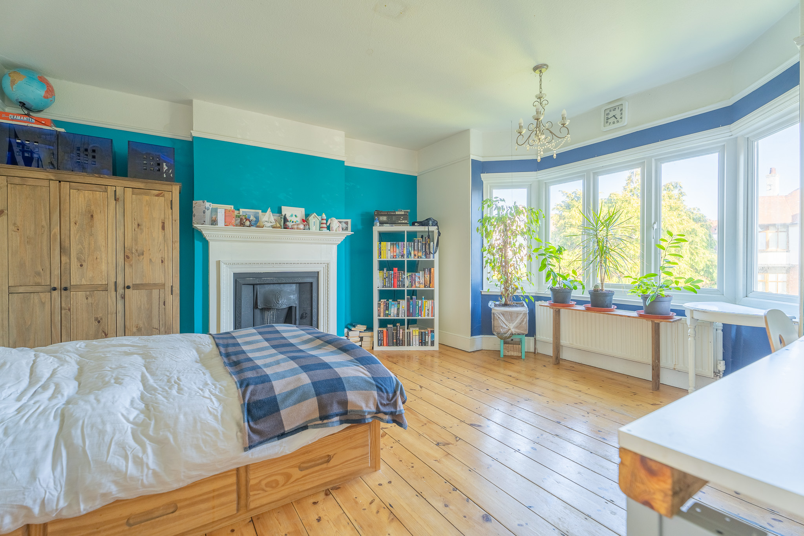
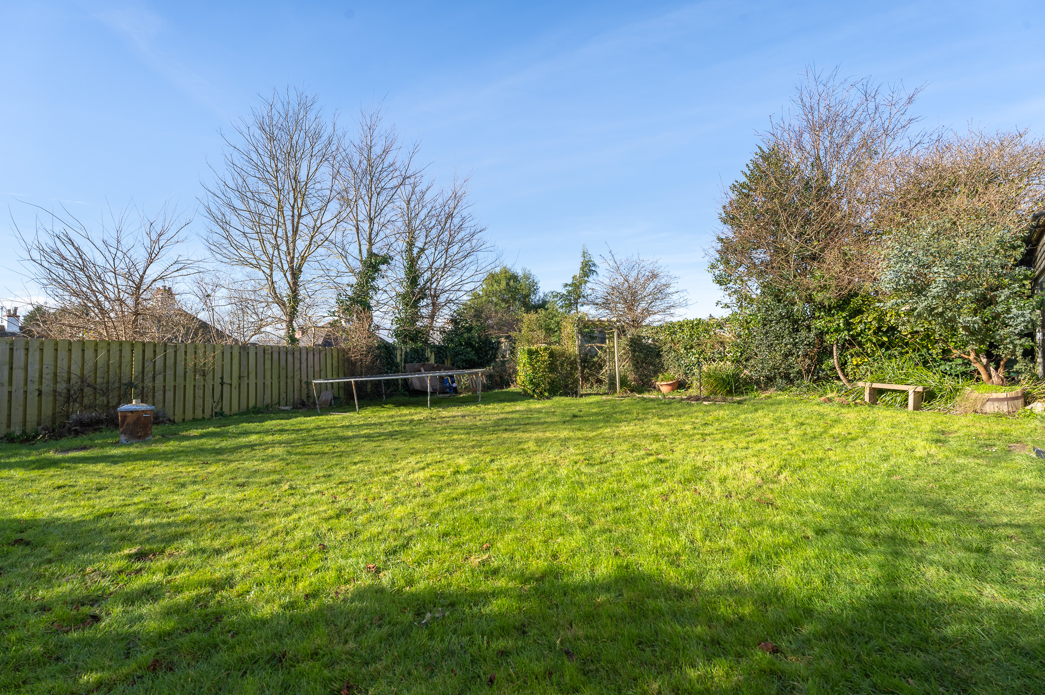
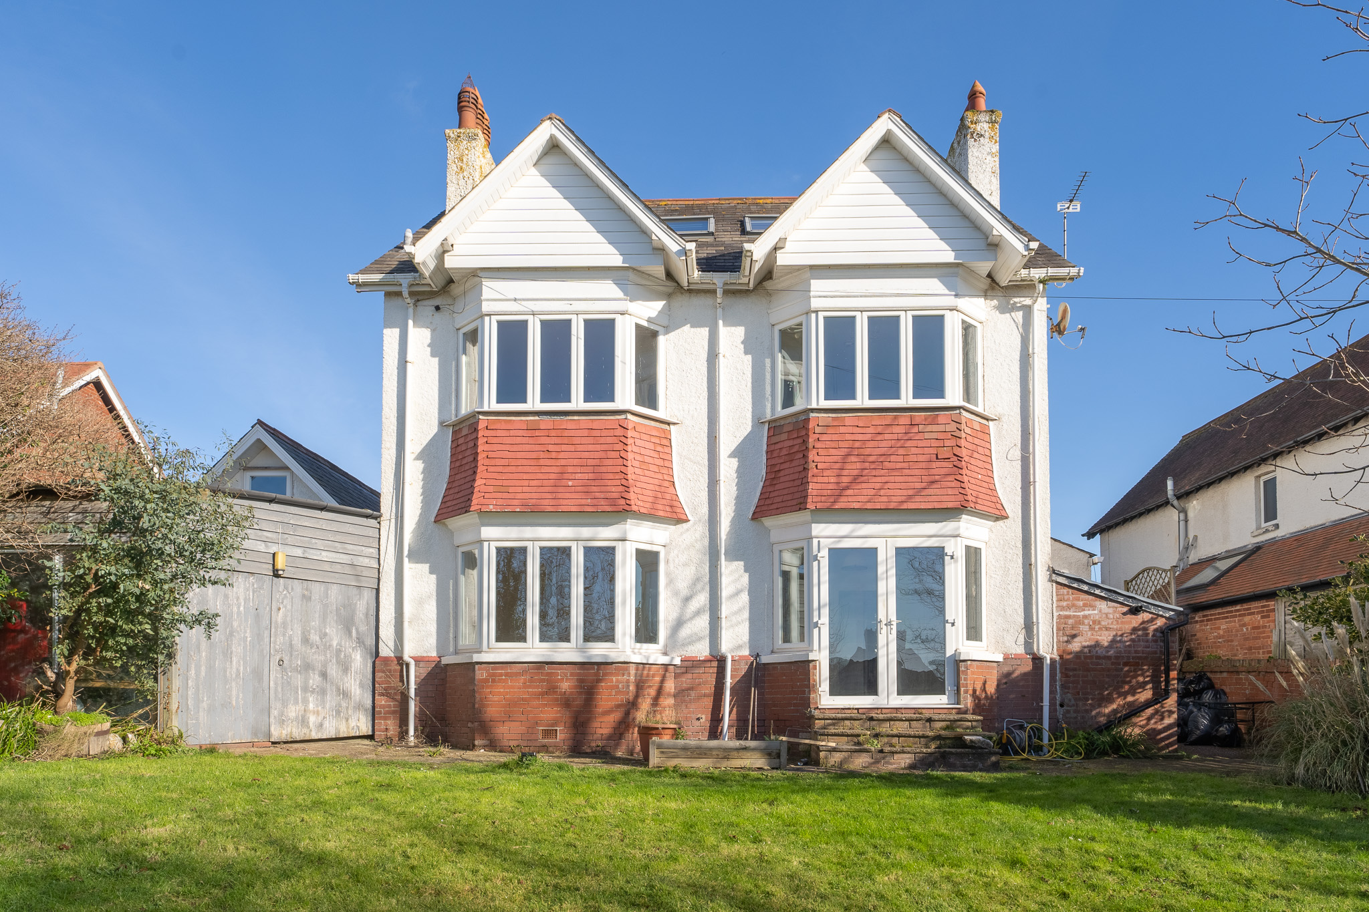
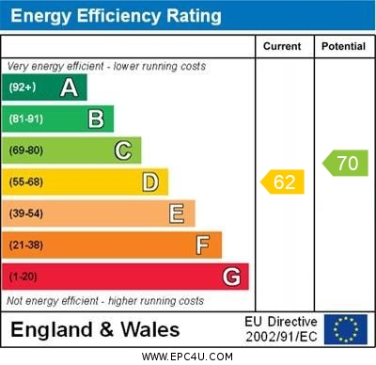
www.pennys.net
5 Belle Vue Road, Exmouth, EX8 3DR
GUIDE PRICE £850,000
TENURE Freehold
An Impressive 1920’s Built Detached Five Bedroom Residence Enjoying An Enviable Location With Southerly Aspect Rear Garden, Drive, Large Garage And Workshop
Entrance Veranda And Impressive Reception Hall * Sitting Room * Separate Dining Room * Breakfast Room * Modern Kitchen * Cloakroom/Wc * Three First Floor Double Bedrooms * Spacious Stylish Shower Room/Wc * Two Further Large Second Floor Bedrooms * Spacious Modern Bathroom With Shower Cubicle * Double Glazed Windows * Gas Central Heating *Many Fine Period Features * Superb Family Home * Estuary And Coastline Views From The Upper Floors * Viewing Recommended
Pennys Estate Agents Limited for themselves and for the vendor of this property whose agents they are give notice that:- (1) These particulars do not constitute any part of an offer or a contract. (2) All statements contained in these particulars are made without responsibility on the part of Pennys Estate Agents Limited. (3) None of the statements contained in these particulars are to be relied upon as a statement or representation of fact. (4) Any intending purchaser must satisfy himself/herself by inspection or otherwise as to the correctness of each of the statements contained in these particulars. (5) The vendor does not make or give and neither do Pennys Estate Agents Limited nor any person in their employment has any authority to make or give any representation or warranty whatever in relation to this property.
PENNYS ESTATE AGENTS
2 Rolle House, Rolle Street, Exmouth, Devon, EX8 2SN
Tel: 01395 264111 EMail: help@pennys.net

Slide 2
5 Belle Vue Road, Exmouth, EX8 3DR
Pennys are delighted to offer for sale this large detached residence, understood to have been built in the 1920’s and keeping a much inherent character of this era, which includes panelled doors, stripped pine flooring, with some decorative leaded stained glass windows, picture rails and fireplaces. The accommodation is well planned and proportioned, and provides an abundance of light with character features providing a wonderfully spacious family home, viewing is strongly recommended.
THE ACCOMMODATION COMPRISES: A glazed covered veranda with attractive traditional tiled floor with composite front door with pattern window inset, giving access to:
SPACIOUS RECEPTION HALL: An elegant entrance to the property with impressive turning staircase rising to first floor landing with large stained glass window on half landing, allowing an abundance of light, wood flooring, radiator, good size understairs storage cupboards with electric consumer units and meters, picture rail, port hole style internal lead light window.
SITTING ROOM: 5.18m x 4.55m (17'0" x 14'11") An elegant room with feature fireplace with tiled hearth, double glazed bay window to front aspect, two leaded light stained glass windows, picture rail, wood effect flooring, radiator, TV point.
DINING ROOM: 4.88m x 3.99m (16'0" x 13'1") Another impressive reception room with double glazed bay window overlooking the rear aspect, radiator, picture rail.
BREAKFAST ROOM: 4.22m x 3.4m (13'10" x 11'2") Double glazed double doors opening onto the rear garden with uPVC double glazed windows to either side, radiator, dresser style unit fitted into wall recess, further storage cupboard in wall recess, opening to:
KITCHEN: 3.61m x 3.4m (11'10" x 11'2") Stylish modern kitchen with range of patterned worktops with inset Franke sink unit with mixer tap with water filter and integrated drainer with matching splashbacks, inset induction hob, built-in double oven, space for dishwasher, range of cupboards and drawer units beneath worktops with matching wall mounted cupboards, space for American style fridge/freezer, double glazed windows to front and side aspects, recessed ceiling led spotlighting, radiator, opening to REAR PORCH with double glazed door to outside and access to:
CLOAKROOM/WC: Fitted with a corner wash hand basin with tiled splashback, fitted mirror, WC, radiator, double glazed window.
FIRST FLOOR SPACIOUS LANDING: Picture rail, radiator, turning staircase rising to second floor, uPVC double glazed on half landing gaining estuary views.
BEDROOM 1: 4.93m x 4.37m (16'2" x 14'4") Measurement into double glazed bay window to rear aspect, feature fireplace with tiled hearth, stripped wood flooring, picture rail, radiator.
BEDROOM 2: 4.78m x 4.78m (15'8" x 15'8") Measurement into double glazed bay window to front aspect, stripped wood flooring, feature fireplace with tiled hearth, picture rail, radiator.
BEDROOM 3: 4.93m x 3.91m (16'2" x 12'10") Measurement into double glazed bay window to rear aspect, stripped wood flooring, picture rail, radiator.
SHOWER ROOM/WC: 3.18m x 1.93m (10'5" x 6'4") With ease of access, large shower cubicle with sliding splash screen doors, shower unit, wash hand basin set in display surface with cupboards beneath, mirror fronted medicine cabinet over, WC with push button flush, radiator, attractive tiled walls, tiled flooring, linen cupboard, two sets of double glazed windows with patterned glass, underfloor heating.
SECOND FLOOR LANDING:
BEDROOM 4: 3.89m x 3.71m (12'9" x 12'2") Stripped wood flooring, double glazed window to side aspect, double glazed velux window to rear elevation gaining views to the estuary and coastline beyond, accessed eaves storage space, radiator, feature fireplace.
BEDROOM 5: 4.27m x 3m (14'0" x 9'10") Feature fireplace, stripped flooring, double glazed window to side aspect enjoying estuary and coastline views, radiator and further double glazed velux window also gaining views across the town to the estuary and coastline beyond.
BATHROOM/WC: 4.83m maximum x 2.24m (15'10" x 7'4") A stylish modern suite with whirlpool bath, ease of access shower cubicle with splashback walls, wash hand basin with adjoining display surface with cupboard and WC with push button flush beneath, chrome heated towel rail, recessed ceiling led spotlighting, double glazed velux window to open aspect, underfloor heating, fitted range of cupboards.
OUTSIDE: Approached from Belle Vue Road to driveway together with a pedestrian gate leading to a pathway leading to the property. The front garden is laid to lawn extensively stocked with a variety of shrubs and trees, which screen the house from the road, garden shed. Beyond the drive is a GARAGE/WORKSHOP.
GARAGE/WORKSHOP: 7.01m x 3.05m (23'0" x 10'0") With electric up and over door, windows, radiator, recessed ceiling spotlighting, access to boarded roof space, door to SHOWER ROOM: With fitted sauna/shower, WC and wash hand basin, further door to LEAN-TO WORKSHOP STORE: 5.11m x 4.57m (16'9" x 15'0") under a corrugated plastic roof, power and lighting, large doors giving access through to the rear garden.
The rear garden is located in the Southern side of the house enjoying the benefits of high degree of privacy and a Southerly aspect comprising of a good size lawned area of garden with shrubs and trees. There is a side outside store/utility fitted with a sink unit and houses the gas boiler for hot water and central heating.
SEPARATE FLOOR PLAN:

