Slide 1
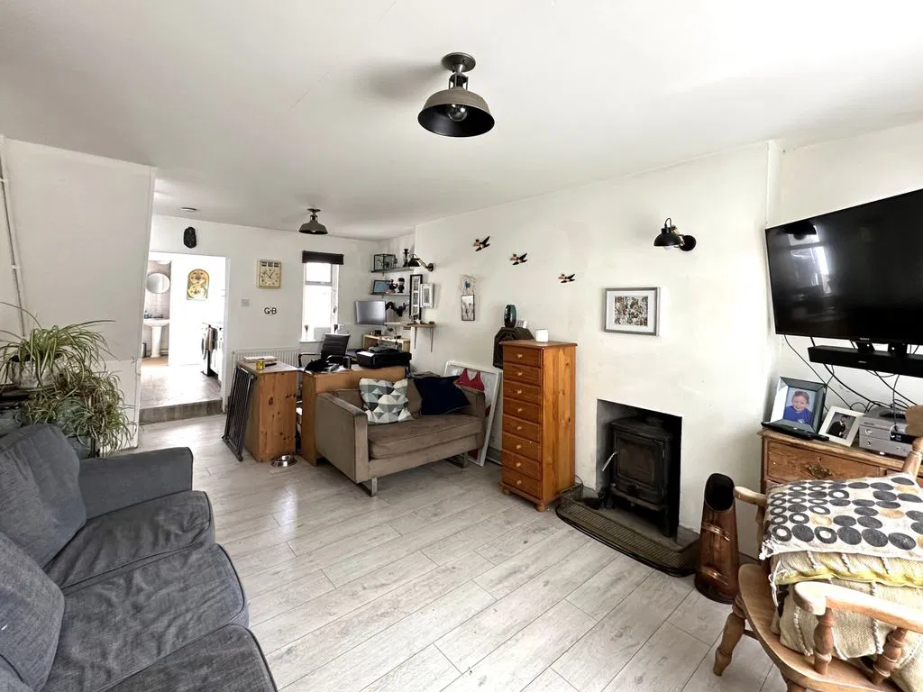
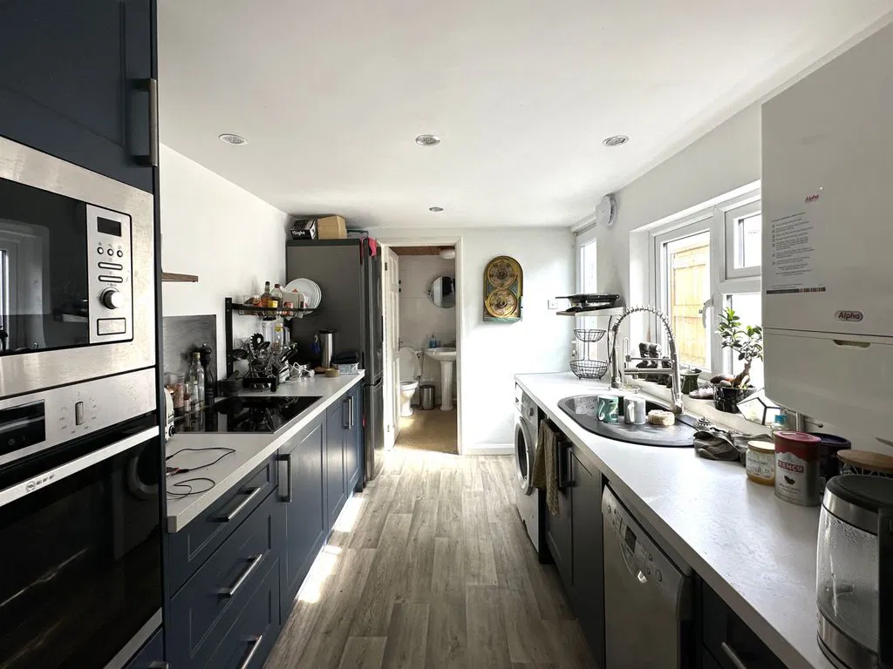
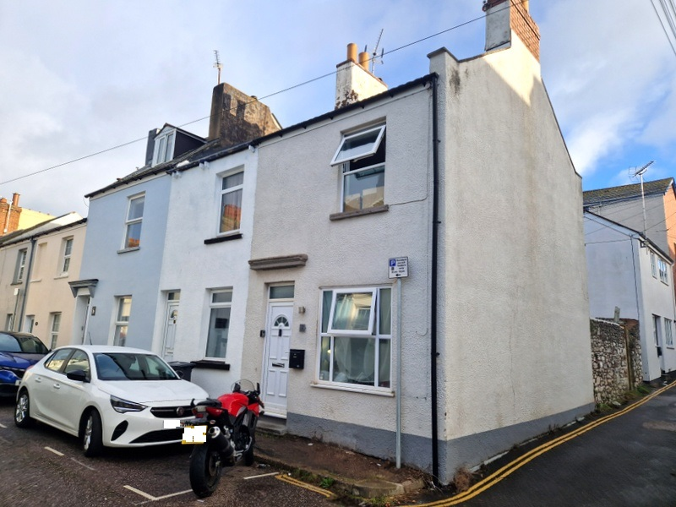
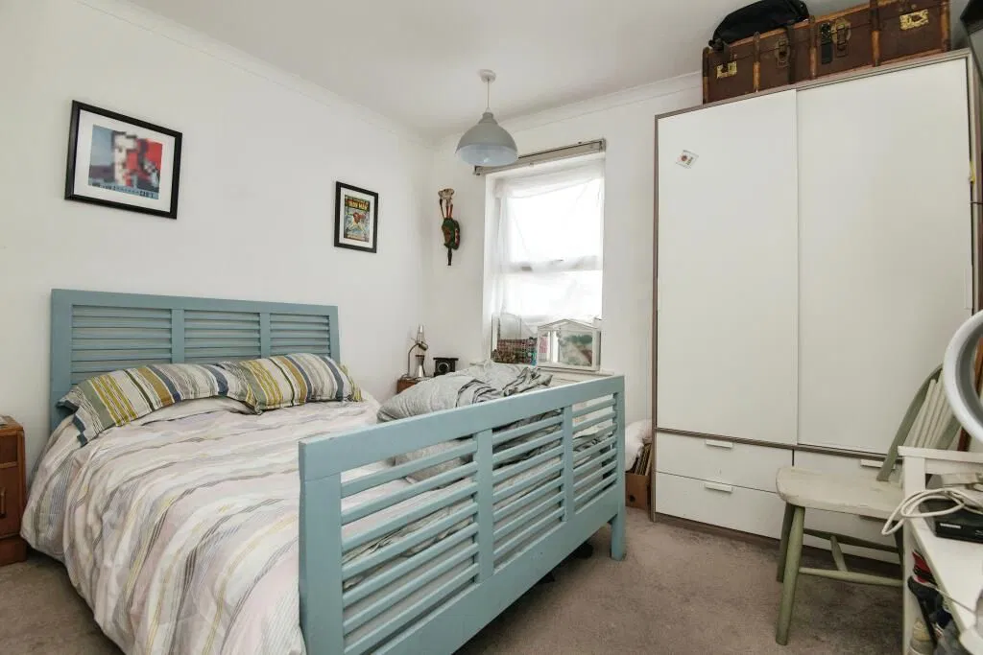
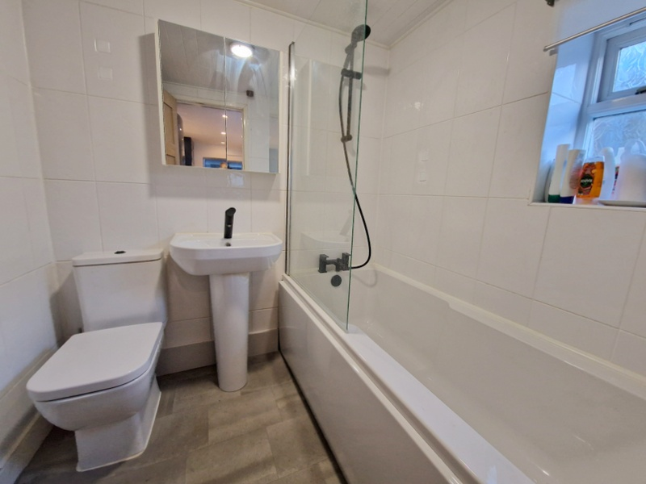
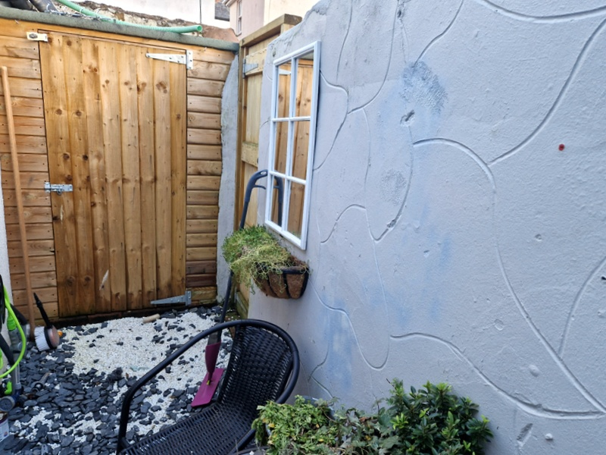
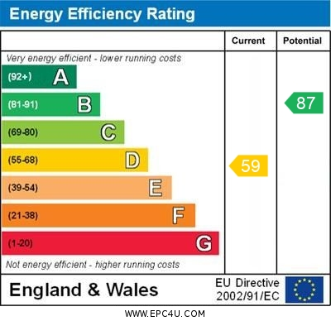
www.pennys.net
2 Charles Street, Exmouth, EX8 1LW
GUIDE PRICE £200,000
TENURE Freehold
A Two Bedroom End Of Terrace House Enjoying A Town Centre Location Offering Refurbished Accommodation Ideal For First Time Buyers
Lounge/Dining Room * Modern Kitchen * Newly Installed Bathroom Suite Two First Floor Double Bedrooms * Gas Central Heating * Double Glazing Enclosed Courtyard Garden With Pedestrian Access
Pennys Estate Agents Limited for themselves and for the vendor of this property whose agents they are give notice that:- (1) These particulars do not constitute any part of an offer or a contract. (2) All statements contained in these particulars are made without responsibility on the part of Pennys Estate Agents Limited. (3) None of the statements contained in these particulars are to be relied upon as a statement or representation of fact. (4) Any intending purchaser must satisfy himself/herself by inspection or otherwise as to the correctness of each of the statements contained in these particulars. (5) The vendor does not make or give and neither do Pennys Estate Agents Limited nor any person in their employment has any authority to make or give any representation or warranty whatever in relation to this property.
PENNYS ESTATE AGENTS
2 Rolle House, Rolle Street, Exmouth, Devon, EX8 2SN
Tel: 01395 264111 EMail: help@pennys.net

Slide 2
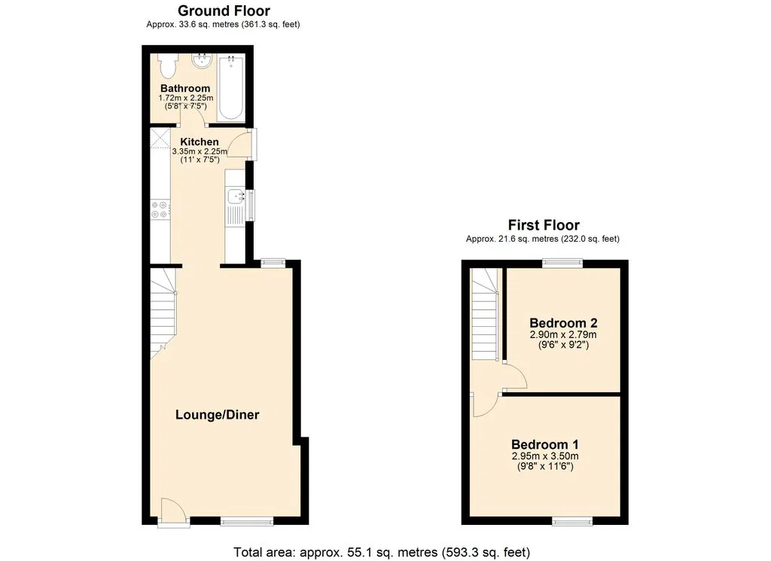
2 Charles Street, Exmouth, EX8 1LW
THE ACCOMMODATION COMPRISES: uPVC front door giving access to:
LOUNGE/DINING ROOM: 6.27m x 3.56m (20'7" x 11'8") A most spacious through room with solid wood burner stove housed in chimney recess, TV point, two radiators, stairs rising to first floor uPVC double glazed window to front aspect and window to rear elevation.
KITCHEN: 3.35m x 2.13m (11'0" x 7'0") A modern stylish kitchen fitted with a range of worktops with cupboards, drawer units, plumbing for automatic washing machine and space for slimline dishwasher beneath worktops, built-in induction hob with stainless steel back and built-in oven and microwave, space for upright fridge/freezer, recessed ceiling spotlighting, uPVC double glazed window to side aspect and double glazed door giving access to the rear courtyard.
GROUND FLOOR BATHROOM/WC: Recently installed suite comprising; bath with shower attachment, pedestal wash hand basin, WC, heated towel rail, mirror fronted medicine cabinet, fully tiled wall, extractor fan, spotlights.
FIRST FLOOR LANDING: With window to rear elevation, access to roof space via loft ladder (this loft could be converted to give additional accommodation subject to the necessary planning consents).
BEDROOM 1: 3.3m x 2.95m (10'10" x 9'8") uPVC double glazed window to front elevation, TV point, radiator.
BEDROOM 2: 3.05m x 2.74m (10'0" x 9'0") Radiator, window to rear aspect.
OUTSIDE: To the rear of the property is an enclosed courtyard garden with decorative stone flooring, TIMBER GARDEN STORE, gate providing pedestrian access.
FLOOR PLAN:

