Slide 1
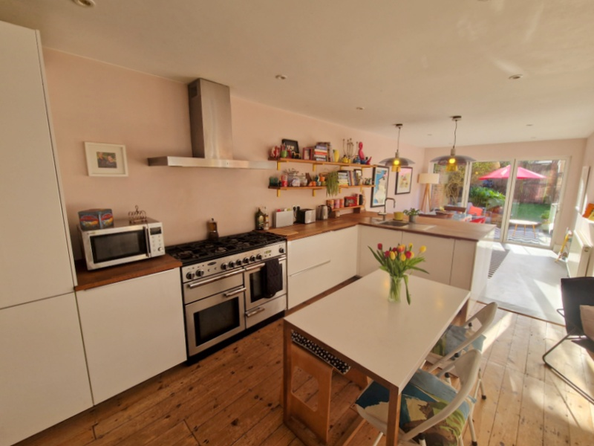
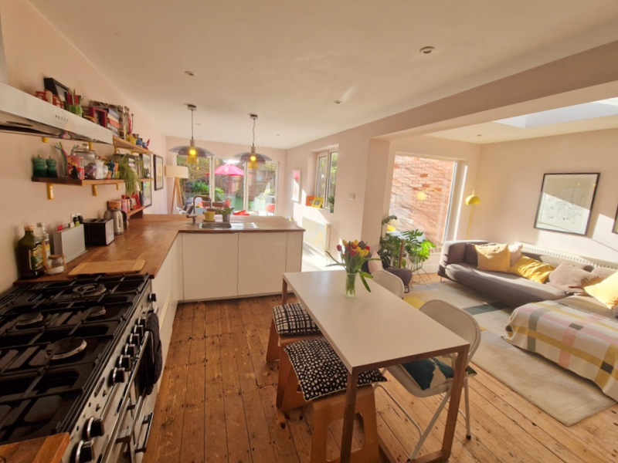
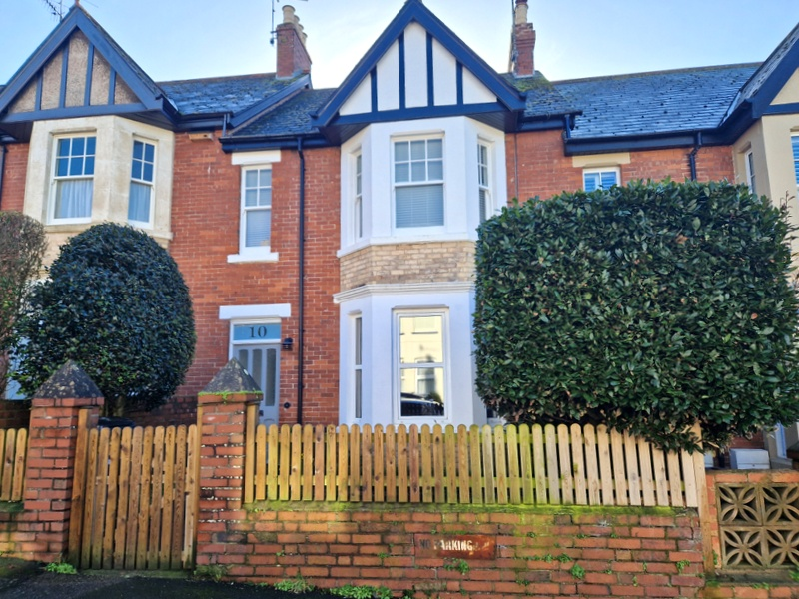
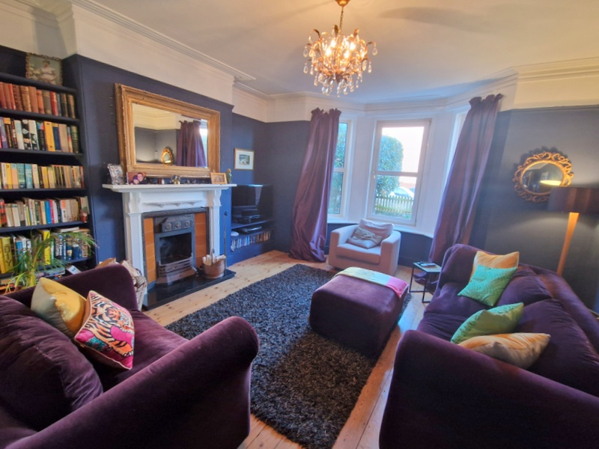
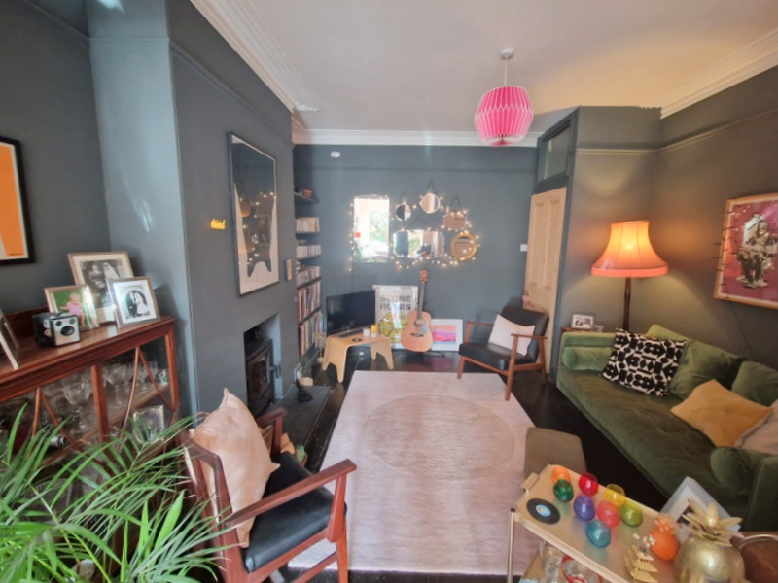
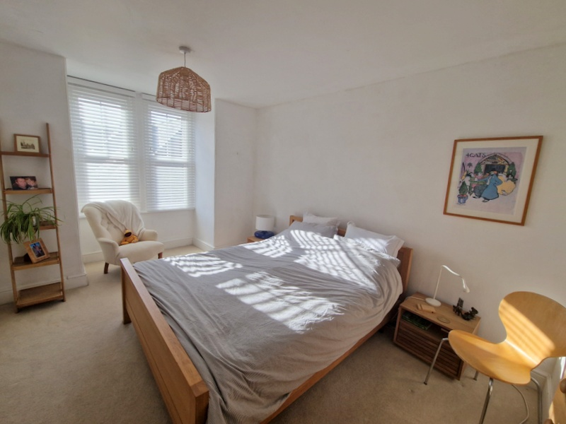
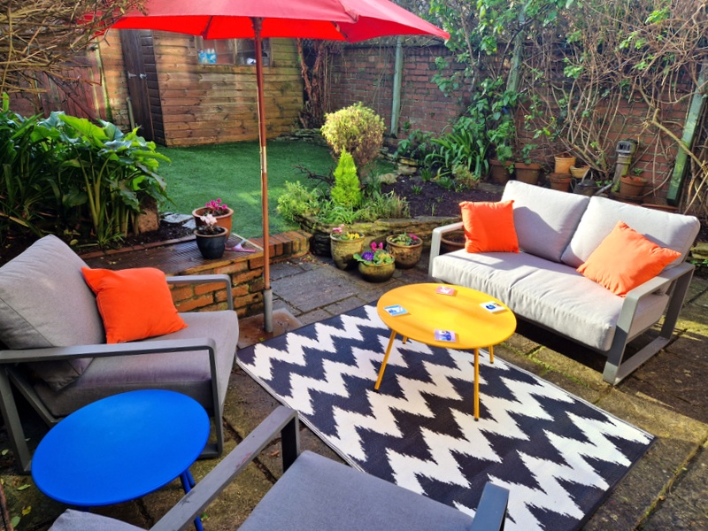
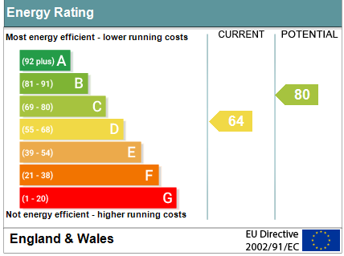
www.pennys.net
10 Raleigh Road, Exmouth, EX8 2SB
GUIDE PRICE £595,000
TENURE Freehold
A Substantial Period Terraced House Enjoying An Enviable Location In A Favoured Road Close To The Heart Of Exmouth Town Centre And Within Easy Reach Of The Seafront
Spacious Well Presented Accommodation Full Of Character And Charm * Entrance Vestibule & Reception Hall * Downstairs WC * Lounge * Snug * Open-Plan Kitchen/Breakfast/Dining Room * Five First Floor Bedrooms * Modern Bathroom Suite * Attractive Enclosed Rear Garden * Double Glazed Windows Where Stated * Gas Central Heating * Super Family Home Central Location
Pennys Estate Agents Limited for themselves and for the vendor of this property whose agents they are give notice that:- (1) These particulars do not constitute any part of an offer or a contract. (2) All statements contained in these particulars are made without responsibility on the part of Pennys Estate Agents Limited. (3) None of the statements contained in these particulars are to be relied upon as a statement or representation of fact. (4) Any intending purchaser must satisfy himself/herself by inspection or otherwise as to the correctness of each of the statements contained in these particulars. (5) The vendor does not make or give and neither do Pennys Estate Agents Limited nor any person in their employment has any authority to make or give any representation or warranty whatever in relation to this property.
PENNYS ESTATE AGENTS
2 Rolle House, Rolle Street, Exmouth, Devon, EX8 2SN
Tel: 01395 264111 EMail: help@pennys.net

Slide 2
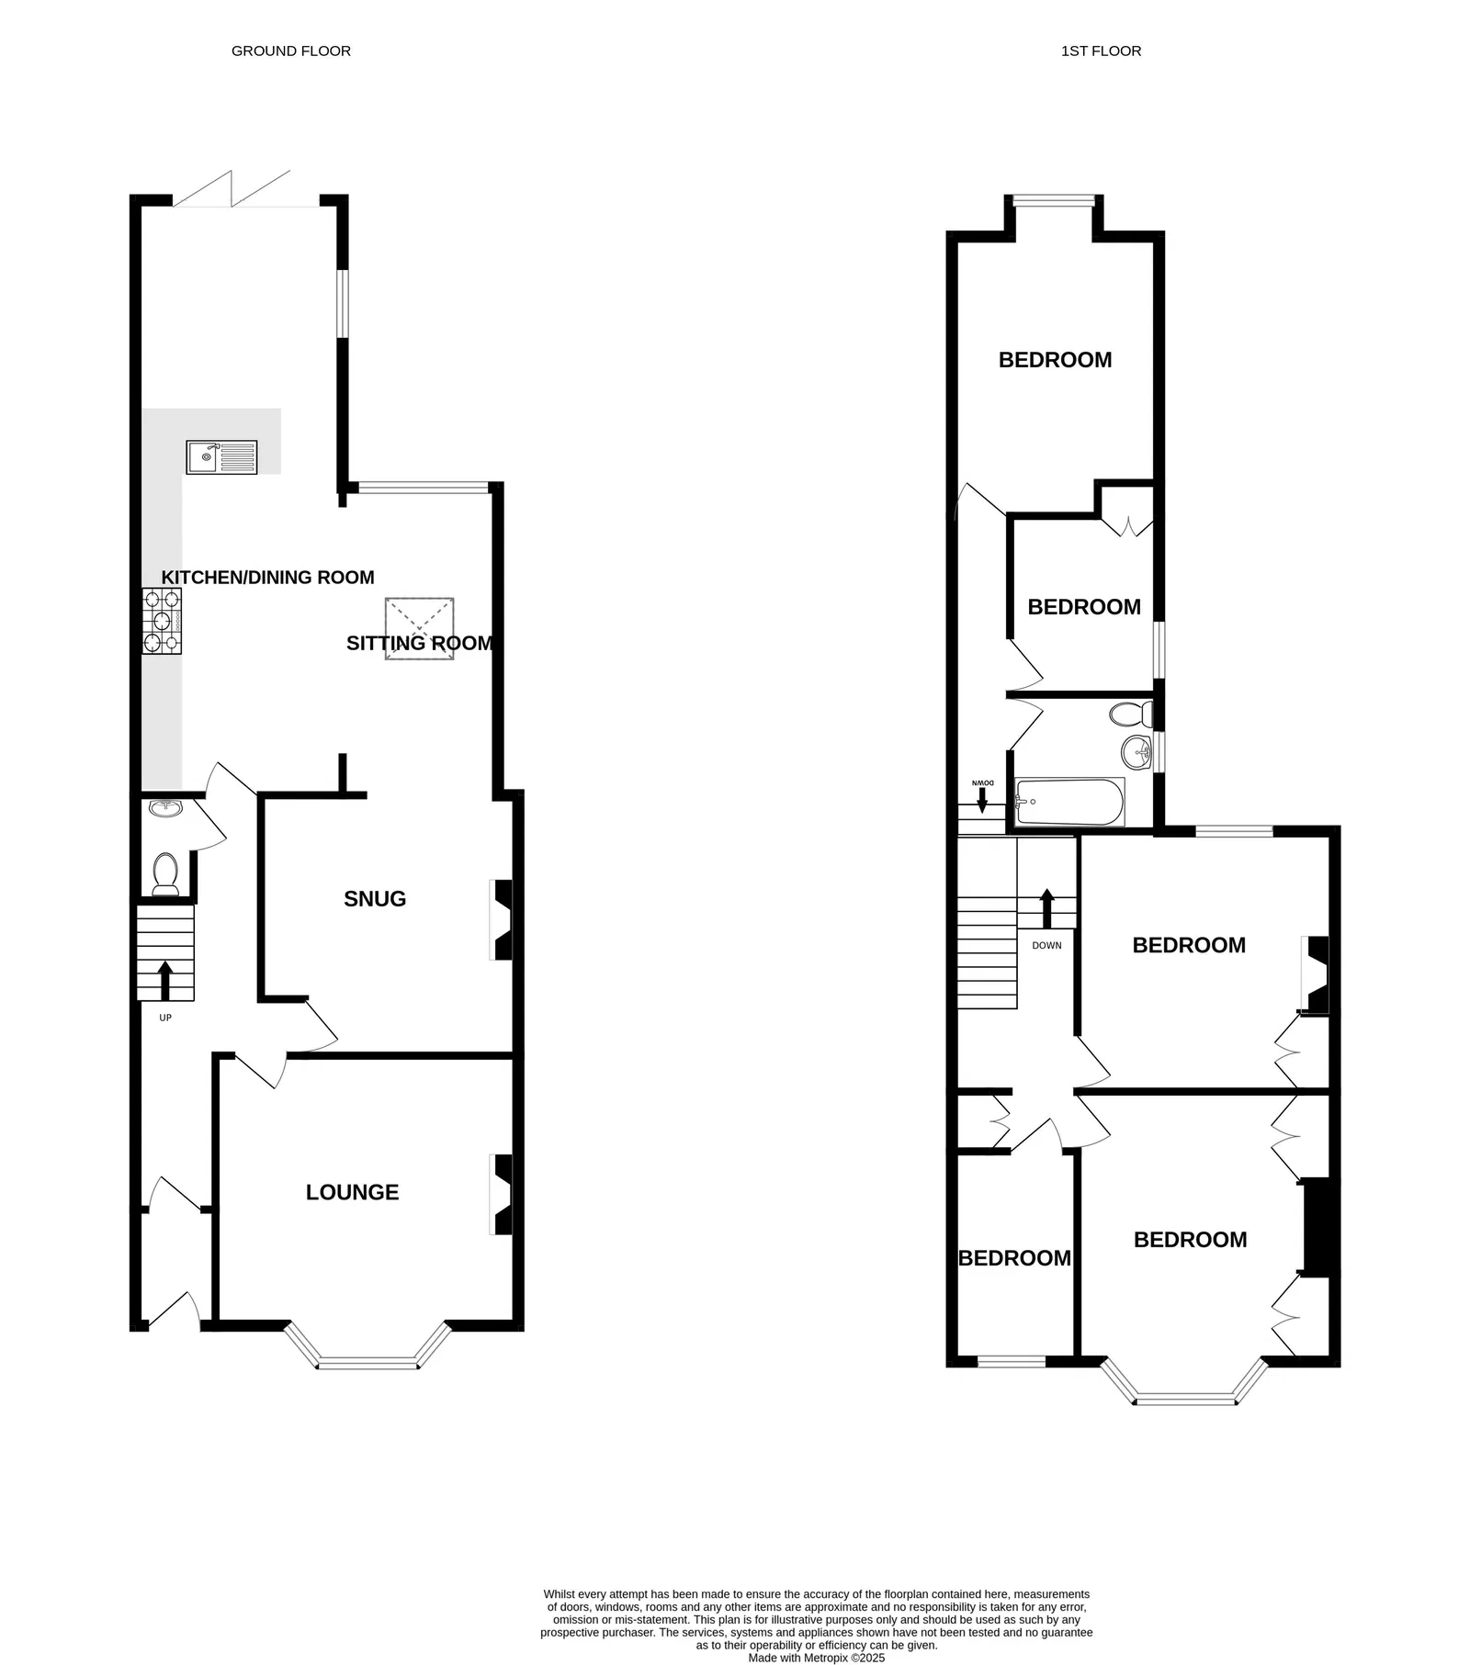
10 Raleigh Road, Exmouth, EX8 2SB
THE ACCOMMODATION COMPRISES: Solid wood front door with glazed panel inset to:
ENTRANCE VESTIBULE: Inner solid wood door with leaded light window inset to:
RECEPTION HALL: A lovely entrance to the property with stripped wood flooring, radiator, feature ceiling arch, staircase rising to first floor landing, UNDERSTAIRS TOILET with WC and wash hand basin beneath.
LOUNGE: 4.78m x 4.47m (15'8" x 14'8") maximum measurement into wall recesses with fitted shelving and display unit. Double glazed bay window overlooking the front elevation. A charming room full of character with feature fireplace and cast iron grate with tiled hearth, picture rail, cornice ceiling and stripped wood flooring, TV point, radiator.
SNUG: 3.94m x 3.89m (12'11" x 12'9") measurement into wall recess. A cosy room with chimney recess housing log burner stove standing on a slate hearth, fitted shelving in wall recess, picture rail, cornice ceiling, stripped wood flooring, opening through to:
OPEN-PLAN KITCHEN/SITTING/DINING ROOM: SITTING ROOM AREA: 3.51m x 2.18m (11'6" x 7'2") A lovely bright area with lantern window and picture window overlooking the rear garden, radiator. KITCHEN/DINING AREA: 8.84m x 3.07m (29'0" x 10'1") An extremely spacious and bright room with kitchen area fitted with solid wood working surfaces extended to provide a breakfast bar area with cupboards, deep drawer units, space for integrated dishwasher and washing machine beneath surfaces, upright larder style cupboards, gas cooker point with stainless steel chimney style extractor hood over with light, recessed ceiling spotlighting and downlighters over the breakfast bar area, single drainer sink unit with hose style mixer tap, fitted wall shelving, space for large American style fridge/freezer, stripped wood flooring. DINING AREA: Double glazed bi-fold doors opening onto the rear garden, further double glazed window to side aspect, radiator, recessed ceiling spotlighting.
FIRST FLOOR SPLIT LEVEL LANDING: Feature ceiling arch, window with patterned glass, radiator, access to loft space via loft ladder, linen/storage cupboard.
BEDROOM 1: 5m x 3.07m (16'5" x 10'1") maximum measurement into double glazed square bay window overlooking the rear aspect. Fitted with two sash style double glazed windows, radiator, TV point.
BEDROOM 2: 4.85m x 3.2m (15'11" x 10'6") measurement into bay window. Fitted with sash windows overlooking the front aspect, radiator, two sets of built-in wardrobes with storage cupboards over housed in wall recesses.
BEDROOM 3: 3.91m x 3.45m (12'10" x 11'4") plus wall recesses, which are fitted with shelving and built-in wardrobe with storage cupboard over, feature fireplace, radiator, uPVC double glazed sash style window to rear aspect, picture rail.
BEDROOM 4: 3m x 2.13m (9'10" x 7'0") With sash style window to front aspect, radiator.
BEDROOM 5: 2.59m x 2.13m (8'6" x 7'0") uPVC double glazed sash style window to side aspect, built-in cupboard in wall recess housing Worcester Bosch boiler for hot water and central heating, radiator.
BATHROOM/WC: 2.06m x 1.8m (6'9" x 5'11") Fitted with modern suite comprising bath with Mira shower unit over, shower splash screen, pedestal wash hand basin, tiling to splash prone areas, WC with push button flush, chrome heated towel rail, uPVC double glazed sash style window with frosted glass, access to roof space, wood effect flooring.
OUTSIDE: To the front of the property there is a pedestrian gate giving access to a decorative stone garden enclosure with pathway to front door. To the rear is a most attractive enclosed garden comprising of a good size patio area ideal for outside entertaining, artificial lawned garden edged with raised flower and shrub beds, outside power supply, outside cold water tap, timber garden store, rear pedestrian gate.
FLOOR PLAN:

