Slide 1
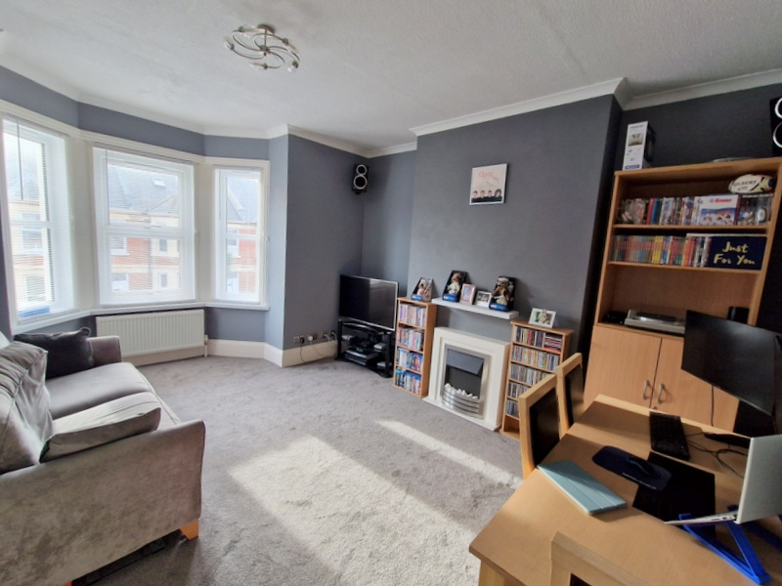
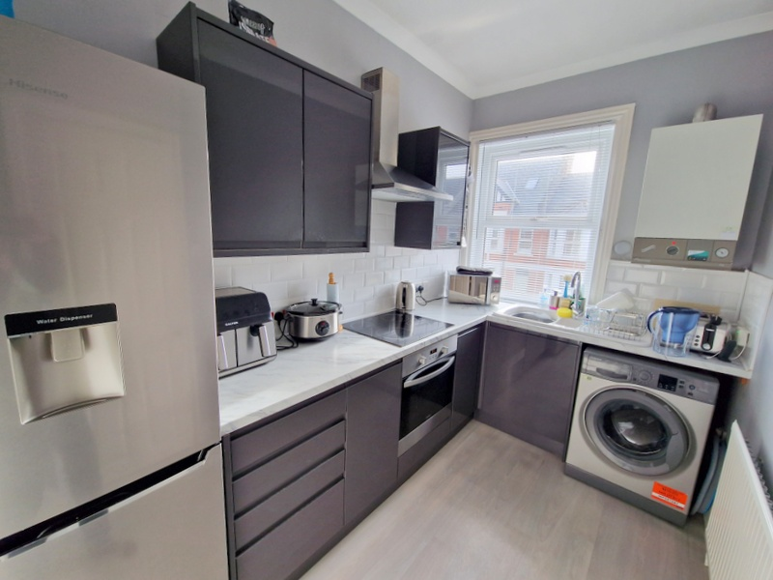
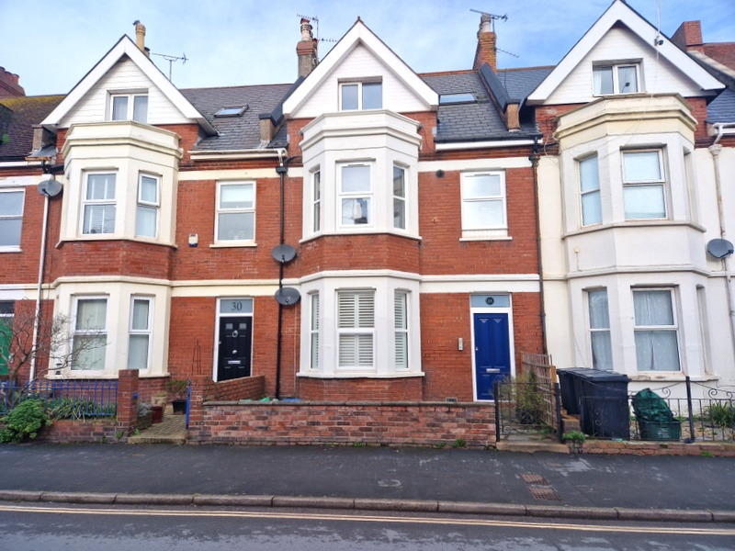
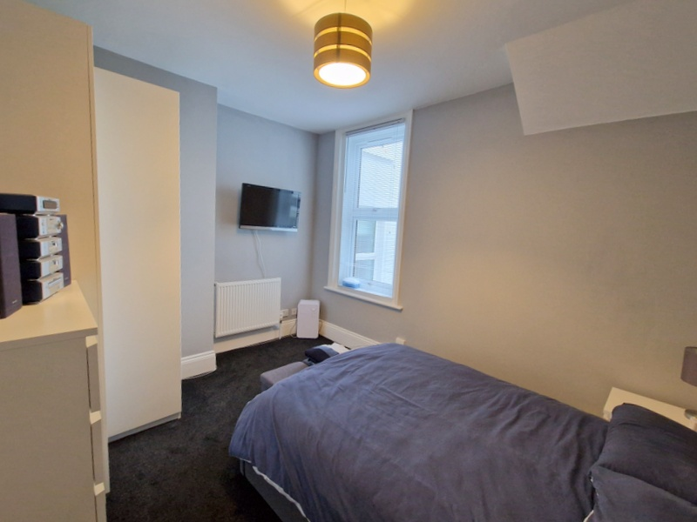
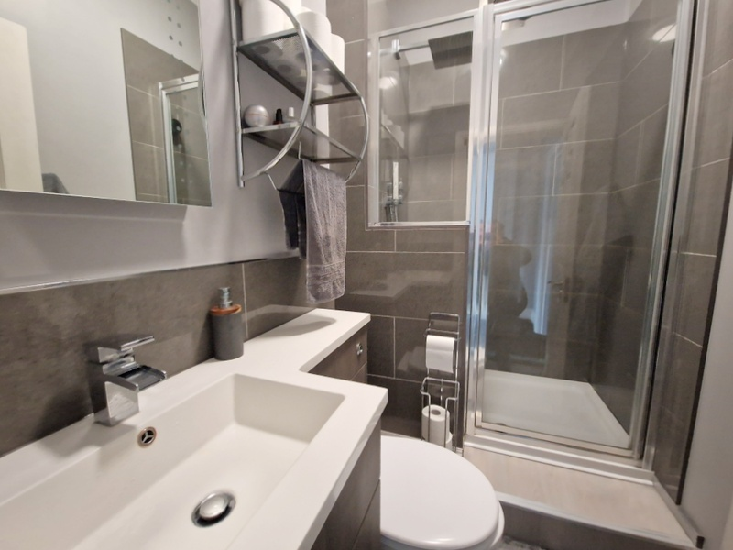
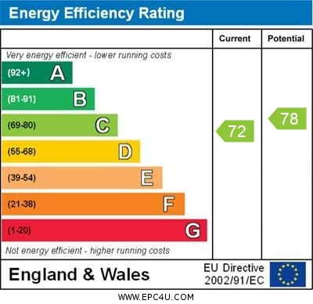
www.pennys.net
Flat 3, 28 Victoria Road, Exmouth, EX8 1DW
GUIDE PRICE £167,500
TENURE Share of Freehold
A Stunning First Floor Flat Enjoying An Enviable Location Just A Short Distance From Both The Town Centre And Seafront Offering Beautifully Presented Accommodation, Ideal For A Permanent Or A Holiday Home Retreat
Modern Upvc Double Glazed Windows * Gas Central Heating * Spacious Bay Window Lounge/Dining Room * Stylish Kitchen * Good Size Double Bedroom * Quality Shower Room/Wc * Viewing Recommended
Pennys Estate Agents Limited for themselves and for the vendor of this property whose agents they are give notice that:- (1) These particulars do not constitute any part of an offer or a contract. (2) All statements contained in these particulars are made without responsibility on the part of Pennys Estate Agents Limited. (3) None of the statements contained in these particulars are to be relied upon as a statement or representation of fact. (4) Any intending purchaser must satisfy himself/herself by inspection or otherwise as to the correctness of each of the statements contained in these particulars. (5) The vendor does not make or give and neither do Pennys Estate Agents Limited nor any person in their employment has any authority to make or give any representation or warranty whatever in relation to this property.
PENNYS ESTATE AGENTS
2 Rolle House, Rolle Street, Exmouth, Devon, EX8 2SN
Tel: 01395 264111 EMail: help@pennys.net

Slide 2
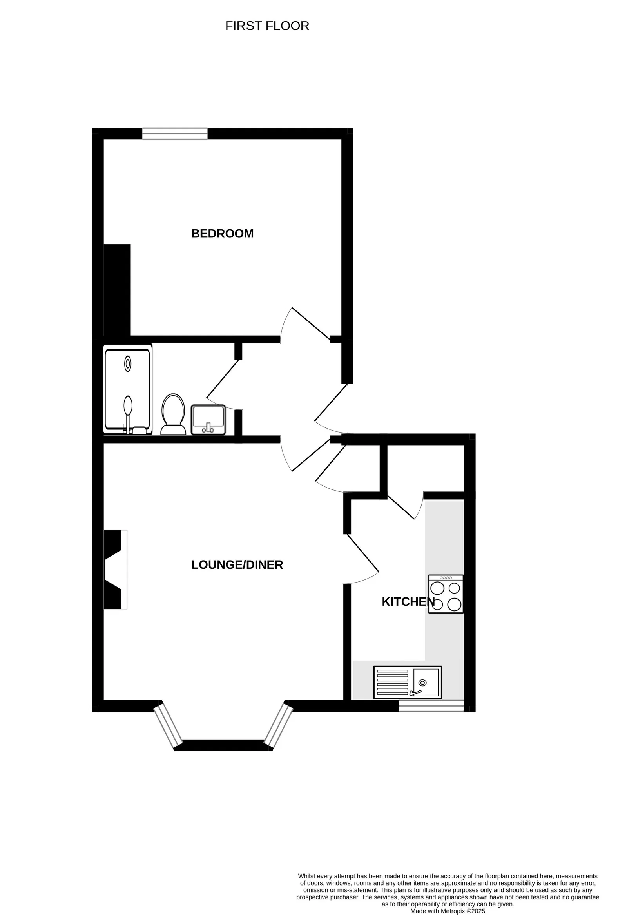
Flat 3, 28 Victoria Road, Exmouth, EX8 1DW
THE ACCOMMODATION COMPRISES: Communal entrance with door entry intercom with stairs rising to first floor landing, private front door to:
ENTRANCE HALL: With Hive thermostat, door entry phone.
LOUNGE/DINING ROOM: 5.03m x 3.78m (16'6" x 12'5") A bright spacious room with measurement into wall recesses and uPVC double glazed windows to front aspect, radiator, TV point, coved ceiling, electric living flame pebble effect fire and fire surround with mantel over, telephone point.
KITCHEN: 3.43m x 1.96m (11'3" x 6'5") Beautifully and stylishly fitted with a range of patterned worktops with tiled surrounds with inset ceramic one and a quarter bowl single drainer sink unit with chrome mixer tap over, inset four ring electric hob with stainless steel chimney extractor hood over with light and built-in oven below, range of cupboards and drawer units, plumbing for automatic washing machine beneath worktops, wall mounted cupboards, wall mounted Worcester boiler for hot water and central heating, space for upright
fridge/freezer, good size storage cupboard with shelving, uPVC double glazed window to front aspect, radiator.
BEDROOM: 3.84m x 3.15m (12'7" x 10'4") TV point, radiator, uPVC double glazed window to rear aspect.
SHOWER ROOM/WC: 2.34m x 1.42m (7'8" x 4'8") Beautifully refitted comprising of a double width shower cubicle with shower splash screen door, fixed rainfall shower head hose and detachable shower head hose with chrome controls, wash hand basin with display surface with cupboards, WC with concealed cistern and push button flush beneath, chrome heated towel rail, extractor fan, coved ceiling, fitted mirror with integrated shaver point.
OUTSIDE: There are no gardens to maintain.
TENURE & SERVICE CHARGES: The property is held on 163 year lease from 2015 and also enjoys a ¼ share of the freehold. Service Charge: £60 per month.
Mortgage Assistance: We are pleased to recommend Meredith Morgan Taylor, who would be pleased to help no matter which estate agent you finally buy through. For a free initial chat please contact us on to arrange an appointment. Your home may be repossessed if you do not keep up repayments on your mortgage. Meredith Morgan Taylor Ltd is an appointed representative of The Openwork Partnership, a trading style of Openwork Ltd which is authorised and regulated by the Financial Conduct Authority (FCA).
FLOOR PLAN:

