Slide 1
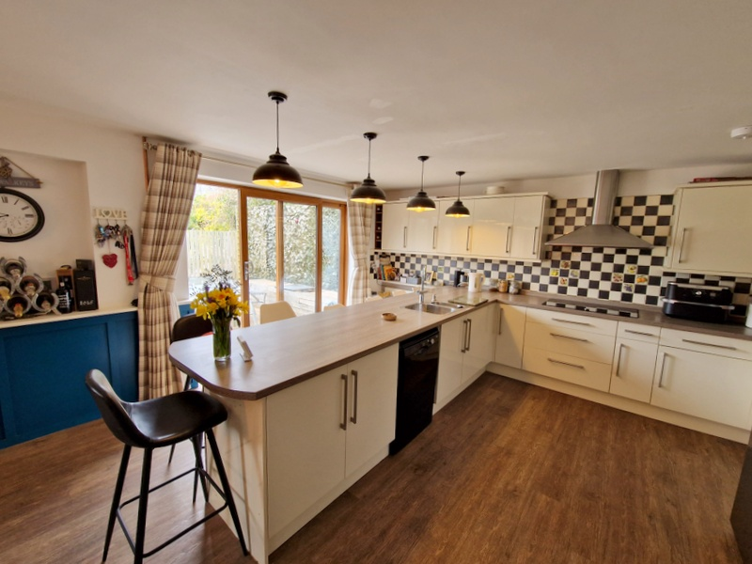
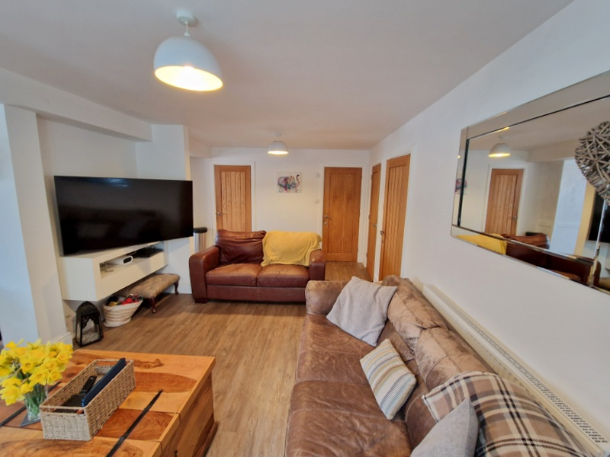

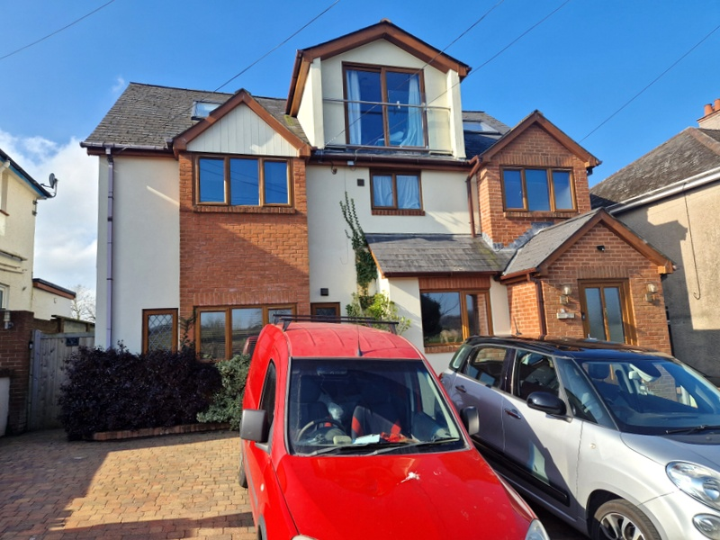
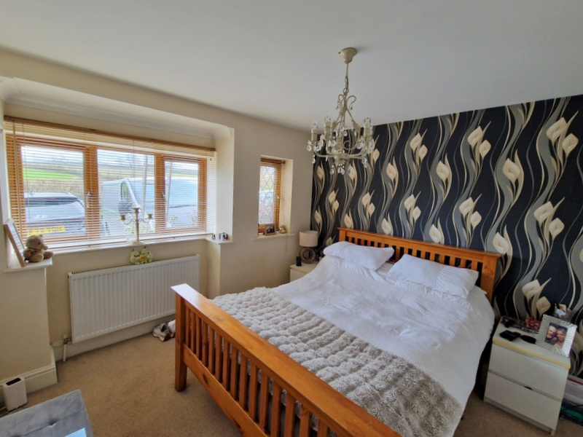
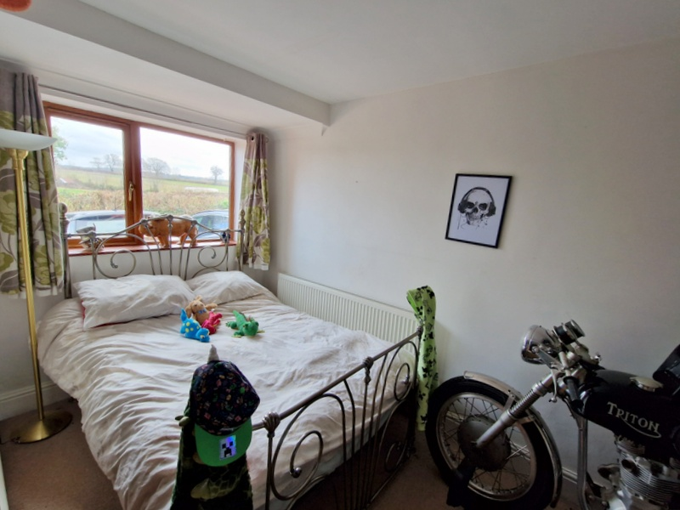
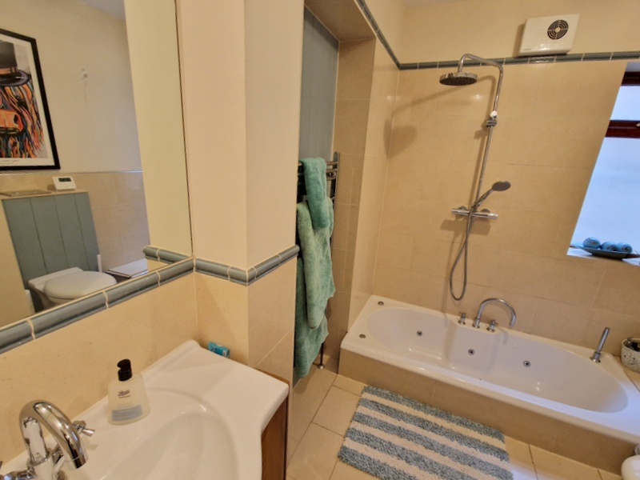
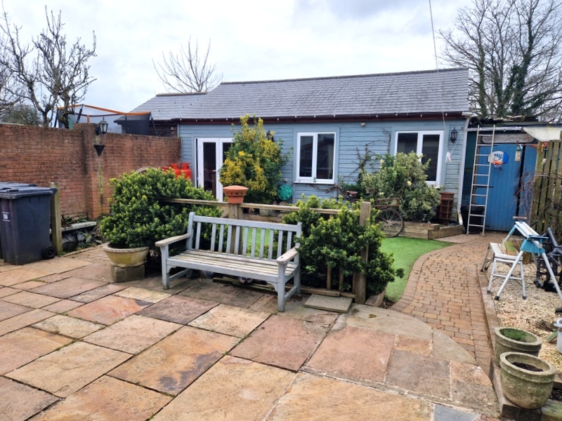
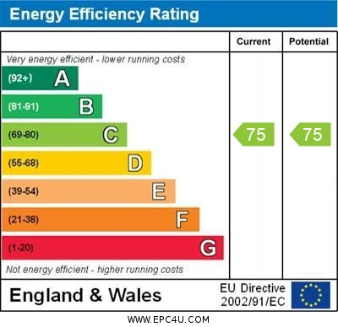

www.pennys.net
6a Dawlish Park Terrace, Courtlands Lane, Lympstone, Exmouth, EX8 5AA
GUIDE PRICE £625,000
TENURE Leasehold
A Unique Opportunity To Purchase An Extremely Spacious Ground Floor Apartment Located In Sought After Village Of Lympstone With Its Own Private Landscaped Rear Garden With Access To Potential Annexe, Parking For Numerous Cars And Large Workshops
Extremely Spacious Open-Plan Living Area * Superb Stylish Kitchen/Breakfast Room * Dining Area * Two Double Bedrooms – Main Bedroom With Dressing Area And En-Suite Shower Room * Main Well Appointed Bathroom Suite * Gas Central Heating And Double Glazing * Separate Potential Annexe Area Comprising Kitchen, Bedroom, Shower Room And Large Workshop Area * Viewing Recommended
Pennys Estate Agents Limited for themselves and for the vendor of this property whose agents they are give notice that:- (1) These particulars do not constitute any part of an offer or a contract. (2) All statements contained in these particulars are made without responsibility on the part of Pennys Estate Agents Limited. (3) None of the statements contained in these particulars are to be relied upon as a statement or representation of fact. (4) Any intending purchaser must satisfy himself/herself by inspection or otherwise as to the correctness of each of the statements contained in these particulars. (5) The vendor does not make or give and neither do Pennys Estate Agents Limited nor any person in their employment has any authority to make or give any representation or warranty whatever in relation to this property.
PENNYS ESTATE AGENTS
2 Rolle House, Rolle Street, Exmouth, Devon, EX8 2SN
Tel: 01395 264111 EMail: help@pennys.net

Slide 2
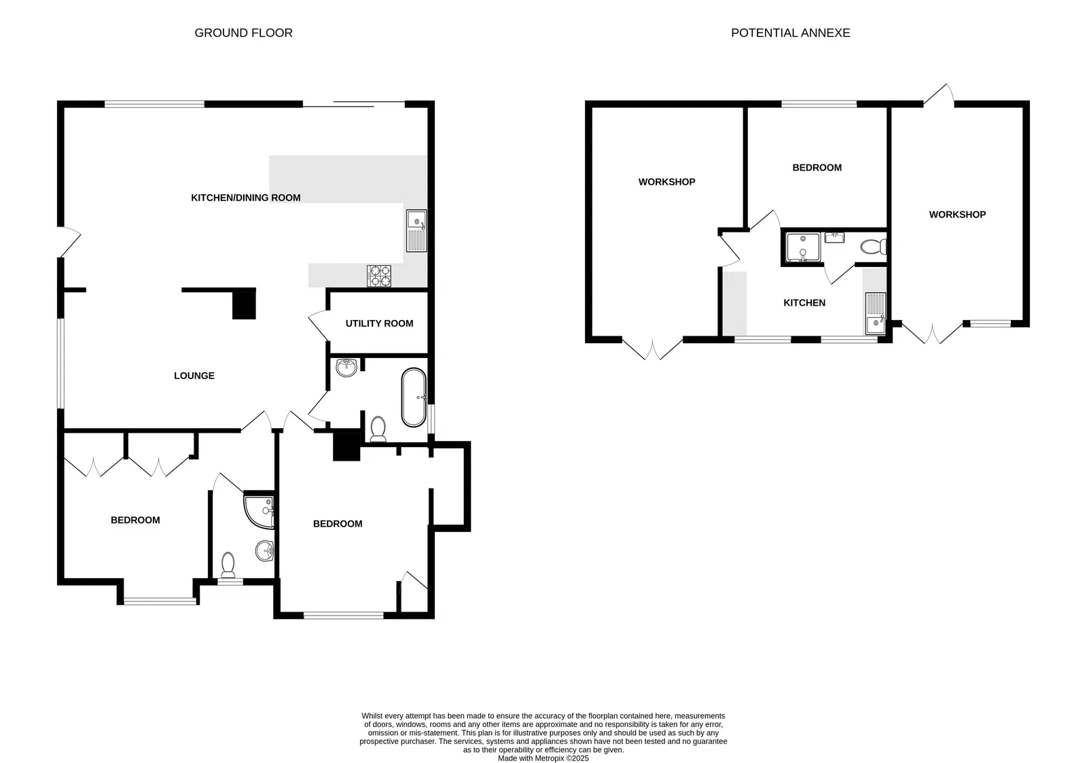
6a Dawlish Park Terrace, Courtlands Lane, Lympstone, Exmouth, EX8 5AA
THE ACCOMMODATION COMPRISES: Covered entrance with lighting, wood-effect uPVC double glazed front door giving access to:
OPEN-PLAN LIVING SPACE - KITCHEN/BREAKFAST AND DINING ROOM: 9.14m x 4.57m (30'0" x 15'0") A wonderful open space. KITCHEN/BREAKFAST AREA: Fitted range of wood-effect worktops with matching splashbacks incorporating large breakfast bar area with range of cupboards and drawer units, dishwasher space beneath worktops, inset one and a half bowl Rangemaster sink unit with water filter and mixer tap, inset induction hob with stainless steel chimney style extractor hood over with light, built-in double oven, space for large American style fridge/freezer, range of wall mounted cupboards with concealed lighting beneath, patterned tiled surrounds around work surfaces, radiator, sliding double glazed patio doors opening onto the rear garden, downlighters over the breakfast bar area, wood laminate flooring. DINING AREA: Superb large entertaining area with double glazed window overlooking the rear garden, part wood panelled walls to dado rail height with display shelf, downlighters over the dining area, going back to the kitchen area.
UTILITY ROOM: 2.72m x 1.55m (8'11" x 5'1") Plumbing for automatic washing machine, water cylinder, Vaillant gas boiler for hot water and central heating, wall mounted cupboards, light connected.
SITTING ROOM: 6.38m x 3.51m (20'11" x 11'6") TV point, double glazed window to side aspect, wood laminate flooring, radiator.
BEDROOM 1: Walk through dressing area with access to en-suite and opening through to:
BEDROOM AREA: 3.43m x 3.23m (11'3" x 10'7") into double glazed square bay window overlooking the front aspect enjoying pleasant views over the countryside, further double glazed window to front aspect, two built-in double wardrobes, clothes rail and shelf, TV point, radiator.
EN-SUITE SHOWER ROOM/WC: 2.13m x 1.63m (7'0" x 5'4") Corner shower cubicle with ease of access area with curved shower splash screen doors, Mira shower unit, wash hand basin with fitted mirror with light over, WC with concealed cistern and push button flush, fully tiled walls and colour co-ordinated tiled flooring, chrome heated towel rail, extractor fan, double glazed window, shaver socket.
BEDROOM 2: 4.57m x 3.15m (15'0" x 10'4") Double glazed window to front aspect enjoying countryside views, radiator, TV point, access to understairs storage cupboard housing electric consumer unit.
BATHROOM/WC: 2.64m x 2.18m (8'8" x 7'2") Stylish suite with sunken whirlpool bath with shower unit over having rainfall shower head hose and detachable shower head hose, vanity wash hand basin, WC with concealed cistern and push button flush, chrome heated towel rail, large fitted mirror over vanity hand basin area with light over and shaver socket, chrome heated towel rail, attractively tiled walls to splash prone areas, part tongue & groove walling, further large fitted mirror, colour co-ordinated tiled flooring.
OUTSIDE: To the front of the property is a good size block paved parking area providing ample parking, covered side walkway, wooden gate gives access to the fully enclosed rear garden which offers a high degree of privacy and seclusion, and enjoys a sunny aspect. The garden is beautifully landscaped comprising of patio sun terrace areas ideal for outside entertaining, artificial lawned garden area, block paved pathways, raised shrub beds, water feature, decorative garden area, rear lighting, outside cold water tap, covered storage area with double wooden gates giving access to: WORKSHOP: 5.38m x 3.35m (17'8" x 11'0") Power and light connected. From the garden there is access to:
POTENTIAL ANNEXE:
KITCHEN AREA: 4.11m x 2.74m (13'6" x 9'0") Two double glazed windows overlooking the garden, worktops with cupboards and drawer units,, wall mounted cupboards, wood-effect flooring.
BEDROOM: 3.45m x 3.05m (11'4" x 10'0") Radiator, TV point, double glazed window to rear aspect.
SHOWER ROOM/WC: Fitted with shower cubicle with splash back walls, vanity wash hand basin with fitted mirror over, WC with push button flush, radiator, double glazed window, shaver socket.
LARGE WORKSHOP AREA/POTENTIAL SITTING/DINING ROOM: 6.05m x 3.94m (19'10" x 12'11") Currently a large workshop area that could be converted into a sitting room with double glazed double doors opening onto the rear garden, gas boiler for hot water and central heating for the annexe, power and light connected.
TENURE: We understand the flat is held on a 999 year lease. Service Charge: to he confirmed.
FLOOR PLAN:

