Slide 1
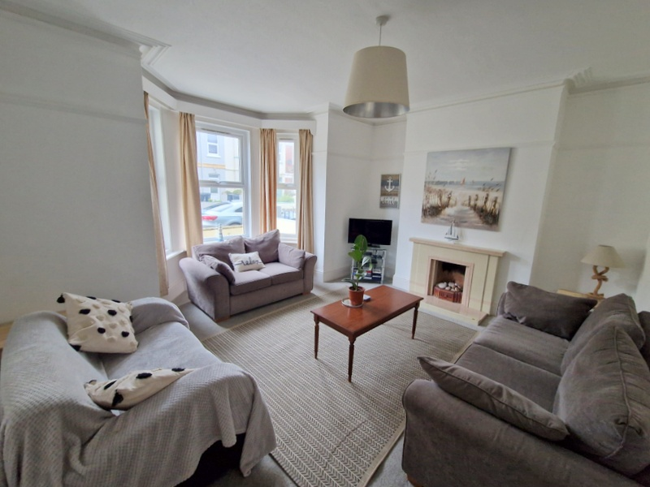
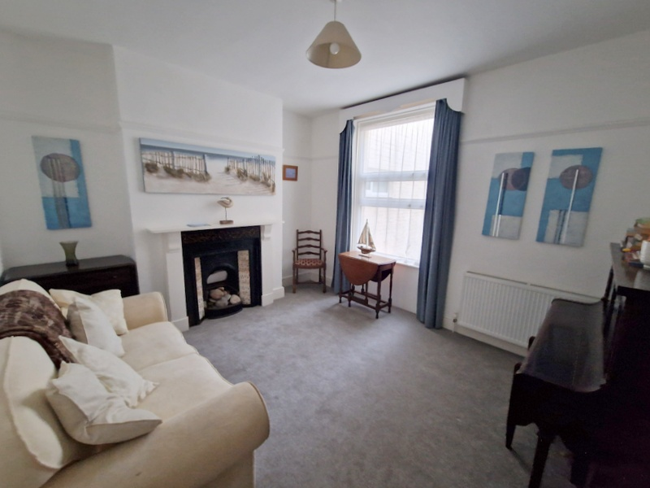
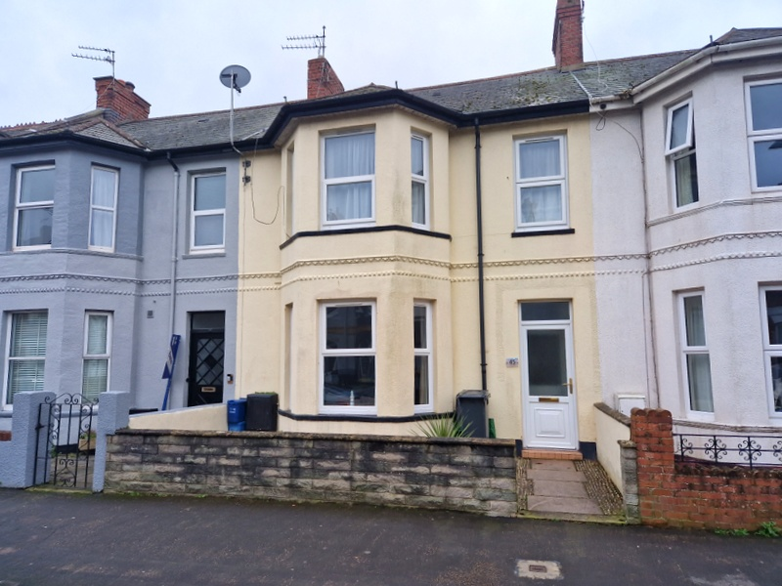
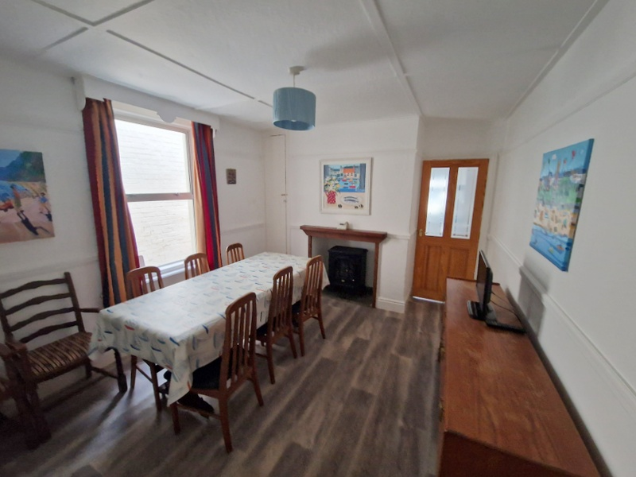
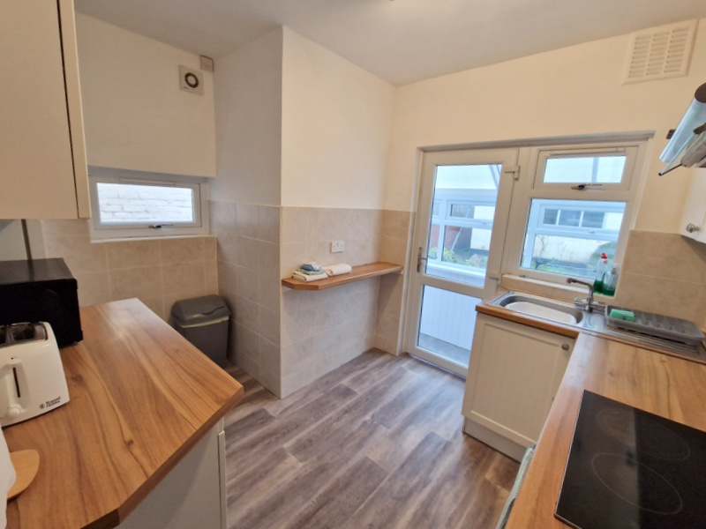
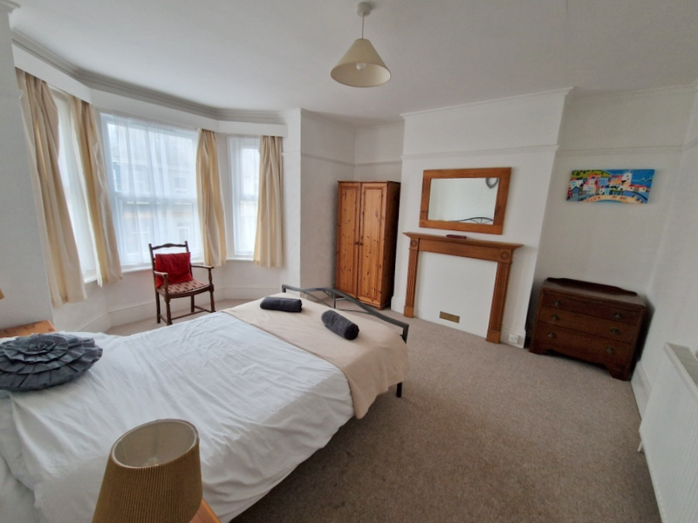
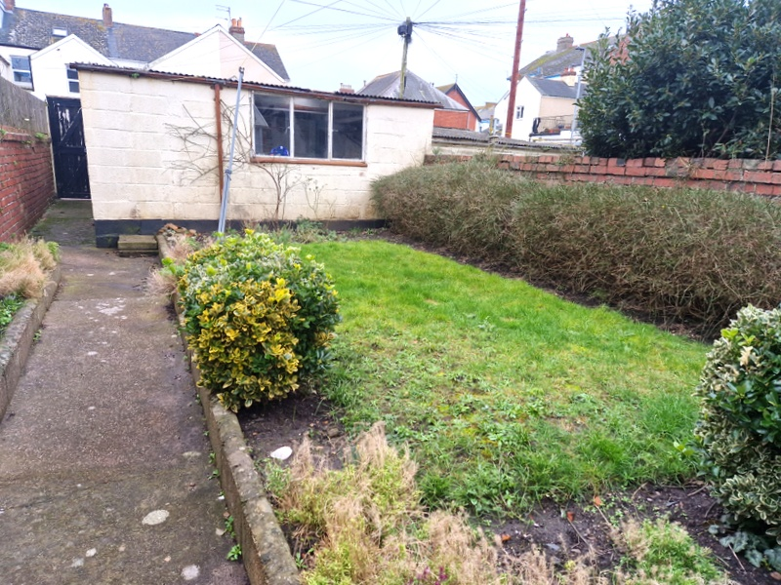
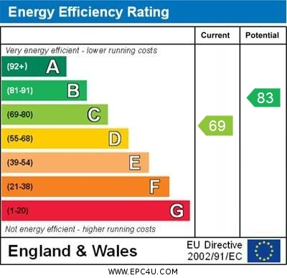
www.pennys.net
45 Victoria Road, Exmouth, EX8 1DW
GUIDE PRICE £460,000
TENURE Freehold
A Period Bay Fronted Terraced House Enjoying An Enviable Location Only A Short Distance From Both The Town Centre And Seafront With Lawned Rear Garden And Double Garage
Entrance Vestibule & Reception Hall * Bay Windowed Lounge * Sitting Room * Dining Room * Modern Kitchen * Rear Double Glazed Utilities/Porch * Ground Floor Cloakroom/WC * Four First Floor Bedrooms Spacious Bathroom With Bath And Shower Cubicle * Separate Wc * Enclosed Rear Garden * Double Garage * Gas Central Heating Double Glazed Windows * Viewing Recommended
Pennys Estate Agents Limited for themselves and for the vendor of this property whose agents they are give notice that:- (1) These particulars do not constitute any part of an offer or a contract. (2) All statements contained in these particulars are made without responsibility on the part of Pennys Estate Agents Limited. (3) None of the statements contained in these particulars are to be relied upon as a statement or representation of fact. (4) Any intending purchaser must satisfy himself/herself by inspection or otherwise as to the correctness of each of the statements contained in these particulars. (5) The vendor does not make or give and neither do Pennys Estate Agents Limited nor any person in their employment has any authority to make or give any representation or warranty whatever in relation to this property.
PENNYS ESTATE AGENTS
2 Rolle House, Rolle Street, Exmouth, Devon, EX8 2SN
Tel: 01395 264111 EMail: help@pennys.net

Slide 2
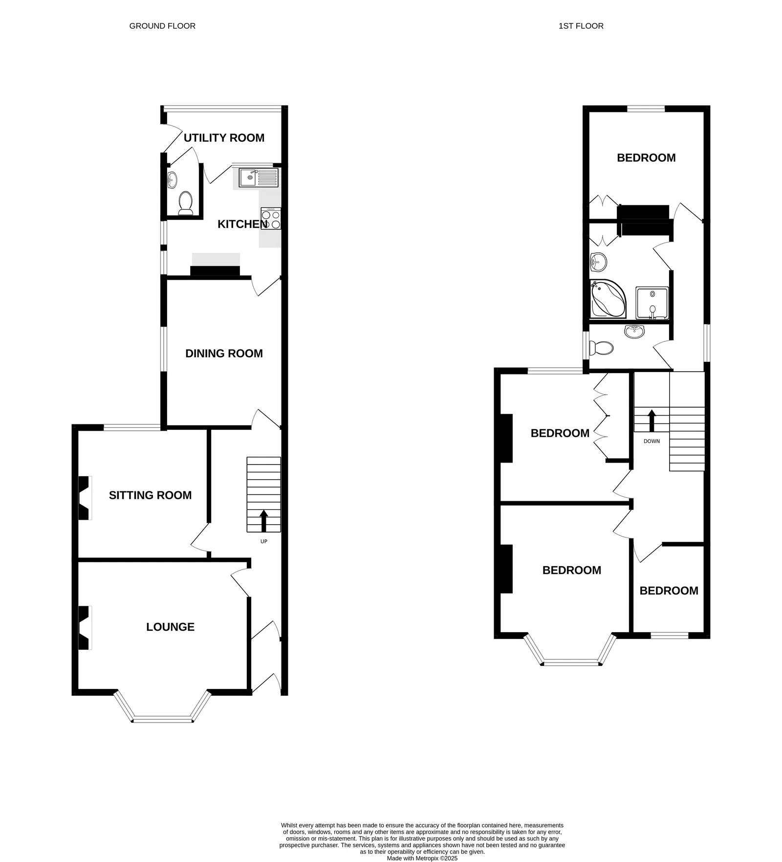
45 Victoria Road, Exmouth, EX8 1DW
THE ACCOMMODATION COMPRISES: uPVC front door with patterned window inset with matching picture window over, giving access to:
ENTRANCE VESTIBULE: Dado rail, inner solid wood door with patterned window inset to:
RECEPTION HALL: Staircase rising to first floor landing, with useful understairs storage cupboard beneath, radiator, electric consumer unit and electric meter.
LOUNGE: 4.7m x 4.57m (15'5" x 15'0") maximum measurement into wall recesses and uPVC double glaze bay window which overlooks the front aspect. A charming room with tiled fireplace with matching hearth, picture rail, cornice ceiling, TV point, radiator.
SITTING ROOM: 3.94m x 3.51m (12'11" x 11’6”) A versatile room with feature fireplace, picture rail, radiator, double glazed window to rear aspect.
DINING ROOM: 3.53m x 3.23m (11'7" x 10'7") plus doorway recess. Chimney recess with slate hearth and mantel over, double glazed window to side aspect, linen cupboard with slatted shelving, dado rail and picture rail, radiator, part glazed door to:
KITCHEN: 3.2m x 3.05m (10'6" x 10'0") maximum overall measurement. Fitted range of wood effect worktops with inset single drainer sink unit with mixer tap and inset four ring ceramic hob with filter extractor hood over and built in oven beneath, tiled surrounds, wall mounted cupboards, space for upright fridge/freezer, radiator, three sets of uPVC double glazed windows and uPVC double glazed door giving access to:
REAR UTILITIES PORCH: 3.61m x 1.22m (11'10" x 4'0") uPVC double glazed windows and door giving access to the rear garden, patterned worktop with plumbing for automatic washing machine beneath, tiled flooring, door to:
CLOAKROOM/WC: Fitted with WC and space saver wash hand basin with part tiled walls and uPVC double glazed window with patterned glass.
FIRST FLOOR SPLIT LEVEL LANDING: Window with patterned glass, fitted cupboards, radiator.
BEDROOM 1: 4.75m x 3.99m (15'7" x 13'1") maximum measurement into wall recesses. uPVC double glazed bay window to front aspect, picture rail, wooden fire surround, radiator.
BEDROOM 2: 3.63m x 3.48m (11'11" x 11'5") plus wall recesses (one wall recess with fitted wardrobe and storage cupboard over). Wooden fire surround, radiator, double glazed window to rear aspect, further range of built-in wardrobes with clothes rail and storage cupboards over.
BEDROOM 3: 3.25m x 3m (10'8" x 9'10") uPVC double glazed window to rear aspect, pedestal wash hand basin with tiled splashback, fitted pine wardrobe in wall recess with clothes rail and storage cupboard over, wooden fire surround, picture rail, radiator,
BEDROOM 4: 2.44m x 1.83m (8'0" x 6'0") uPVC double glazed window to front aspect, radiator, picture rail.
BATHROOM: 2.67m x 2.24m (8'9" x 7'4") Corner bath with shower mixer tap and shower attachment, shower cubicle with shower unit, folding shower splash screen door and splashback walls, pedestal wash hand basin with large fitted mirror over, floor to ceiling cupboard also housing gas boiler for hot water and central heating, radiator, extensively tiled walls, further fitted mirror with light shaver socket over, corner medicine cabinet, uPVC double glazed window with patterned glass.
SEPARATE CLOAKROOM/WC: 2.24m x 0.91m (7'4" x 3'0") Fitted with space saver wash hand basin with chrome mixer tap and splashback, WC with push button flush, radiator, uPVC double glazed window with patterned glass, access to roof space.
OUTSIDE: To the front of the property is a patio garden enclosure with flower beds, with patio path leading to front door. To the rear of the property is a lovely enclosed garden comprising level lawned garden edged with shrub beds, concrete hardstanding, an area with outside cold water tap and seating area, pathway leading the length of the garden with pedestrian gate to rear service lane and door to:
DOUBLE GARAGE: 5.05m x 4.98m (16'7" x 16'4") With two up and over doors, light and power connected, window overlooking the rear garden, door giving direct access to the rear garden.
FLOOR PLAN:

