Slide 1
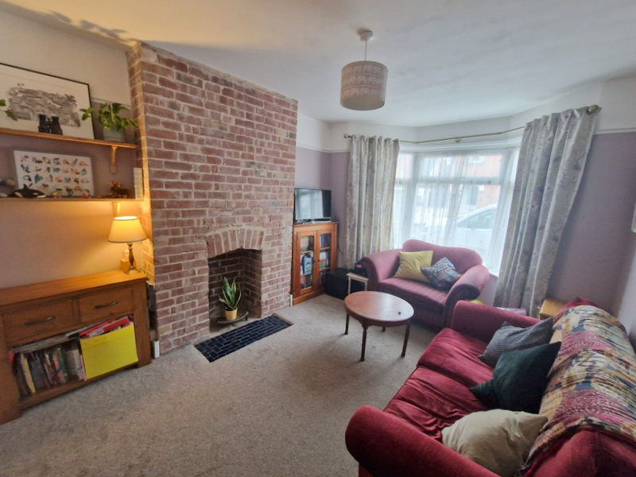
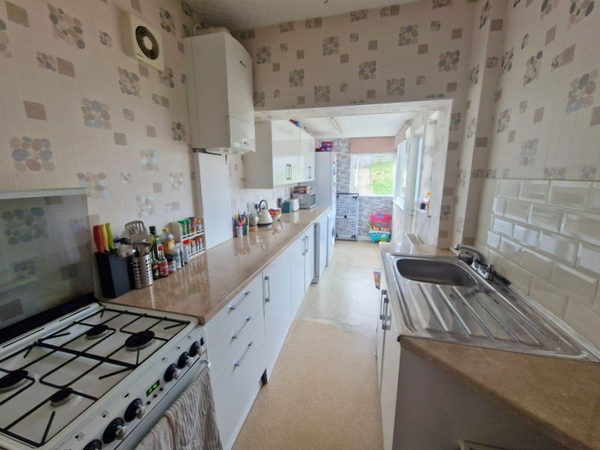
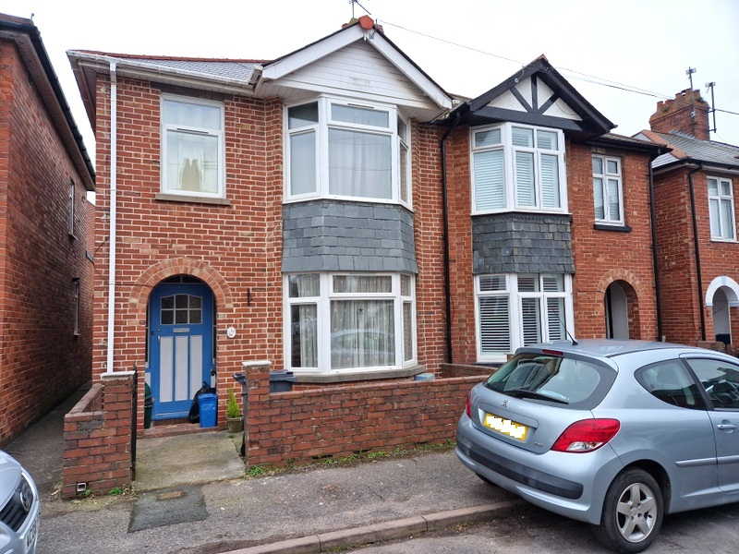
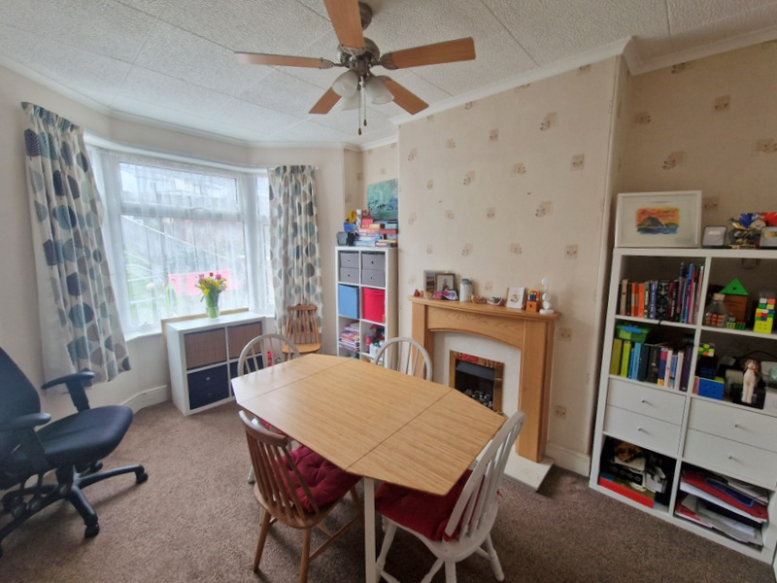
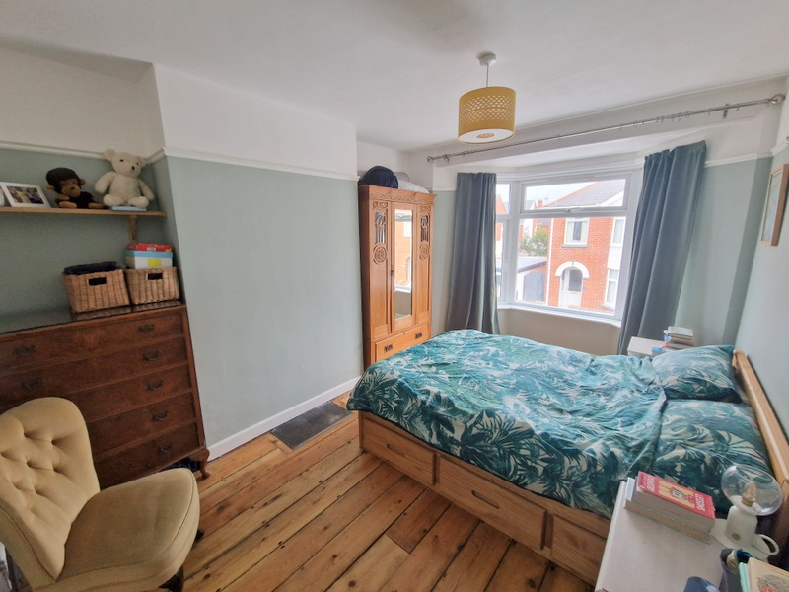
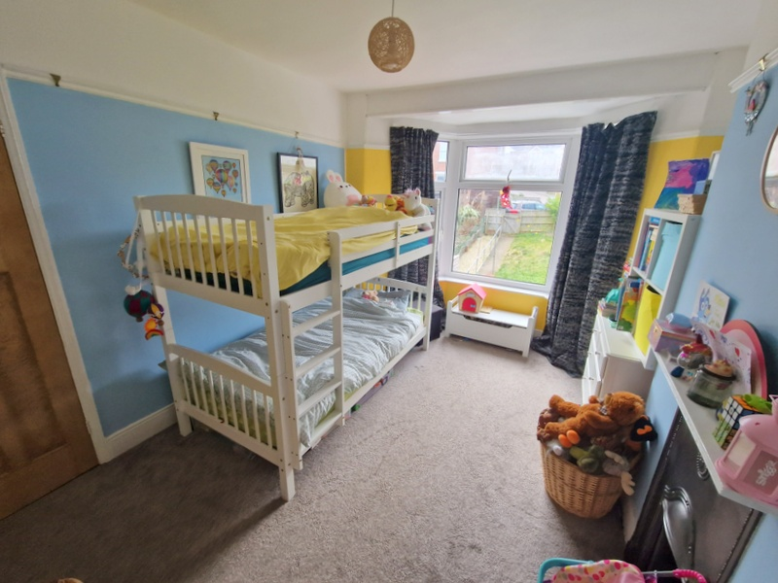
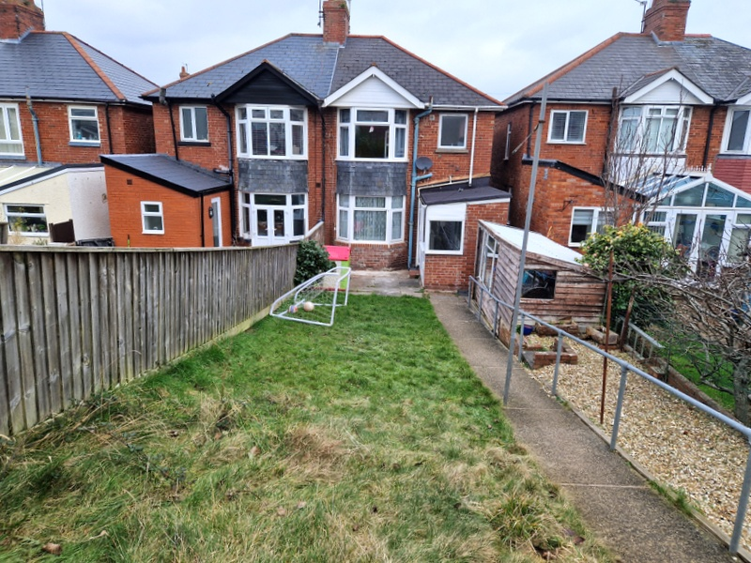
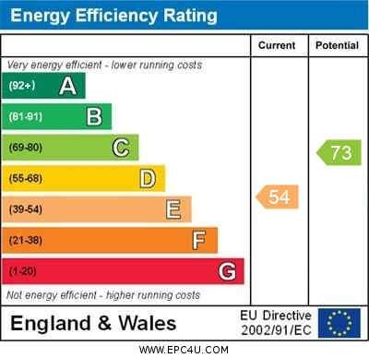
www.pennys.net
40 Madeira Villas, Exmouth, EX8 1QP
GUIDE PRICE £325,000
TENURE Freehold
A 1930’s Style Semi Detached House Enjoying An Excellent Cul-De-Sac Location Close To The Town Centre And Amenities With A Good Size Rear Garden And Parking Area
Reception Hall * Lounge * Separate Dining Room * Kitchen * Three Bedrooms * Bathroom/Wc * Gas Central Heating * Double Glazing * Super Family Home Close To The Town Centre
Pennys Estate Agents Limited for themselves and for the vendor of this property whose agents they are give notice that:- (1) These particulars do not constitute any part of an offer or a contract. (2) All statements contained in these particulars are made without responsibility on the part of Pennys Estate Agents Limited. (3) None of the statements contained in these particulars are to be relied upon as a statement or representation of fact. (4) Any intending purchaser must satisfy himself/herself by inspection or otherwise as to the correctness of each of the statements contained in these particulars. (5) The vendor does not make or give and neither do Pennys Estate Agents Limited nor any person in their employment has any authority to make or give any representation or warranty whatever in relation to this property.
PENNYS ESTATE AGENTS
2 Rolle House, Rolle Street, Exmouth, Devon, EX8 2SN
Tel: 01395 264111 EMail: help@pennys.net

Slide 2
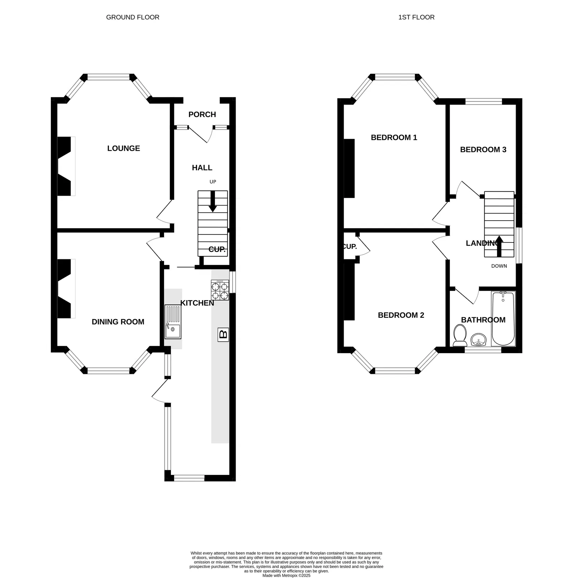
40 Madeira Villas, Exmouth, EX8 1QP
THE ACCOMMODATION COMPRISES: Feature arched entrance porch with tiled floor, solid wood front door with patterned window insets, inside screen windows to:
RECEPTION HALL: Radiator, staircase rising to first floor landing with useful understairs storage cupboard beneath, telephone point.
LOUNGE: 4.37m x 3.25m (14'4" x 10'8") maximum measurement into wall recesses. uPVC double glazed bay window overlooking the front aspect, feature exposed brick chimneybreast and recess with tiled hearth, TV point, radiator, picture rail.
DINING ROOM: 4.14m x 3.05m (13'7" x 10'0") maximum measurement into wall recess. uPVC double glazed bay window overlooking the rear garden, wooden fire surround housing living flame-effect coal gas fire, radiator.
KITCHEN: 15.89m x 1.96m (19'4" x 6'5") Comprising single drainer sink unit with tiled splashback and cupboards beneath, range of gloss finish patterned worktops with cupboards, drawer units, plumbing for automatic washing machine, further appliance space beneath worktops, wall mounted cupboards, wall mounted Worcester gas boiler for hot water and central heating, space for upright fridge/freezer, two uPVC double glazed windows overlooking the rear garden and part glazed door giving access to the rear garden, radiator, two single glazed windows.
FIRST FLOOR LANDING: Window to side aspect, access to loft space.
BEDROOM 1: 4.37m x 3.05m (14'4" x 10'0") Lovely main bedroom with measurement into wall recesses. uPVC double glazed bay window to front aspect, stripped wood flooring, picture rail, radiator.
BEDROOM 2: 4.04m x 3.05m (13'3" x 10'0") measurement into wall recesses. Double glazed bay window overlooking the rear aspect, fitted cupboard in wall recess, feature fireplace, picture rail, radiator.
BEDROOM 3: 2.64m x 1.98m (8'8" x 6'6") uPVC double glazed window to front aspect, radiator.
BATHROOM/WC: 1.93m x 1.7m (6'4" x 5'7") Comprising bath with Mira shower unit over, shower rail and curtain, pedestal wash hand basin, WC with push button flush, radiator, fully tiled walls, extractor fan, uPVC double glazed window with patterned glass.
OUTSIDE: Pedestrian gate and pathway to front door with small front garden enclosure. To the rear is a good sized pathway and a gate gives access through to the rear garden. The rear garden is a good size, laid to lawn with decorative stone garden area and patio area, pedestrian gate with access to PARKING AREA, with vehicular access into Ryll Grove. There is a large GARDEN STORE.
FLOOR PLAN:

