Slide 1
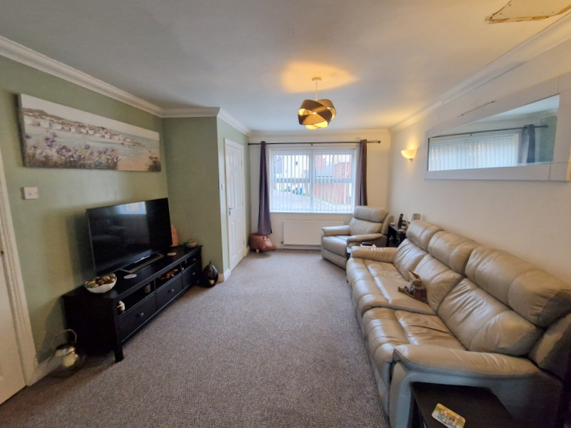
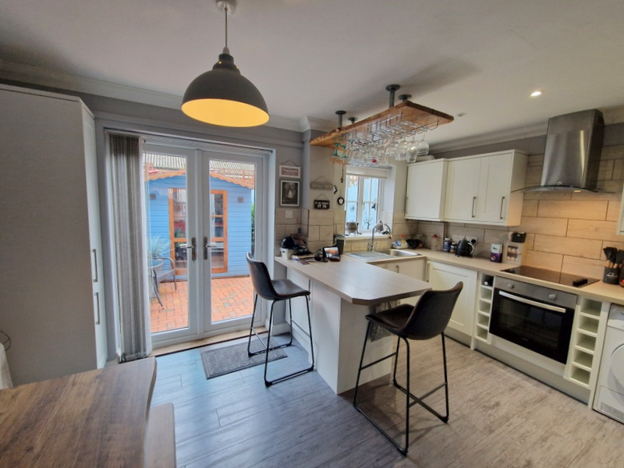
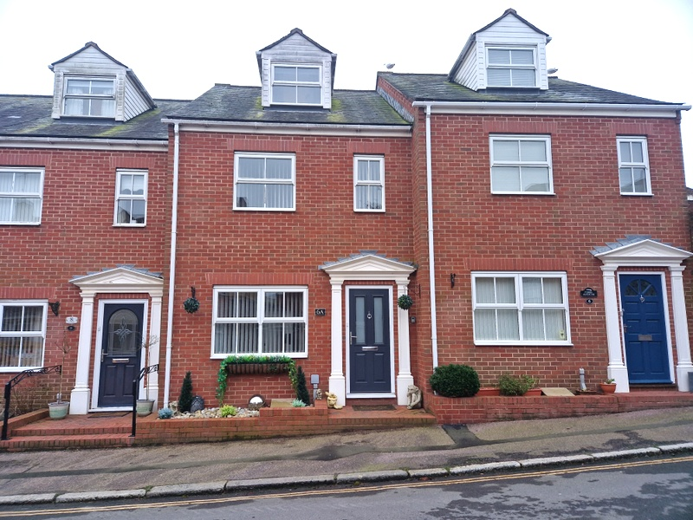
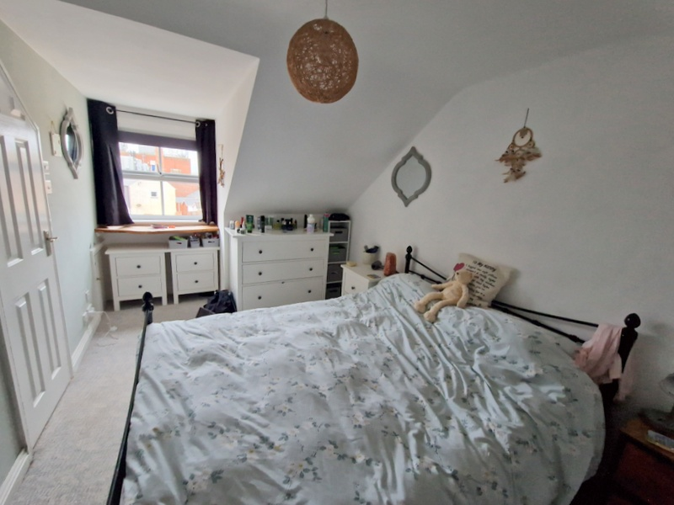
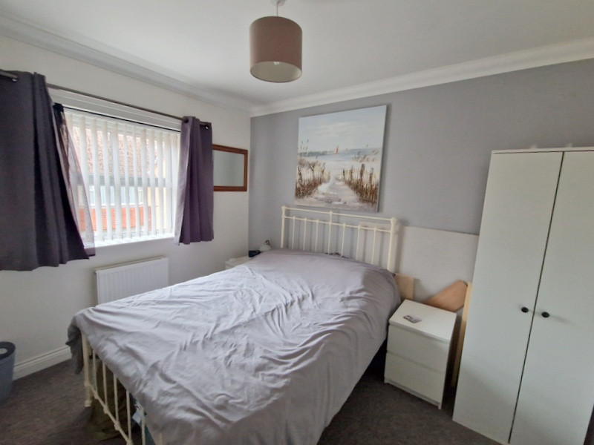
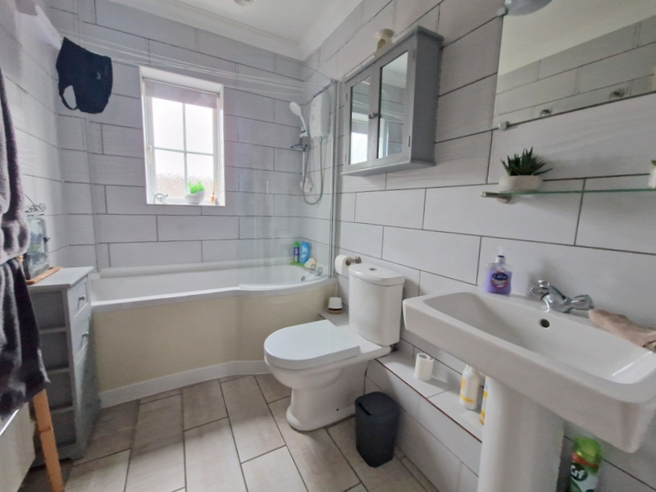
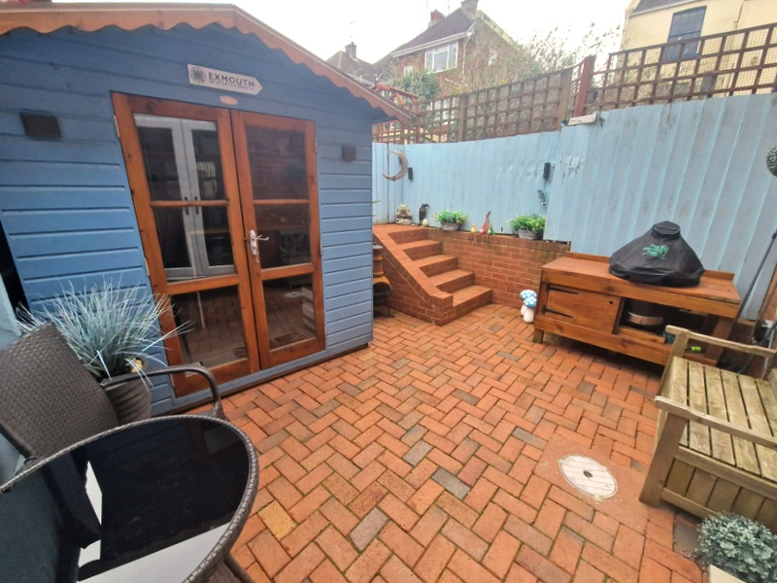
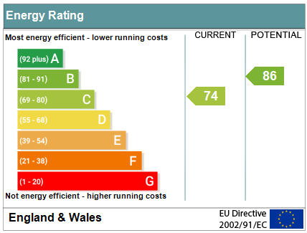
www.pennys.net
6a Bicton Street, Exmouth, EX8 2RT
GUIDE PRICE £385,000
TENURE Freehold
Deceptively Spacious Modern House Arranged Over Three Floors With Garage, Located Close To The Heart Of The Town Centre And Within Easy Reach Of The Seafront
Lounge * Kitchen/Dining Room * Three Double Bedrooms Arranged Over Upper Floors * Two En-Suite Shower Room/Wc’s * Main First Floor Bathroom/Wc * Attractive Enclosed Rear Garden * Garage
Pennys Estate Agents Limited for themselves and for the vendor of this property whose agents they are give notice that:- (1) These particulars do not constitute any part of an offer or a contract. (2) All statements contained in these particulars are made without responsibility on the part of Pennys Estate Agents Limited. (3) None of the statements contained in these particulars are to be relied upon as a statement or representation of fact. (4) Any intending purchaser must satisfy himself/herself by inspection or otherwise as to the correctness of each of the statements contained in these particulars. (5) The vendor does not make or give and neither do Pennys Estate Agents Limited nor any person in their employment has any authority to make or give any representation or warranty whatever in relation to this property.
PENNYS ESTATE AGENTS
2 Rolle House, Rolle Street, Exmouth, Devon, EX8 2SN
Tel: 01395 264111 EMail: help@pennys.net

Slide 2
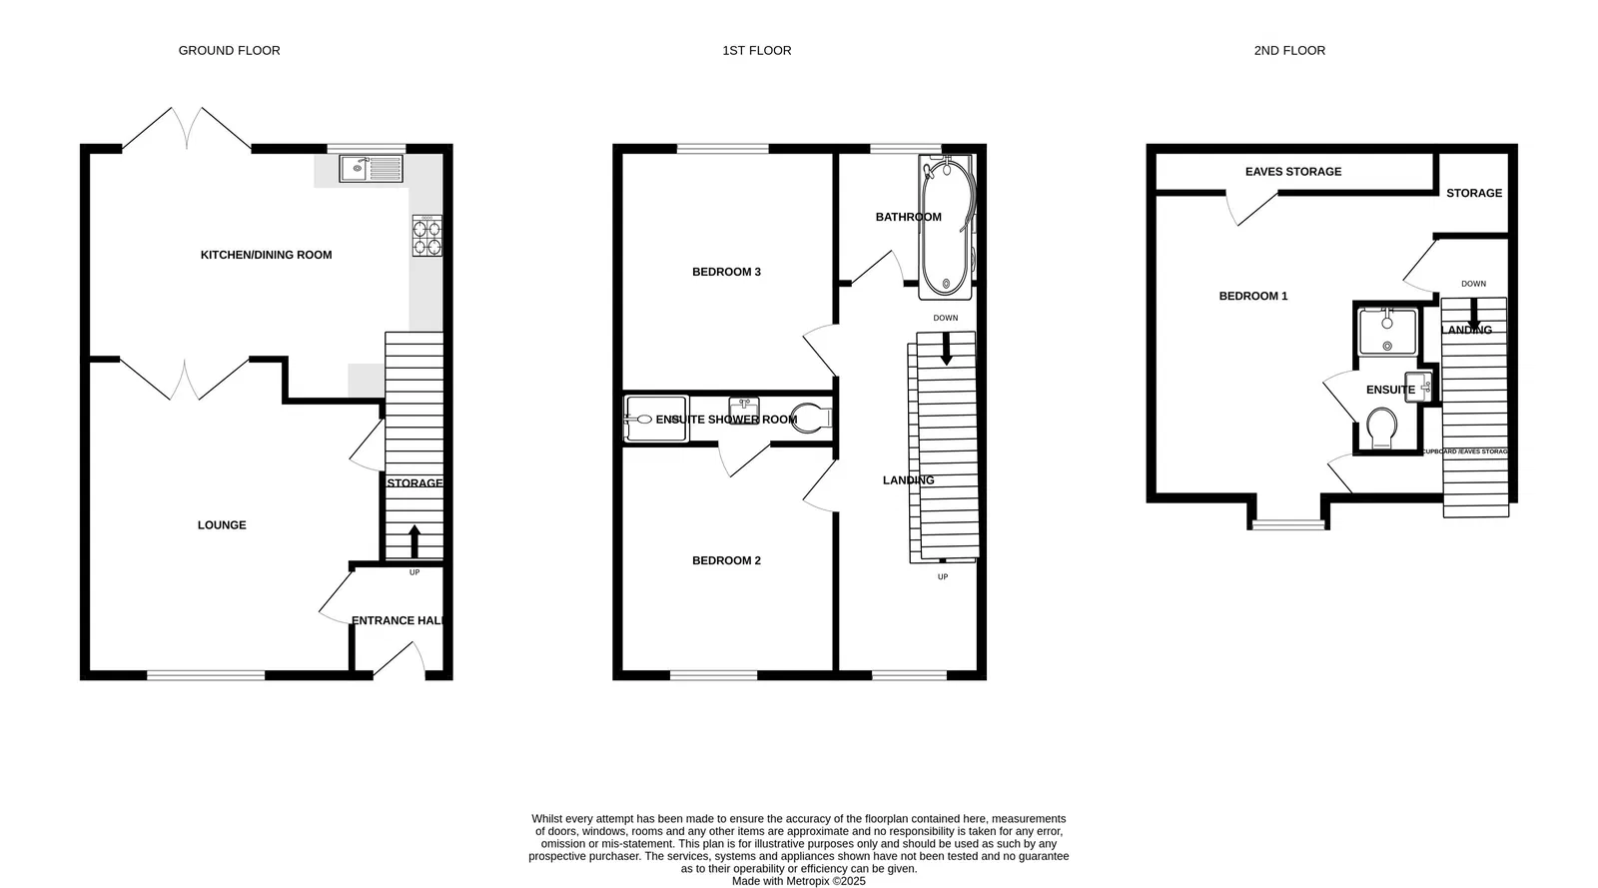
6a Bicton Street, Exmouth, EX8 2RT
Located in the sought after road of Bicton Street close to the heart of Exmouth town centre and seafront. The property offers deceptively spacious accommodation arranged over three floors with an advantage of a good size garage located close by. Viewing of this ideally postioned property is highly recommended.
THE ACCOMMODATION COMPRISES: Front door giving access to:
ENTRANCE HALL: Attractive period style tiled flooring, radiator, stairs rising to first floor landing, wall mounted electric consumer unit, door giving access to:
LOUNGE: 4.88m x 3.48m (16'0" x 11'5") maximum overall measurement. Double glazed window to front aspect, radiator, TV point, wall lighting, access to understairs storage cupboard with light, glazed panel door to:
KITCHEN/DINING ROOM: 4.42m x 2.95m (14'6" x 9'8") Spacious stylish room with uPVC double glazed French patio doors opening onto the rear garden, double glazed window looking over the rear garden, fitted with a range of worktops extended to provide a breakfast bar area with range of cupboards and drawer units, wine rack, plumbing for automatic washing machine, integrated fridge and freezer, washing machine and dishwasher beneath worktops. Range of matching wall mounted cupboards, pull-out larder style cupboard, wall mounted gas boiler for hot water and central heating, bespoke overhead wood glass rack, inset single drainer stainless steel sink unit set with mixer tap into work surface, built-in electric oven and hob with extractor hood over, radiator, led ceiling spotlighting, ceiling downlighting in dining area, wood flooring.
FIRST FLOOR LANDING: Double glazed window to front aspect, staircase rising to second floor, radiator.
BEDROOM 2: 3.3m x 2.59m (10'10" x 8'6") Double glazed window to front aspect, radiator.
EN-SUITE SHOWER ROOM/WC: Comprising shower cubicle with folding doors, WC, wash hand basin with cabinet beneath, tiled walls, radiator.
BEDROOM 3: 3.63m x 2.59m (11'11" x 8'6") Double glazed window to rear aspect, radiator.
BATHROOM/WC: 2.67m x 1.68m (8'9" x 5'6") Comprising bath with shower over, shower splash screen, WC, pedestal wash hand basin, fully tiled walls, radiator, extractor fan.
SECOND FLOOR LANDING: Door giving access to:
MAIN BEDROOM 1: 5.11m x 3.51m (16'9" x 11'6") maximum overall measurement. A spacious main bedroom suite with double glazed window to front aspect with part sloping ceiling, radiator, access to eaves storage cupboards, further storage area with hanging rail and door to:
EN-SUITE SHOWER ROOM/WC: Comprising shower cubicle with folding glass doors, WC, wash hand basin, attractive tiling, floor and wall tiling, inset led lighting, extractor fan.
OUTSIDE: To the front of the property is an attractively planned small garden area. To the rear of the property there is an enclosed garden laid to block paving enjoying a sunny aspect, ideal for outside entertaining, access to: SUMMER HOUSE 1.96m x 1.63m (6'5" x 5'4") A useful area with power and light connected, glazed double doors. From the garden a few steps rise to a pedestrian gate with access pathway leading to South Street and the garage.
GARAGE: Vehicular access via South Street, with electric roller door, power and light connected.
Mortgage Assistance: We are pleased to recommend Meredith Morgan Taylor, who would be pleased to help no matter which estate agent you finally buy through. For a free initial chat please contact us on to arrange an appointment. Your home may be repossessed if you do not keep up repayments on your mortgage. Meredith Morgan Taylor Ltd is an appointed representative of The Openwork Partnership, a trading style of Openwork Ltd which is authorised and regulated by the Financial Conduct Authority (FCA).
FLOOR PLAN:

