Slide 1
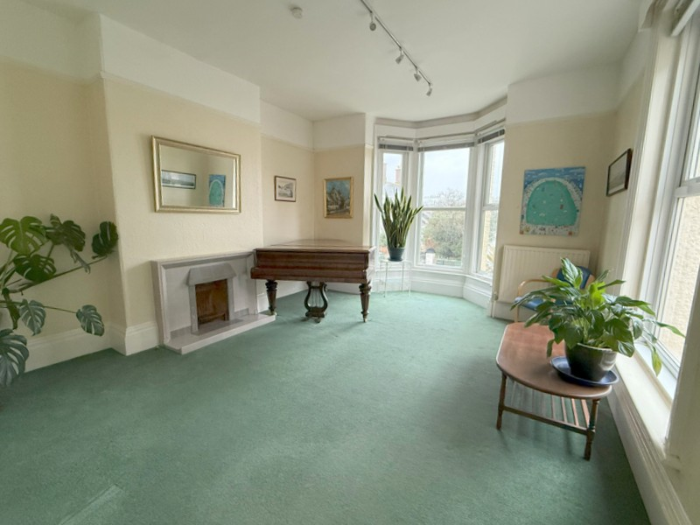
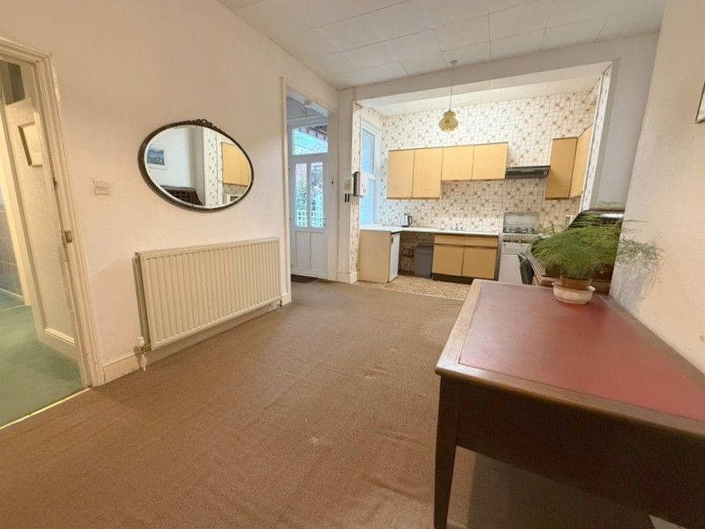
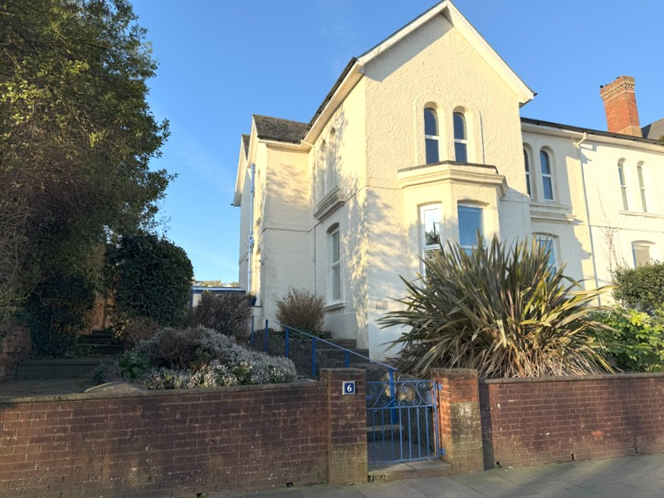
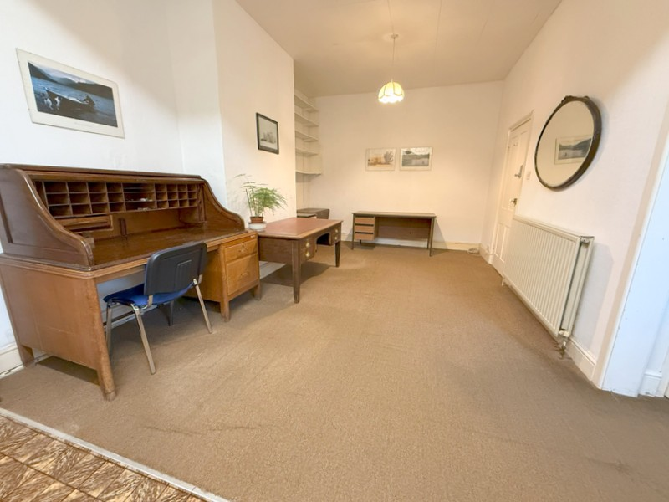
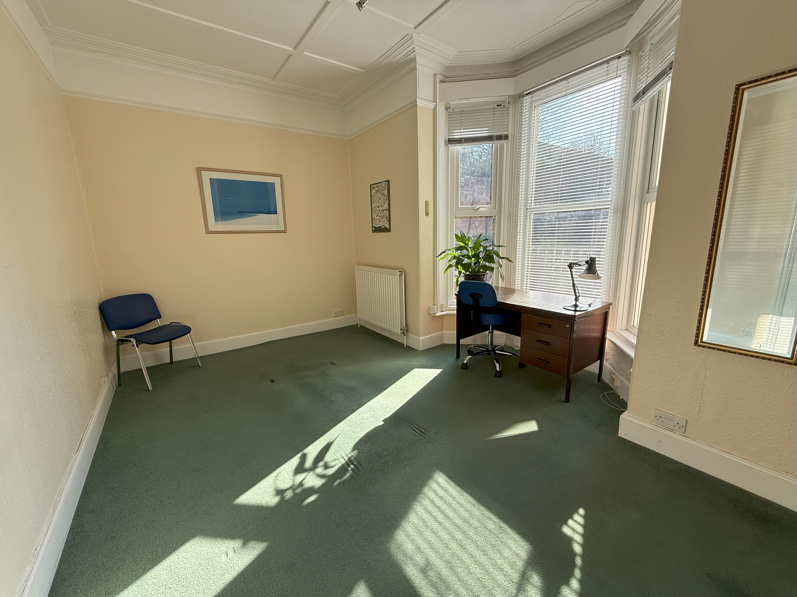
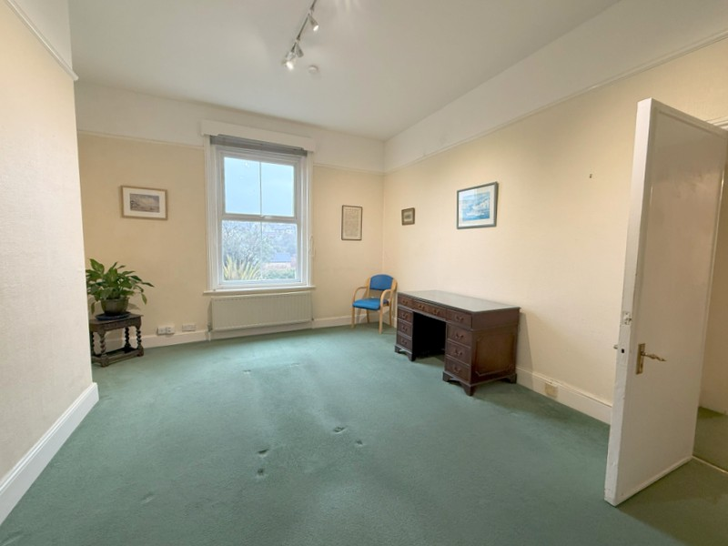
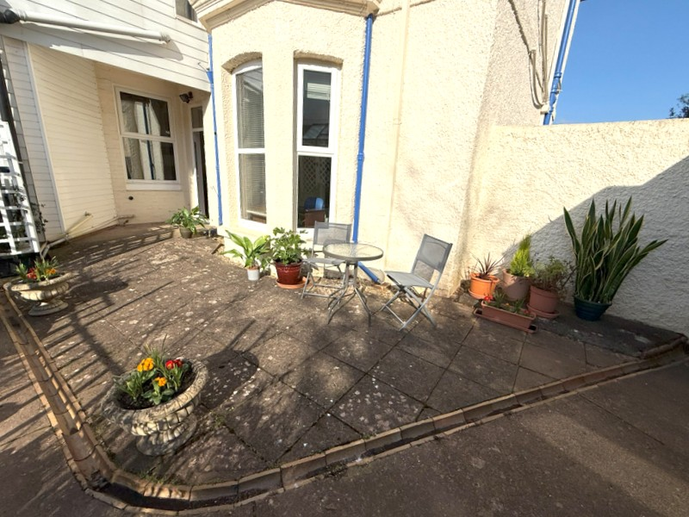
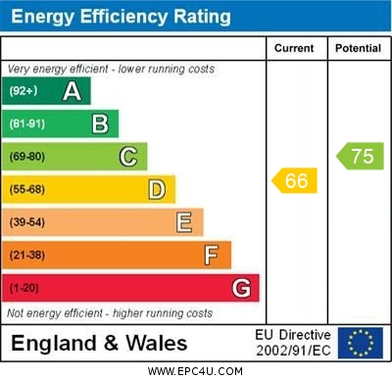
www.pennys.net
Flat 1, 6 Rolle Road, Exmouth, EX8 2AB
GUIDE PRICE £239,950
TENURE Freehold
An Extremely Spacious Ground Floor Flat Located Close To The Heart Of Exmouth Town Centre Enjoying Its Own Garden Areas And Offered For Sale With No Ongoing Chain
Reception Hall * Dual Aspect Living Room * Spacious Kitchen/Dining Room * Two Double Bedrooms * Bathroom/Wc * Double Glazed Windows * Gas Central Heating * Some General Refurbishment Required
Pennys Estate Agents Limited for themselves and for the vendor of this property whose agents they are give notice that:- (1) These particulars do not constitute any part of an offer or a contract. (2) All statements contained in these particulars are made without responsibility on the part of Pennys Estate Agents Limited. (3) None of the statements contained in these particulars are to be relied upon as a statement or representation of fact. (4) Any intending purchaser must satisfy himself/herself by inspection or otherwise as to the correctness of each of the statements contained in these particulars. (5) The vendor does not make or give and neither do Pennys Estate Agents Limited nor any person in their employment has any authority to make or give any representation or warranty whatever in relation to this property.
PENNYS ESTATE AGENTS
2 Rolle House, Rolle Street, Exmouth, Devon, EX8 2SN
Tel: 01395 264111 EMail: help@pennys.net

Slide 2
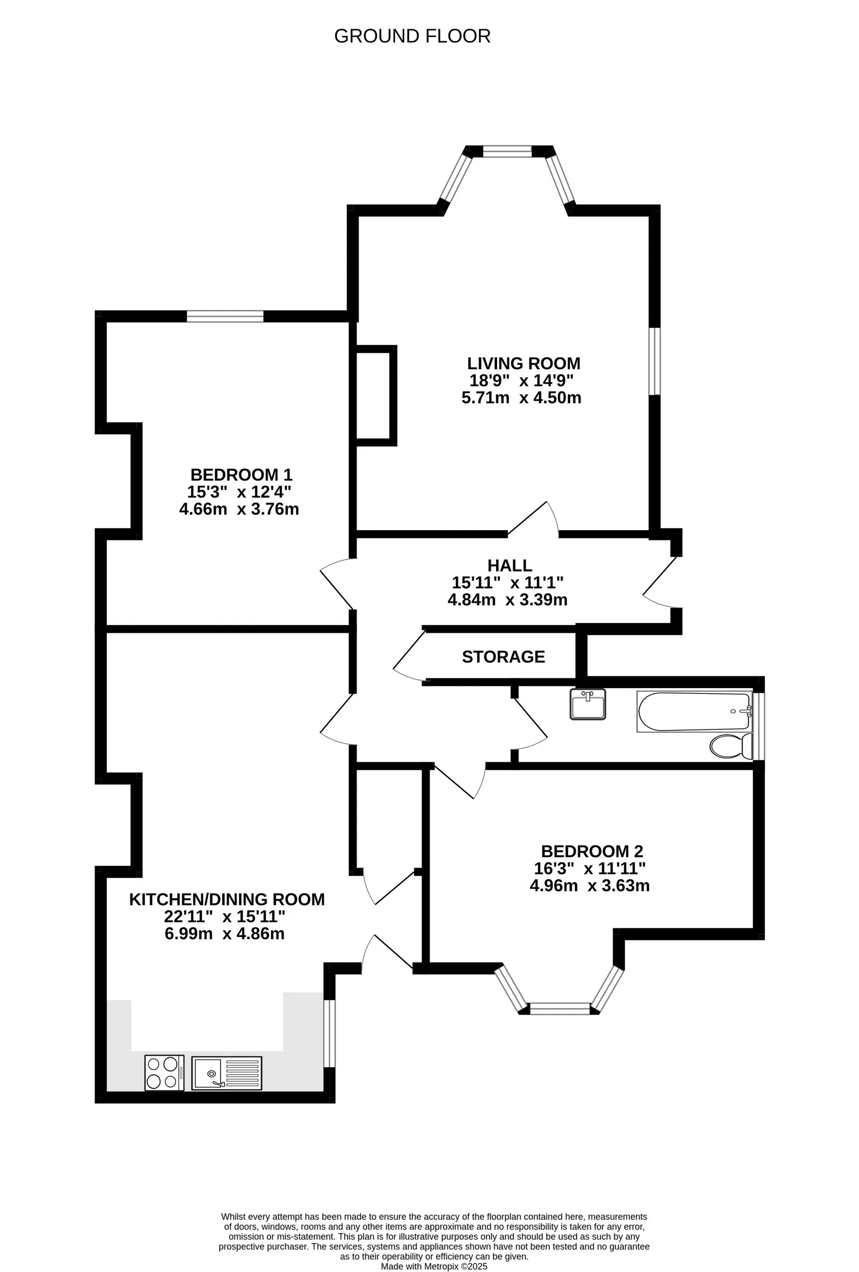
Flat 1, 6 Rolle Road, Exmouth, EX8 2AB
THE ACCOMMODATION COMPRISES: Communal entrance and hallway giving access to private front door to:
RECEPTION HALL: Radiator, good size understairs storage cupboard, doors giving access to all rooms.
LIVING ROOM: 4.5m x 5.71m (14'9" x 18'8") An elegant dual aspect room with double glazed bay window overlooking the front aspect with further double glazed window to side elevation, tiled fireplace with open grate and gas point, picture rail, two radiators.
KITCHEN/DINING ROOM: 4.86m x 6.99m (15'11" x 22'11") A spacious room with kitchen area fitted with a stainless steel single drainer sink unit set into worktops, cupboards and drawer units beneath, gas and electric cooker points, wall mounted cupboards, double glazed window to rear elevation and double glazed door giving access to the rear aspect, large walk-in storage cupboard, large radiator..
BEDROOM 1: 4.66m x 3.76m (15'3" x 12'4") Double glazed window to front aspect, picture rail, radiator.
BEDROOM 2: 4.96m x 3.63m (16'3" x 11'10") Double glazed bay window to rear aspect, radiator, picture rail, built-in wardrobes housing modern gas boiler for hot water and central heating.
BATHROOM/WC: 3.58m x 1.16m (11'8" x 3'9") Comprising bath, pedestal wash hand basin with fitted mirror over and light and shaver socket, WC, radiator, fully tiled walls, double glazed window with patterned glass.
OUTSIDE: The property owns the front garden which offers an array of colour with a variety of flower beds and borders, pedestrian gate and pathway gives access to the property. To the rear of the property there is a South-West facing patio/sun terrace for the sole use of this flat. Shared pathway gives rear access.
TENURE: The property owns the benefit of the freehold of the whole building with the upstairs flat on a long lease. Maintenance is on a 50/50 basis. Recent electric (EICR) with new electric consumer unit February 2025. Gas safety and boiler service August 2024.
Mortgage Assistance: We are pleased to recommend Meredith Morgan Taylor, who would be pleased to help no matter which estate agent you finally buy through. For a free initial chat please contact us on to arrange an appointment. Your home may be repossessed if you do not keep up repayments on your mortgage. Meredith Morgan Taylor Ltd is an appointed representative of The Openwork Partnership, a trading style of Openwork Ltd which is authorised and regulated by the Financial Conduct Authority (FCA).
FLOOR PLAN:

