Slide 1
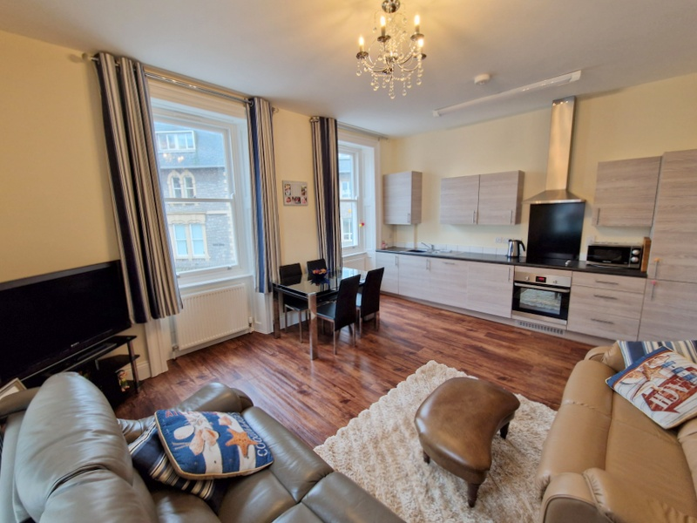
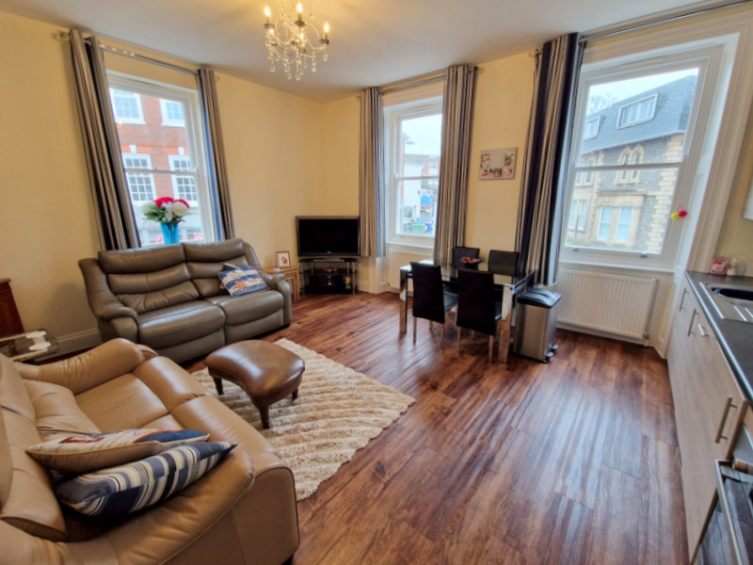
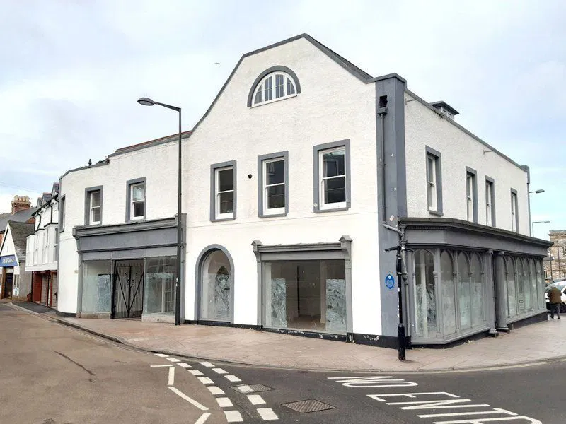
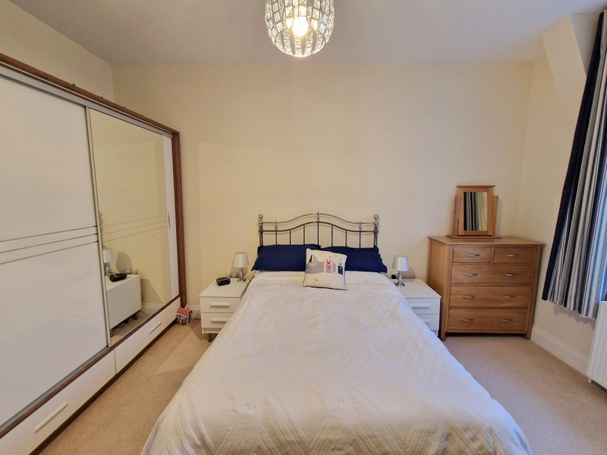
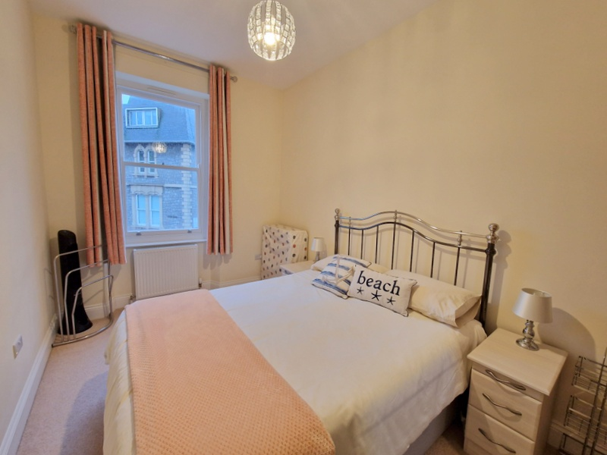
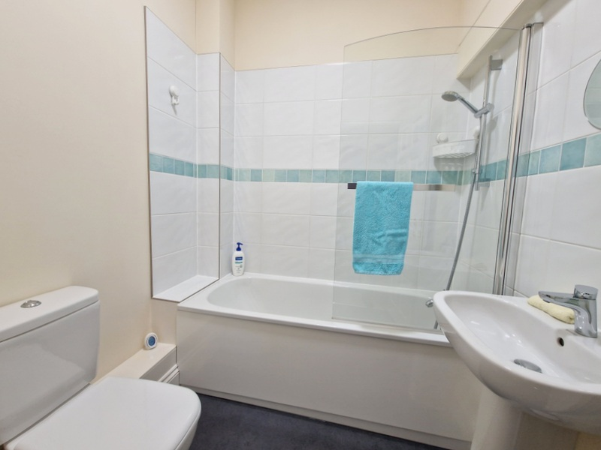
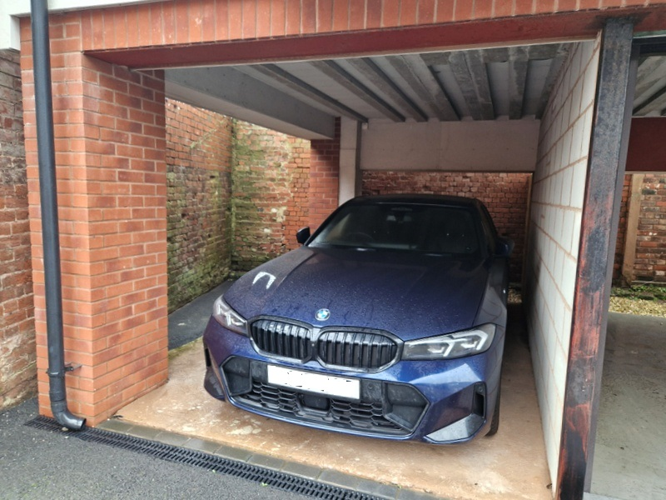
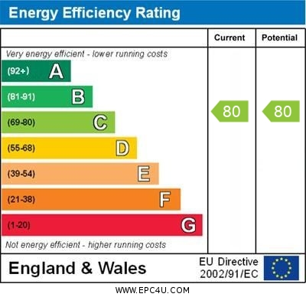
www.pennys.net
Flat 2 Thomas Tucker Building, 37 The Strand, Exmouth, EX8 1AQ
GUIDE PRICE £250,000
TENURE Freehold
A Stunning First Floor Apartment Within An Impressive Grade II Listed Building Converted In 2018 To An Extremely High Standard, Located In The Heart Of Exmouth Town Centre Within Easy Reach Of The Seafront With Covered Parking Space
Stylish Accommodation Coupled With Character Features * Open-Plan Lounge And Kitchen With Integrated Appliances * Two Good Size Double Bedrooms * Stylish Bathroom Suite * Double Glazed Sash Windows * Gas Central Heating * Ideal Permanent Or Holiday Home Retreat
Pennys Estate Agents Limited for themselves and for the vendor of this property whose agents they are give notice that:- (1) These particulars do not constitute any part of an offer or a contract. (2) All statements contained in these particulars are made without responsibility on the part of Pennys Estate Agents Limited. (3) None of the statements contained in these particulars are to be relied upon as a statement or representation of fact. (4) Any intending purchaser must satisfy himself/herself by inspection or otherwise as to the correctness of each of the statements contained in these particulars. (5) The vendor does not make or give and neither do Pennys Estate Agents Limited nor any person in their employment has any authority to make or give any representation or warranty whatever in relation to this property.
PENNYS ESTATE AGENTS
2 Rolle House, Rolle Street, Exmouth, Devon, EX8 2SN
Tel: 01395 264111 EMail: help@pennys.net

Slide 2
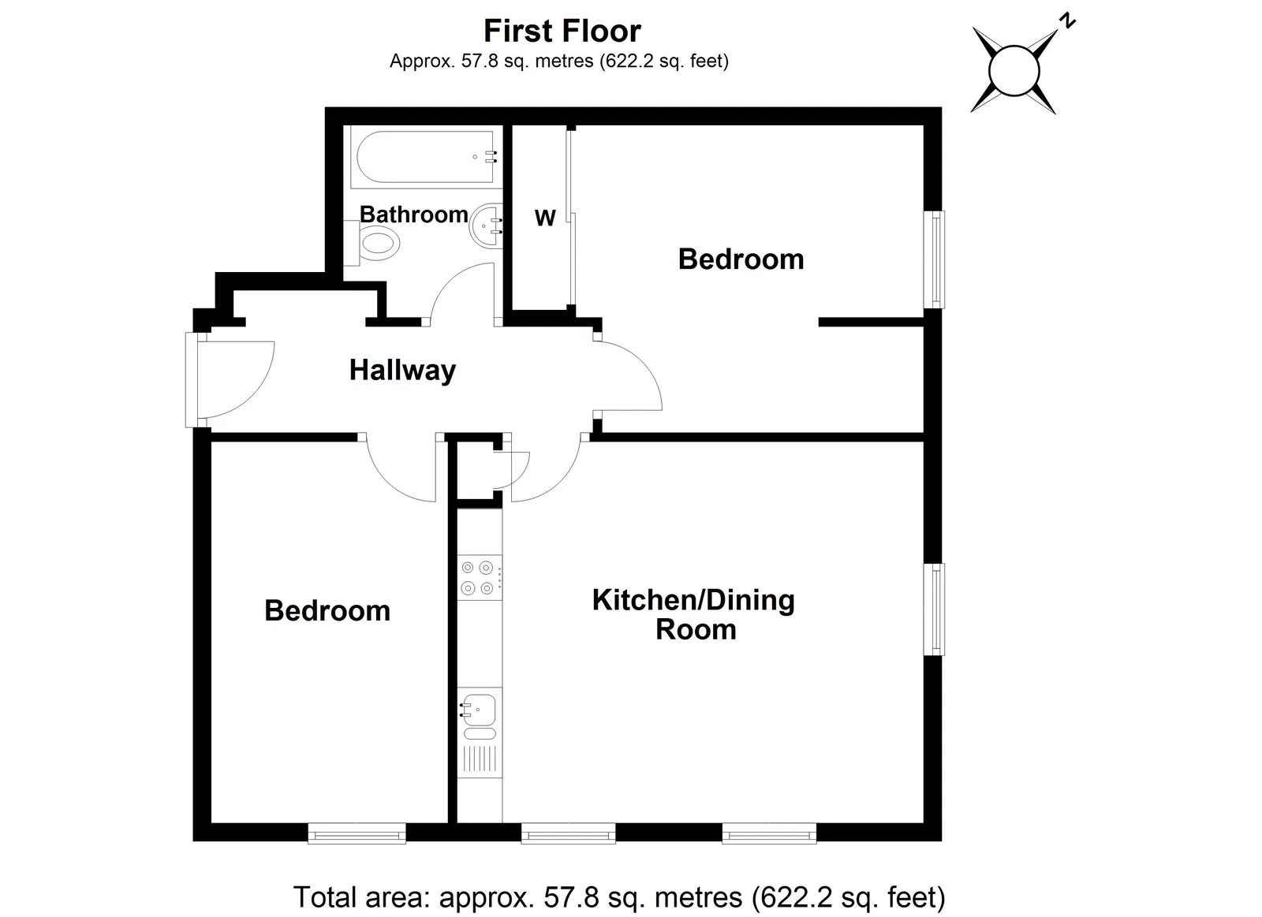
Flat 2 Thomas Tucker Building, 37 The Strand, Exmouth, EX8 1AQ
THE ACCOMMODATION COMPRISES: Communal front door with entry intercom with stairs rising to SPACIOUS FIRST FLOOR COMMUNAL LANDING with two lantern ceiling windows, allowing an abundance of light, private front door giving access to:
RECEPTION HALL: Door entry phone, electric consumer unit, feature arched wall recess ideal for coat rack/shoe rack, doors giving access to all rooms.
LOUNGE/KITCHEN AREA: 5.18m x 4.24m (17'0" x 13'11") A spacious and bright dual aspect room comprising of KITCHEN AREA with range of worktops with matching splashbacks with inset single drainer sink unit, mixer tap, inset electric hob with matching splashback and chimney style extractor hood over, range of cupboards and drawer units, integrated dishwasher and washing machine beneath worktops, integrated fridge and freezer, sealed unit double glazed window, wall mounted cupboards. LOUNGE AREA fitted with two further double glazed sash style windows, TV point, radiator.
BEDROOM 1: 4.57m x 3.51m (15'0" x 11'6") A most spacious bedroom with feature recess areas and with decorative wall arch, double glazed sash style window, radiator, large wardrobes with sliding doors with led lighting over.
BEDROOM 2: 4.27m x 2.59m (14'0" x 8'6") With double glazed sash style window, radiator, double wardrobe with sliding doors.
BATHROOM/WC: 2.16m x 1.85m (7'1" x 6'1") Fitted with bath having shower attachment, shower splash screen, pedestal wash hand basin, WC with push button flush, chrome heated electric towel rail, upright floor standing cabinet, ceiling extractor fan.
OUTSIDE: The property benefits from a COVERED PARKING AREA measuring 4.34m x 2.49m (14'3" x 8'2") with further storage areas to the rear and side of the parking bay. There are no gardens to maintain.
TENURE: The property is held on a 250 year lease from 2018. Current Service Charge: £110 per annum. Current Ground Rent: £150 per annum. Current Insurance: £274.53 per annum.
FLOOR PLAN:

