Slide 1
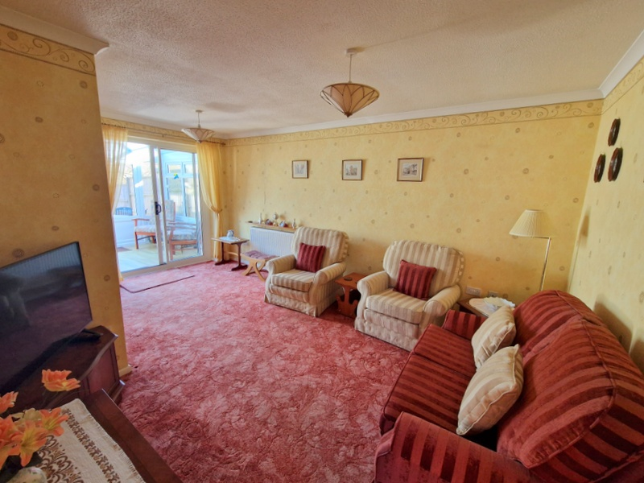
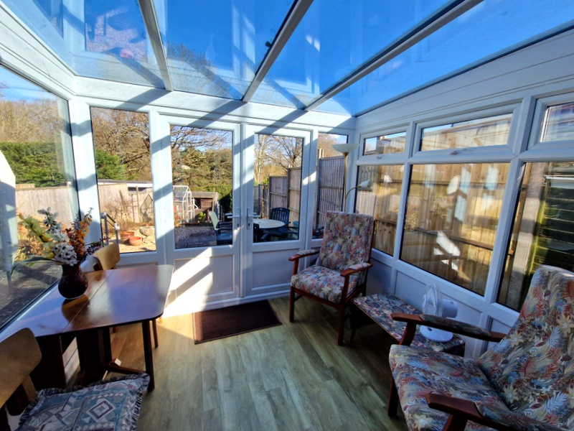
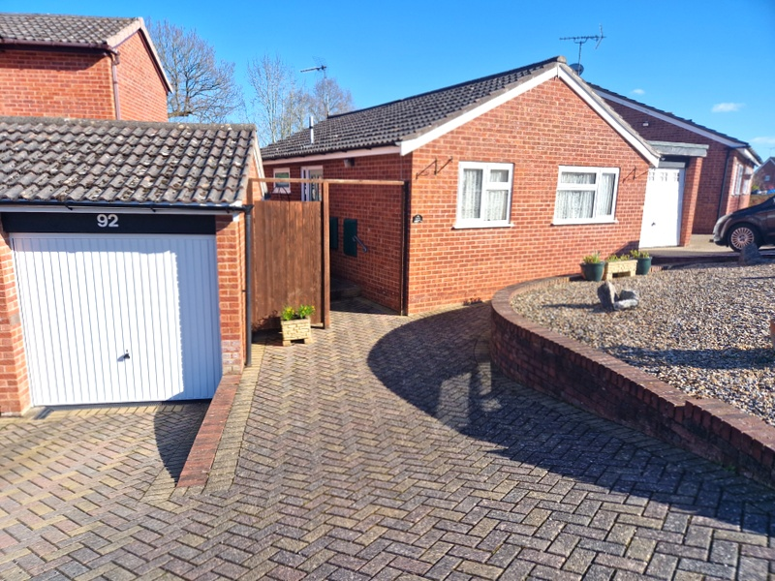
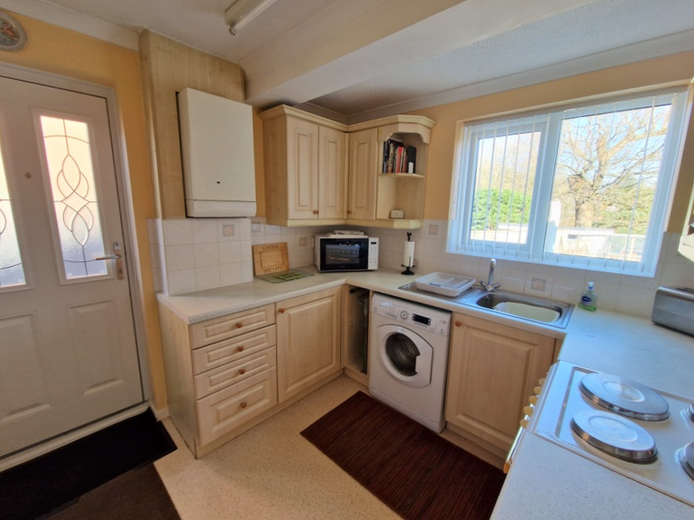
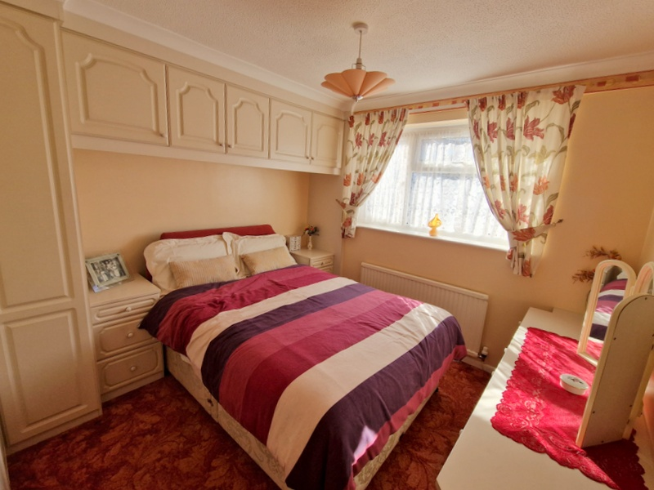
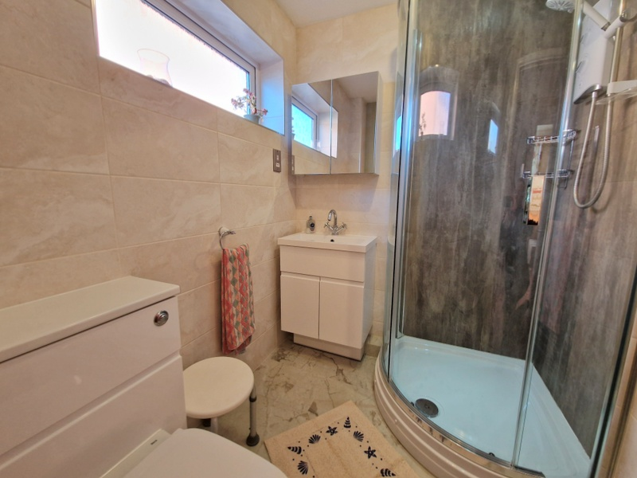
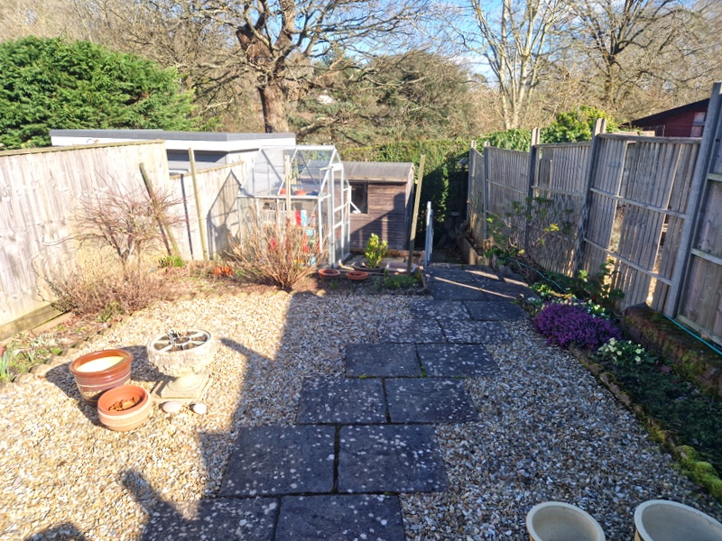
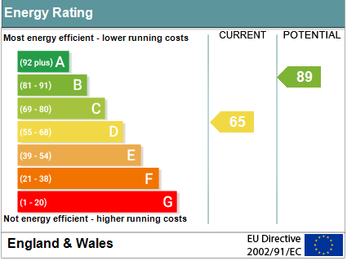
www.pennys.net
92 Valley Way, Exmouth, EX8 4RL
GUIDE PRICE £300,000
TENURE Freehold
A Detached Two Bedroom Bungalow Enjoying A Favoured Location With Well Planned Easy To Maintain Gardens, Good Size Block Paved Driveway/Parking Area And Garage
Lounge/Dining Room * Conservatory * Kitchen * Two Bedrooms * Stylish Shower Room/Wc * Gas Central Heating * Double Glazed Windows * No Ongoing Chain
Pennys Estate Agents Limited for themselves and for the vendor of this property whose agents they are give notice that:- (1) These particulars do not constitute any part of an offer or a contract. (2) All statements contained in these particulars are made without responsibility on the part of Pennys Estate Agents Limited. (3) None of the statements contained in these particulars are to be relied upon as a statement or representation of fact. (4) Any intending purchaser must satisfy himself/herself by inspection or otherwise as to the correctness of each of the statements contained in these particulars. (5) The vendor does not make or give and neither do Pennys Estate Agents Limited nor any person in their employment has any authority to make or give any representation or warranty whatever in relation to this property.
PENNYS ESTATE AGENTS
2 Rolle House, Rolle Street, Exmouth, Devon, EX8 2SN
Tel: 01395 264111 EMail: help@pennys.net

Slide 2
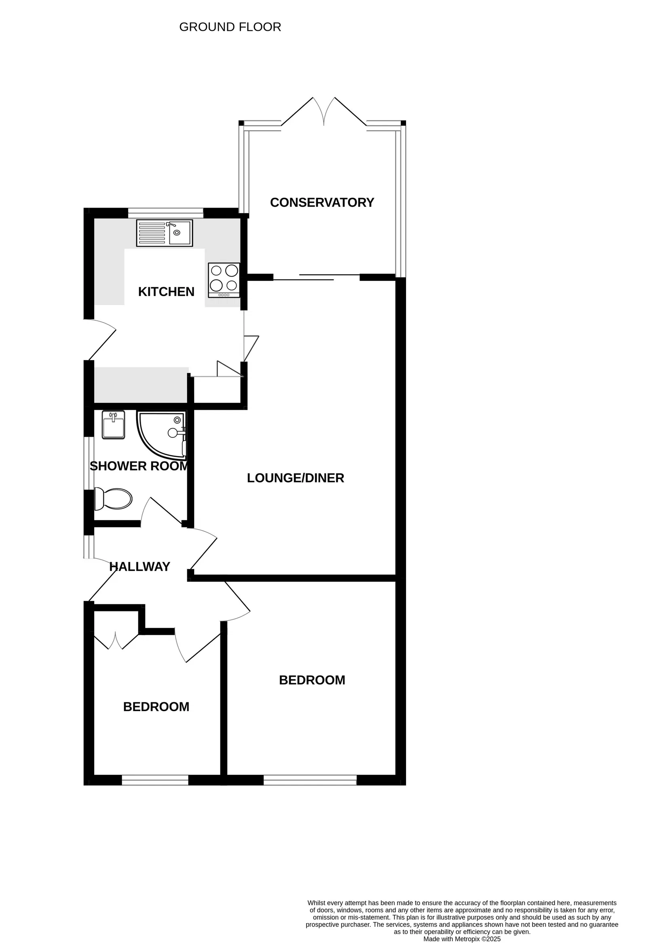
92 Valley Way, Exmouth, EX8 4RL
THE ACCOMMODATION COMPRISES: Composite front door with patterned glass window inset, with picture window side screen, giving access to:
RECEPTION HALL: Radiator, telephone point, access to loft space via loft ladder.
LOUNGE/DINING ROOM: 5.16m x 3.53m (16'11" x 11'7") narrowing in dining area to 2.62m (8’7") TV point, radiator, thermostat control heating, sliding patio doors to:
CONSERVATORY: 2.59m x 2.44m (8'6" x 8'0") A fine addition to the accommodation with uPVC double glazed windows and double glazed double doors overlooking and opening onto the rear garden, power connected.
From the dining area there is a folding door to:
KITCHEN: 3.33m x 2.62m (10'11" x 8'7") Fitted range of patterned work surfaces with range of cupboards and drawer units, plumbing for automatic washing machine beneath, patterned tiled surrounds, inset single drainer sink unit with mixer tap, electric point, wall mounted cupboards, upright larder style cupboard, cupboard housing water cylinder with shelving, radiator, wall mounted gas boiler for hot water and central heating, double glazed window overlooking the rear garden and composite door with patterned glass giving access to outside.
BEDROOM 1: 3.3m x 2.95m (10'10" x 9'8") Double glazed window to front aspect, radiator, built-in range of bedroom furniture to include the built-in wardrobes, two bedside tables, wall mounted storage cupboards and dressing table.
BEDROOM 2: 2.41m x 2.29m (7'11" x 7'6") Double glazed window to front aspect, radiator, built-in wardrobe.
SHOWER ROOM/WC: 1.96m x 1.68m (6'5" x 5'6") Stylishly refitted comprising corner shower cubicle with curved splash screen doors, splashback walls and Mira shower unit, vanity style vanity wash hand basin with mirror fronted medicine cabinet over and shaver socket, WC with concealed system and push button flush with display surface over, chrome heated towel rail, ceiling extractor fan, spotlighting, extensively tiled walls, double glazed window with patterned glass.
OUTSIDE: The property enjoys decorative stone garden with good size block paved driveway and parking area leading to a single GARAGE. Side pathway with outside courtesy light leads through to the rear garden with storage container. The rear garden has again been planned with ease of maintenance in mind comprising of a patio sun terrace, ideal for outside entertaining, decorative stone garden edged with flower and shrub beds, GREENHOUSE, TIMBER GARDEN STORE, outside cold water tap.
SINGLE GARAGE: With up and over door, power and light connected.
Mortgage Assistance: We are pleased to recommend Meredith Morgan Taylor, who would be pleased to help no matter which estate agent you finally buy through. For a free initial chat please contact us on to arrange an appointment. Your home may be repossessed if you do not keep up repayments on your mortgage. Meredith Morgan Taylor Ltd is an appointed representative of The Openwork Partnership, a trading style of Openwork Ltd which is authorised and regulated by the Financial Conduct Authority (FCA).
FLOOR PLAN:

