Slide 1
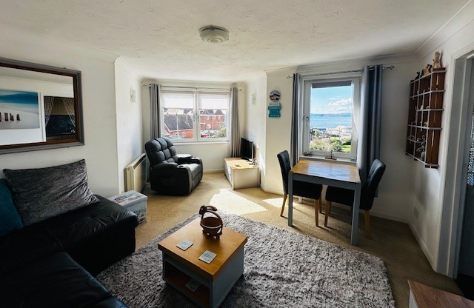
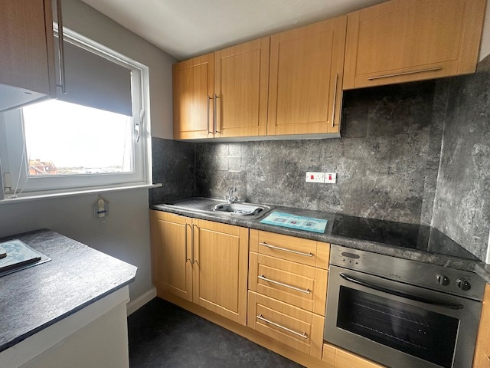
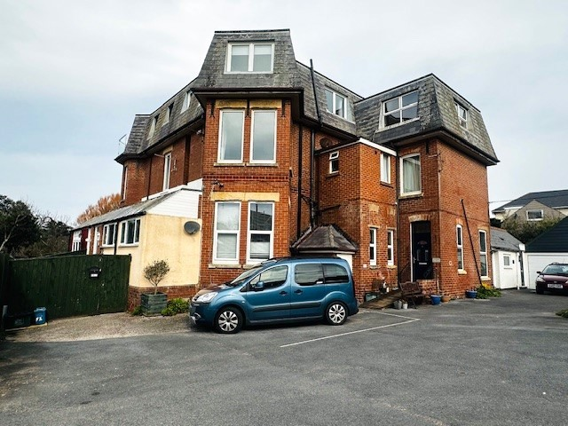
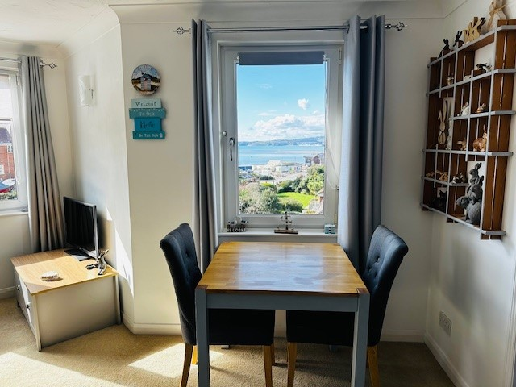
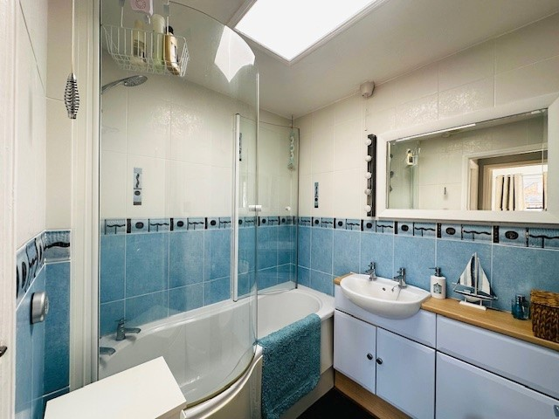
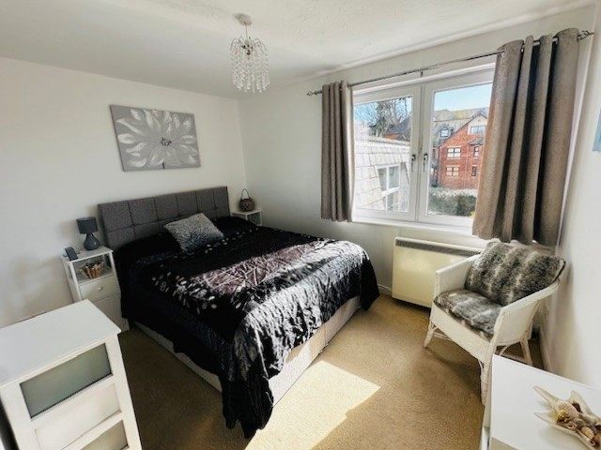
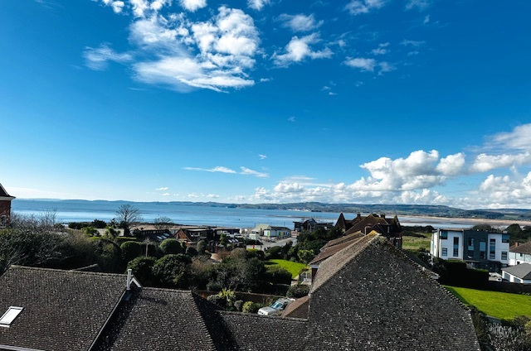
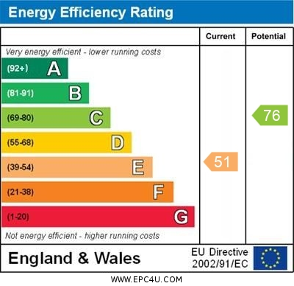
www.pennys.net
Flat 8 The Moorings, Maer Lane, Exmouth, EX8 2DD
GUIDE PRICE £175,000
TENURE Freehold
A Well Presented Second Floor Flat Located Within Walking Distance Of Exmouth Beach Offering Stunning Sea & Coastline Views To Berry Head And Beyond
Double Bedroom * Lounge/Dining Room * Separate Kitchen * Bathroom/WC uPVC Double Glazed Windows * Electric Heating * Stunning Sea & Coastline Views * Allocated Parking Space * Ideal Permanent Or Holiday Home No Onward Chain
Pennys Estate Agents Limited for themselves and for the vendor of this property whose agents they are give notice that:- (1) These particulars do not constitute any part of an offer or a contract. (2) All statements contained in these particulars are made without responsibility on the part of Pennys Estate Agents Limited. (3) None of the statements contained in these particulars are to be relied upon as a statement or representation of fact. (4) Any intending purchaser must satisfy himself/herself by inspection or otherwise as to the correctness of each of the statements contained in these particulars. (5) The vendor does not make or give and neither do Pennys Estate Agents Limited nor any person in their employment has any authority to make or give any representation or warranty whatever in relation to this property.
PENNYS ESTATE AGENTS
2 Rolle House, Rolle Street, Exmouth, Devon, EX8 2SN
Tel: 01395 264111 EMail: help@pennys.net

Slide 2
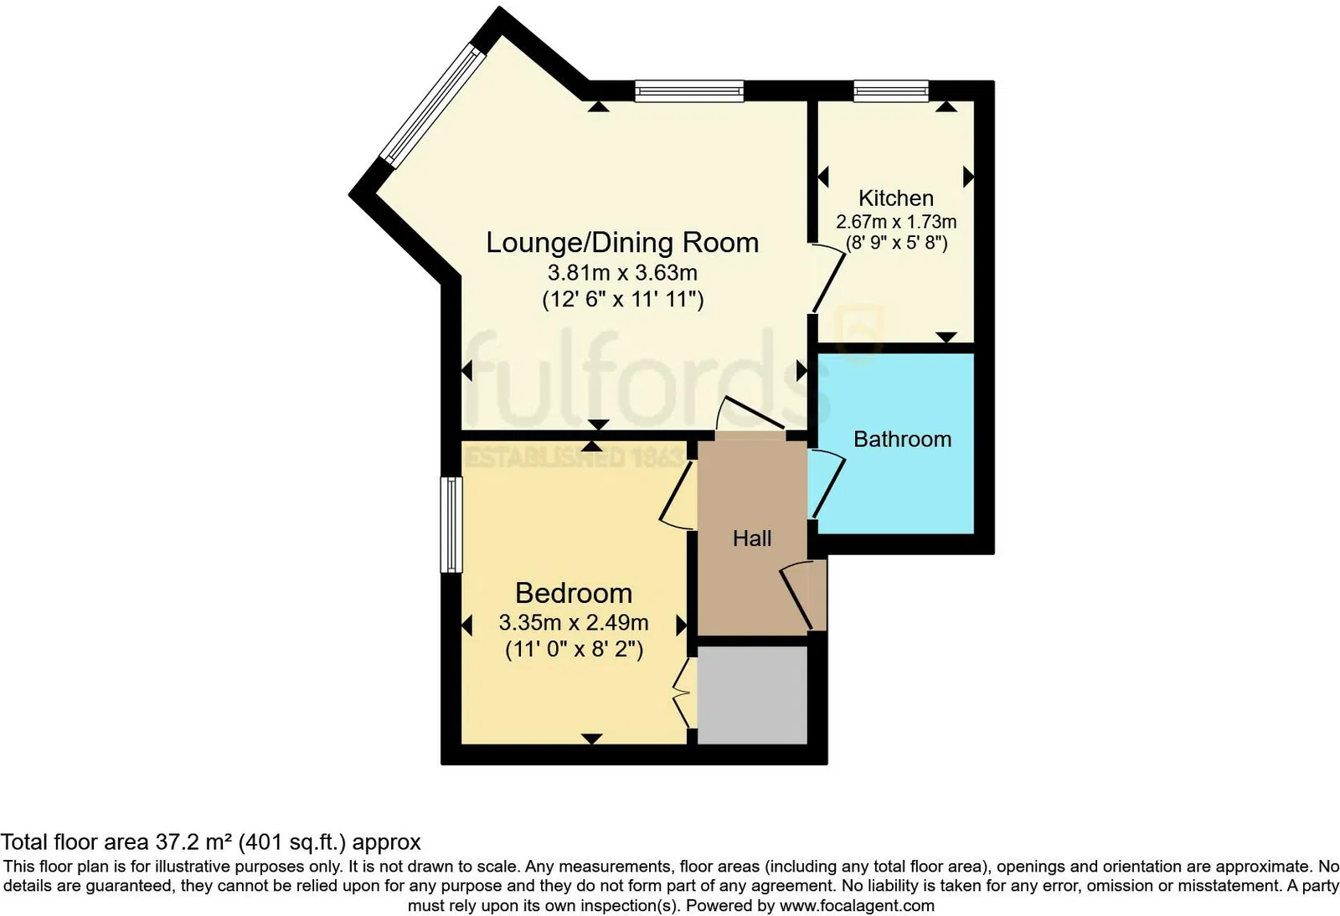
Flat 8 The Moorings, Maer Lane, Exmouth, EX8 2DD
THE ACCOMMODATION COMPRISES: Communal entrance and stairs leading to first and second floors with courtesy lighting. Private front door giving access to: RECEPTION HALL: 2.06m x 0.89m (6'9" x 2'11") High level cupboard housing electric consumer unit; door entry system; ceiling light; smoke detector; power points; Doors to: LOUNGE / DINING ROOM: 3.81m x 3.63m (12’6" x 11’11"). A lovely bright sunny aspect room with uPVC tilt and turn windows with stunning sea and coastline views from side and front aspects; electric dimplex storage heater; power points; central ceiling light; opening to: KITCHEN: 2.67m x 1.73m (8'9" x 5'8") Fitted with a range of base cupboards and drawer units; laminate marble effect worktops and matching tiled surrounds; appliance space beneath; stainless steel single drainer sink unit with mixer tap over; cupboard housing hot water tank; electric Moffat single oven and induction Logik 4 ring hob and concealed extractor hood over; appliance space for undercounter fridge / freezer and further appliance space; eye level wall units; uPVC double glazed tilt and turn window to front aspect gaining another lovely sea view; patterned effect vinyl flooring; central ceiling light; power points. BEDROOM: 3.35m x 2.51m (11'0" x 8’2") uPVC double glazed tilt and turn windows to side aspects with sea glimpses; electric Dimplex storage heater; fitted wardrobe with hanging and shelving space; central ceiling light; power points.
BATHROOM / WC: 1.98m x 1.73m (6'6" x 5'8") With "P" shaped bath and chrome taps over; Triton shower with detachable shower head and curved shower screen enclosure; fully patterned tiled walls; vanity sink unit with cupboards beneath; low level WC with concealed cistern and push button flush; fitted wall mirror with lighting alongside; shaver socket; extractor fan; wall heater; chrome towel rail; single glazed skylight offering additional light; vinyl flooring. OUTSIDE: There is a lawned area of garden located to the front of the building which is for communal use and a bike store. Flat 8 benefits from an ALLOCATED PARKING SPACE for one car. TENURE & OUTGOINGS: We understand that the property will be subject to an extended lease upon completion - Details TBC and owns a 1/10th share of the freehold. Maintenance charges are approximately £900 a year which includes the buildings insurance. The ground rent is approx £30 a year. We have been advised that there is a replacement roof scheduled for Spring 2025.
FLOOR PLAN:

