Slide 1
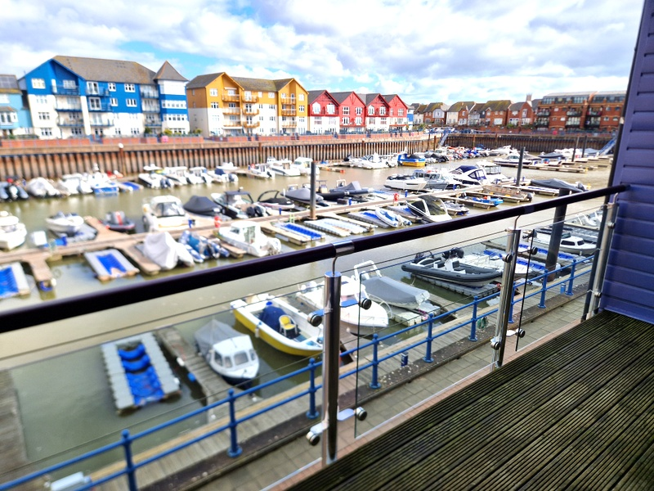
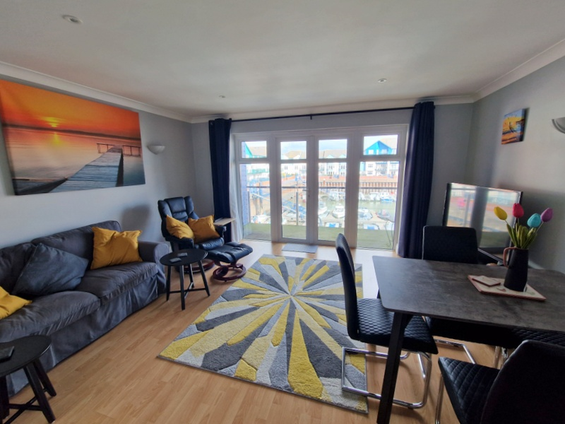
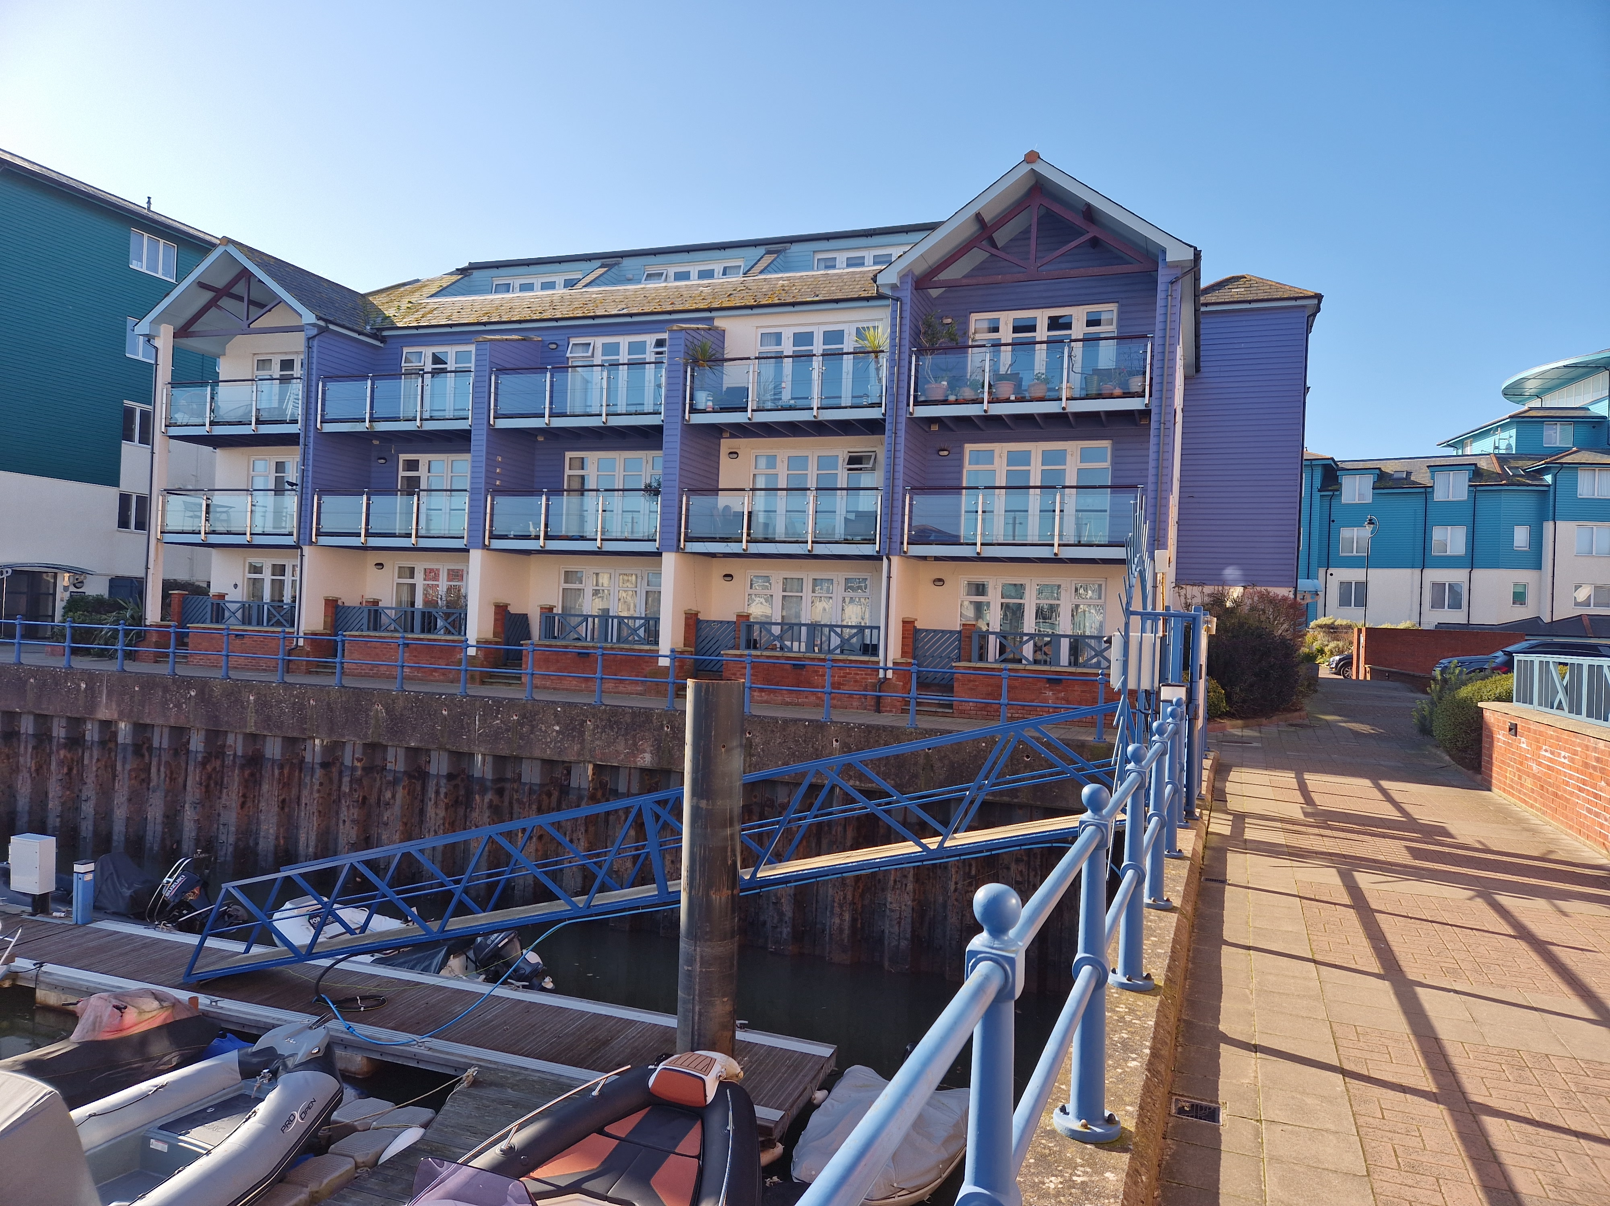
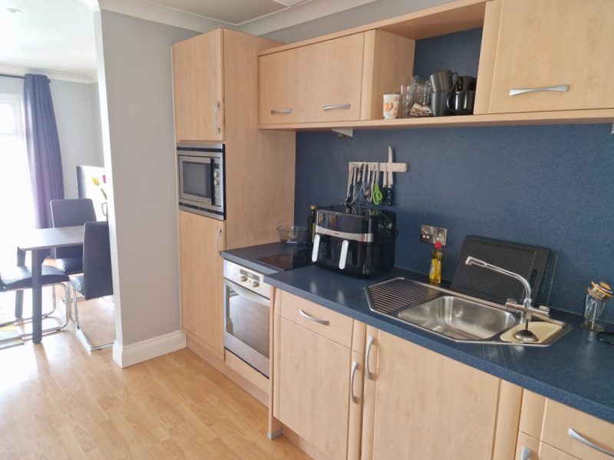
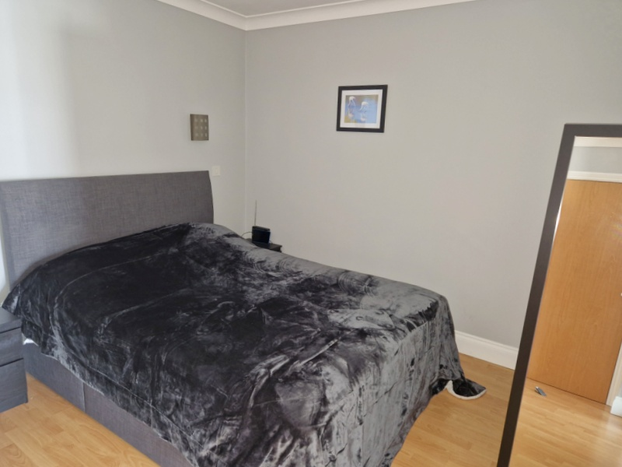
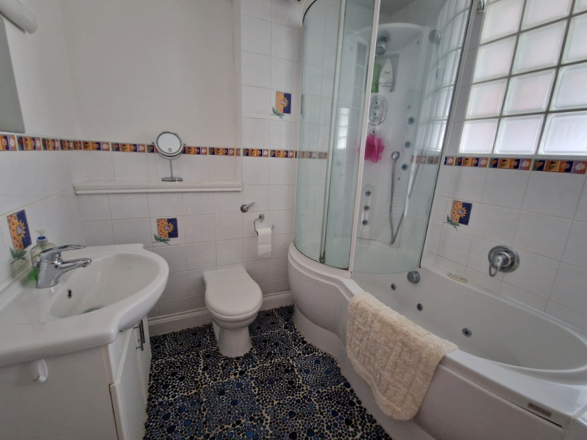
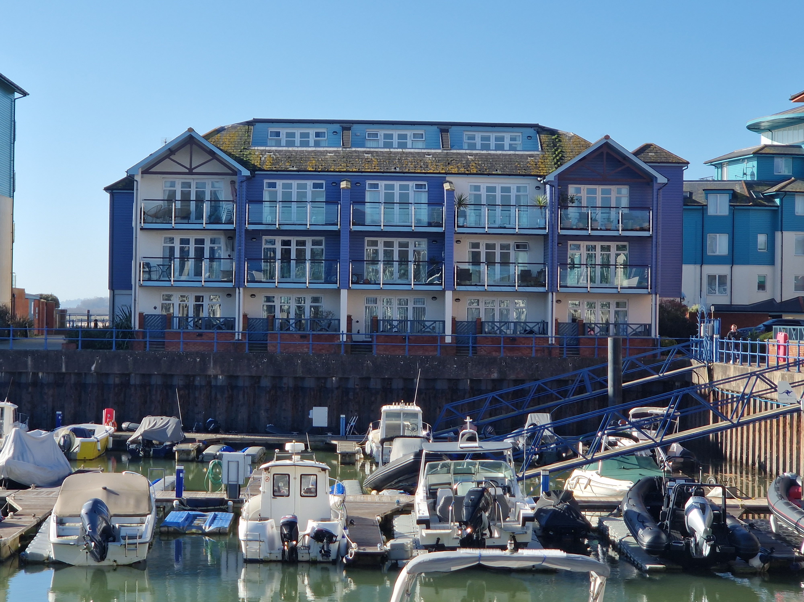
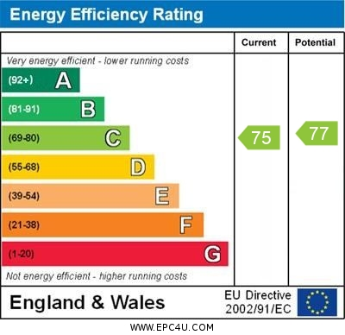
www.pennys.net
17 Madison Wharf, Shelly Road, Exmouth, EX8 1DA
GUIDE PRICE £295,000
TENURE Freehold
A Well Presented First Floor Studio Apartment Overlooking Exmouth’s Prestigious Marina, Ideal For An Excellent Permanent Or Holiday Home Retreat
Kitchen With Range Of Built-In Appliances * Sitting/Dining Room With Access To Balcony * Double Bedroom * Stylish Bathroom/Wc * Allocated Parking Space * Viewing Recommended
Pennys Estate Agents Limited for themselves and for the vendor of this property whose agents they are give notice that:- (1) These particulars do not constitute any part of an offer or a contract. (2) All statements contained in these particulars are made without responsibility on the part of Pennys Estate Agents Limited. (3) None of the statements contained in these particulars are to be relied upon as a statement or representation of fact. (4) Any intending purchaser must satisfy himself/herself by inspection or otherwise as to the correctness of each of the statements contained in these particulars. (5) The vendor does not make or give and neither do Pennys Estate Agents Limited nor any person in their employment has any authority to make or give any representation or warranty whatever in relation to this property.
PENNYS ESTATE AGENTS
2 Rolle House, Rolle Street, Exmouth, Devon, EX8 2SN
Tel: 01395 264111 EMail: help@pennys.net

Slide 2
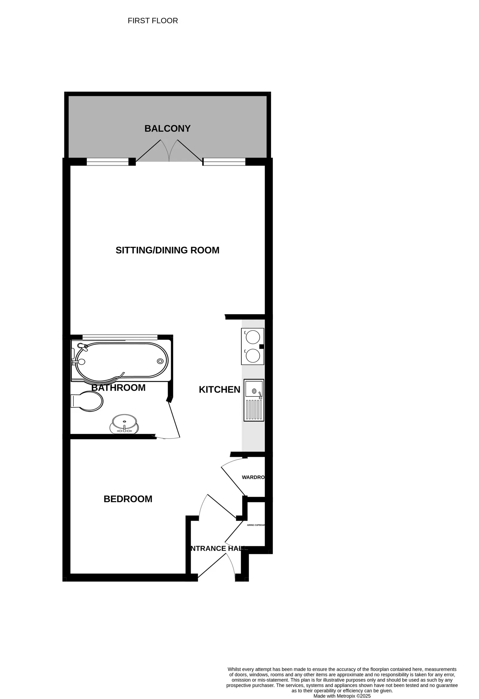
17 Madison Wharf, Shelly Road, Exmouth, EX8 1DA
THE ACCOMMODATION COMPRISES: Communal entrance with door security intercom system giving access to:
COMMUNAL HALLWAY: Stairs and lift to first floor. Private front door to the apartment giving access to:
LOBBY AREA: Laminate flooring, built-in airing cupboard housing hot water tank and electric boiler. Door leads through to:
OPEN-PLAN LIVING ACCOMMODATION:
BEDROOM AREA: 3.15m x 2.74m (10'4" x 9'0") With downlighters, wall lighting, radiator, laminate flooring and built-in wardrobe.
KITCHEN AREA: 4.42m x 3.05m (14'6" x 10'0") A well equipped kitchen comprising of worktops with matching splashbacks with built-in oven and inset two ring ceramic hob, built-in microwave oven, stainless steel sink unit set into worktops with mixer tap, integrated fridge and freezer compartment, integrated washer dryer and dishwasher under worktops, wall mounted cupboards with concealed lighting beneath, wood laminate flooring, door entry phone.
SITTING/DINING AREA: Exceptional living space with TV point, radiator, downlighters and wall lighting, double glazed double doors with matching windows overlooking and opening onto:
COVERED BALCONY: Gaining wonderful views over the marina.
BATHROOM/WC: 2.16m x 1.93m (7'1" x 6'4") Fitted with modern suite comprising bath with jacuzzi spa bath with curved shower splash screen, WC with push button flush, wash hand basin with concealed system, extractor fan, pebble effect tiled floor and attractively tiled walls, fitted mirror over wash basin.
OUTSIDE: The apartment benefits from allocated parking space.
TENURE: The property is Leasehold held on a 125 year lease from 2001. Maintenance Charge: Approximately £2,250 per annum. Ground Rent: £391 per annum.
AGENTS NOTE: No pets are allowed without prior consent and granted by the management company.
Mortgage Assistance: We are pleased to recommend Meredith Morgan Taylor, who would be pleased to help no matter which estate agent you finally buy through. For a free initial chat please contact us on to arrange an appointment. Your home may be repossessed if you do not keep up repayments on your mortgage. Meredith Morgan Taylor Ltd is an appointed representative of The Openwork Partnership, a trading style of Openwork Ltd which is authorised and regulated by the Financial Conduct Authority (FCA).
FLOOR PLAN:

