Slide 1
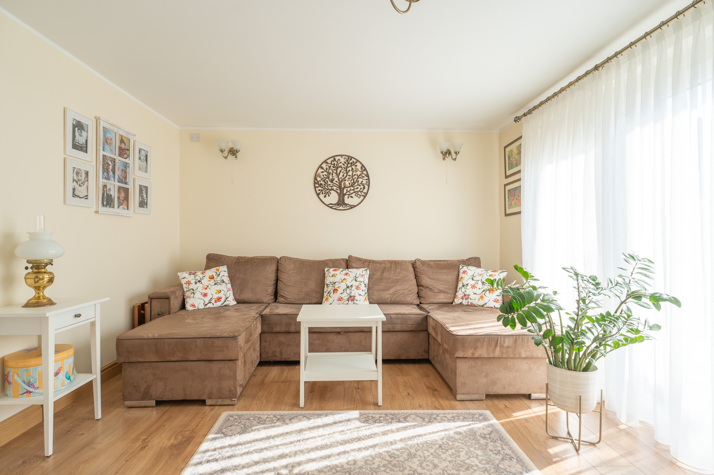
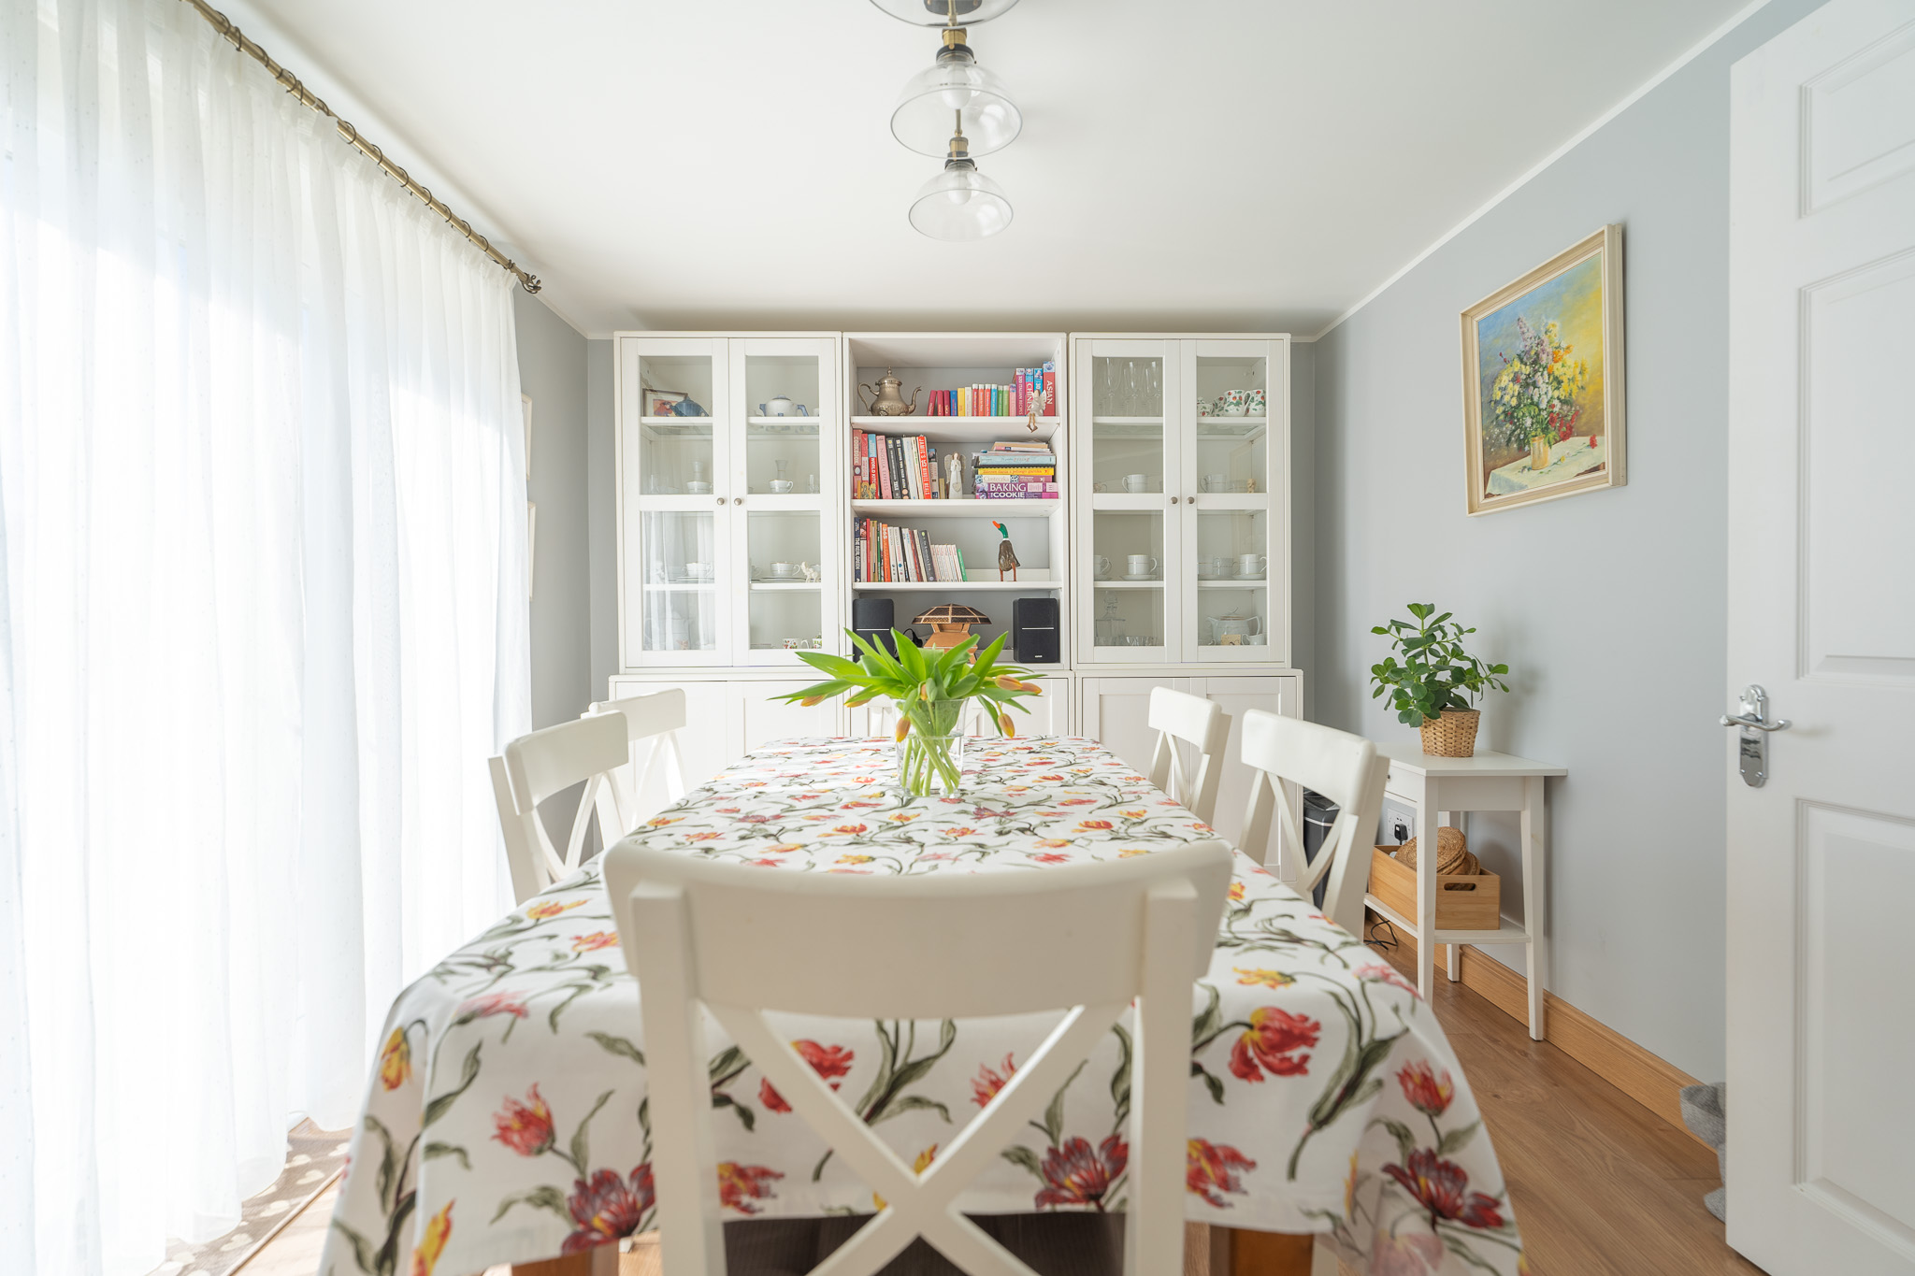
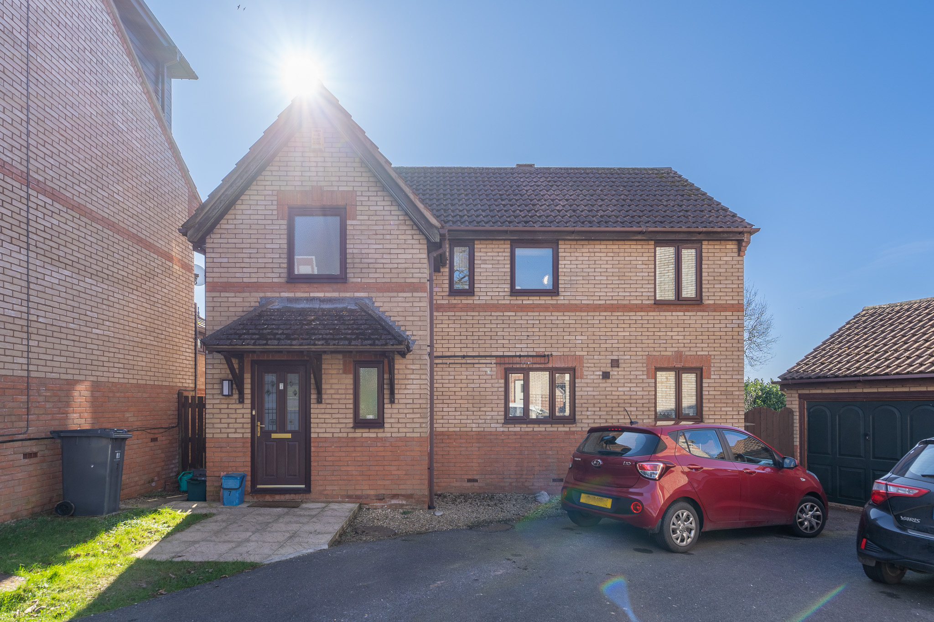
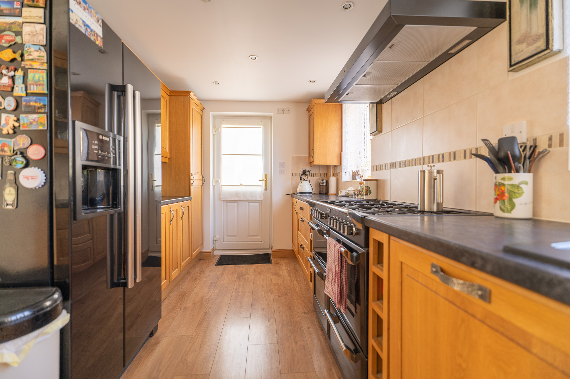
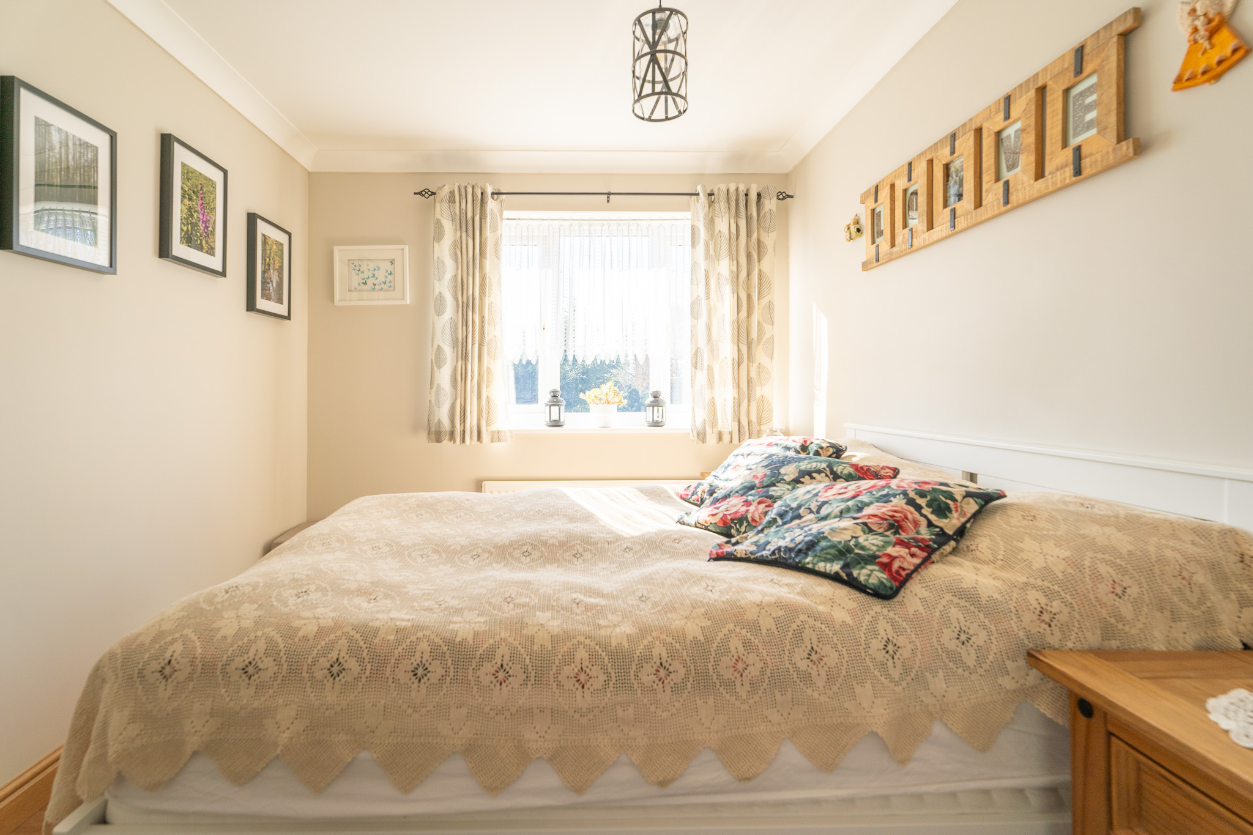
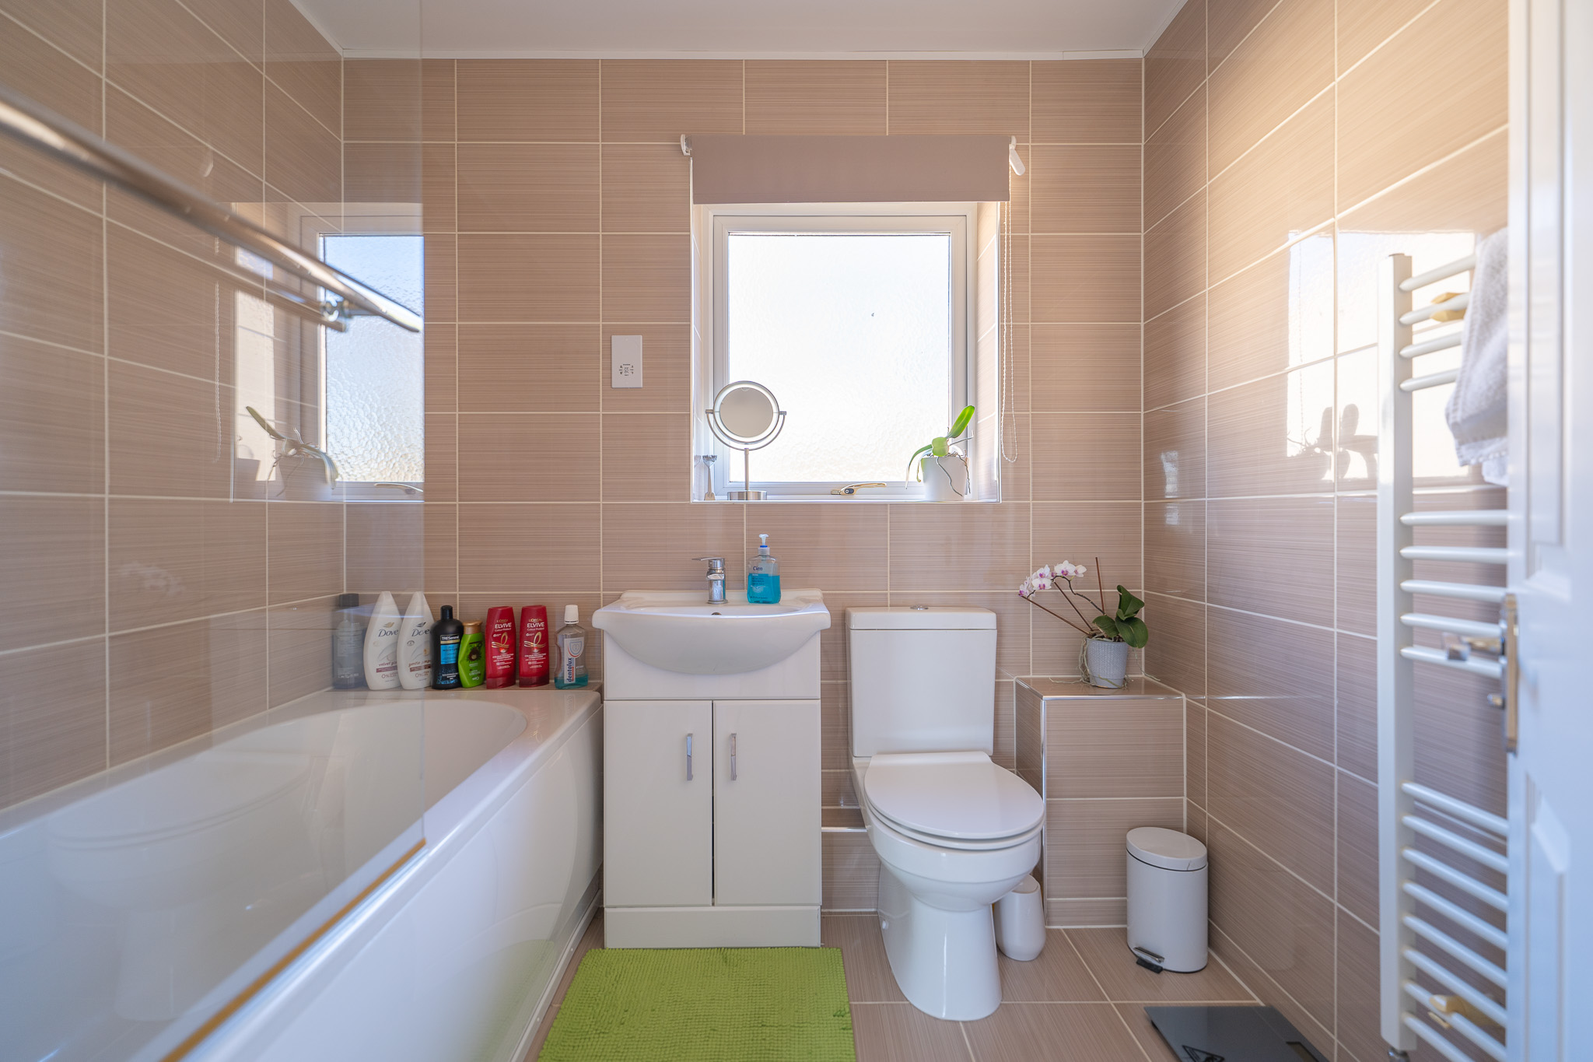
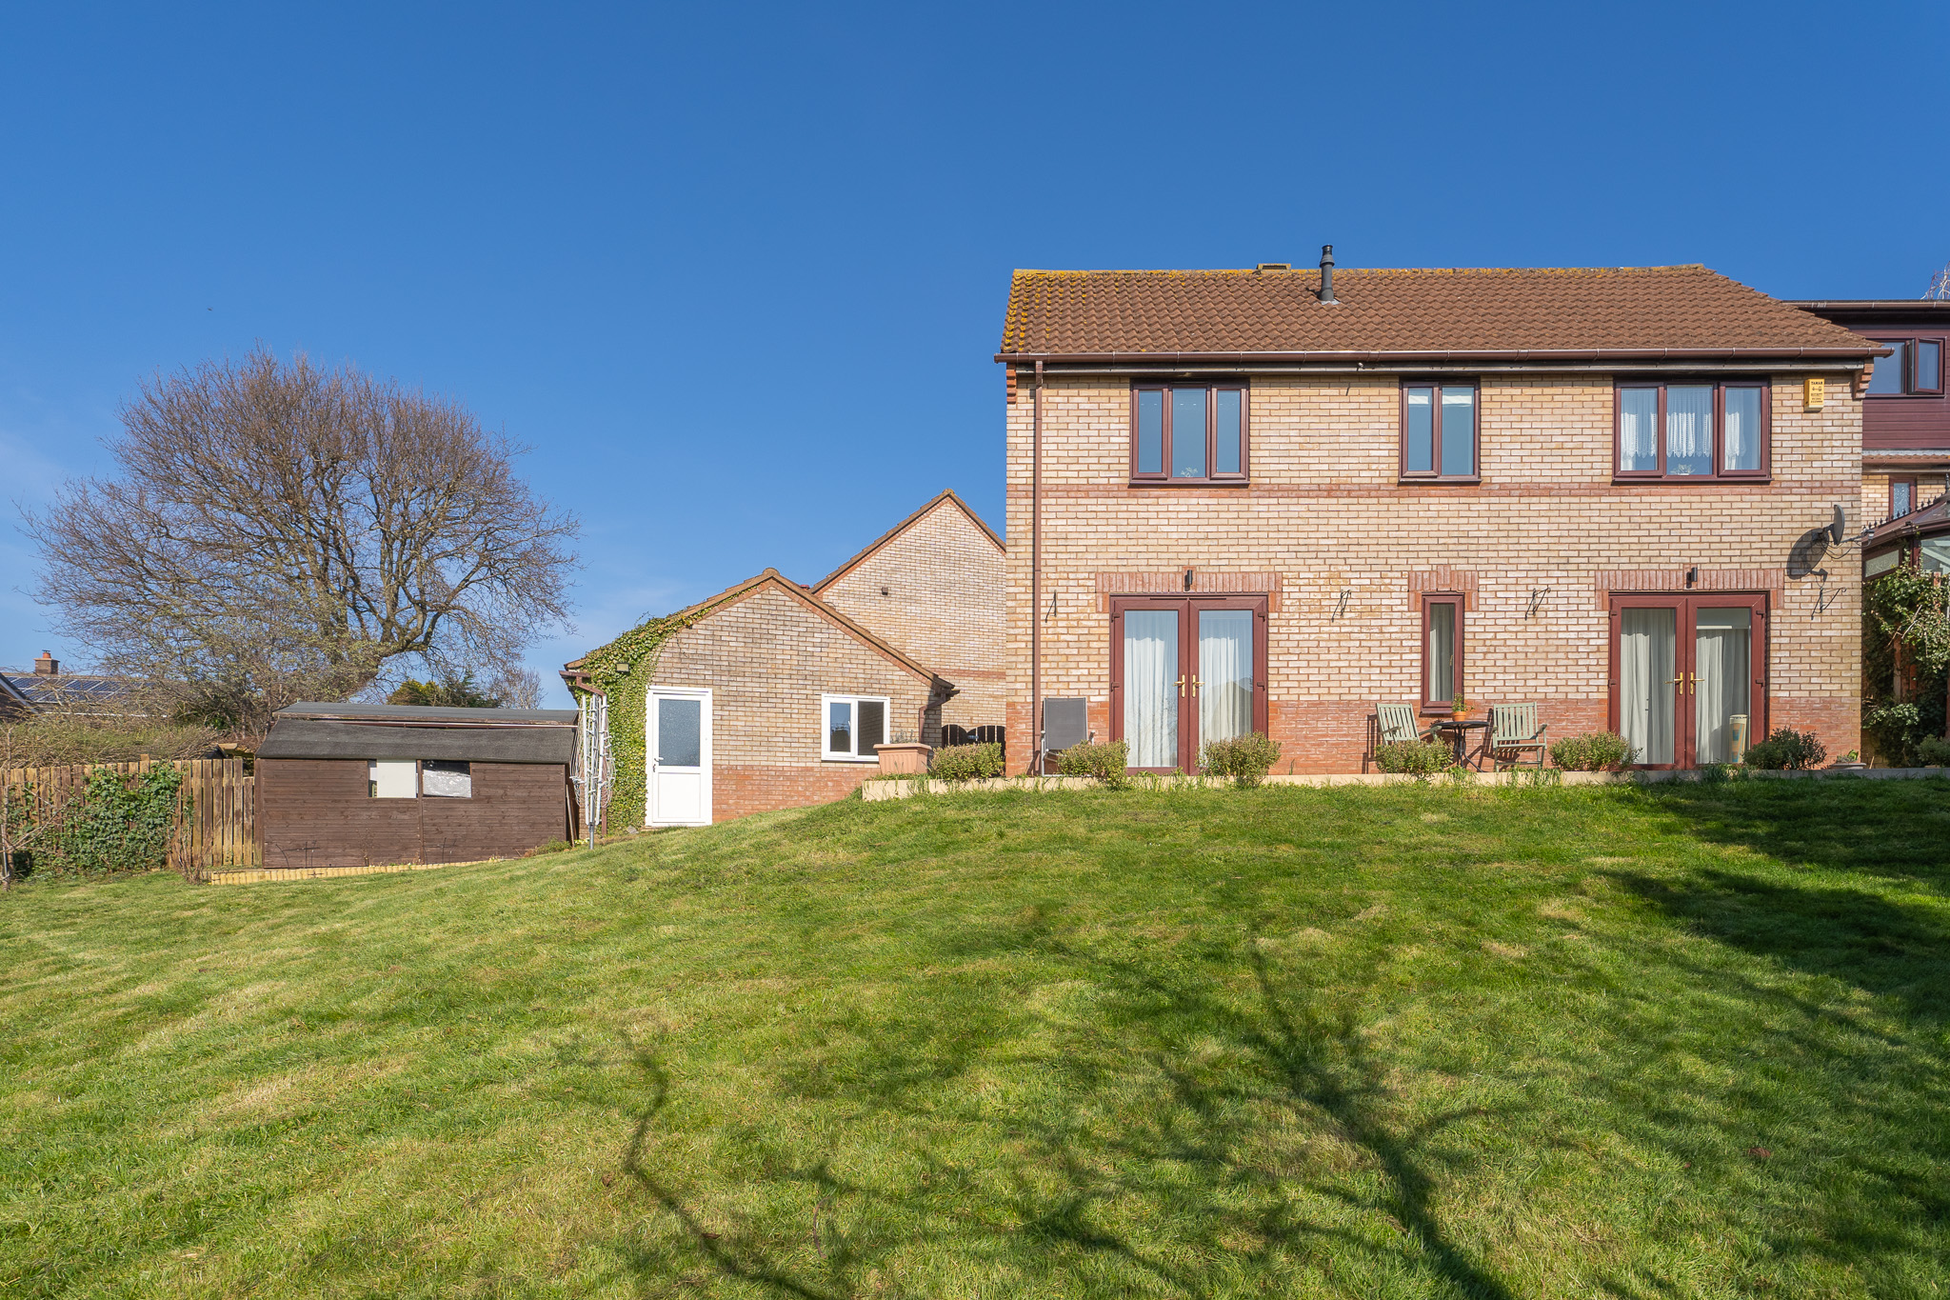
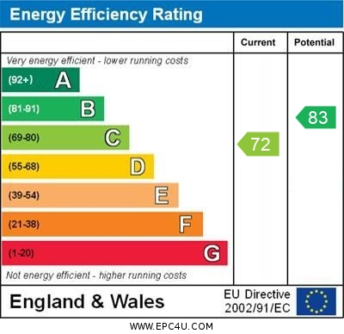
www.pennys.net
7 Cheriswood Avenue, Exmouth, EX8 4HG
GUIDE PRICE £497,000
TENURE Freehold
A Beautifully Presented Detached House Forming Part Of A Select Development Enjoying A Larger Than Average Sunny Aspect Rear Garden, Driveway Parking And Converted Garage Providing An Office And Utility Area
Reception Hall * Ground Floor Cloakroom/Wc * Lounge * Separate Dining Room * Modern Kitchen * Four Bedrooms * En-Suite Shower Room/Wc * Well Appointed Bathroom Suite * Gas Central Heating * Double Glazing * Viewing Strong Recommended
Pennys Estate Agents Limited for themselves and for the vendor of this property whose agents they are give notice that:- (1) These particulars do not constitute any part of an offer or a contract. (2) All statements contained in these particulars are made without responsibility on the part of Pennys Estate Agents Limited. (3) None of the statements contained in these particulars are to be relied upon as a statement or representation of fact. (4) Any intending purchaser must satisfy himself/herself by inspection or otherwise as to the correctness of each of the statements contained in these particulars. (5) The vendor does not make or give and neither do Pennys Estate Agents Limited nor any person in their employment has any authority to make or give any representation or warranty whatever in relation to this property.
PENNYS ESTATE AGENTS
2 Rolle House, Rolle Street, Exmouth, Devon, EX8 2SN
Tel: 01395 264111 EMail: help@pennys.net

Slide 2
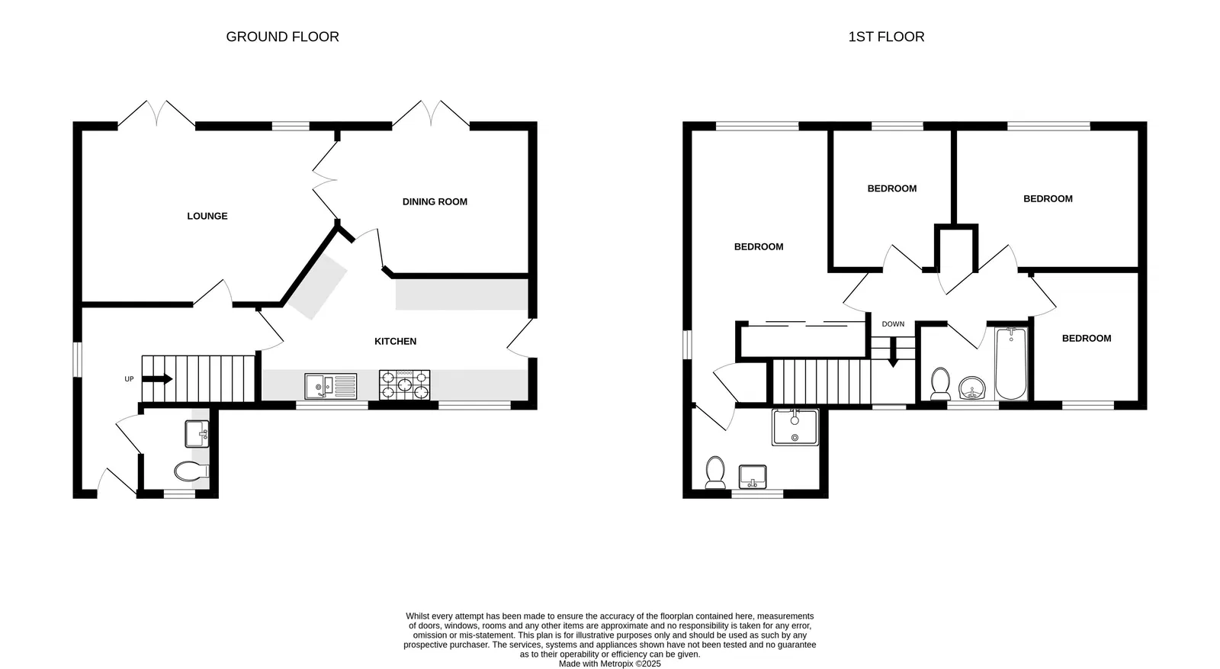
7 Cheriswood Avenue, Exmouth, EX8 4HG
THE ACCOMMODATION COMPRISES: Entrance canopy with wood-effect front door with patterned window inset giving access to:
RECEPTION HALL: With fitted floor to ceiling coats cupboard, stairs rising to first floor landing with two bespoke design pull-out storage units, double glazed window to side aspect.
GROUND FLOOR CLOAKROOM/WC: Stylishly refitted comprising wash hand basin with display surface with cupboards and WC beneath with push button flush, fully tiled walls, wall mounted cupboard housing electric consumer unit, heated towel rail, double glazed window with patterned glass, wood-effect flooring.
LOUNGE: 5.03m x 3.43m (16'6" x 11'3") A spacious room enjoying a sunny aspect with double glazed window and double glazed double doors opening onto the rear garden, wood-effect flooring, TV point, radiator, double doors opening to:
DINING ROOM: 3.76m x 2.97m (12'4" x 9'9") Another sunny aspect room with double glazed double doors opening onto the rear garden, wood-effect flooring, ceiling downlighters, radiator, door to:
KITCHEN: 5.33m x 3.15m (17'6" x 10'4") narrowing to 2.44m (8') (also accessed via the reception hall). A well equipped kitchen fitted with a range of patterned working surfaces, with a range of cupboards, drawer units, integrated dishwasher and wine racks beneath work surfaces, inset one and a half bowl single drainer sink unit with hose style mixer tap with attractive tiled surrounds, Stoves seven ring gas oven with stainless steel Stoves stainless steel extractor hood over with light, range of wall mounted cupboards incorporating two glass fronted display units, pull-out larder style cupboard, two sets of double glazed windows overlooking the front aspect, wood-effect flooring, recessed ceiling spotlighting, uPVC double glazed door giving access to the rear garden.
FIRST FLOOR LANDING: uPVC double glazed window to front aspect, roof space accessed via loft ladder to part-boarded roof space, linen cupboard also housing gas boiler for hot water and central heating.
BEDROOM 1: 3.84m x 3.43m (12'7" x 11'3") into doorway recess. A fine main bedroom with range of floor to ceiling built-in wardrobes with triple sliding doors, clothes rail and shelf, radiator, wood-effect flooring, double glazed window to rear aspect, opening with further double glazed window to side aspect and access to linen cupboard and door to:
EN-SUITE SHOWER ROOM/WC: 2.74m x 1.47m (9'0" x 4'10") Stylishly refitted with an ease of access tiled shower cubicle with shower unit, shower splash screen door, pedestal wash hand basin, WC with push button flush, shaver socket, fully tiled walls and colour coordinated tiled flooring, heated towel rail, uPVC double glazed window with patterned glass, ceiling extractor fan.
BEDROOM 2: 3.48m x 2.72m (11'5" x 8'11") Wood-effect flooring, radiator, double glazed window to rear aspect.
BEDROOM 3: 2.67m x 2.59m (8'9" x 8'6") into wall recess. Double glazed window to rear aspect, radiator, wood-effect flooring.
BEDROOM 4: 2.79m x 2.13m (9'2" x 7'0") With wood-effect flooring, radiator, double glazed window to front aspect.
FAMILY BATHROOM/WC: 2.24m x 1.8m (7'4" x 5'11") Comprising stylishly fitted with bath with shower attachment, shower splash screen, vanity style wash hand basin, WC with push button flush, attractive fully tiled walls, colour coordinated tiled flooring, heated towel rail, shaver socket, ceiling extractor fan, double glazed window with patterned glass.
OUTSIDE: Enjoying a tucked away location in a favoured development, the property is approached via a driveway which leads to the property with a patio sun terrace directly outside the front door and a decorative stone garden area. Side gate gives access through to the rear garden. The rear garden is worthy of notice being larger than average and enjoying a Southerly aspect and comprising of a good size patio sun terrace, ideal for outside entertaining, extensive area of lawned garden with mature shrubs and plants, with two storage sheds, outside lighting and cold water tap.
CONVERTED GARAGE: Divided into two areas comprising: OFFICE: 3m x 2.44m (9'10" x 8'0") With two sets of power sockets, recessed ceiling spotlighting, double glazed window overlooking the rear garden, sliding door to: UTILITY ROOM: 2.44m x 1.8m (8'0" x 5'11") With tiled flooring, worktop with plumbing for automatic washing machine in cupboard beneath, wall mounted cupboards, space for upright fridge/freezer, recessed ceiling spotlighting, uPVC double glazed door with patterned glass giving access into the rear garden.
Mortgage Assistance: We are pleased to recommend Meredith Morgan Taylor, who would be pleased to help no matter which estate agent you finally buy through. For a free initial chat please contact us on to arrange an appointment. Your home may be repossessed if you do not keep up repayments on your mortgage. Meredith Morgan Taylor Ltd is an appointed representative of The Openwork Partnership, a trading style of Openwork Ltd which is authorised and regulated by the Financial Conduct Authority (FCA).
FLOOR PLAN:

