Slide 1
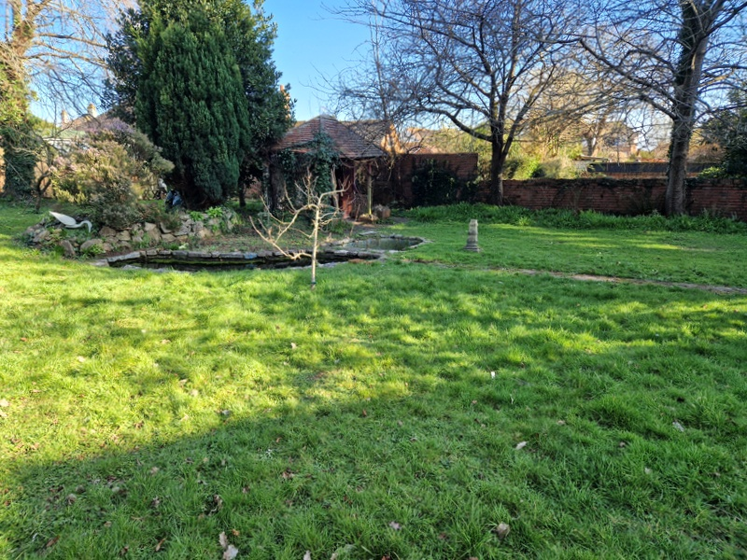
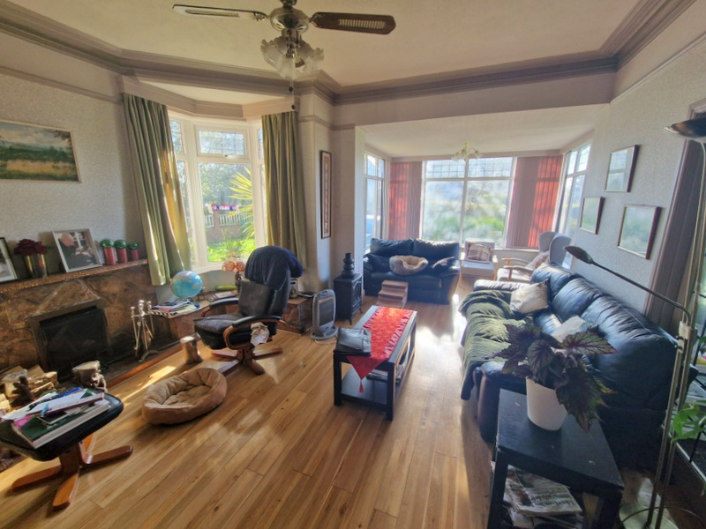
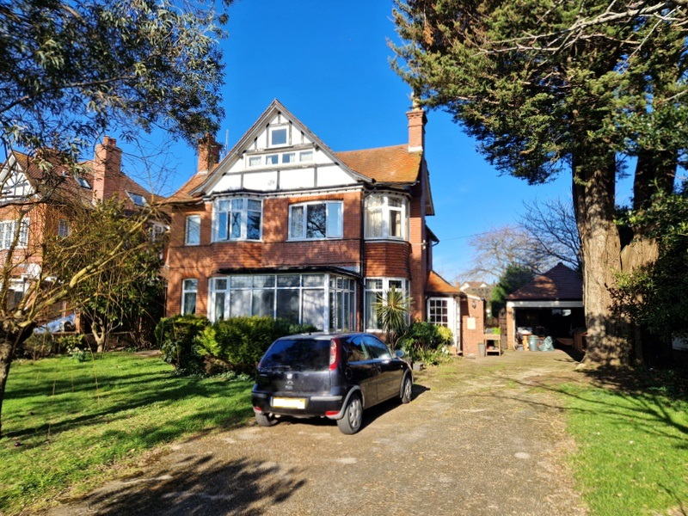
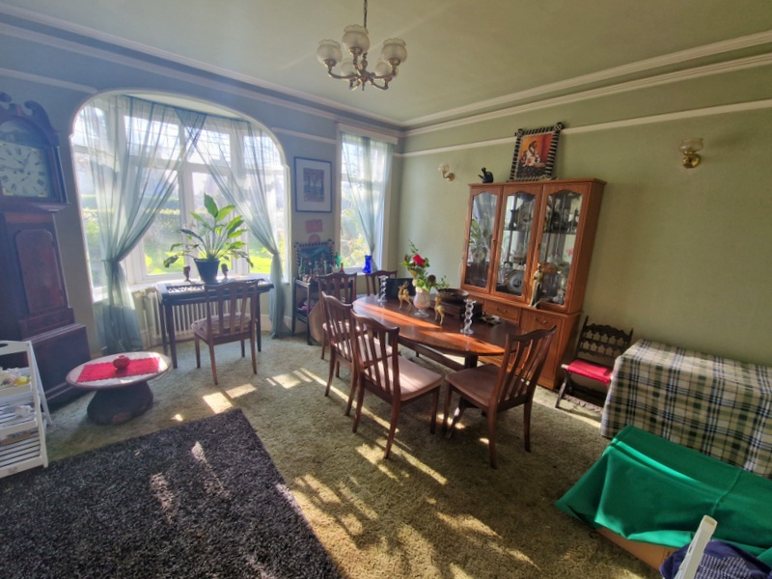
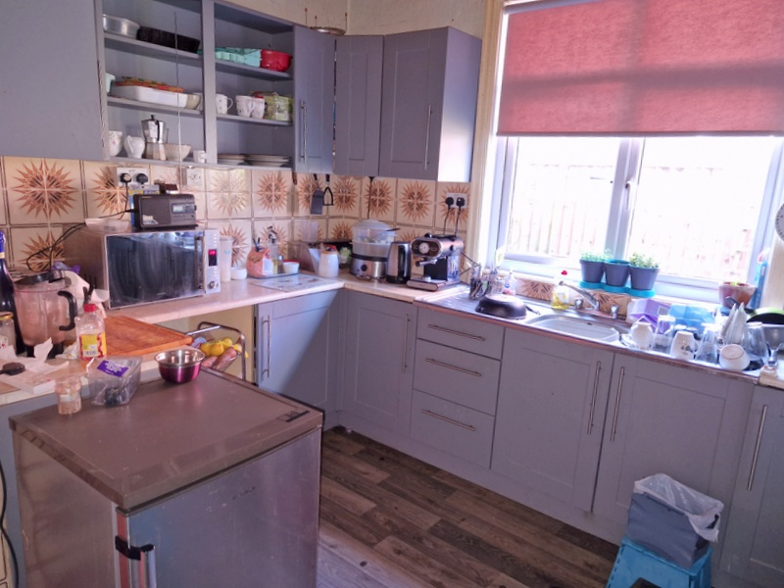
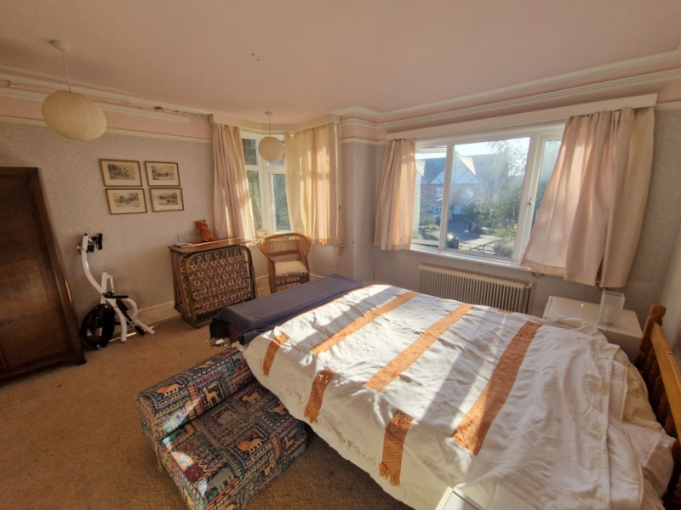
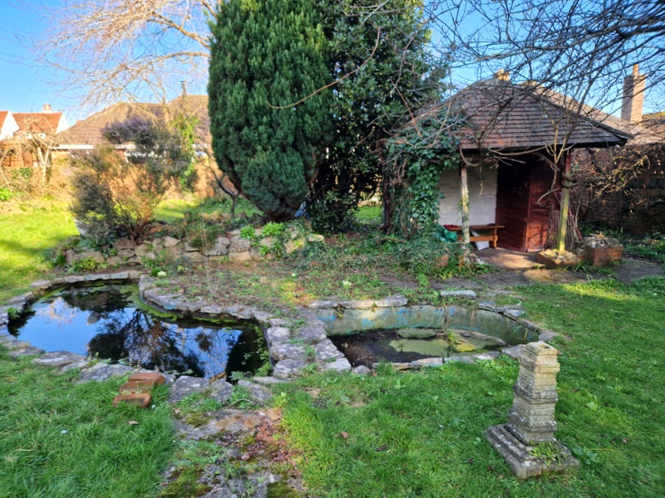
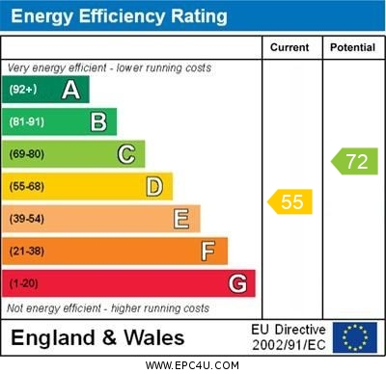
www.pennys.net
8 Avondale Road, Exmouth, EX8 2NQ
GUIDE PRICE £750,000
TENURE Freehold
A Most Attractive Detached Period House Enjoying Extensive Front And Rear Gardens, Ample Parking And Large Garage, Located In One Of Exmouth’s Most Favourable Locations
Entrance Vestibule * Reception Hall * Sitting Room * Dining Room * Study Kitchen/Breakfast Room * Utility Room * Ground Floor Cloakroom/Wc * Three First Floor Bedrooms * Main Bathroom/Wc * Shower Room & Separate Wc * Second Floor Fourth Bedroom * Gated Entrance With Long Driveway * Extensive Good Size Front And Rear Gardens * Viewing Recommended
Pennys Estate Agents Limited for themselves and for the vendor of this property whose agents they are give notice that:- (1) These particulars do not constitute any part of an offer or a contract. (2) All statements contained in these particulars are made without responsibility on the part of Pennys Estate Agents Limited. (3) None of the statements contained in these particulars are to be relied upon as a statement or representation of fact. (4) Any intending purchaser must satisfy himself/herself by inspection or otherwise as to the correctness of each of the statements contained in these particulars. (5) The vendor does not make or give and neither do Pennys Estate Agents Limited nor any person in their employment has any authority to make or give any representation or warranty whatever in relation to this property.
PENNYS ESTATE AGENTS
2 Rolle House, Rolle Street, Exmouth, Devon, EX8 2SN
Tel: 01395 264111 EMail: help@pennys.net

Slide 2
8 Avondale Road, Exmouth, EX8 2NQ
This is a fine example of an Edwardian home featuring a gated driveway with off road parking for numerous cars, good size front and rear gardens and large garage. The accommodation requires some general refurbishment, arranged over three floors affording entrance vestibule and impressive reception hall, sitting room, separate dining room, kitchen/breakfast room, study, ground floor cloakroom/wc, three first floor bedrooms, first floor bathroom/wc, first floor shower room, first floor cloakroom/wc and second floor bedroom four. Ideally located in a sought-after area close to amenities and transport links, viewing is strongly recommended.
THE ACCOMMODATION COMPRISES: Glazed panelled double doors to:
ENTRANCE VESTIBULE: With feature tiled floor, glazed panelled window, inner solid wood door to:
RECEPTION HALL: A fine entrance to the property with impressive staircase rising to first floor landing, exposed ceiling beam, glass fronted floor to ceiling dresser unit, two radiators, double glazed window to side aspect, picture rail.
SITTING ROOM: 6.83m x 4.17m (22'5" x 13'8") maximum measurement into double glazed sun room area with outlook over front elevation. Feature wood-effect flooring, stone fireplace with open grate, double glazed bay window, picture rail, cornice ceiling, radiator, glazed leaded light double doors to:
DINING ROOM: 4.11m x 4.11m (13'6" x 13'6") also accessed from the reception hall, measurement excluding double glazed bay window overlooking the front aspect, further double glazed window overlooking the front aspect, picture rail, cornice ceiling, radiator.
STUDY: 3.25m x 3.05m (10'8" x 10'0") A versatile room with double glazed window overlooking the rear garden, antique style radiator, picture rail, cornice ceiling.
KITCHEN/BREAKFAST ROOM: 3.89m x 3.78m (12'9" x 12'5") maximum overall measurement. Comprising; double drainer sink unit with cupboard and drawer units beneath with adjoining worktops, cupboards and drawer units and appliance spaces beneath, patterned tiled surrounds, chimney recess with electric point, wall mounted cupboards incorporating shelving unit, radiator, part-tiled walls, radiator, double glazed window to side aspect, door to:
UTILITY ROOM: 3.28m x 2.26m (10'9" x 7'5") With Gloworm gas boiler for hot water and central heating, timer control for hot water and central heating, plumbing for automatic washing machine, double glazed window, walk-in coats cupboard with double glazed window and shelving, sliding door to:
WALK-IN LARDER: With shelving and double glazed window.
CLOAKROOM/WC: Pedestal wash hand basin with tiled splashback, fitted mirror over, WC with push button flush, radiator, double glazed window with patterned glass. From the utility room solid wood door to rear lobby with uPVC door with double glazed window with inset giving access to the rear garden.
FIRST FLOOR LANDING: Staircase rising to second floor, picture rail.
BEDROOM 1: 4.11m x 4.11m (13'6" x 13'6") measurement excluding double glazed bay window overlooking the front aspect with two further double glazed windows letting in an abundance of light. Picture rail, cornice ceiling, floor to ceiling built-in wardrobes with shelving, drawer units and clothes rail, wood-effect flooring.
BEDROOM 2: 4.11m x 3.96m (13'6" x 13'0") A charming room with double glazed bay style window and further double glazed window both looking over the front elevation, antique style radiator, picture rail, cornice ceiling, built-in wardrobe.
BEDROOM 3: 3.84m x 3.12m (12'7" x 10'3") With picture rail, fitted display area with cupboards below, radiator, floor to ceiling built-in wardrobes with storage cupboards over and double glazed window to rear aspect.
MAIN BATHROOM/WC: 2.84m x 2.72m (9'4" x 8'11") Fitted with corner bath, pedestal wash hand basin with fitted mirror with light shaver socket over, WC, airing cupboard housing lagged water cylinder with slatted shelving, part-tiled walls, double glazed windows with patterned glass, mirror fronted medicine cabinet.
SHOWER ROOM: 1.93m x 1.73m (6'4" x 5'8") Fitted with shower cubicle with splashback walls, vanity wash hand basin set in display surface with cupboards beneath, chrome heated towel rail, part-tiled walls, extractor fan, double glazed window with patterned glass.
SEPARATE CLOAKROOM/WC: Fitted with WC with push button flush, double glazed window with patterned glass.
SECOND FLOOR LANDING: With access to boarded roof space.
BEDROOM 4: 5.18m x 2.79m (17'0" x 9'2") Another spacious room with three double glazed windows to front aspect, built-in wardrobe, radiator, sloping ceiling.
OUTSIDE: The property stands in impressive level generously sized plot approached via a wooden gate to long driveway, providing ample off-road parking leading to a LARGE GARAGE, lawned front garden with mature trees, shrub and flower beds. Wrought iron gate gives access through to the rear garden, which again is a great size, extensively laid to lawn, with fish pond, mature flower beds, feature covered seating area with tiled roof, GREENHOUSE, outside STORES/POTTING SHED: 6.98m x 1.93m (22'11" x 6'4") With windows overlooking the gardens. Outside cold water tap, OUTSIDE WC. Gate giving access round to the front of the property.
GARAGE: 6.05m x 4.32m (19'10" x 14'2") With up and over door, two windows, power and light connected.
SEPARATE FLOOR PLAN:

