Slide 1
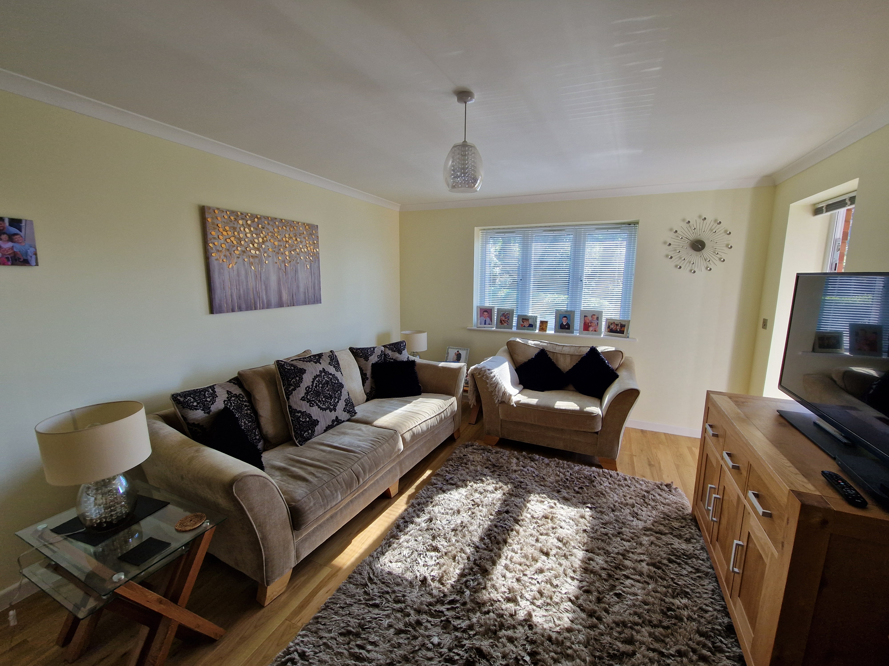
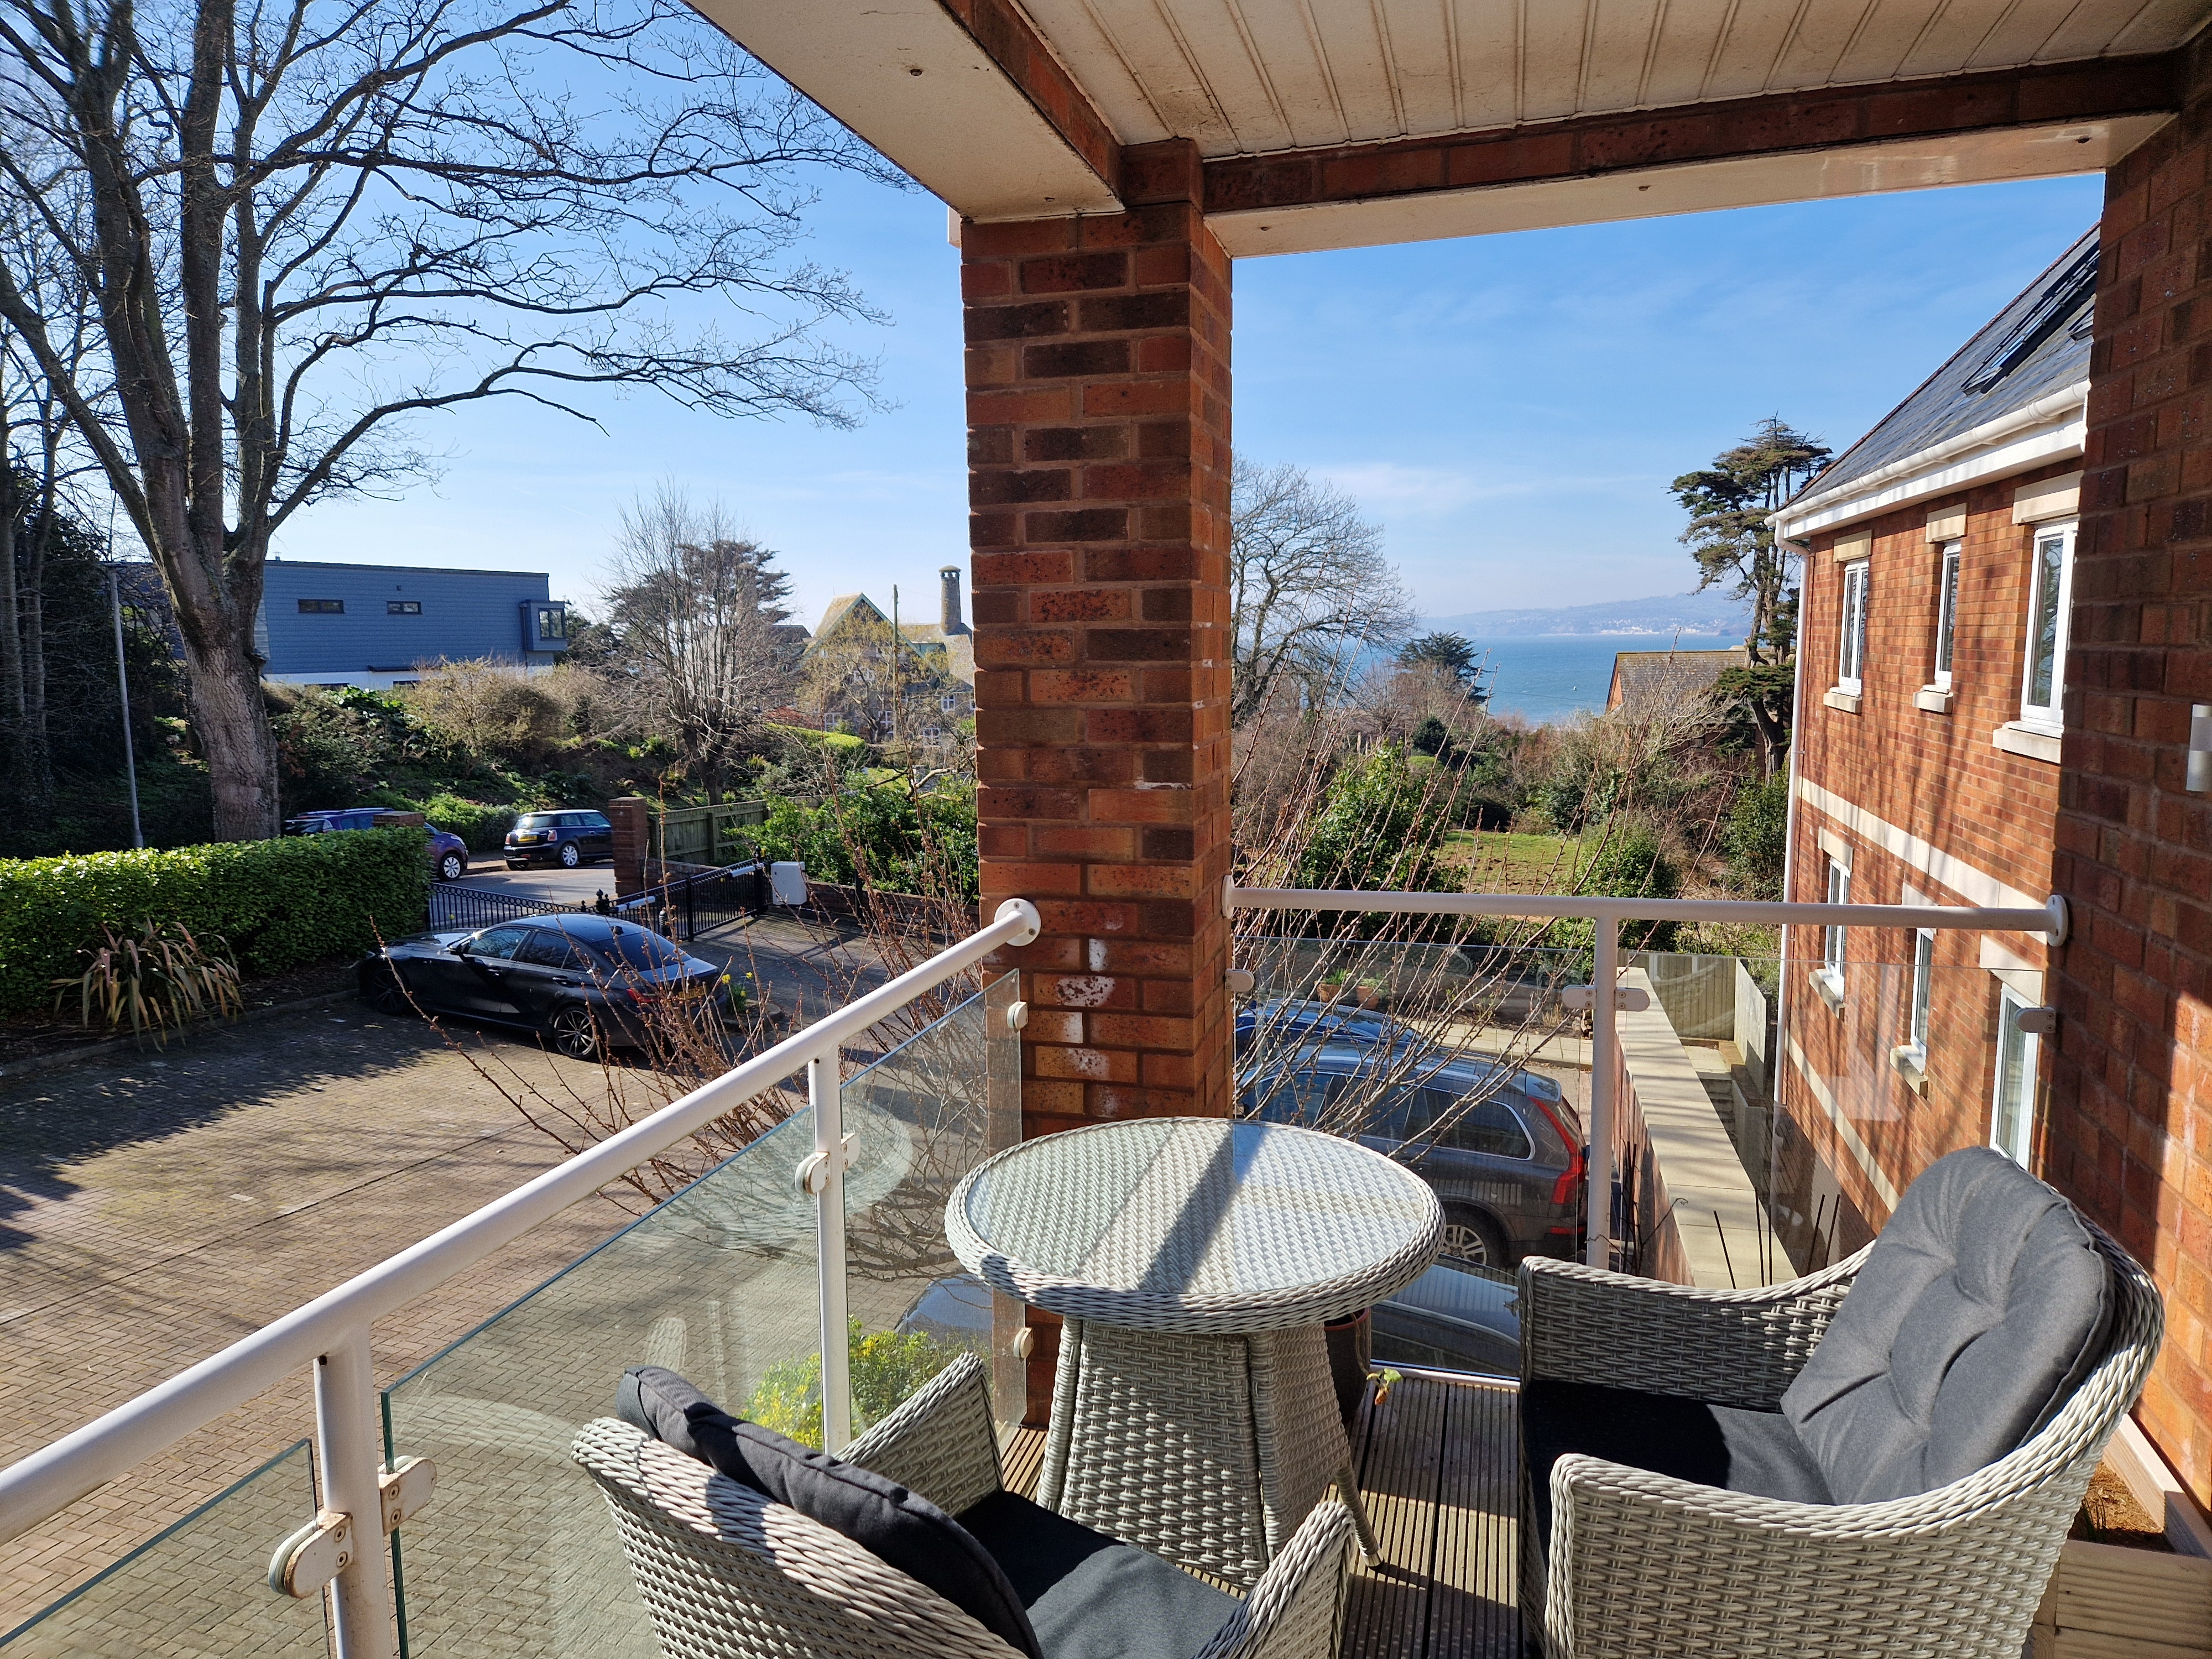

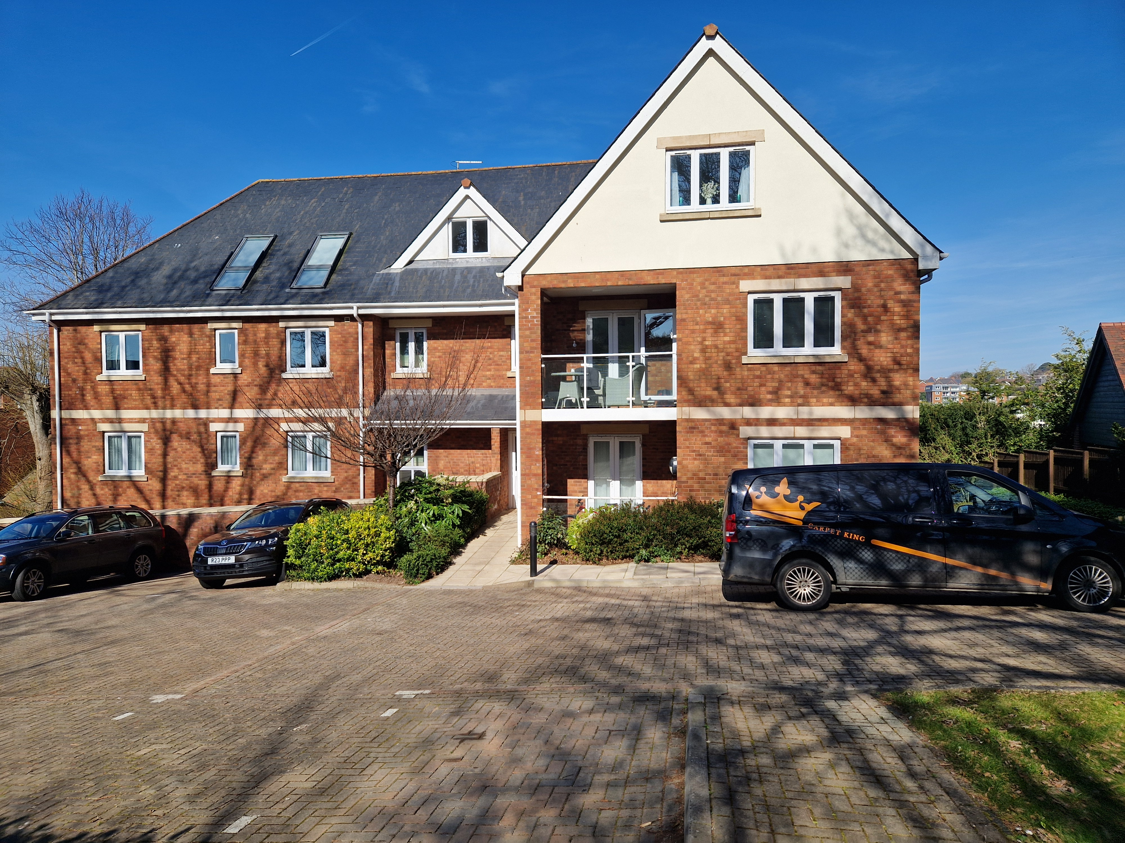
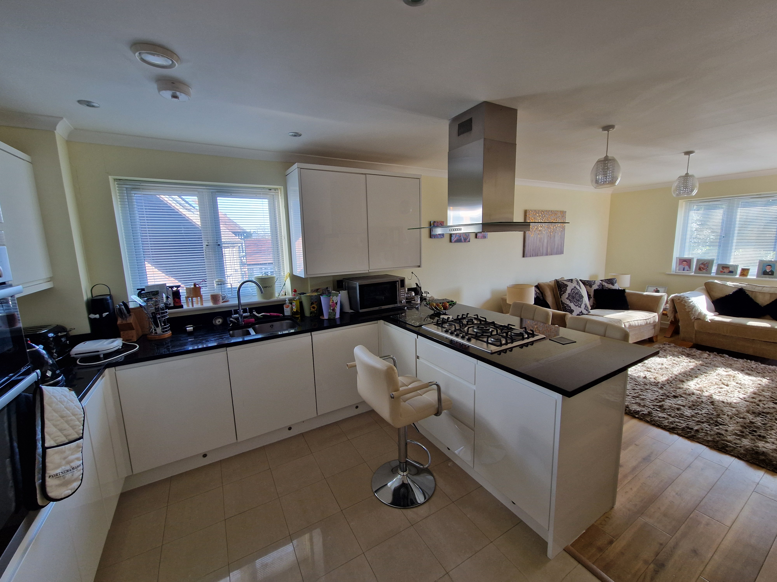
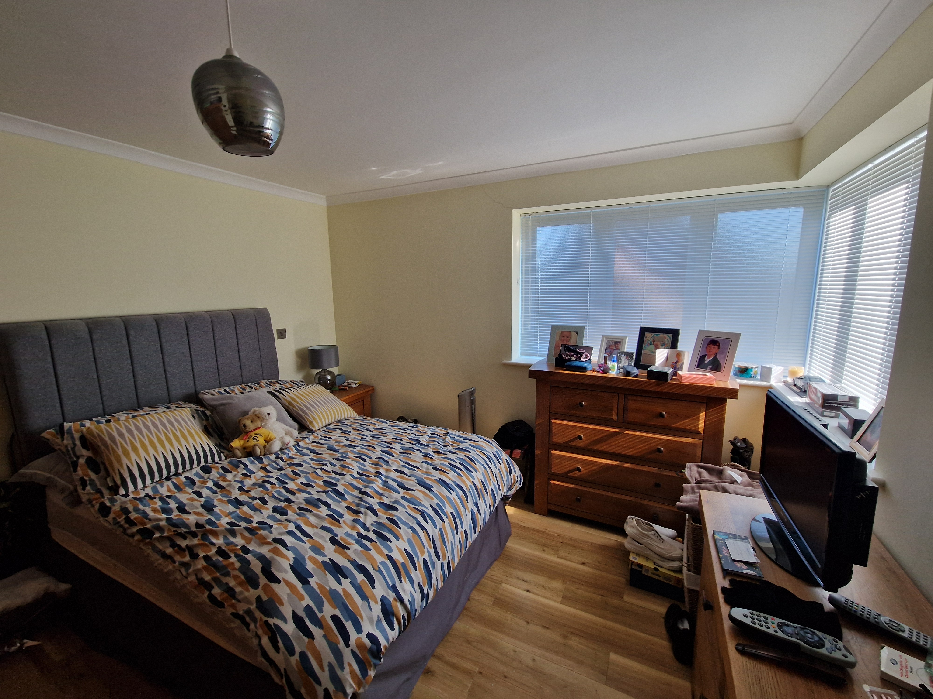
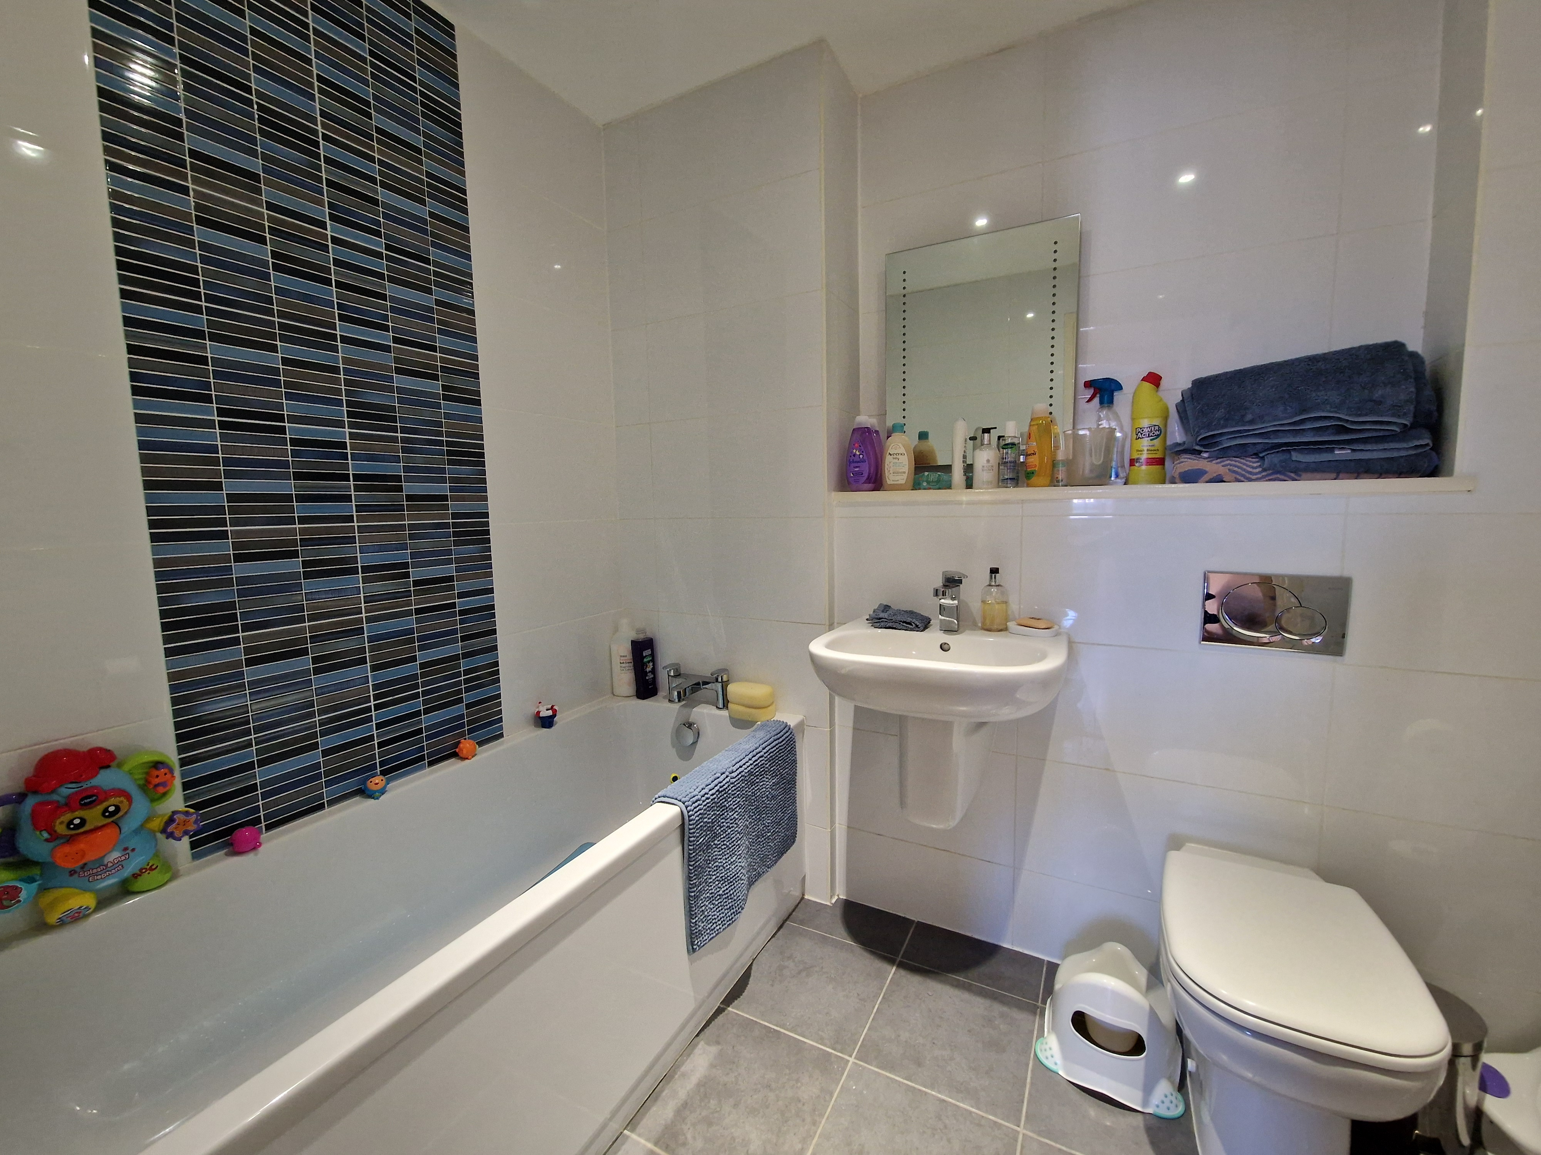
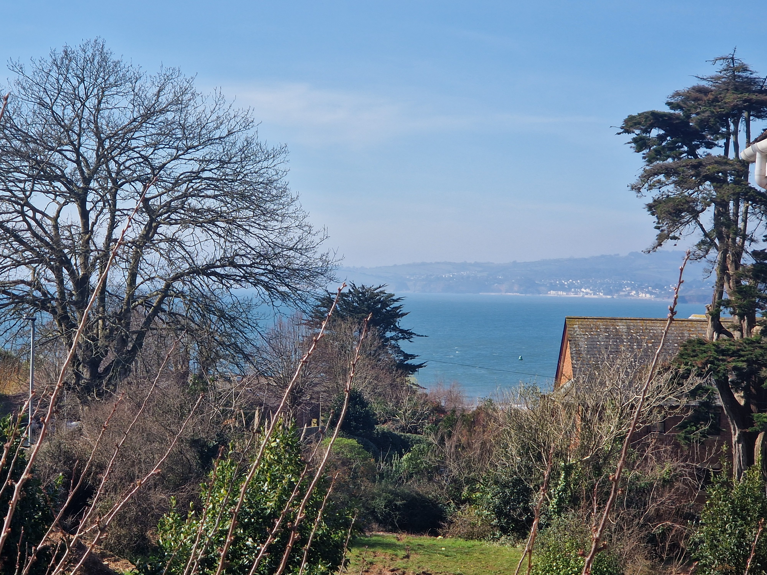

www.pennys.net
Apartment 11 Fennygates, 9 Foxholes Hill, Exmouth, EX8 2DL
GUIDE PRICE £325,000
TENURE Share of Freehold
A Beautifully Appointed Purpose-Built First Floor Apartment With Excellent Sea Views Enjoying An Enviable Position Just Off Exmouth Seafront Within Allocated Secure Parking Space And Sun Balcony
Reception Hall * Open-Plan Stylish Kitchen/Breakfast/Living Room * Two Double Bedrooms * En-Suite Shower Room/Wc * Bathroom/Wc * Underfloor Heating * Double Glazed Windows * Stairs And Lift To All Floors
Awaiting EPC
Pennys Estate Agents Limited for themselves and for the vendor of this property whose agents they are give notice that:- (1) These particulars do not constitute any part of an offer or a contract. (2) All statements contained in these particulars are made without responsibility on the part of Pennys Estate Agents Limited. (3) None of the statements contained in these particulars are to be relied upon as a statement or representation of fact. (4) Any intending purchaser must satisfy himself/herself by inspection or otherwise as to the correctness of each of the statements contained in these particulars. (5) The vendor does not make or give and neither do Pennys Estate Agents Limited nor any person in their employment has any authority to make or give any representation or warranty whatever in relation to this property.
PENNYS ESTATE AGENTS
2 Rolle House, Rolle Street, Exmouth, Devon, EX8 2SN
Tel: 01395 264111 EMail: help@pennys.net

Slide 2
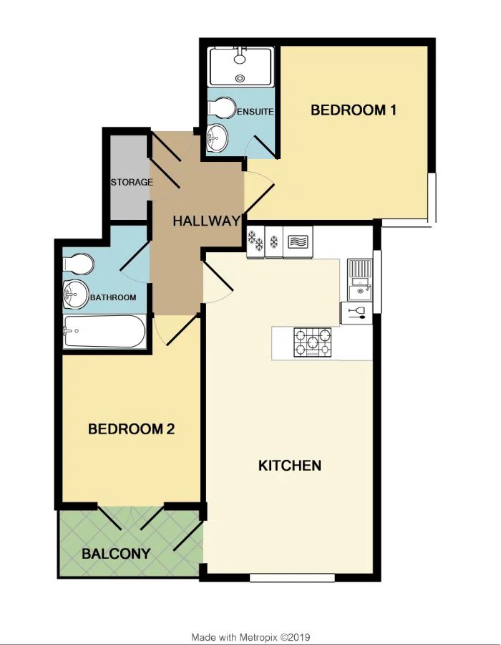
11 Fennygates, 9 Foxholes Hill, Exmouth, EX8 2DL
Fennygates is a contemporary designed development of just thirteen apartments conveniently located just moments from the seafront in the select Foxholes Hill area of Exmouth. The property offers modern stylish accommodation with lift and stairs access providing a wonderful permanent or holiday home retreat.
THE ACCOMMODATION COMPRISES: Communal entrance with door intercom with stairs and lift for first floor, private front door to:
RECEPTION HALL: A fine entrance to the property with feature wood flooring, door entry phone. UTILITIES CUPBOARD: with plumbing for automatic washing machine, water tank, slatted shelving and timer control for hot water and heating, power and light connected.
OPEN-PLAN KITCHEN/BREAKFAST/LIVING ROOM: 7.72m x 3.68m (25'4" x 12'1") A bright spacious room comprising: KITCHEN/BREAKFAST AREA: Fitted range of patterned worktops with inset one and a half bowl ‘Rangemaster’ sink unit with integrated drainer and matching splashbacks, with cupboards, drawer units, integrated dishwasher beneath worktops. The worktops are extended to provide a good size breakfast bar area, built-in oven and grill, wall mounted cupboards, integrated fridge and freezer, five ring gas hob with ceiling mounted chimney style stainless steel extractor hood over with light, recessed ceiling spotlighting, double glazed window to side aspect, tiled flooring, plinth lighting. LIVING AREA: Fitted with feature wood flooring, TV point, double glazed window to front aspect, double glazed door giving access to: SUN BALCONY; Glass balustrade gaining lovely views to the sea, also access from Bedroom two.
MAIN BEDROOM 1: 4.37m including doorway recess x 3.45m (14'4" x 11'4") Two sets of double glazed windows, feature wood flooring, TV point.
EN-SUITE SHOWER ROOM/WC: 2.26m x 1.68m (7'5" x 5'6") Fitted with double width shower cubicle with sliding doors, chrome shower unit, wash hand basin, WC with dual push button flush, fully tiled walls, tiled flooring, chrome heated towel rail, ceiling led lighting and ceiling extractor fan, fitted mirror with integrated light, underfloor heating.
BEDROOM 2: 3.78m including doorway recess x 3.02m (12'5" x 9'11") With feature wood flooring, double glazed double doors opening onto the balcony.
BATHROOM/WC: 2.44m x 1.96m (8'0" x 6'5") Comprising of bath, wall mounted wash hand basin, WC with concealed cistern and dual push button flush, fully tiled walls, tiled flooring and underfloor heating, chrome heated towel rail, recessed ceiling led spotlighting, ceiling extractor fan, mirror with integrated light.
OUTSIDE: Accessed via gated entrance and enjoys an allocated parking space and good size storeroom. There are attractive communal gardens to the rear of the development.
TENURE: The property is leasehold with an equal share of the freehold. Maintenance Charge: To be confirmed.
FLOOR PLAN:

