Slide 1
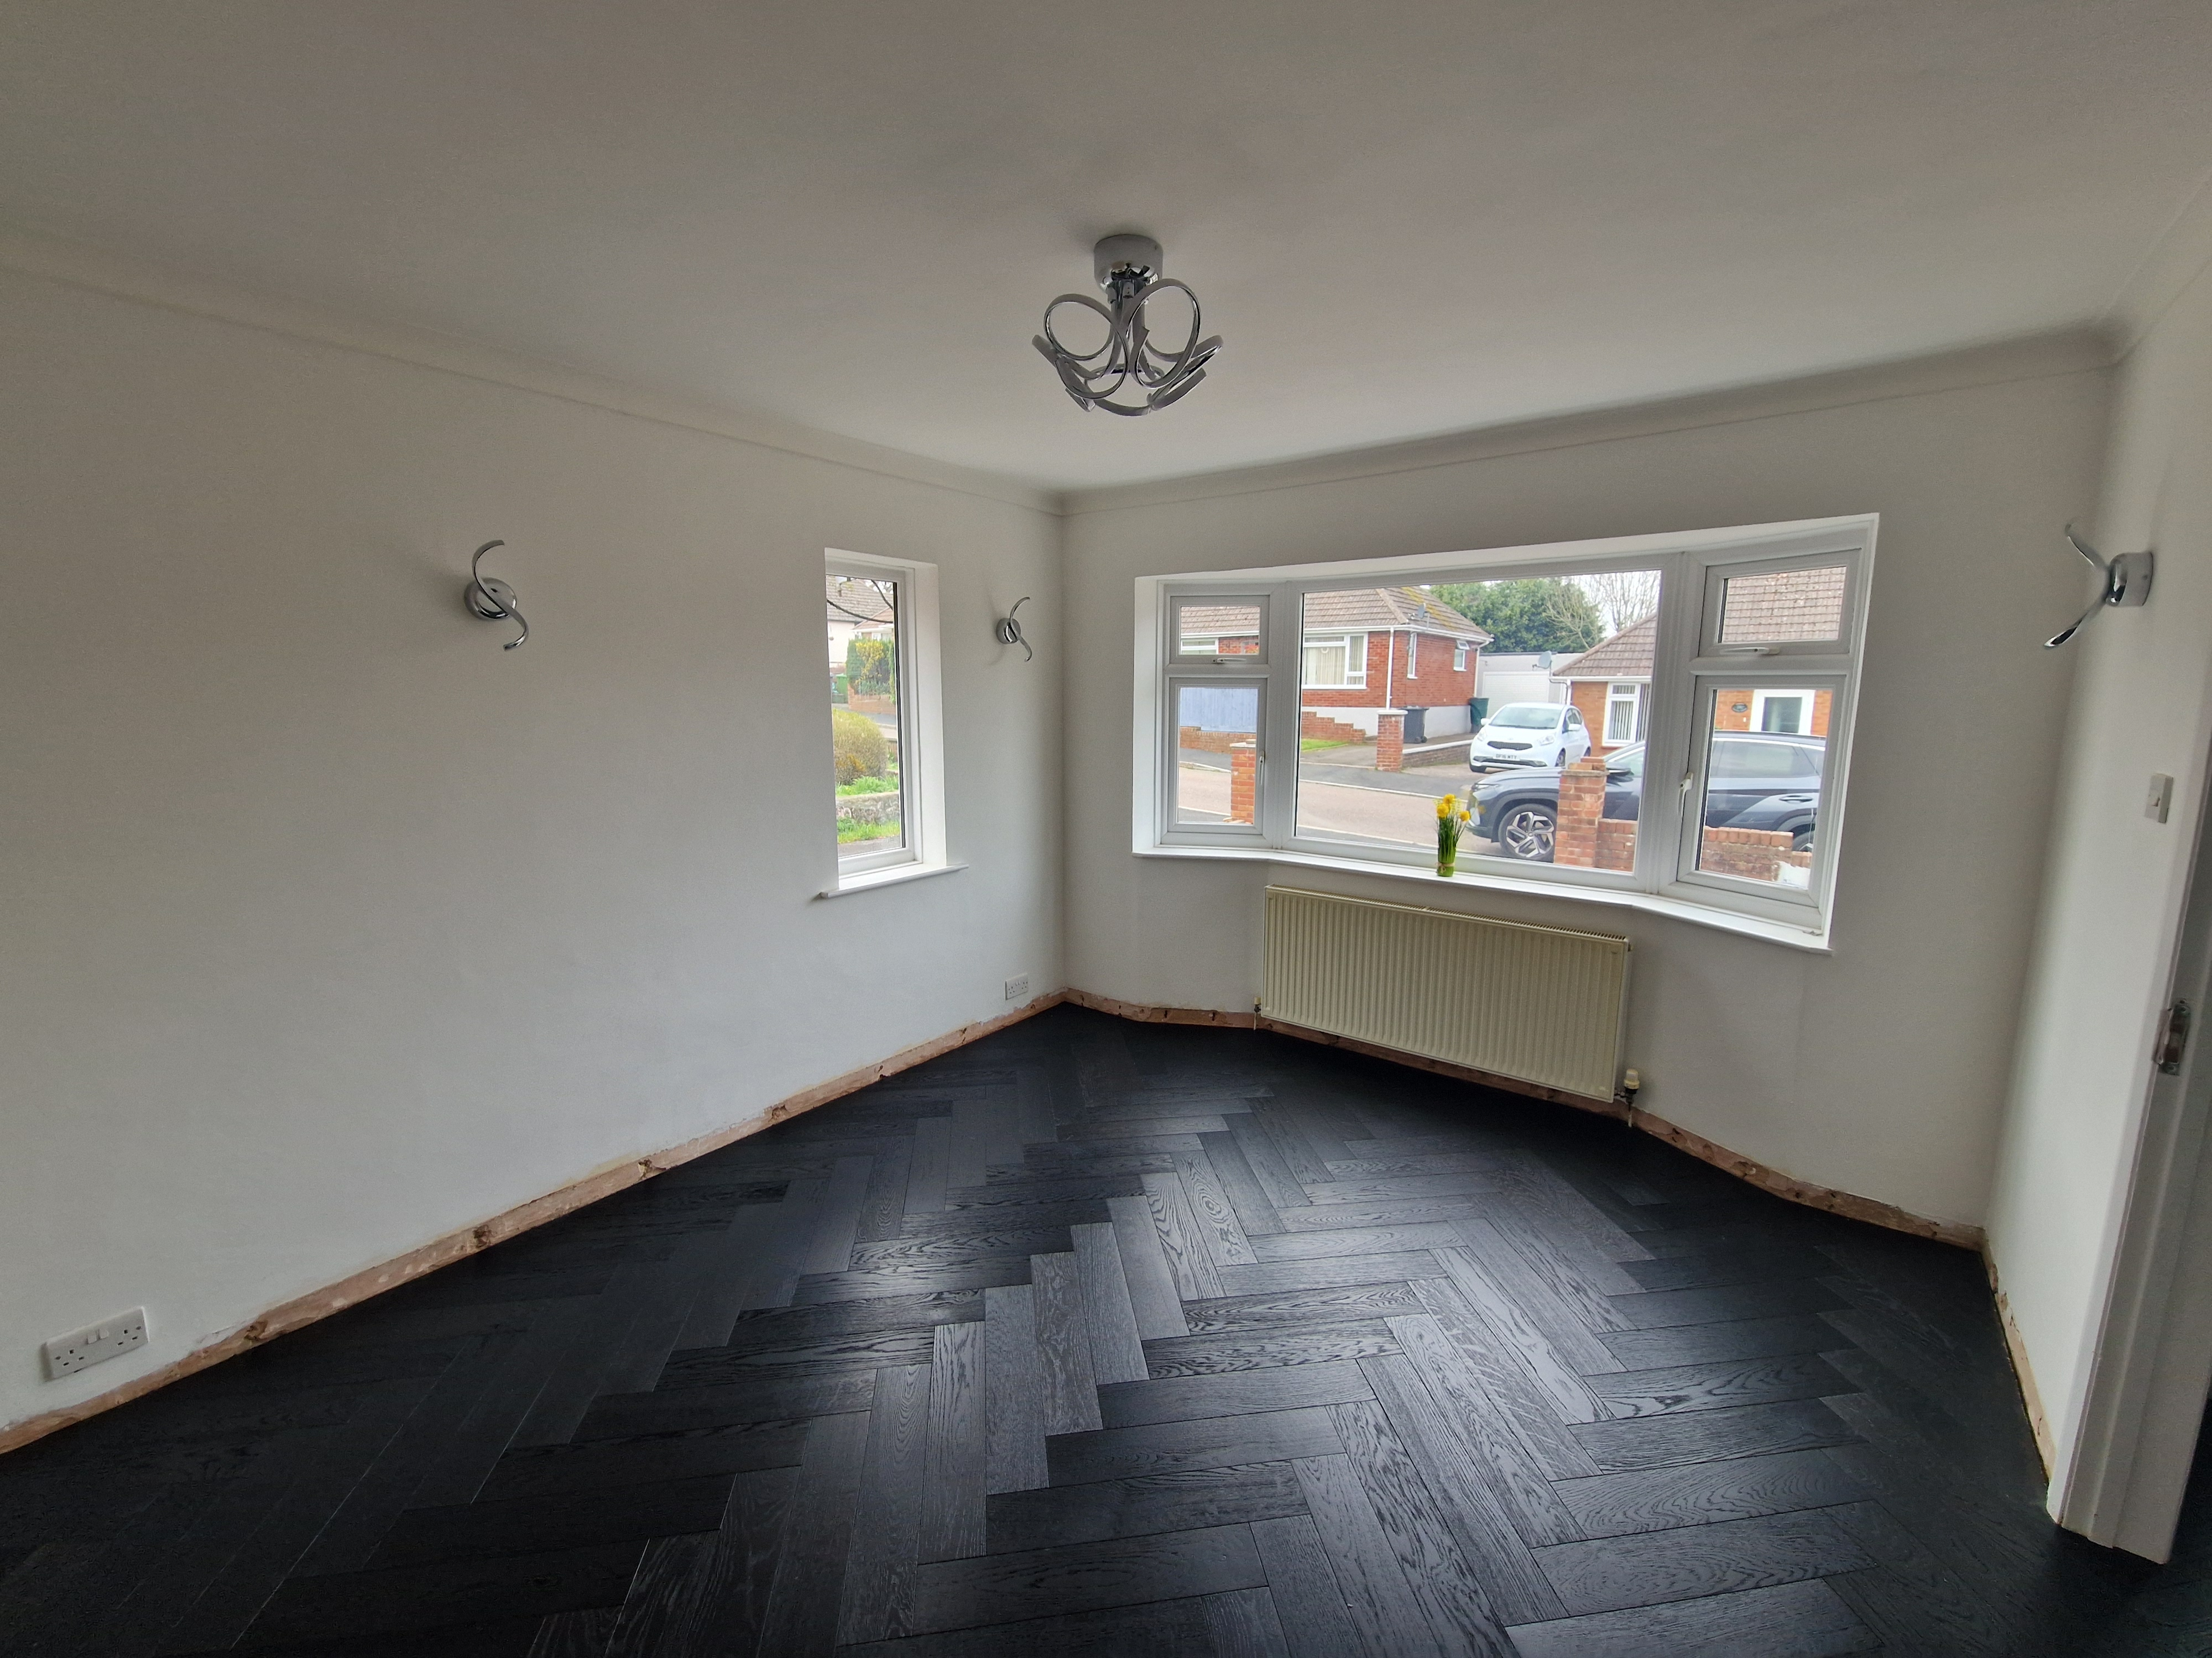
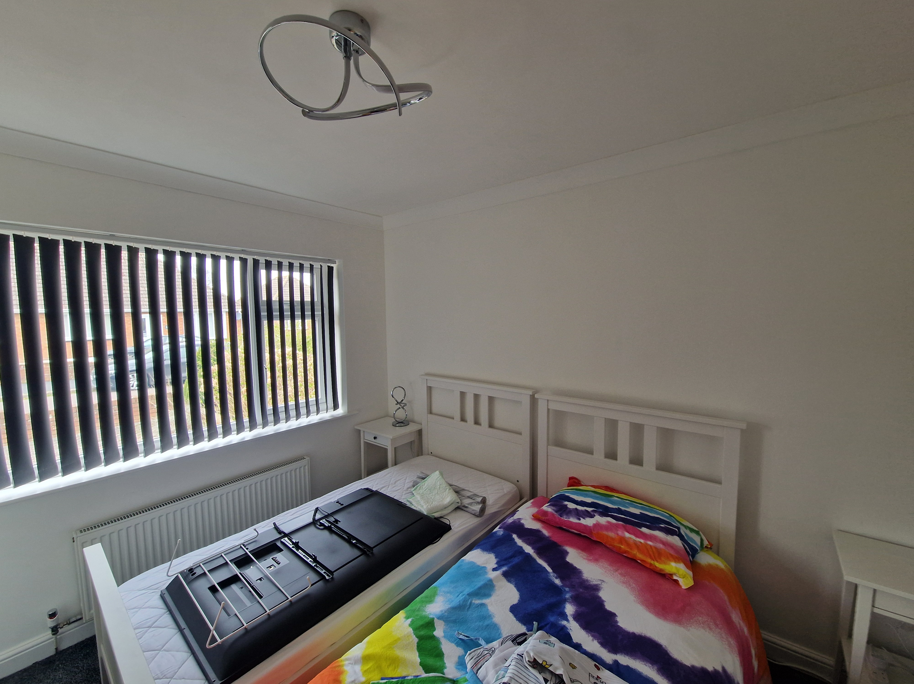
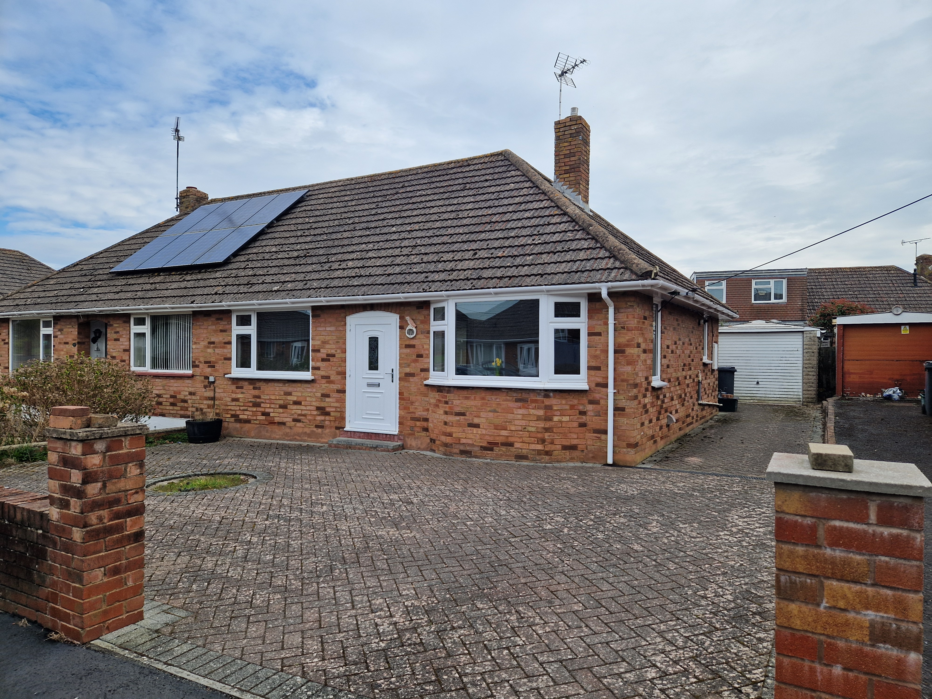
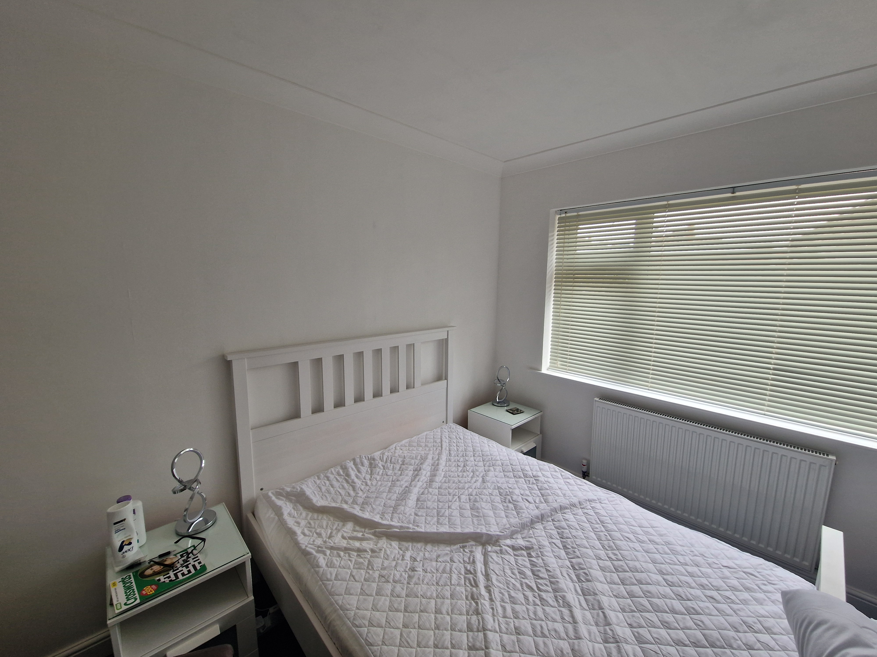
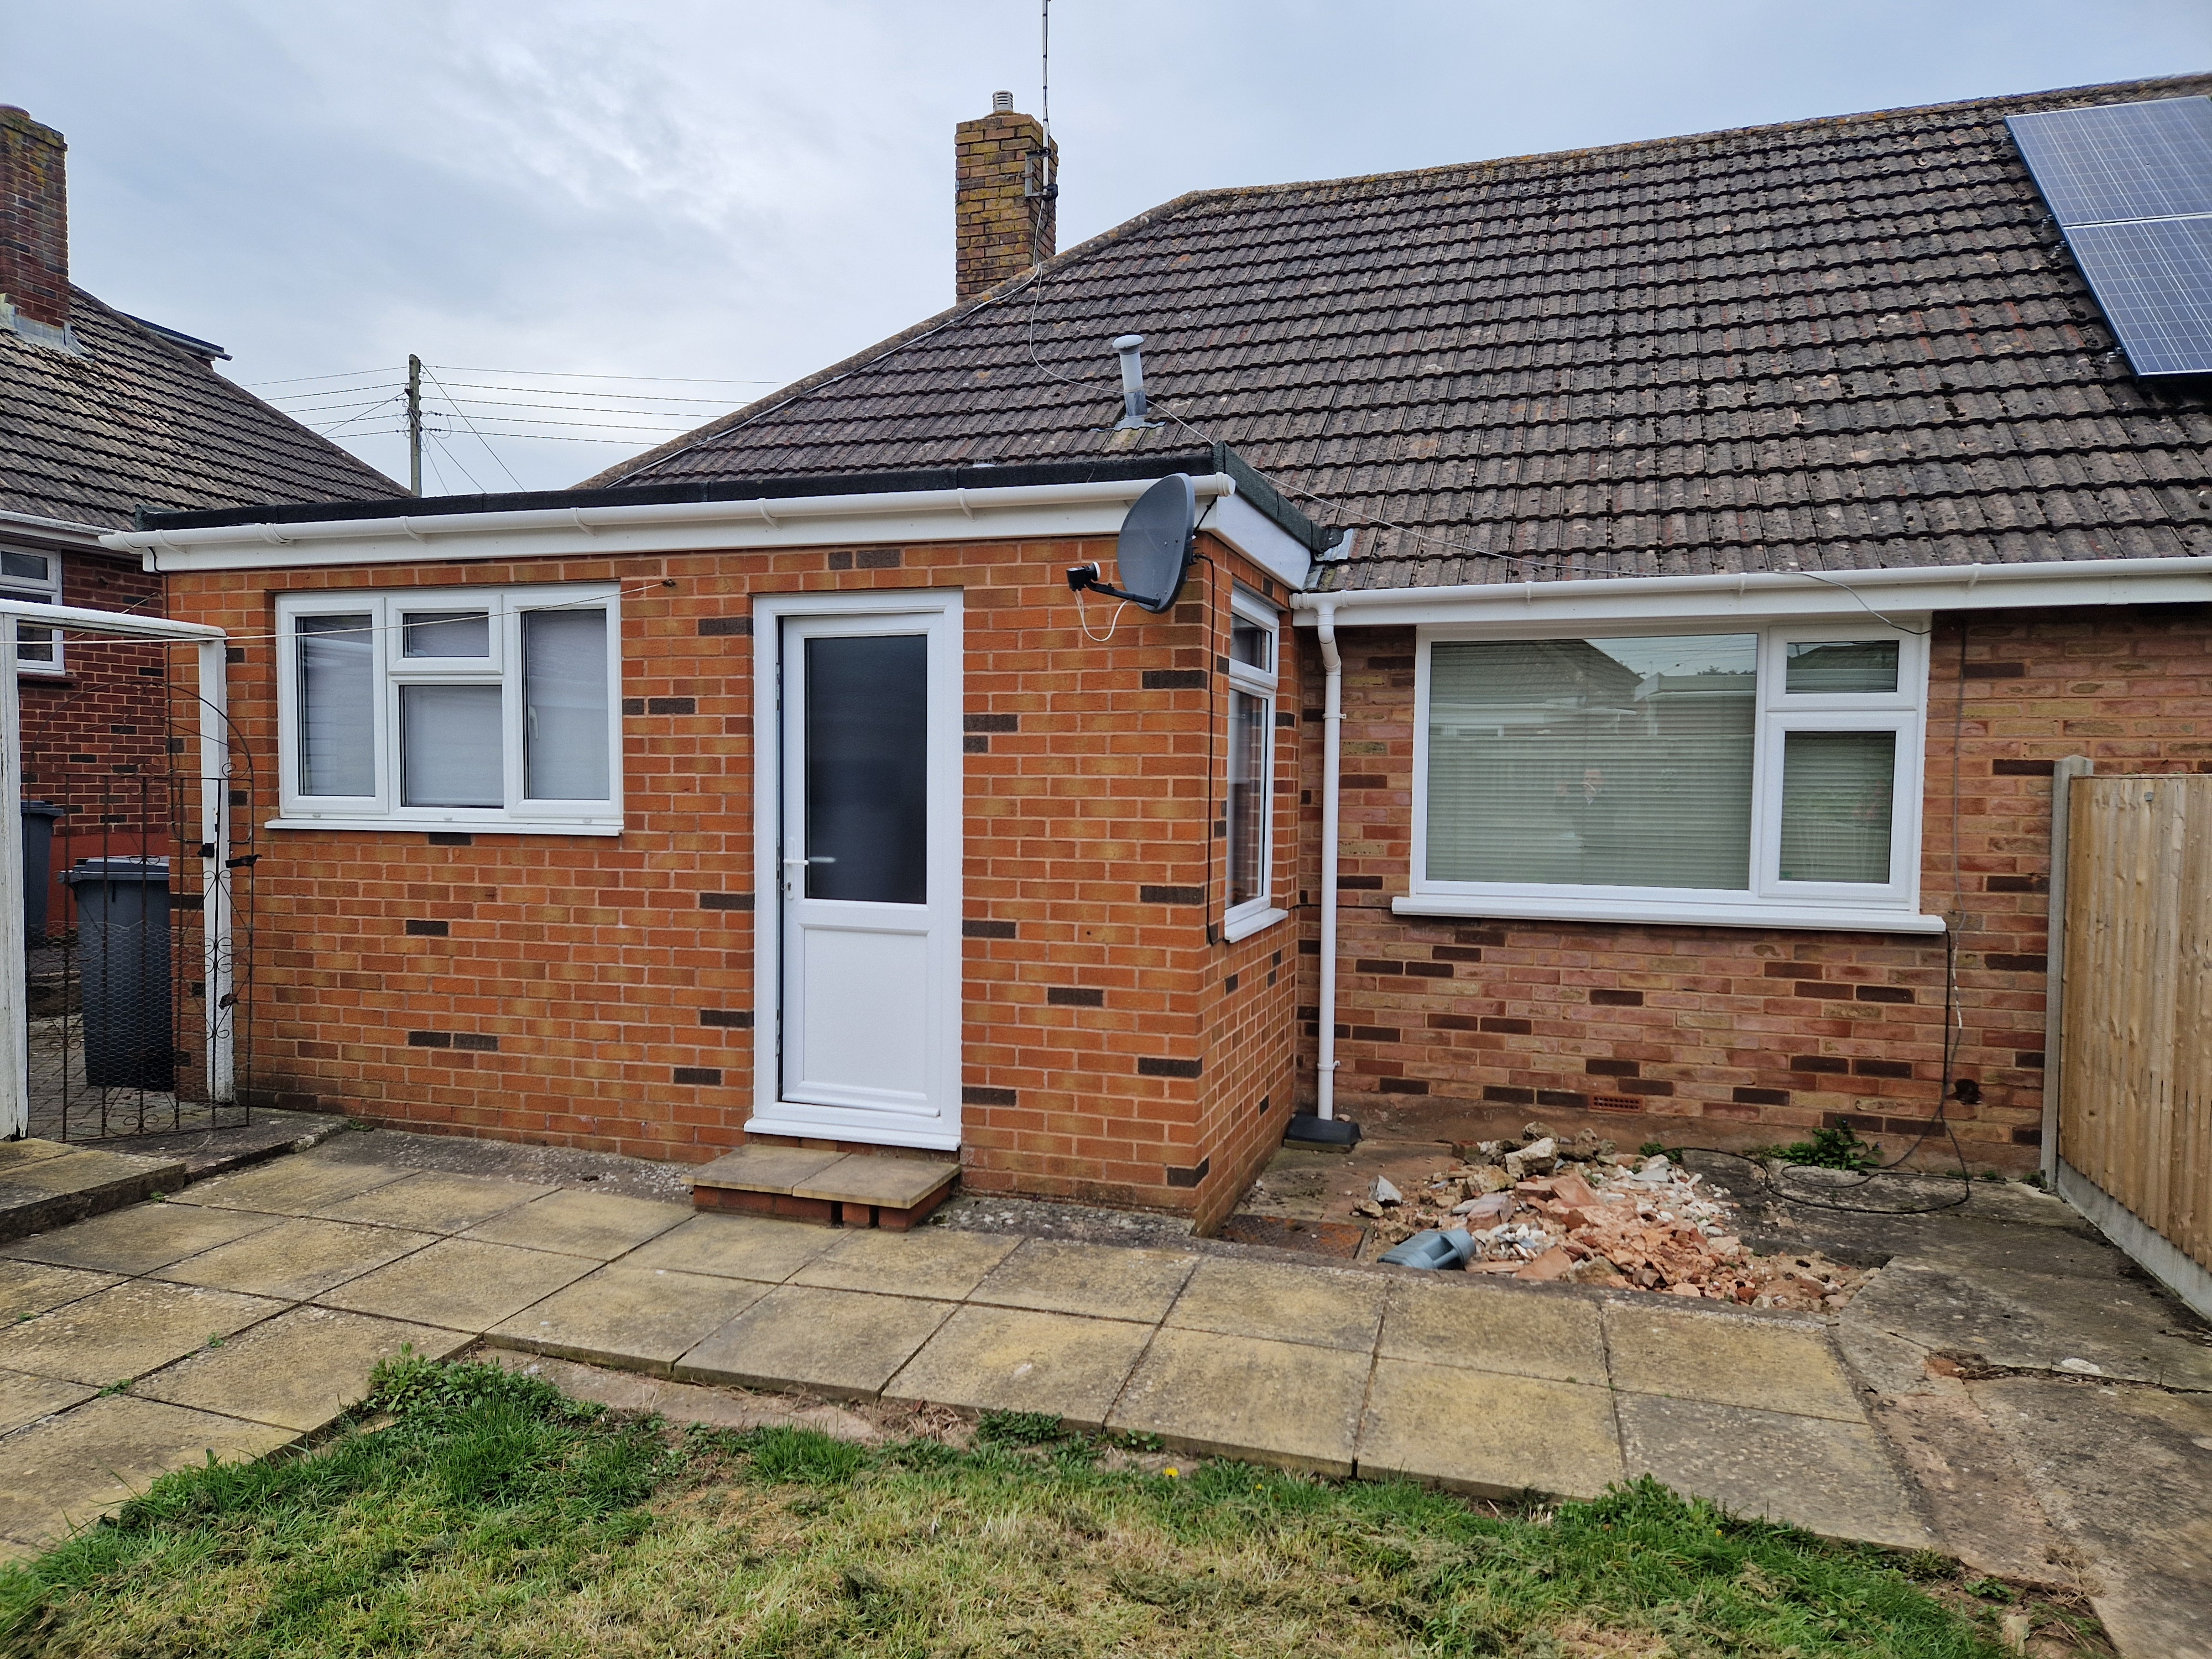
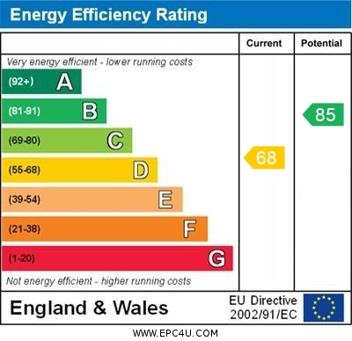
www.pennys.net
17 Elmfield Crescent, Exmouth, EX8 3BL
GUIDE PRICE £360,000
TENURE Freehold
An Extended Semi Detached Bungalow Located In A Favoured Area Close To Amenities With Level Garden, Block Paved Driveway/Parking Area, Offered For Sale With No Ongoing Chain
Significantly Refurbished Accommodation * Mostly Re-Skimmed And Plastered Walls * Modern Double Glazing * Living Room * Two Double Bedrooms * Extended Kitchen/Breakfast Room * Utility Area * Shower Room/Wc * Gas Central Heating * New Floor Coverings Where Stated
Pennys Estate Agents Limited for themselves and for the vendor of this property whose agents they are give notice that:- (1) These particulars do not constitute any part of an offer or a contract. (2) All statements contained in these particulars are made without responsibility on the part of Pennys Estate Agents Limited. (3) None of the statements contained in these particulars are to be relied upon as a statement or representation of fact. (4) Any intending purchaser must satisfy himself/herself by inspection or otherwise as to the correctness of each of the statements contained in these particulars. (5) The vendor does not make or give and neither do Pennys Estate Agents Limited nor any person in their employment has any authority to make or give any representation or warranty whatever in relation to this property.
PENNYS ESTATE AGENTS
2 Rolle House, Rolle Street, Exmouth, Devon, EX8 2SN
Tel: 01395 264111 EMail: help@pennys.net

Slide 2
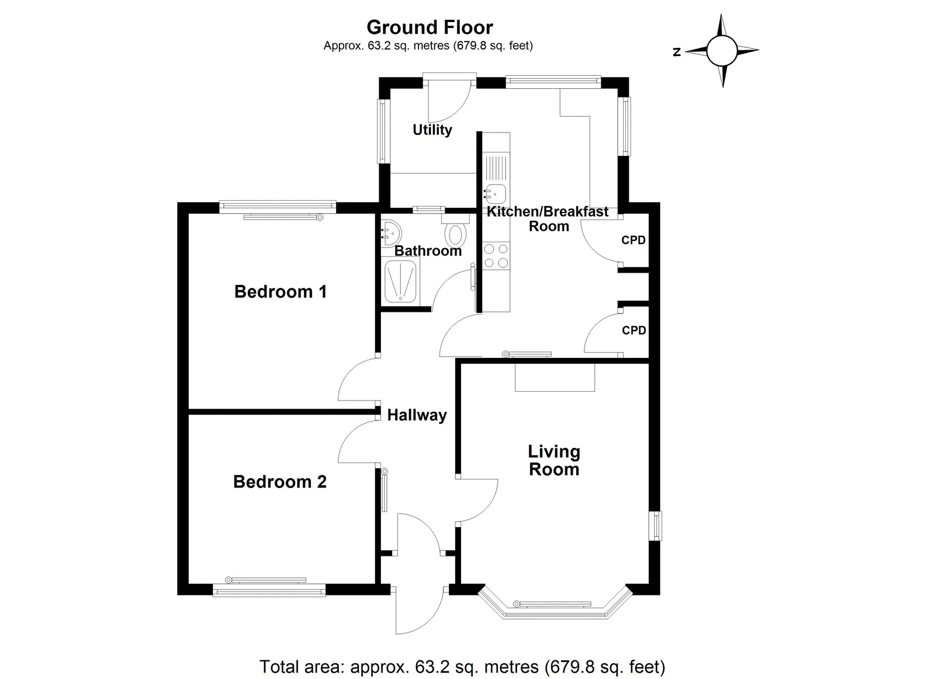
17 Elmfield Crescent, Exmouth, EX8 3BL
A significantly refurbished and extended semi detached bungalow located in a popular area with level gardens, parking and garage. The hallway, lounge and both bedrooms have been beautifully refurbished. Offered with no ongoing chain. Viewing is recommended.
THE ACCOMMODATION COMPRISES: uPVC front door with window inset to:
ENTRANCE PORCH: Inner uPVC double glazed door with patterned glass giving access to:
RECEPTION HALL: Radiator, newly laid feature wood-effect flooring, access to roof space, storage cupboards over doorway recess.
LIVING ROOM: 4.24m x 3.33m (13'11" x 10'11") A bright dual aspect room with double glazed bay window to front aspect, further double glazed window to side elevation, newly laid feature wood-effect flooring, TV point, display area in chimneybreast recess.
EXTENDED KITCHEN/BREAKFAST ROOM: 4.85m x 2.36m (15'11" x 7'9") Fitted with a range of patterned worktops with inset single drainer sink unit, tiled surrounds, cupboards and drawer units beneath worktops, wall-mounted cupboards, gas cooker point with filter extractor hood over, wall recess with double glazed window, cupboard housing modern gas boiler for hot water and central heating, timer control for hot water and central heating, larder style cupboard, TV point, radiator, double glazed windows to side and rear elevations, ceiling spotlighting and recessed spotlighting, opening through to:
UTILITY AREA: 1.73m x 1.6m (5'8" x 5'3") With plumbing for automatic washing machine underneath work surface, double glazed window and door giving access to the rear garden.
BEDROOM 1: 3.33m x 3.05m (10'11" x 10'0") Double glazed window to front aspect, newly laid carpet, radiator.
BEDROOM 2: 3.51m x 3.02m (11'6" x 9'11") Double glazed window to rear aspect, newly laid carpet, radiator.
SHOWER ROOM/WC: 1.7m x 1.7m (5'7" x 5'7") Shower cubicle housing Mira shower unit, pedestal wash hand basin, WC, fully tiled walls, mirror fronted medicine cabinet, double glazed window with patterned glass, ceiling extractor fan, recessed ceiling spotlighting.
OUTSIDE: To the front of the property is a good size block paved garden and driveway leading into the GARAGE. A side gate gives access through to the rear garden, which is level and enclosed, comprising of lawn, garden, patio areas.
GARAGE: 6.65m x 2.64m (21'10" x 8'8") Up and over door, windows, power and light connected.
FLOOR PLAN:

