Slide 1
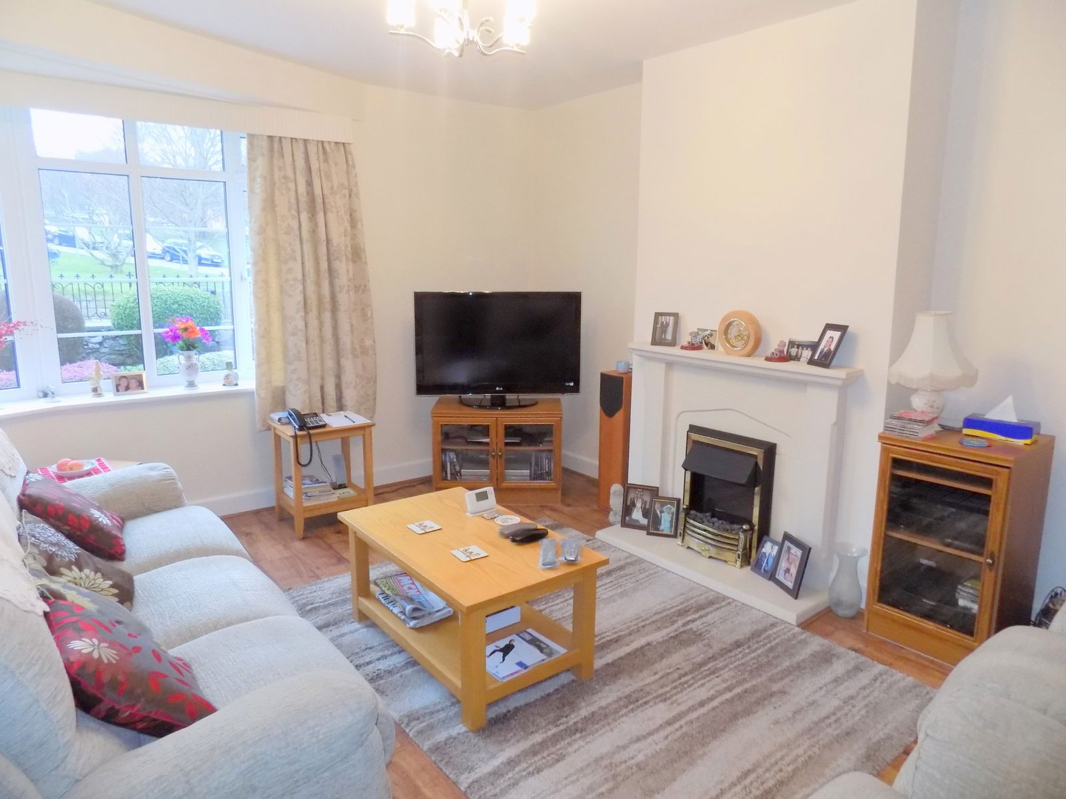
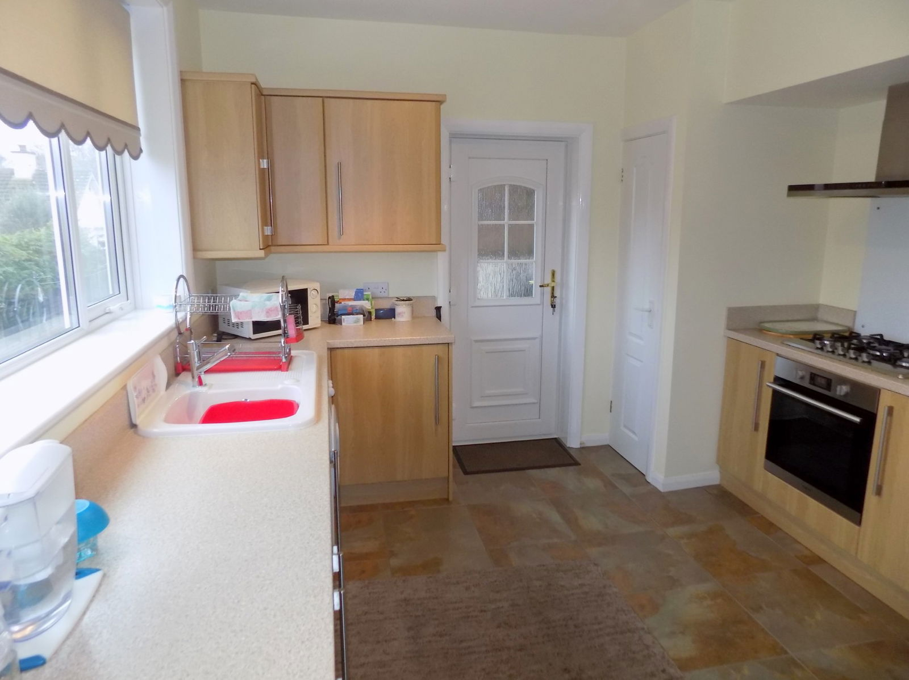
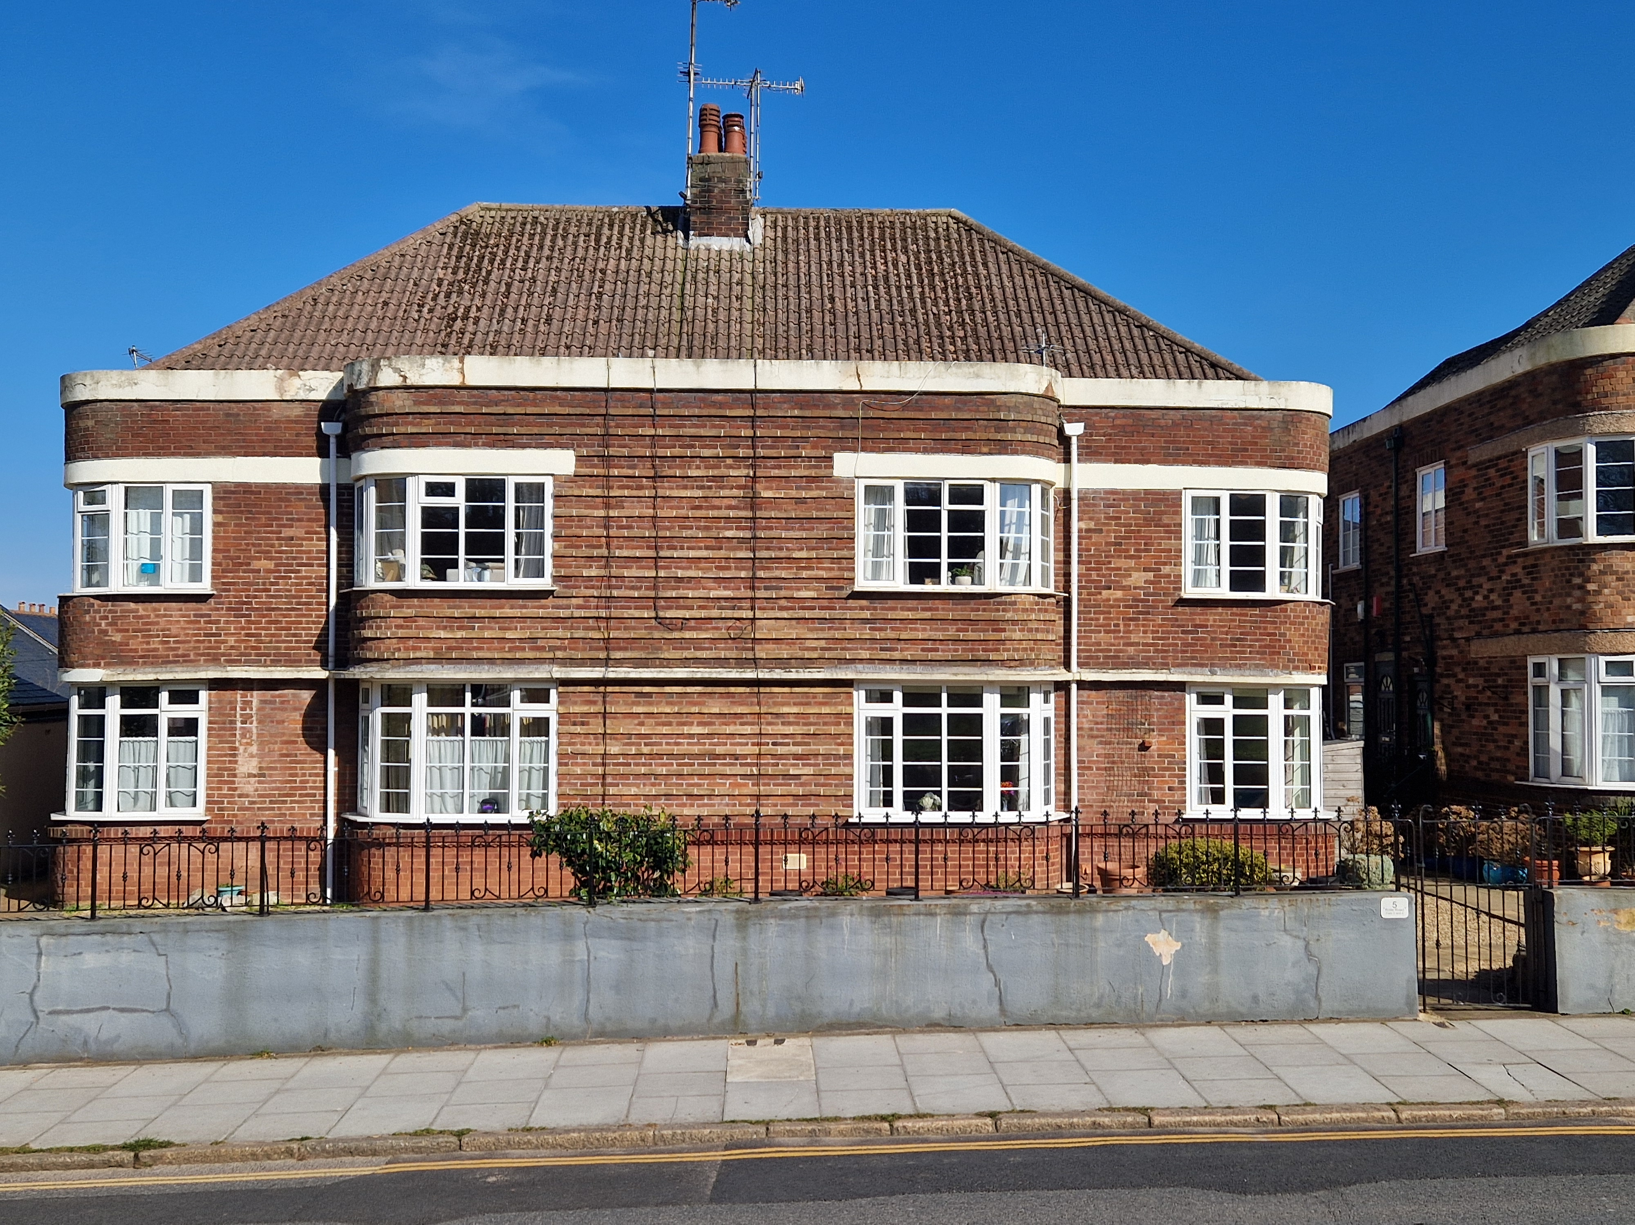
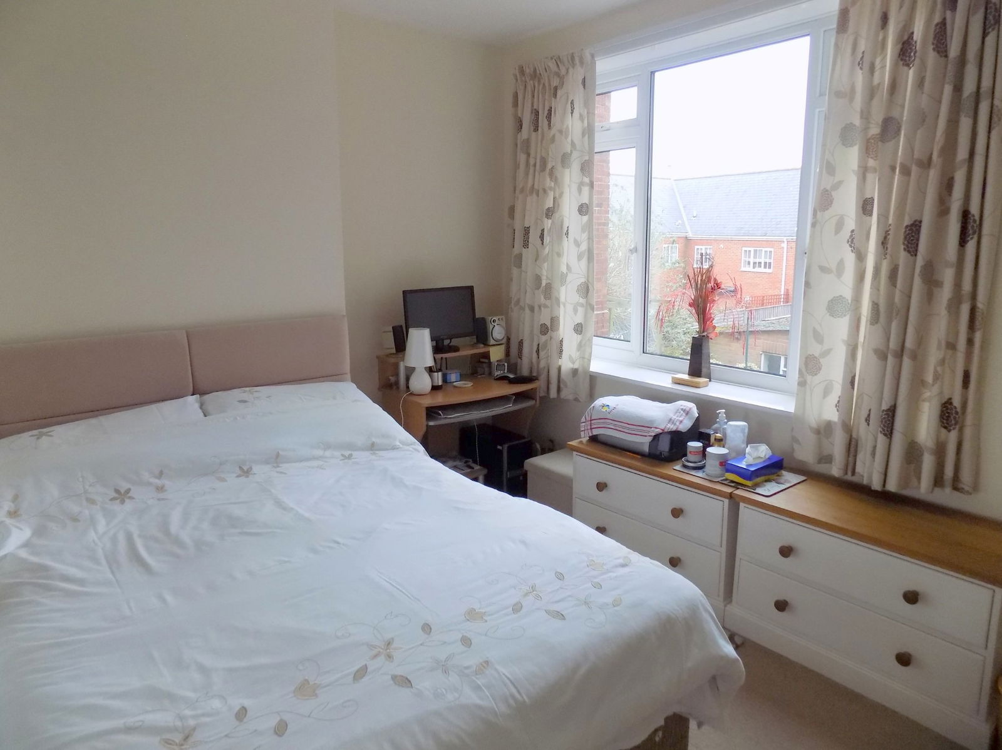
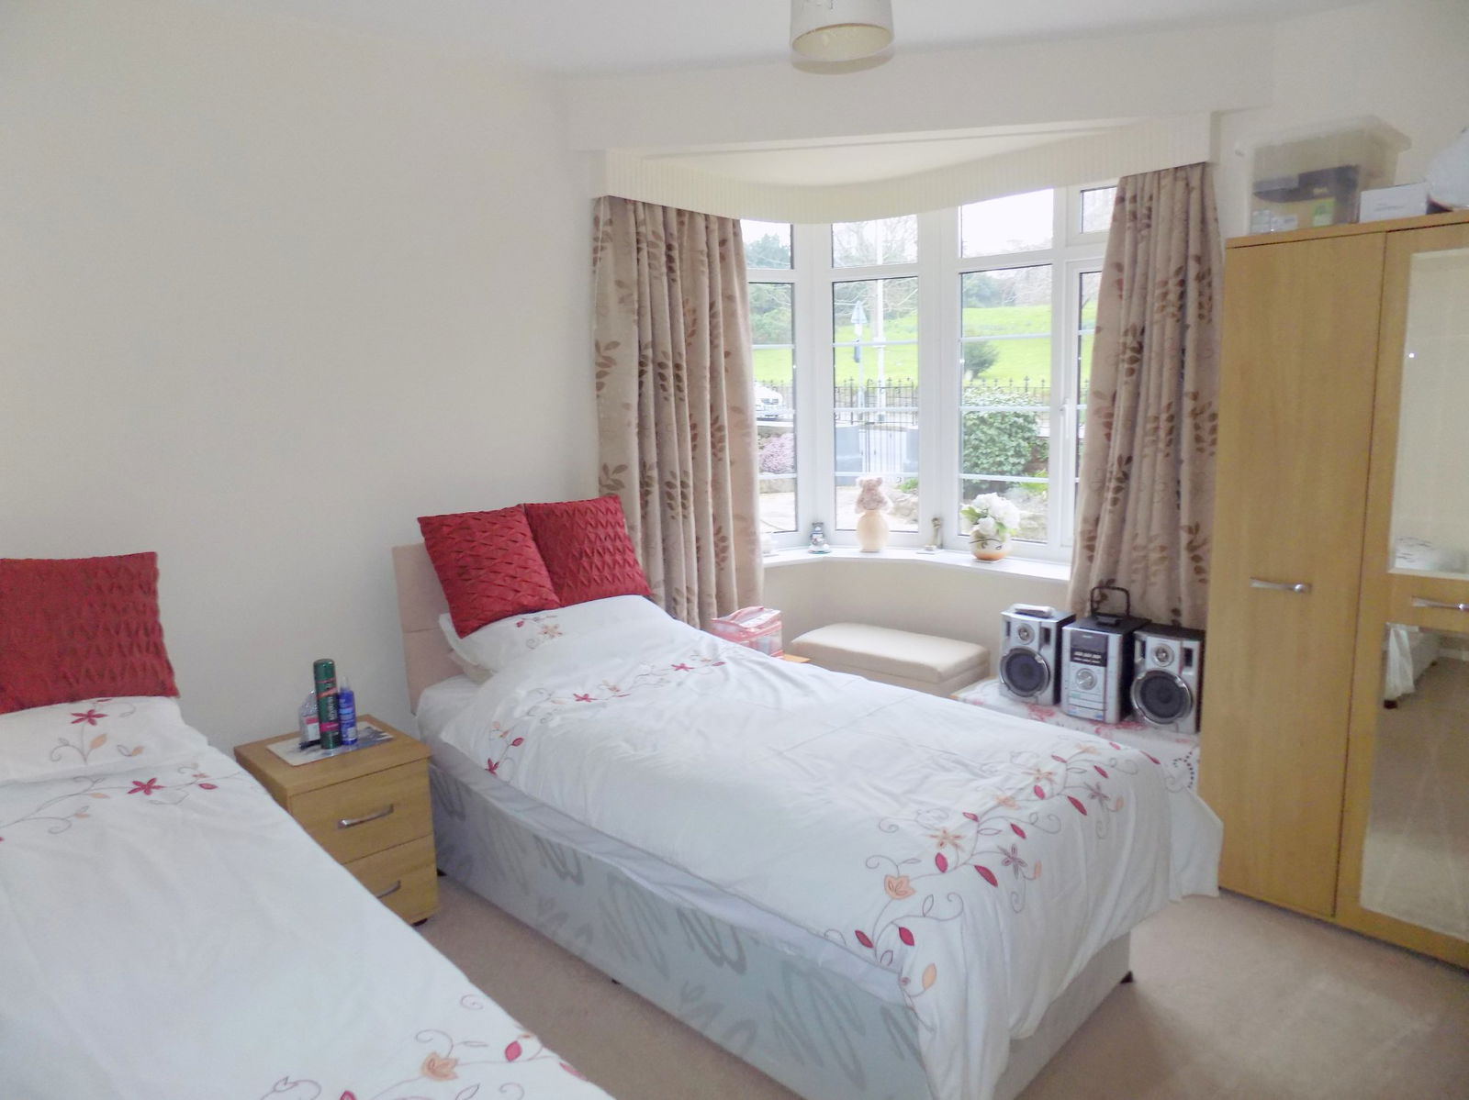
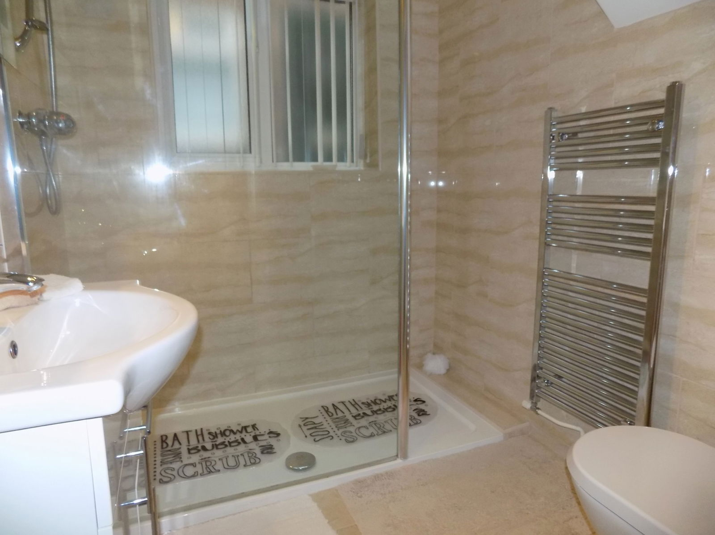
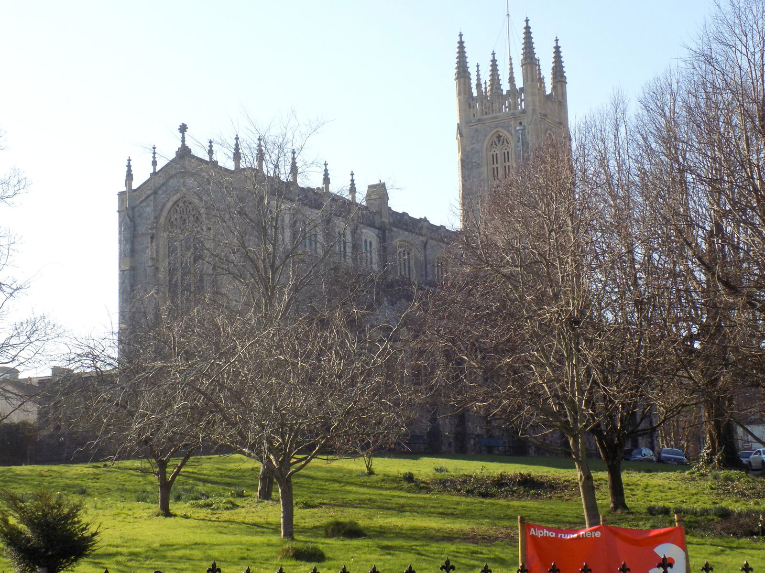
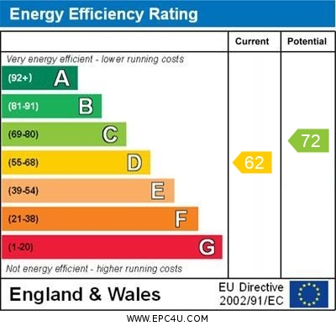
www.pennys.net
Flat 4, 5 Rolle Road, Exmouth, Devon, EX8 2AA
GUIDE PRICE £250,000
TENURE Share of Freehold
A Purpose Built Self Contained Ground Floor Apartment Conveniently Located Only A Short Distance From Exmouth Town Centre And Enjoying A Lovely Outlook Over Holy Trinity Church
Beautifully Presented & Much Improved Accommodation • Own Private Entrance & Reception Hall Attractive Lounge / Dining Room • Stylish Re-Fitted Modern Kitchen/Breakfast Room * Two Double Bedrooms • Stylish Shower Room/WC • Separate Re-Fitted Cloakroom/WC * Gas Central Heating & UPVC Double Glazed Windows
Super Home Located In The Heart Of The Town Centre • Viewing Recommended
Pennys Estate Agents Limited for themselves and for the vendor of this property whose agents they are give notice that:- (1) These particulars do not constitute any part of an offer or a contract. (2) All statements contained in these particulars are made without responsibility on the part of Pennys Estate Agents Limited. (3) None of the statements contained in these particulars are to be relied upon as a statement or representation of fact. (4) Any intending purchaser must satisfy himself/herself by inspection or otherwise as to the correctness of each of the statements contained in these particulars. (5) The vendor does not make or give and neither do Pennys Estate Agents Limited nor any person in their employment has any authority to make or give any representation or warranty whatever in relation to this property.
PENNYS ESTATE AGENTS
2 Rolle House, Rolle Street, Exmouth, Devon, EX8 2SN
Tel: 01395 264111 EMail: help@pennys.net

Slide 2
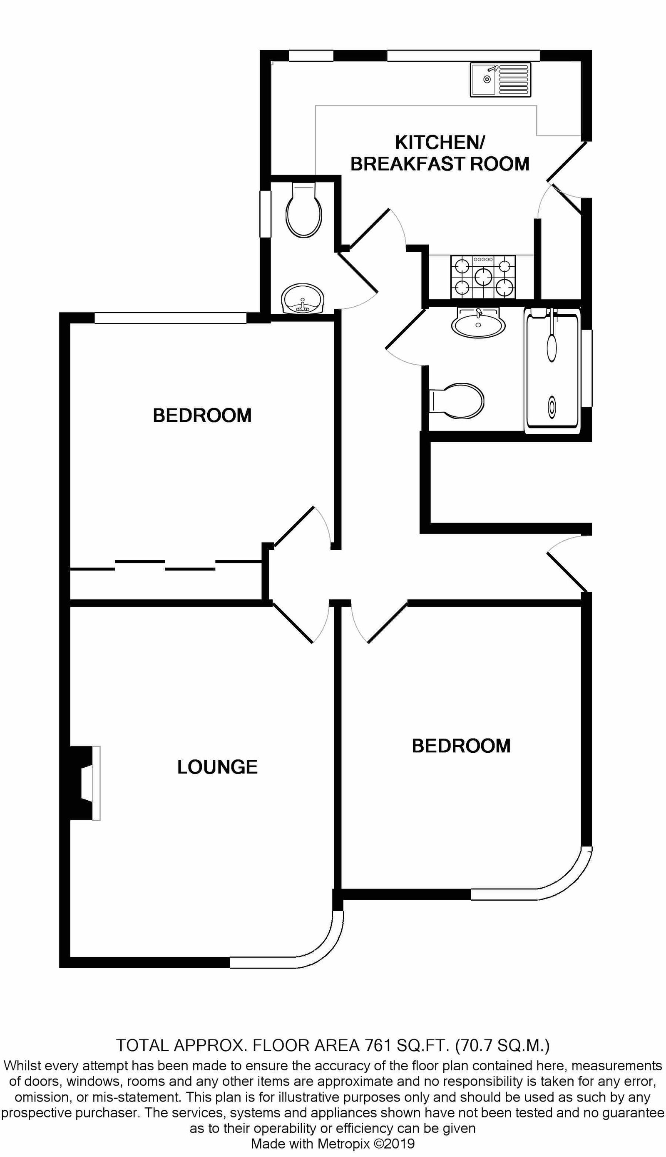
Flat 4, 5 Rolle Road, Exmouth, Devon, EX8 2AA
THE ACCOMMODATION COMPRISES: Private UPVC double glazed front door with attractive patterned window inset giving access to the: RECEPTION HALL: With radiator; doors giving access to all rooms. LOUNGE / DINING ROOM: 16' 2" x 12' 1" (4.93m x 3.68m) Attractive UPVC double glazed bay window overlooking the front aspect gaining lovely views of Holy Trinity Church and grounds; feature fireplace housing living flame effect electric fire; television point; radiator; wood flooring; telephone point. KITCHEN / BREAKFAST ROOM: 14' 5" x 10' 10" (4.39m x 3.3m) measurement into wall recess. A bright and spacious modern kitchen comprising of a range of patterned working surfaces with matching splashbacks; inset ceramic single drainer sink unit with chrome mixer tap; inset five ring gas hob with built-in oven below, glass splashback and stainless steel chimney style extractor hood with light; range of base cupboards, drawer units, integrated fridge and freezer, space and plumbing for washing machine beneath working surfaces; matching range of wall units at eye-level; wall mounted Vaillant gas boiler providing domestic hot water and central heating; built-in larder style cupboard with shelving and housing the electric consumer unit; radiator; tiled flooring; two UPVC double glazed window overlooking the rear aspect; UPVC double glazed door with patterned window inset giving access to outside. BEDROOM ONE: 12' 7" x 11' 0" (3.84m x 3.35m) measurement into attractive UPVC double glazed bay window to front aspect enjoying a lovely view towards Holy Trinity Church and grounds; radiator. BEDROOM TWO: 12' 2" x 11' 4" (3.71m x 3.45m) UPVC double glazed window to rear aspect; floor to ceiling built-in wardrobes with sliding doors - two fitted with mirror fronts, clothes rail and shelving; television point. SHOWER ROOM / WC: Stylishly re-fitted and comprising of an ease of access shower cubicle with Mira shower unit and shower splash screen; wash hand basin with mixer tap, cupboards and drawer unit beneath and mirror fronted medicine cabinet over with integrated light; WC with push button flush; attractive fully tiled walls and colour coordinated tiled flooring; chrome heated towel rail; extractor fan; UPVC double glazed window with patterned glass. CLOAKROOM / WC: Stylishly re-fitted and comprising of a space saver wash hand basin with chrome mixer tap and cabinet beneath; WC with push button flush; attractive extensively tiled walls and colour coordinated tiled flooring; UPVC double glazed window with patterned glass. OUTSIDE: To the front of the property there is an area of garden laid to gravel chippings with colourful flower and shrub beds. To the rear there is an informal arrangement with the other flats that the owner of this flat can park one car. TENURE AND OUTGOINGS: We understand that the property is held on a 199 year lease from 1957, the apartment does also benefit from a 1/4 share of the freehold. The maintenance charges are on an 'as and when' basis.
FLOOR PLAN:

