Slide 1
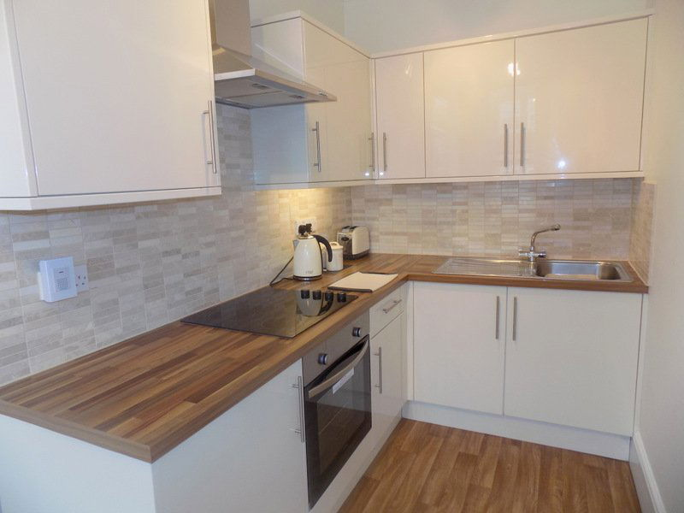
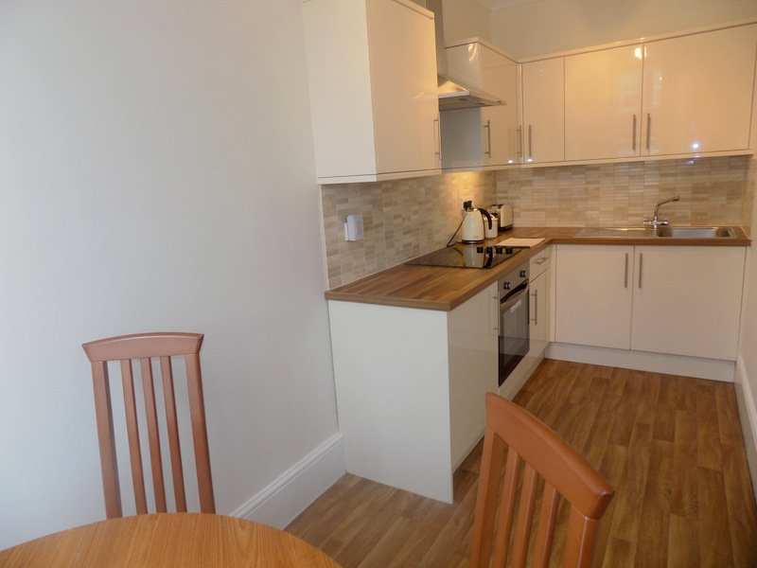
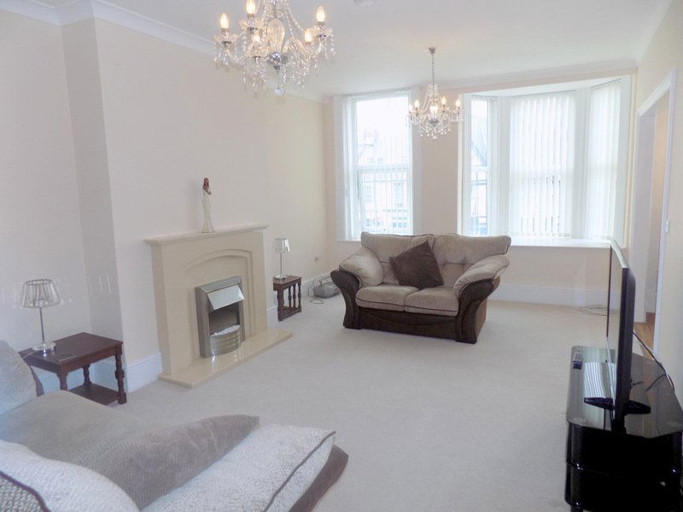
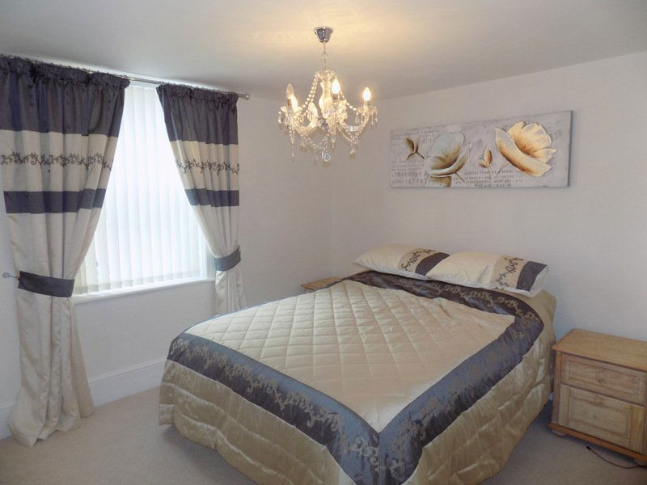
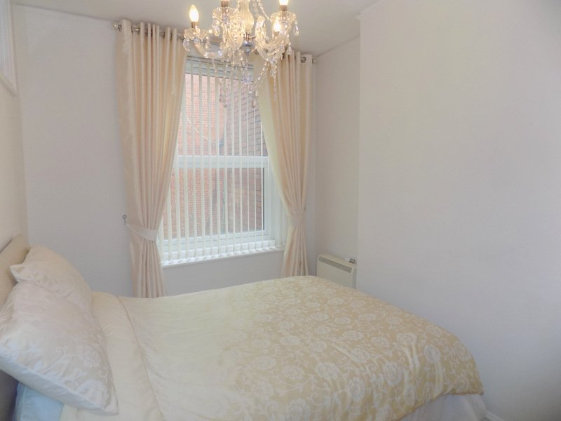
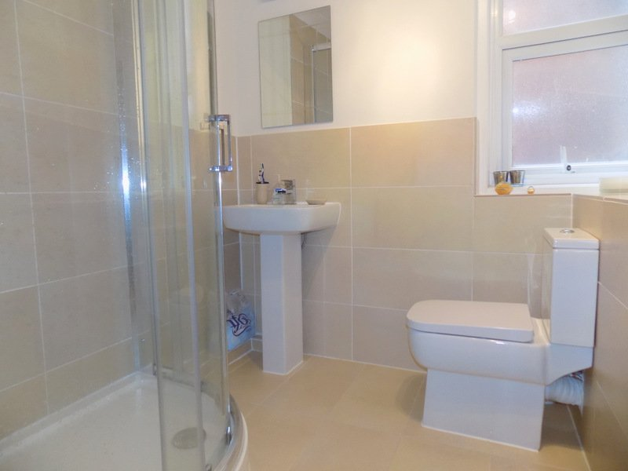
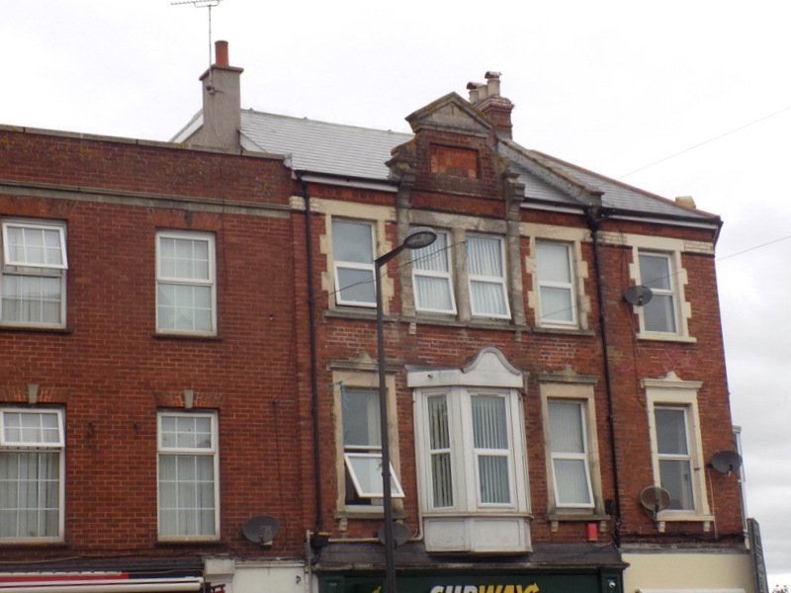
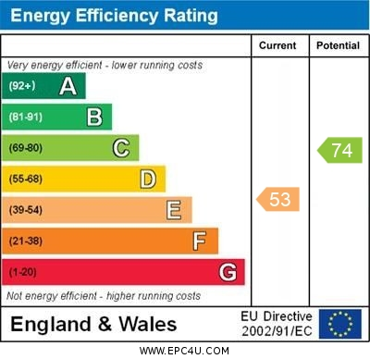
www.pennys.net
First Floor Flat, 4 The Strand, Exmouth, EX8 1AB
GUIDE PRICE £215,000
TENURE Leasehold
A Deceptively Spacious And Beautifully Refurbished Maisonette Located In The Heart Of Exmouth Town Centre
Spacious And Elegant Lounge • Modern Kitchen / Dining Room
Two Double Bedrooms • Stylish Modern Shower Room / WC
UPVC Double Glazed Windows • Super Permanent Or Investment Purchase
Viewing Strongly Recommended • No Onward Chain
Pennys Estate Agents Limited for themselves and for the vendor of this property whose agents they are give notice that:- (1) These particulars do not constitute any part of an offer or a contract. (2) All statements contained in these particulars are made without responsibility on the part of Pennys Estate Agents Limited. (3) None of the statements contained in these particulars are to be relied upon as a statement or representation of fact. (4) Any intending purchaser must satisfy himself/herself by inspection or otherwise as to the correctness of each of the statements contained in these particulars. (5) The vendor does not make or give and neither do Pennys Estate Agents Limited nor any person in their employment has any authority to make or give any representation or warranty whatever in relation to this property.
PENNYS ESTATE AGENTS
2 Rolle House, Rolle Street, Exmouth, Devon, EX8 2SN
Tel: 01395 264111 EMail: help@pennys.net

Slide 2
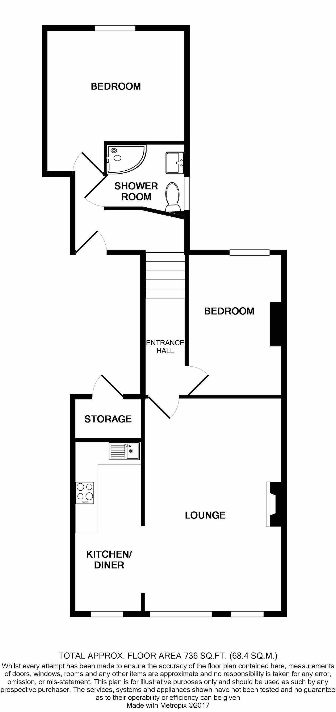
First Floor Flat, 4 The Strand, Exmouth, Devon, EX8 1AB
THE ACCOMMODATION COMPRISES: Communal entrance with stairs to first floor and access to own good size STORAGE CUPBOARD. Own private front door giving access to split level reception hall. Lower landing level gives access to master bedroom and shower room / WC. Upper level leading to lounge, kitchen and second bedroom. LOUNGE: 19' 0" x 12' 5" (5.79m x 3.78m) A bright, spacious and elegant room with UPVC double glazed bay window overlooking the front aspect and further UPVC double glazed window also to the front aspect - both enjoying views towards The Strand Gardens. Feature fireplace housing pebble effect electric fire; television point; coved ceiling; night storage heater; opening through to: KITCHEN / DINING ROOM: 15' 5" x 5' 9" (4.7m x 1.75m) Beautifully fitted with stylish kitchen units comprising wood effect work surfaces with inset stainless steel single drainer sink unit with mixer tap over; range of cupboards, drawer units and built-in oven beneath work surfaces; inset four ring halogen hob and stainless steel chimney style extractor hood over; matching wall units at eye-level; attractive tiled surrounds; ceiling extractor fan; ceiling spotlighting; coved ceiling; UPVC double glazed window to front elevation gaining views towards The Strand Gardens. BEDROOM ONE: 12' 10" x 12' 7" (3.91m x 3.84m) UPVC double glazed window to rear elevation; television point; night storage heater; light dimmer switch. BEDROOM TWO: 12' 8" x 8' 7" (3.86m x 2.62m) UPVC double glazed window to rear elevation; night storage heater; light dimmer switch. SHOWER ROOM / WC: Stylishly fitted and comprising a good sized attractively tiled shower cubicle with Mira shower unit, shower splash screen and curved shower splash screen doors; pedestal wash hand basin with chrome mixer tap and fitted mirror over; WC with push button flush; extensively tiled walls; matching tiled flooring; chrome heated towel rail; ceiling spotlighting; ceiling extractor fan; UPVC double glazed window with patterned glass. TENURE AND OUTGOINGS: We understand that the property will be sold with an extended lease. Service charges to be confirmed.
FLOOR PLAN:

