Slide 1
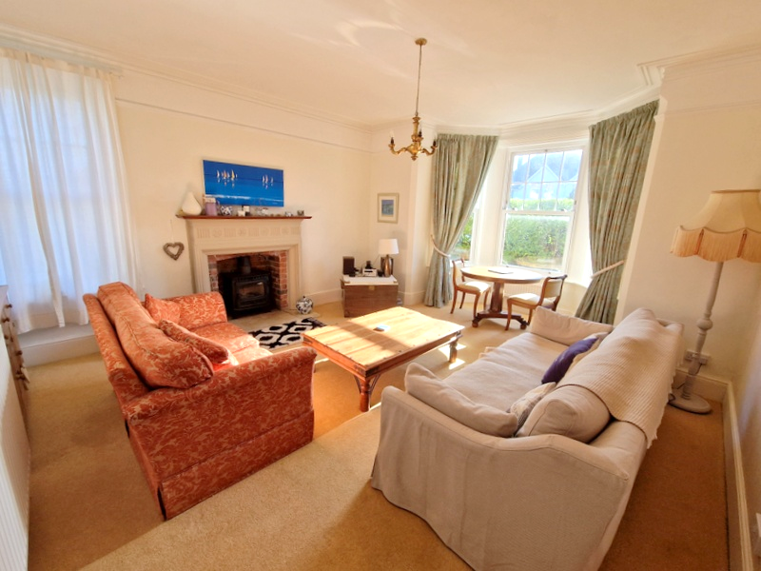
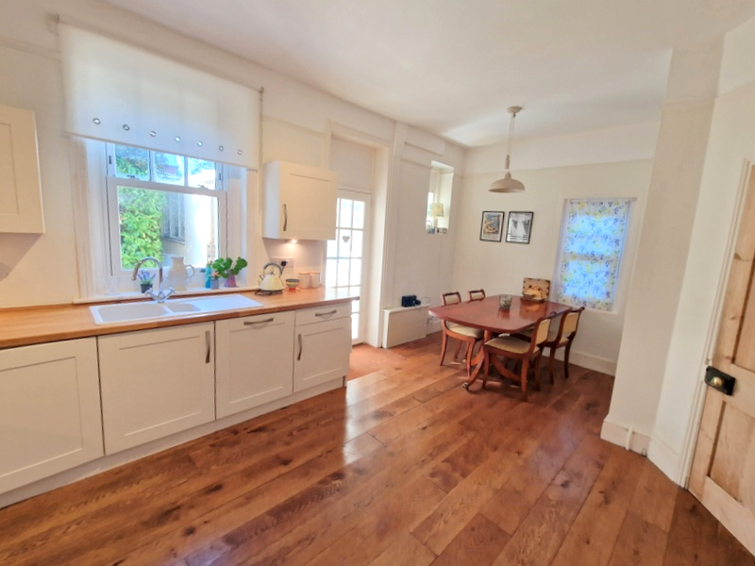
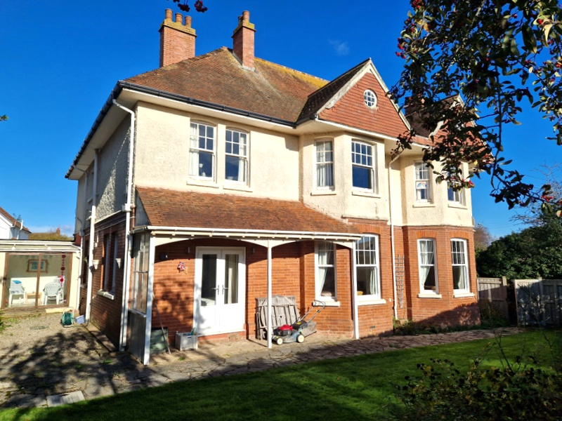
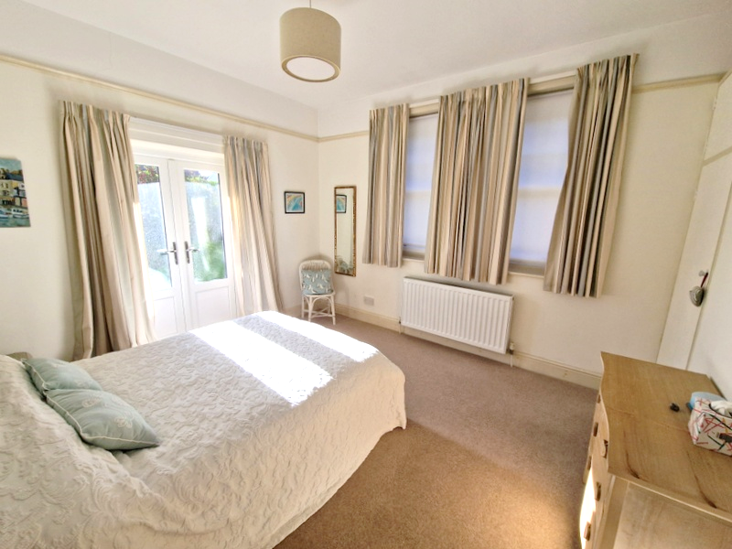
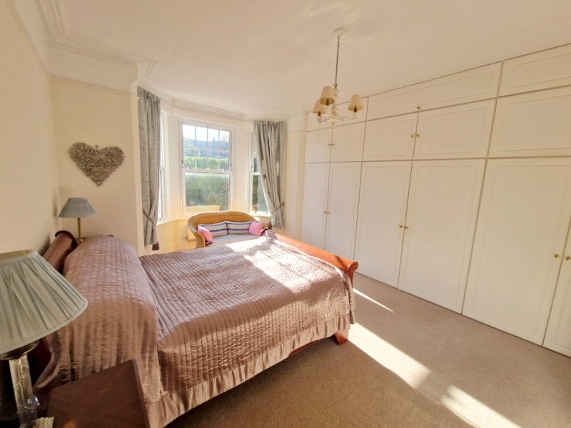
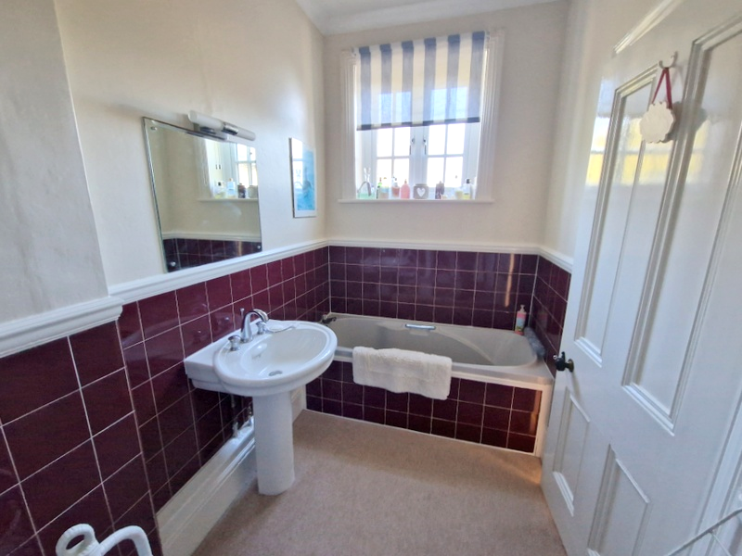
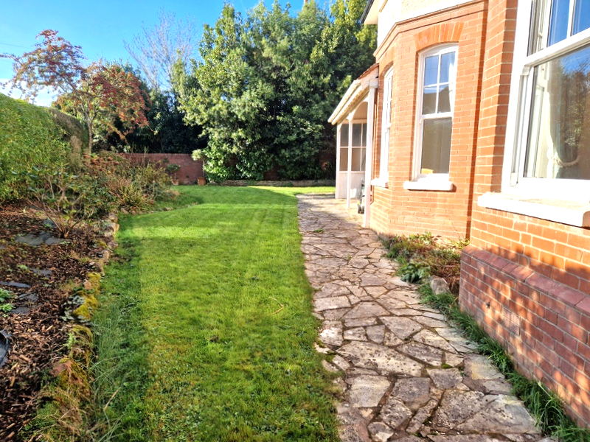
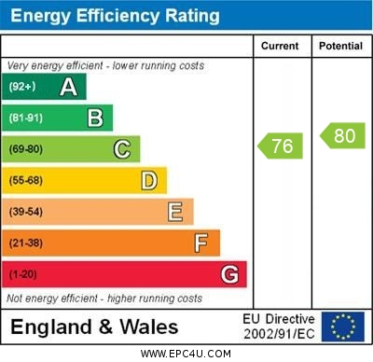
www.pennys.net
Ground Floor Flat, 45 Cranford Avenue, Exmouth, EX8 2QD
GUIDE PRICE £385,000
TENURE Leasehold
A Stunning Ground Floor Apartment Offering Spacious And Elegant Accommodation With Its Own Private Gardens, Garage And Workshop, Located In The Highly Desirable ‘Avenues’ Area Of Exmouth
Private Entrance * Lounge With Wood Burner Stove * Spacious Kitchen/Dining Room Garden Room * Two Double Bedrooms * Bath/Shower Room/Wc Cloakroom/Wc Gas Central Heating * Upvc Double Glazed Sash Style Windows * No Onward Chain Viewing Strongly Recommended
Pennys Estate Agents Limited for themselves and for the vendor of this property whose agents they are give notice that:- (1) These particulars do not constitute any part of an offer or a contract. (2) All statements contained in these particulars are made without responsibility on the part of Pennys Estate Agents Limited. (3) None of the statements contained in these particulars are to be relied upon as a statement or representation of fact. (4) Any intending purchaser must satisfy himself/herself by inspection or otherwise as to the correctness of each of the statements contained in these particulars. (5) The vendor does not make or give and neither do Pennys Estate Agents Limited nor any person in their employment has any authority to make or give any representation or warranty whatever in relation to this property.
PENNYS ESTATE AGENTS
2 Rolle House, Rolle Street, Exmouth, Devon, EX8 2SN
Tel: 01395 264111 EMail: help@pennys.net

Slide 2
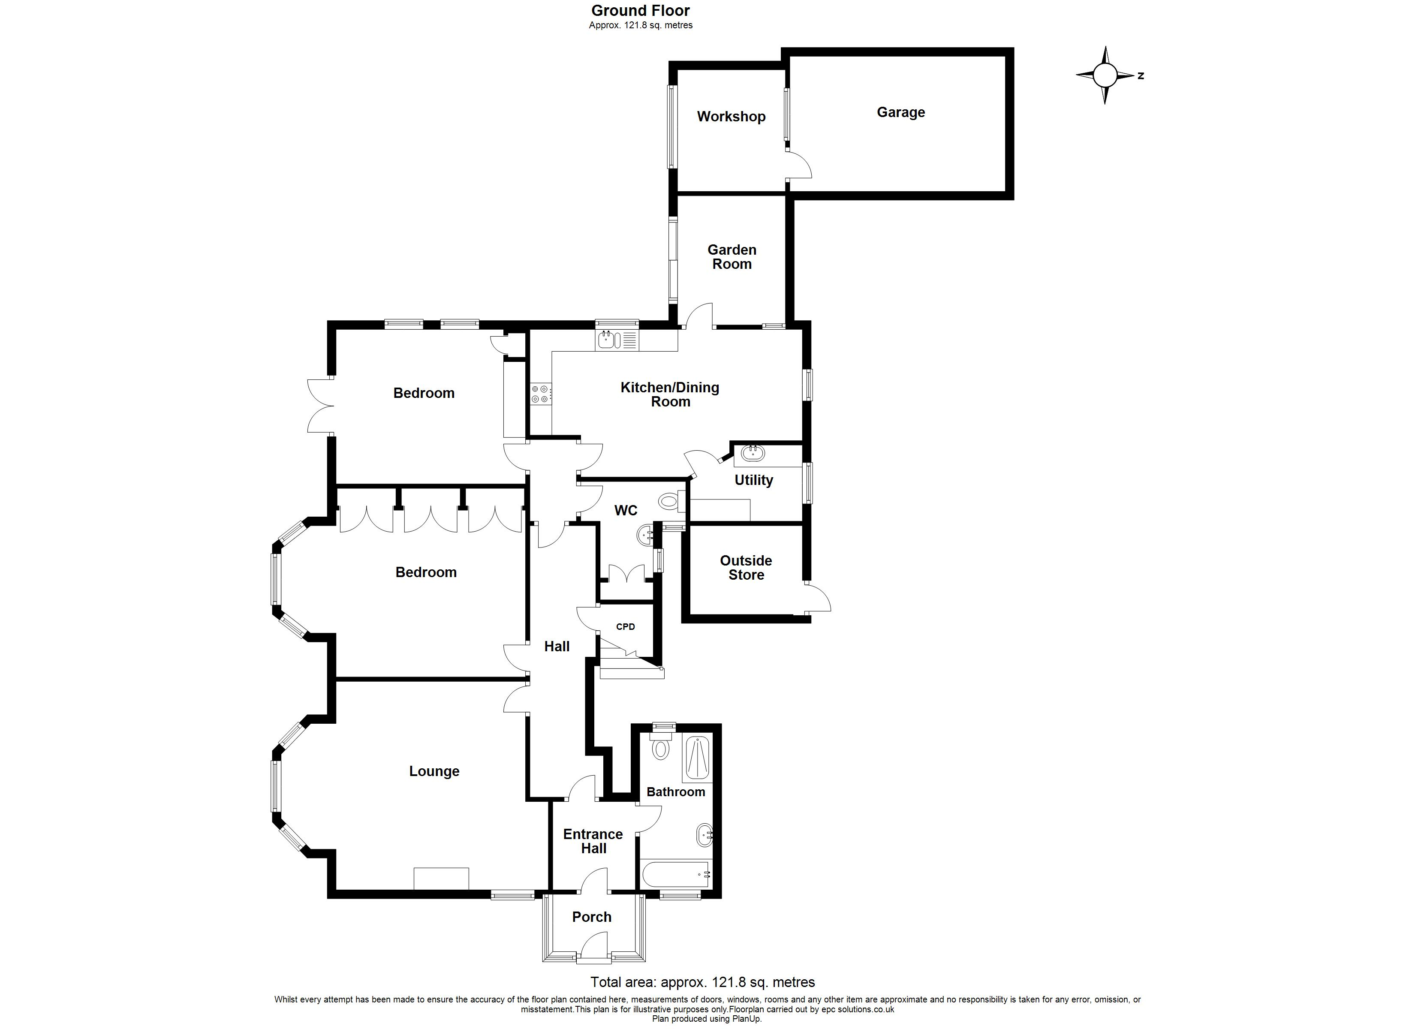
Ground Floor Flat, 45 Cranford Avenue, Exmouth, EX8 2QD
THE ACCOMMODATION COMPRISES: Private uPVC front door giving access to:
ENTRANCE VESTIBULE: Feature quarry tiled floor, solid wood inner door with frosted glass inset to:
ENTRANCE HALL: Cornice ceiling, radiator, inner solid wood part glazed door to:
RECEPTION HALL: Radiator, picture rail, cornice ceiling, access to storage cupboard.
LOUNGE: 5.97m x 4.57m (19'7" x 15'0") maximum measurement into wall recess and bay window fitted with three sets of uPVC sash style windows. A spacious and elegant dual aspect room with further uPVC double glazed sash style window to side aspect, attractive fire surround with exposed brick inset housing log burner stove standing on a stone hearth, two radiators, TV point, picture rail, cornice ceiling.
KITCHEN/DINING ROOM: 5.99m x 3.63m (19'8" x 11'11") narrowing to 2.54m (8'4") A spacious room comprising of solid wood worktops with inset one and a quarter bowl single drainer sink unit with chrome mixer tap, with cupboards, drawer units and integrated dishwasher and fridge beneath worktops, inset ceramic electric hob with built-in oven below, tiled surrounds, wall mounted cupboards with concealed lighting beneath, radiator, picture rail, two sets of uPVC sash style windows to rear and side aspects, solid wood flooring throughout, radiator.
UTILITY ROOM: 2.41m x 1.98m (7'11" x 6'6") Fitted with worktops with inset sink unit, fitted mirror with light over, cupboards and plumbing for automatic washing machine beneath, part tiled walls, wall mounted Vaillant gas boiler for hot water and central heating, wall mounted cupboards, uPVC double glazed windows.
From the kitchen/dining room a glazed panel door leads to:
GARDEN ROOM: 2.92m x 2.44m (9'7" x 8'0") Sliding double glazed patio doors opening onto the rear garden, power and light connected with door giving access to WORKSHOP and GARAGE.
WORKSHOP: 2.74m x 2.31m (9'0" x 7'7") Double glazed window, power connected.
BEDROOM 1: 5.46m x 3.61m (17'11" x 11'10") Superb main bedroom with measurement into uPVC double glazed bay window fitted with three sash style windows overlooking its own gardens, radiator, built-in range of wardrobes with clothes rail and shelf with storage cupboards over. Radiator, wall mounted dresser style unit, picture rail, cornice ceiling.
BEDROOM 2: 4.37m x 3.58m (14'4" x 11'9") Lovely size second bedroom with built-in single wardrobe, uPVC double glazed sash style windows overlooking the gardens, radiator, uPVC double glazed double doors opening onto the veranda and gardens.
BATH/SHOWER ROOM/WC: 3.61m x 1.65m (11'10" x 5'5") Comprising bath, pedestal wash hand basin, shower cubicle, WC with push button flush, radiator, tiling to splash prone areas, fitted mirror with light over, uPVC double glazed window with patterned glass, recessed ceiling spotlighting, coved ceiling/extractor fan.
CLOAKROOM/WC: Fitted with vanity wash hand basin with tiled splashback, WC with push button flush, shelved storage cupboard, radiator, two sets of windows with patterned glass, wood flooring, fitted wall shelving.
OUTSIDE: The property enjoys an impressive position in the sought after ‘Avenues’ area of Exmouth approached by a pedestrian gate and pathway leading to the front door with mature shrub beds. A wooden side gate gives access to the apartment’s own private gardens comprising of lawn edged with flower and shrub beds and veranda with outside lighting, decorative stone area with outside light and cold water tap. Single storey brick built shed with tiled roof.
GARAGE: 4.91m x 3.08m (16'1" x 10’1”) Up and over door, power and light connected.
TENURE: The property is held on a 999 year lease with 50% share of the maintenance on an ‘as and when’ basis.
Mortgage Assistance: We are pleased to recommend Meredith Morgan Taylor, who would be pleased to help no matter which estate agent you finally buy through. For a free initial chat please contact us on to arrange an appointment. Your home may be repossessed if you do not keep up repayments on your mortgage. Meredith Morgan Taylor Ltd is an appointed representative of The Openwork Partnership, a trading style of Openwork Ltd which is authorised and regulated by the Financial Conduct Authority (FCA).
FLOOR PLAN:

