Slide 1
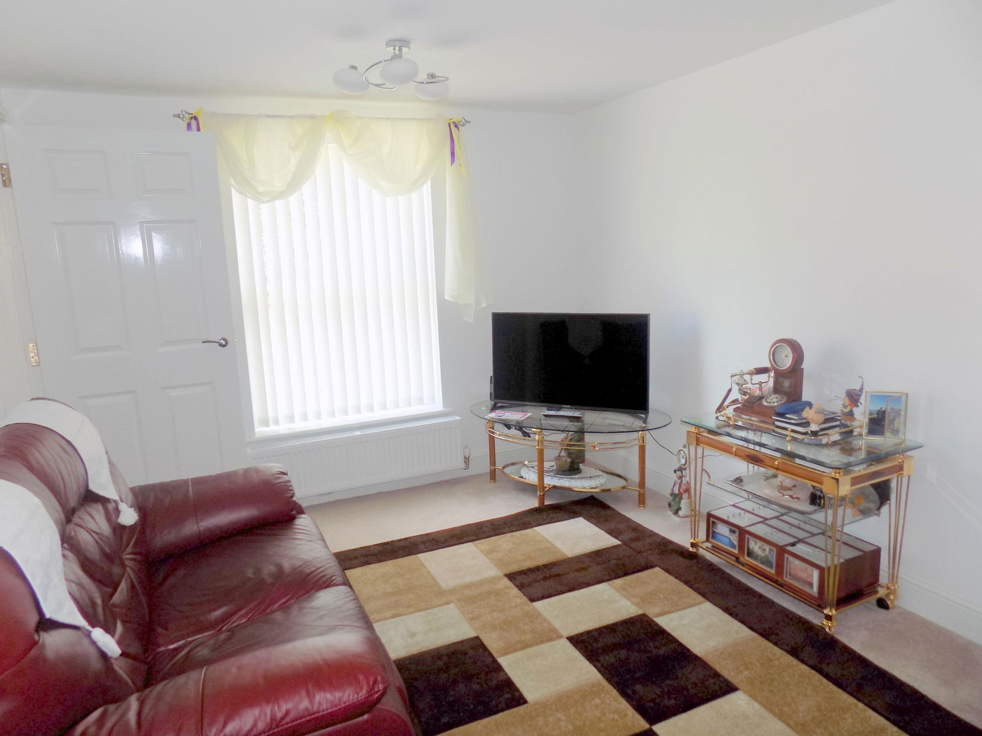
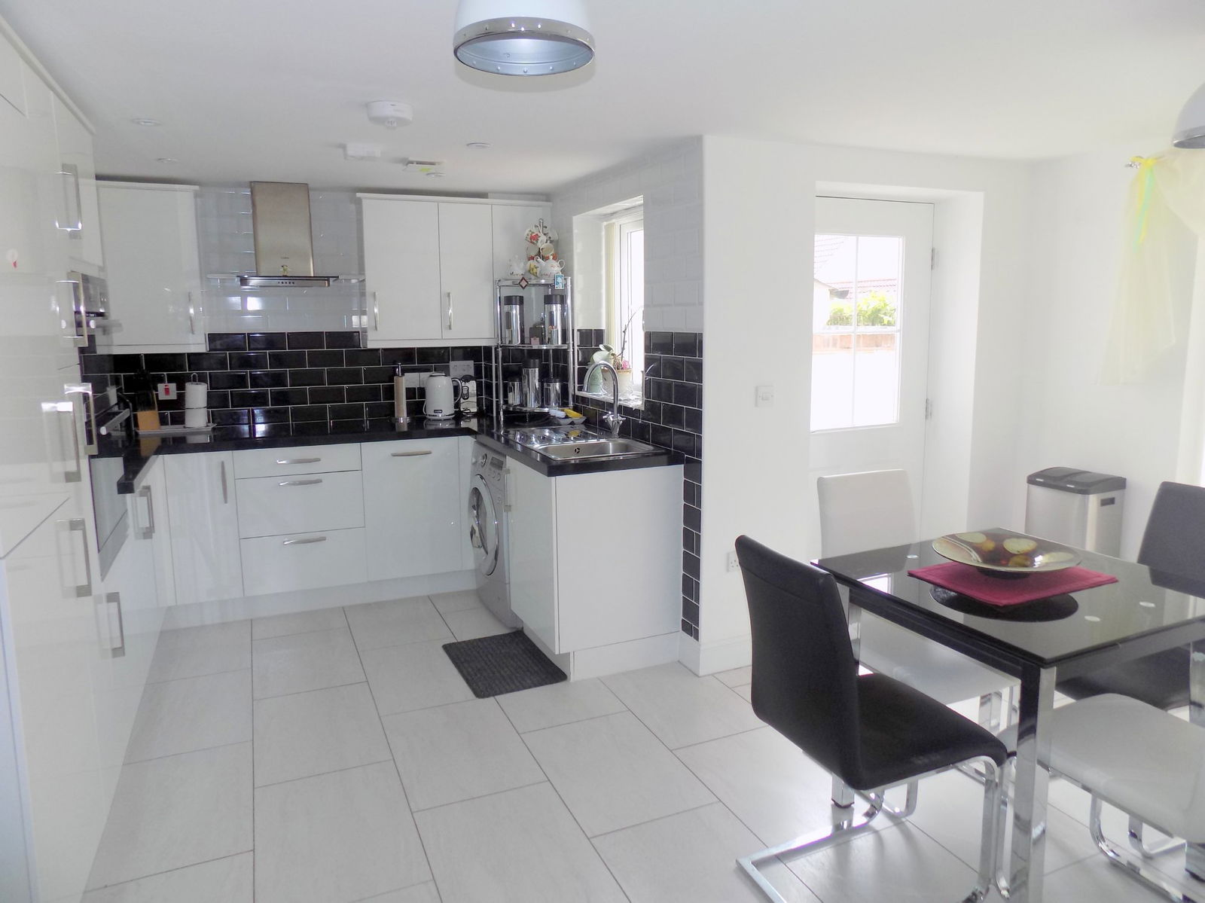
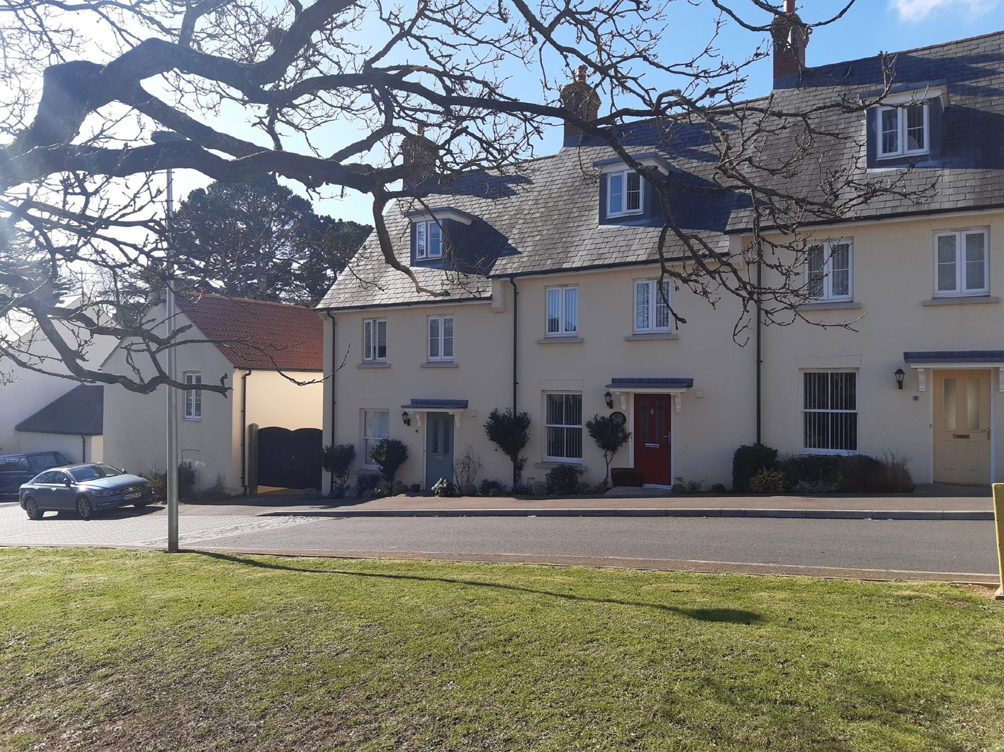
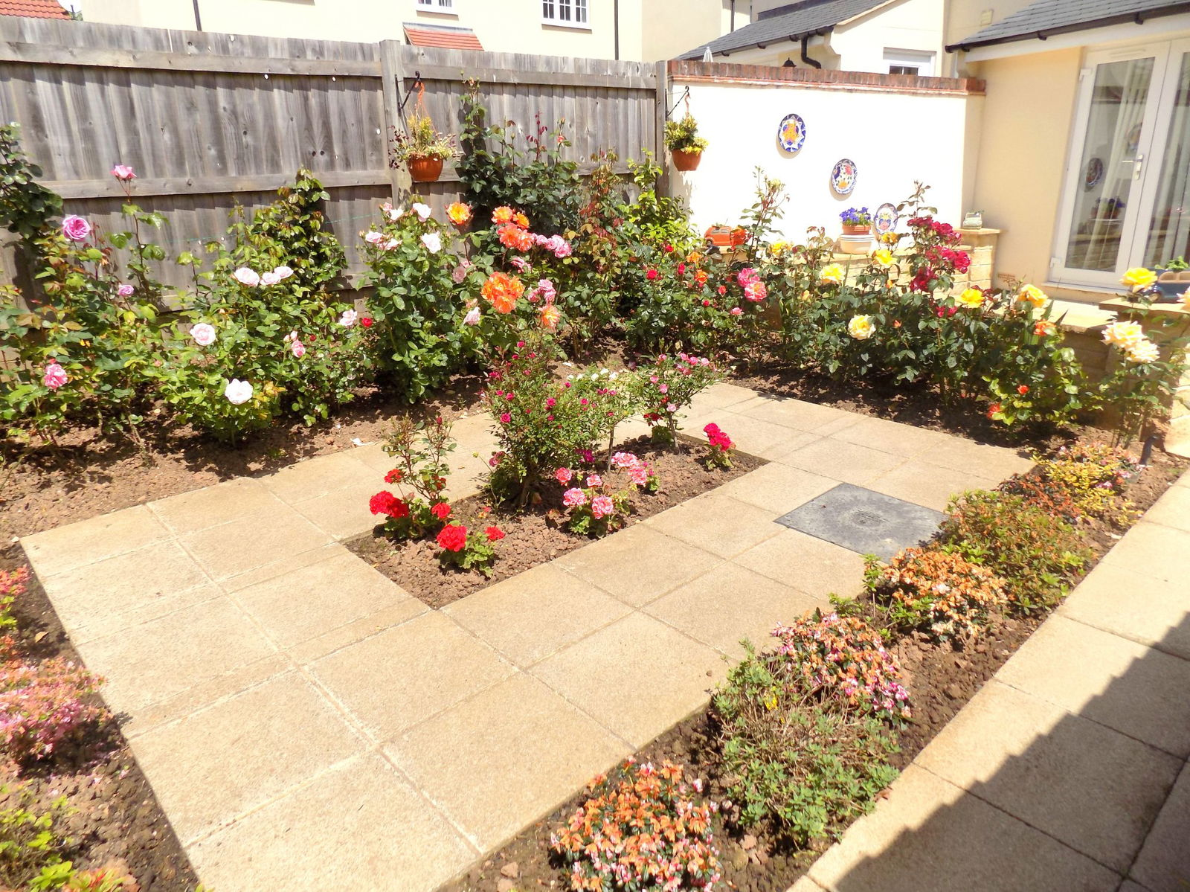
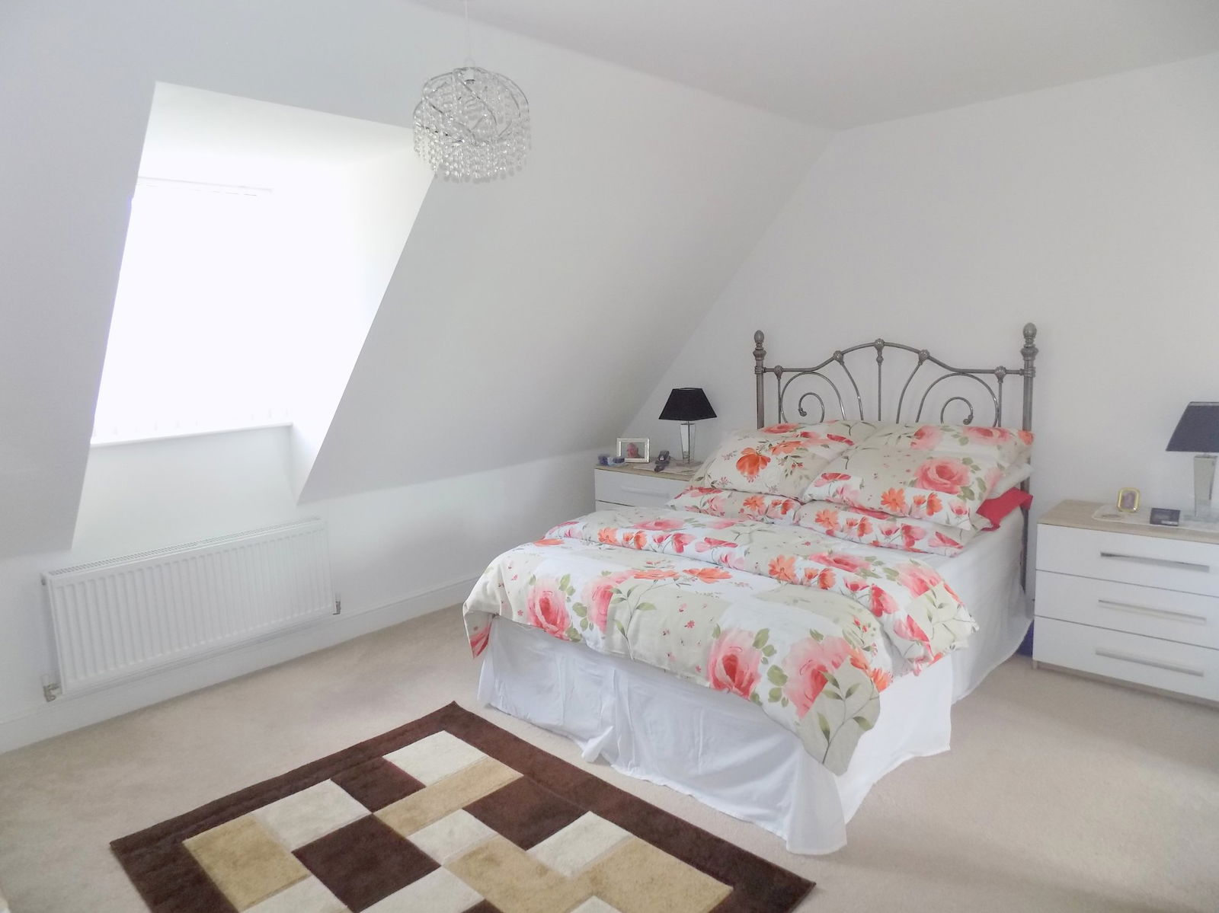
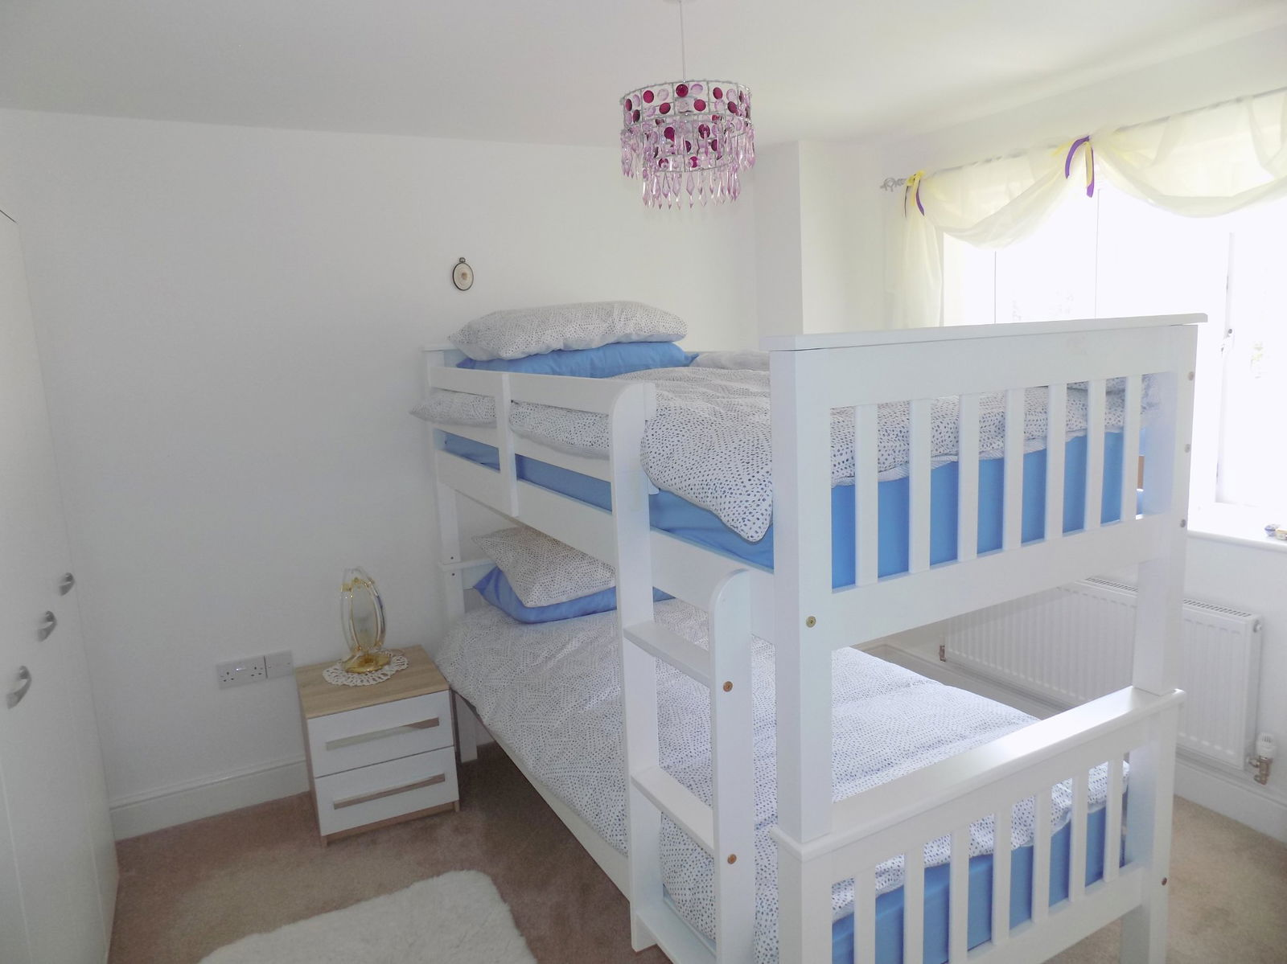
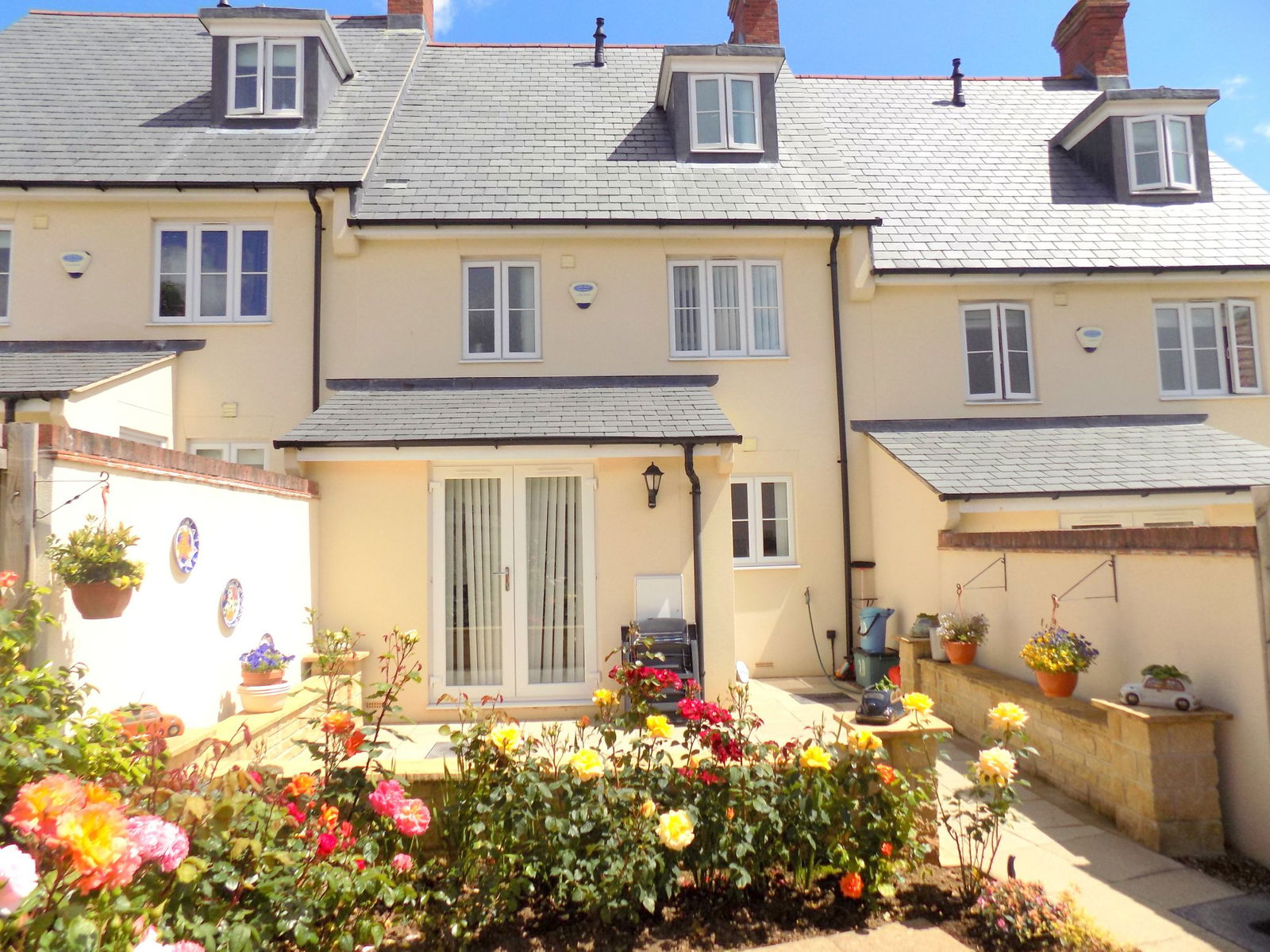
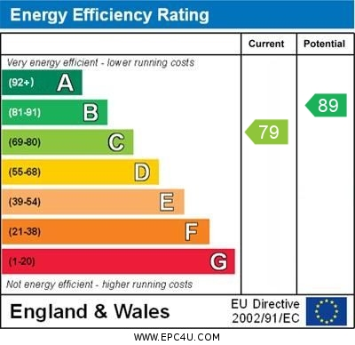
www.pennys.net
20 Hillcrest Gardens, Exmouth, EX8 4FE
GUIDE PRICE £399,950
TENURE Freehold
A Deceptively Spacious And Beautifully Presented Four Bedroom Town House Design Residence Located In A Modern Select Development Of Quality Homes
Attractive Lounge • Superb Open Plan Kitchen / Dining Room • Four Bedrooms Arranged Over The First & Second Floors •
Quality Bathroom Suite • En-Suite Spacious Shower Room Off Master Bedroom •
Gas Central Heating & Double Glazed Windows • Enclosed Attractive Rear Garden• Double Garage Plus Additional Enclosed Parking Space •
Viewing Strongly Recommended •
Pennys Estate Agents Limited for themselves and for the vendor of this property whose agents they are give notice that:- (1) These particulars do not constitute any part of an offer or a contract. (2) All statements contained in these particulars are made without responsibility on the part of Pennys Estate Agents Limited. (3) None of the statements contained in these particulars are to be relied upon as a statement or representation of fact. (4) Any intending purchaser must satisfy himself/herself by inspection or otherwise as to the correctness of each of the statements contained in these particulars. (5) The vendor does not make or give and neither do Pennys Estate Agents Limited nor any person in their employment has any authority to make or give any representation or warranty whatever in relation to this property.
PENNYS ESTATE AGENTS
2 Rolle House, Rolle Street, Exmouth, Devon, EX8 2SN
Tel: 01395 264111 EMail: help@pennys.net

Slide 2
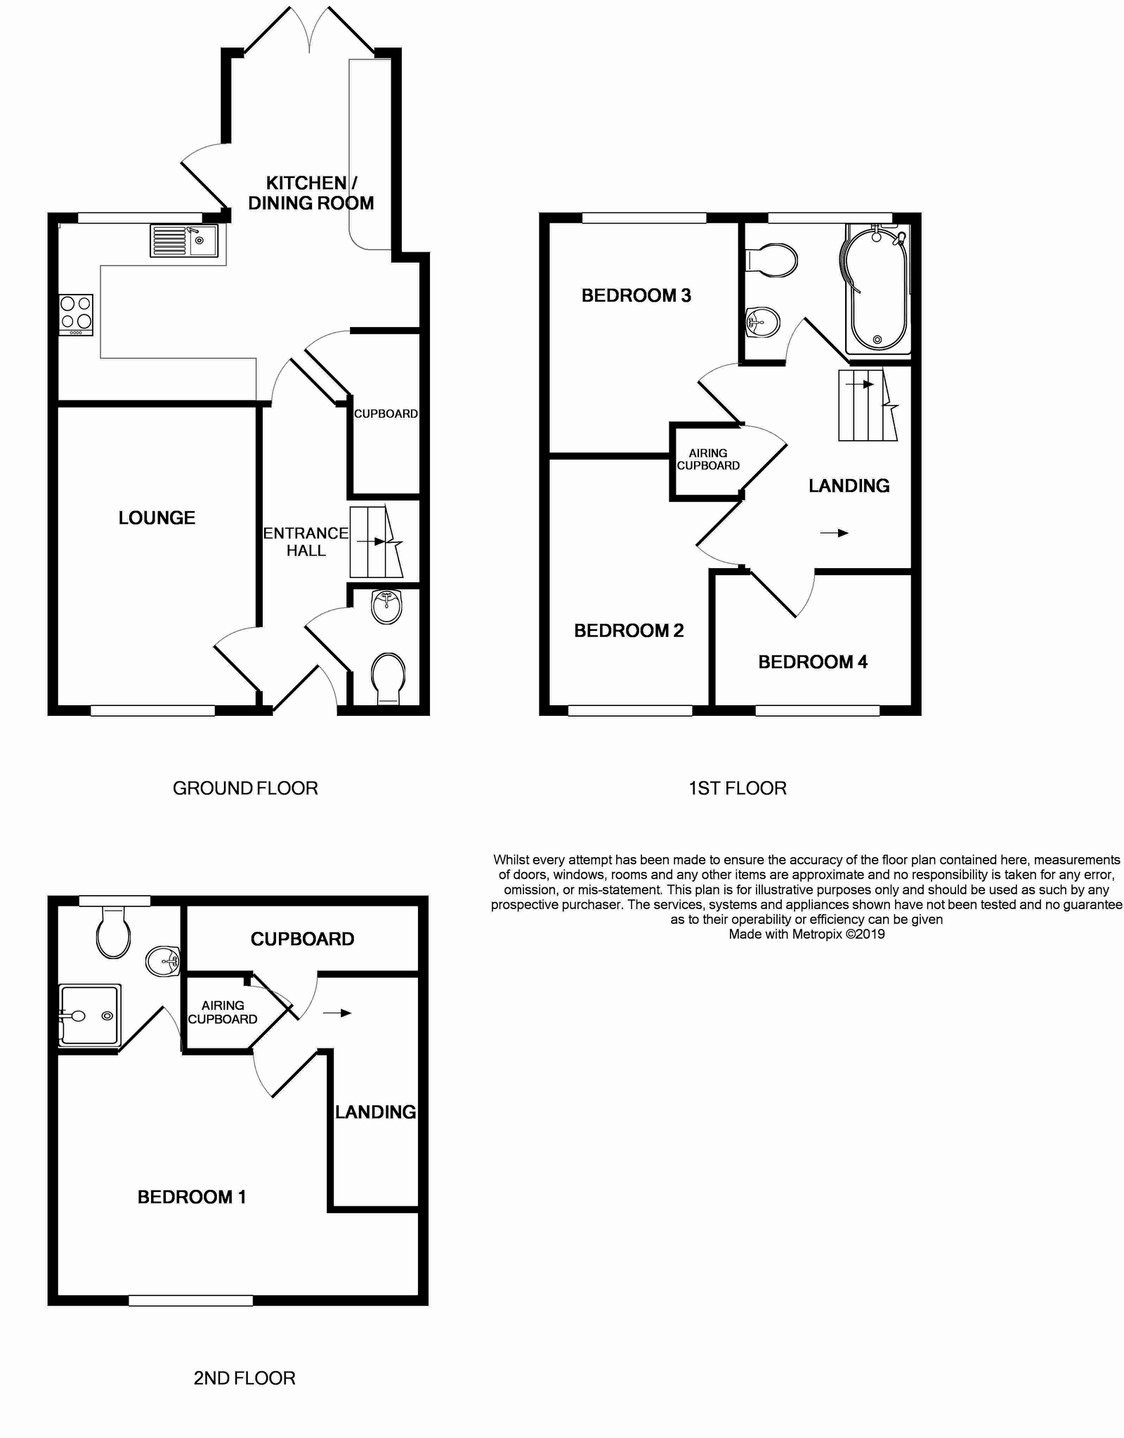
20 Hillcrest Gardens, Exmouth, EX8 4FE
THE ACCOMMODATION COMPRISES:
ENTRANCE CANOPY: With outside courtesy light; composite front door with patterned window inset giving access to the:
RECEPTION HALL: With stairs rising to the first floor; radiator; smoke alarm; thermostat and timer control for central heating.
GROUND FLOOR CLOAKROOM / WC: Comprising of a pedestal wash hand basin with chrome mixer tap and tiled splashback; WC with dual push button flush; radiator.
LOUNGE: 14' 3" (4.34m) x 9' 7" (2.92m) A cosy room with uPVC double glazed sash style window to front aspect; radiator; television point; telephone point.
KITCHEN / DINING ROOM: 17' 3" (5.26m) x 15' 4" (4.67m) narrowing in the kitchen area to 8' 8" (2.64m). A bright and spacious high quality room fitted with a range of composite and granite work top surfaces with tiled surrounds; inset four ring hob with drawer units beneath and stainless steel chimney style extractor hood over with light; inset single drainer sink unit with swan neck mixer tap over; range of cupboards, further drawer units, space and plumbing for washing machine beneath work surfaces; pull-out larder style cupboards; range of eye level cupboards incorporating some glass fronted units; integrated fridge, freezer and dishwasher; built-in double oven with cupboards above and below; recess ceiling spotlighting; understairs storage cupboard; smoke detector; telephone point; radiator; tiled flooring; uPVC double glazed window overlooking the rear garden; uPVC double glazed double doors opening onto the rear garden; further door giving access onto the rear garden.
FIRST FLOOR LANDING: With stairs rising to the second floor; smoke detector; airing cupboard with Megaflow water system and slatted shelf over; doors to:
BEDROOM TWO: 11' 10" (3.61m) x 8' 9" (2.67m) uPVC double glazed window to the front aspect enjoying a pleasant open outlook; wardrobe included within the sale; radiator; television point.
BEDROOM THREE: 11' 5" (3.48m) x 9' 1" (2.77m) plus door recess. uPVC double glazed window to rear aspect; television point; telephone point.
BEDROOM FOUR: uPVC double glazed window to front aspect enjoying a pleasant open outlook; radiator.
FAMILY BATHROOM / WC: Comprising of a bath with shower unit over and curved shower splash screen; pedestal wash hand basin with chrome mixer tap; WC with dual pushbutton flush; mirror fronted medicine cabinet; light / shaver socket; attractive tiling to splash prone areas; uPVC double glazed window with patterned glass.
SECOND FLOOR LANDING: With smoke detector; access to walk-in wardrobe; linen cupboard housing the Baxi gas fired boiler providing domestic hot water and central heating.
MASTER BEDROOM ONE: 13' 9" (4.19m) x 11' 7" (3.53m) plus wall recess A fine spacious master bedroom with dormer style uPVC double glazed window to front aspect enjoying a pleasant open outlook; radiator; television point; thermostat control for central heating.
EN-SUITE SHOWER ROOM / WC: A good size en-suite comprising of a tiled shower cubicle with shower unit and sliding shower splash screen doors; pedestal wash hand basin with chrome mixer tap, tiled splash back and wall mounted mirror fronted medicine cabinet over; WC with push button flush; radiator; light / shaver socket; extractor fan; uPVC double glazed dormer style window with patterned glass.
OUTSIDE: To the front of the property there is a small garden enclosure. The REAR GARDEN offers an array of colour from rose and shrub beds, is planned with ease of maintenance in mind and comprises of patio areas ideal for al-fresco dining. Outside lighting and outside cold water tap. The garden is fully enclosed and enjoys a high degree of privacy and seclusion. From the garden there is a patio pathway with a few steps leading to an enclosed parking area with double wooden gates giving vehicular access, adjoining this and also accessed from the parking area via a pedestrian door is a double garage.
DOUBLE GARAGE: 19' 8" (5.99m) x 19' 3" (5.87m) With two up and over doors; power and light connected. (The garage is held on a 999 year lease).
FLOOR PLAN:

