Slide 1
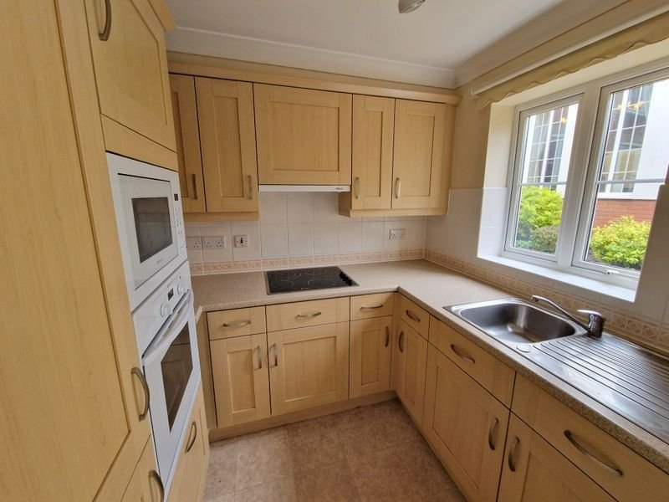
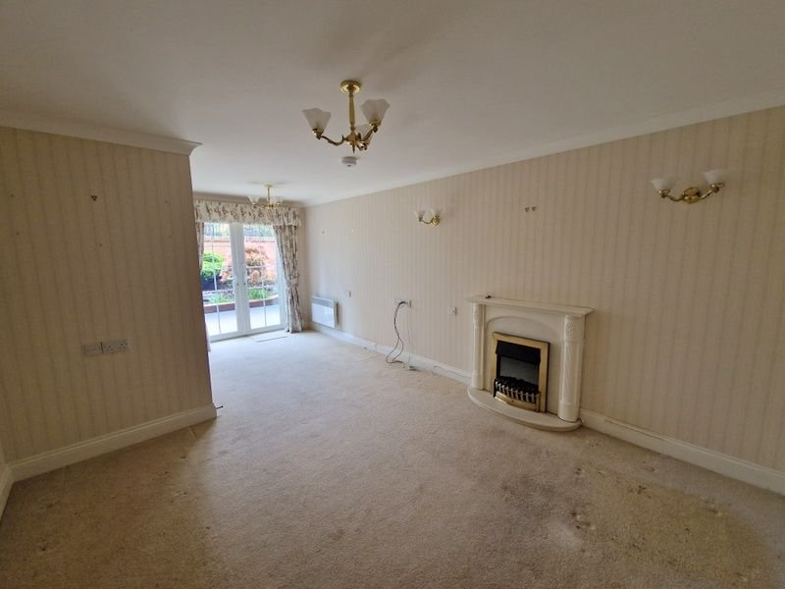
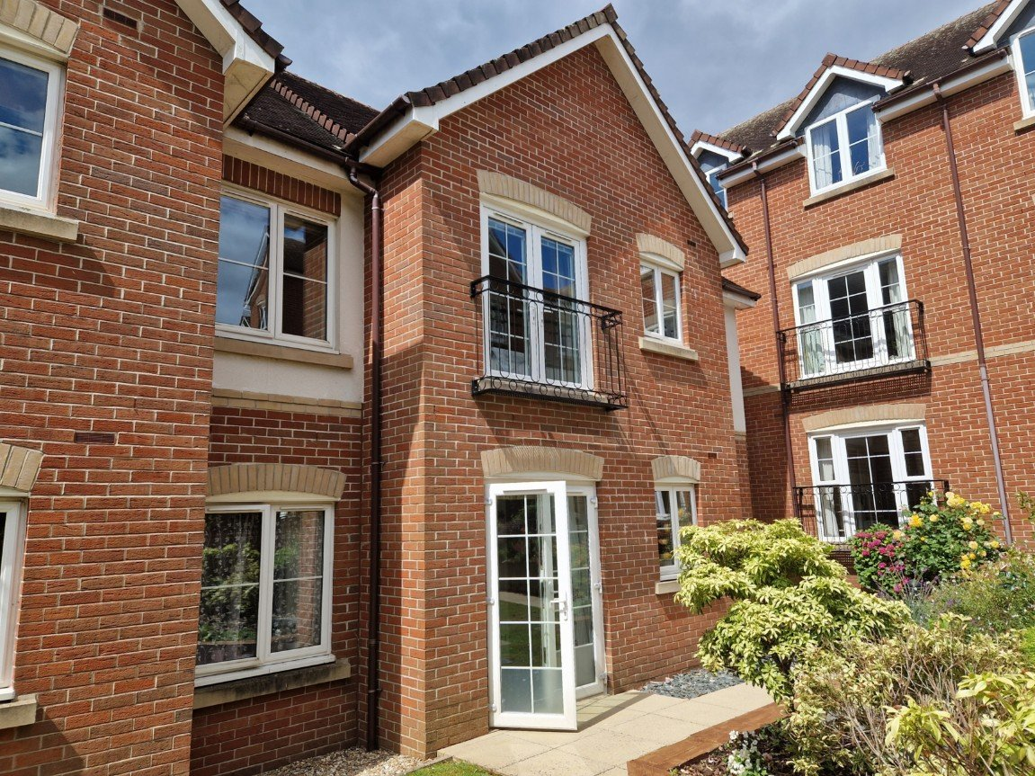
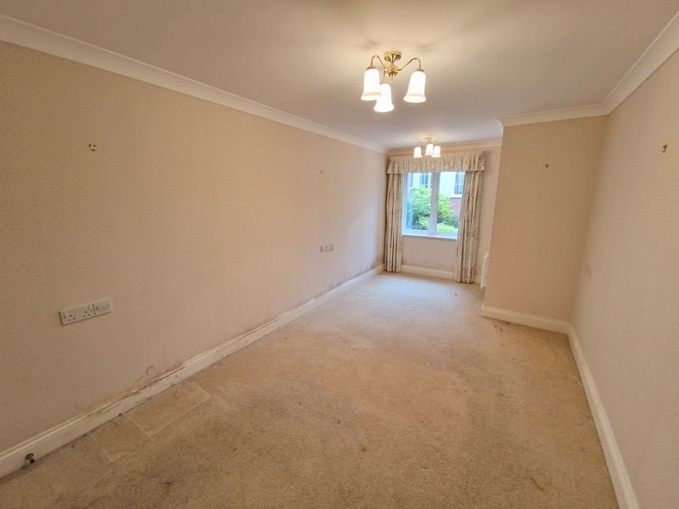
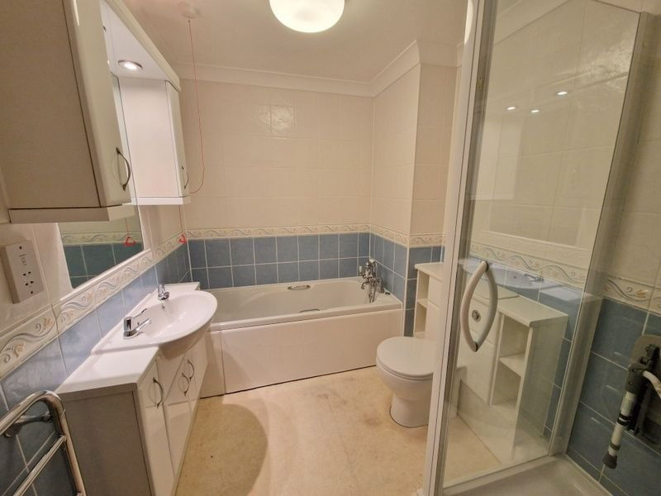
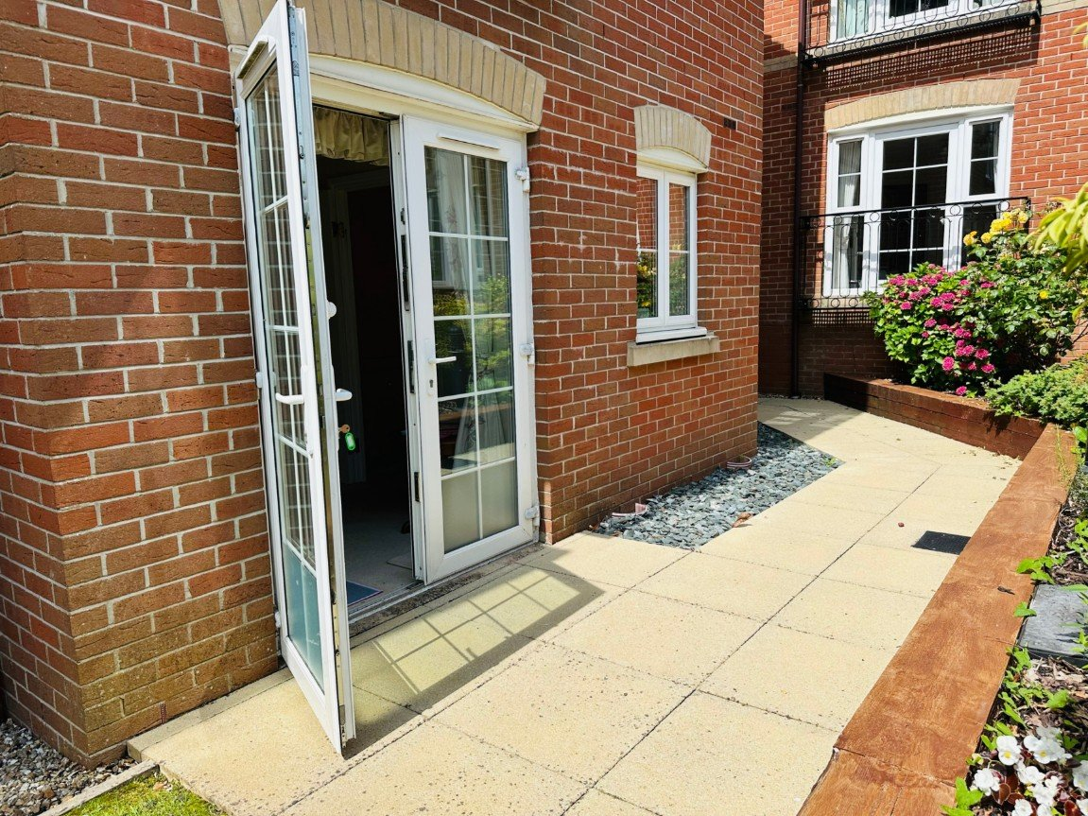
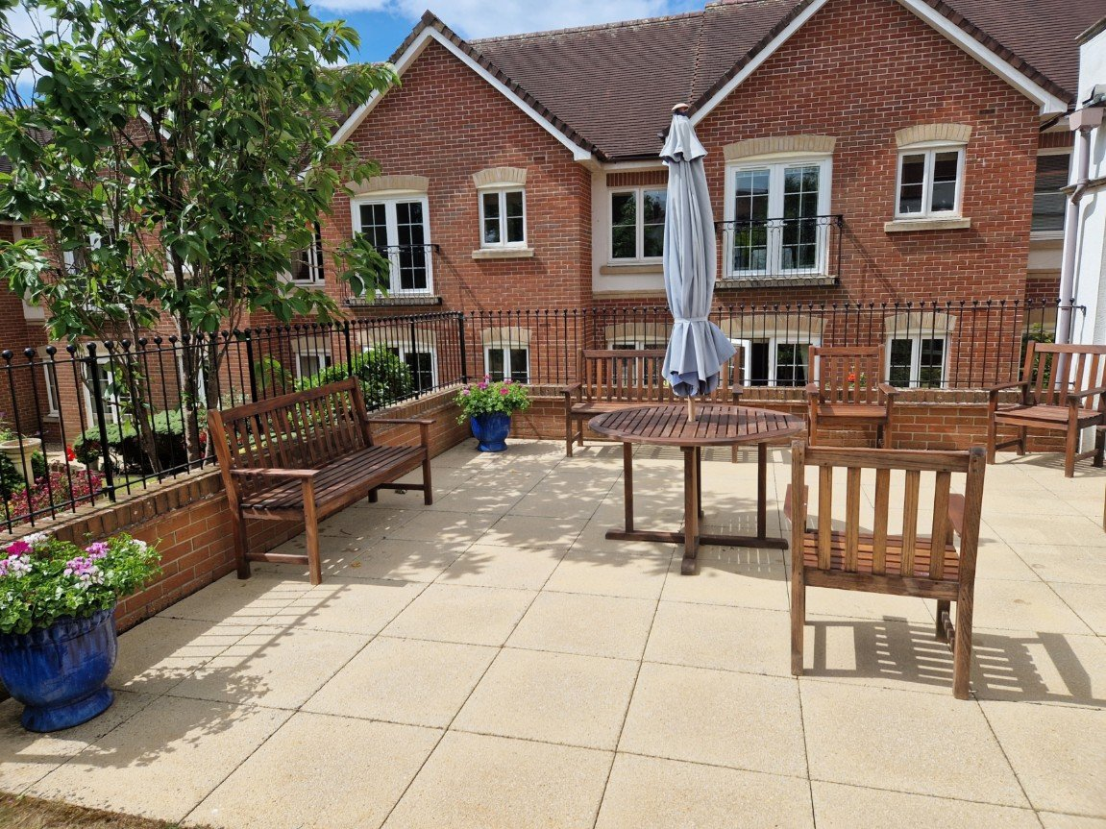
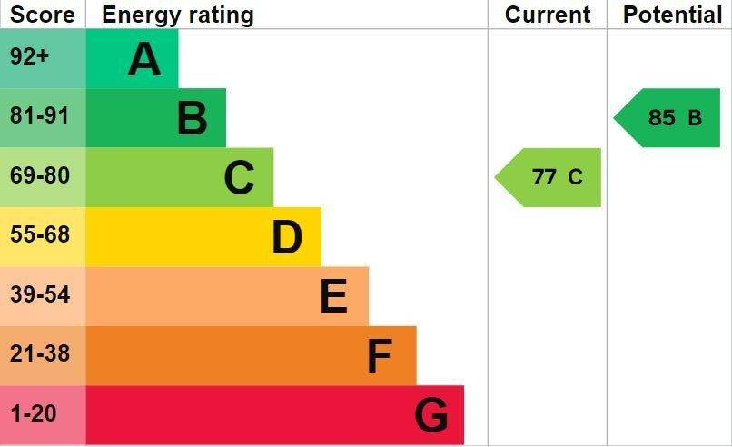
www.pennys.net
6 Pegasus Court, 88 Salterton Road, Exmouth, Devon, EX8 2NN
PRICE £120,000
TENURE Leasehold
A Ground Floor One Bedroom Retirement Apartment Ideally Located To The Rear Of This High Quality Development
Reception Hall • Lounge/Dining Room •
Well Appointed Kitchen • Double Bedroom With Built-In Wardrobes • Bathroom/Shower Room/WC • Excellent Communal Facilities • House Manager •
Secure Parking • No Onward Chain •
Pennys Estate Agents Limited for themselves and for the vendor of this property whose agents they are give notice that:- (1) These particulars do not constitute any part of an offer or a contract. (2) All statements contained in these particulars are made without responsibility on the part of Pennys Estate Agents Limited. (3) None of the statements contained in these particulars are to be relied upon as a statement or representation of fact. (4) Any intending purchaser must satisfy himself/herself by inspection or otherwise as to the correctness of each of the statements contained in these particulars. (5) The vendor does not make or give and neither do Pennys Estate Agents Limited nor any person in their employment has any authority to make or give any representation or warranty whatever in relation to this property.
PENNYS ESTATE AGENTS
2 Rolle House, Rolle Street, Exmouth, Devon, EX8 2SN
Tel: 01395 264111 EMail: help@pennys.net

Slide 2
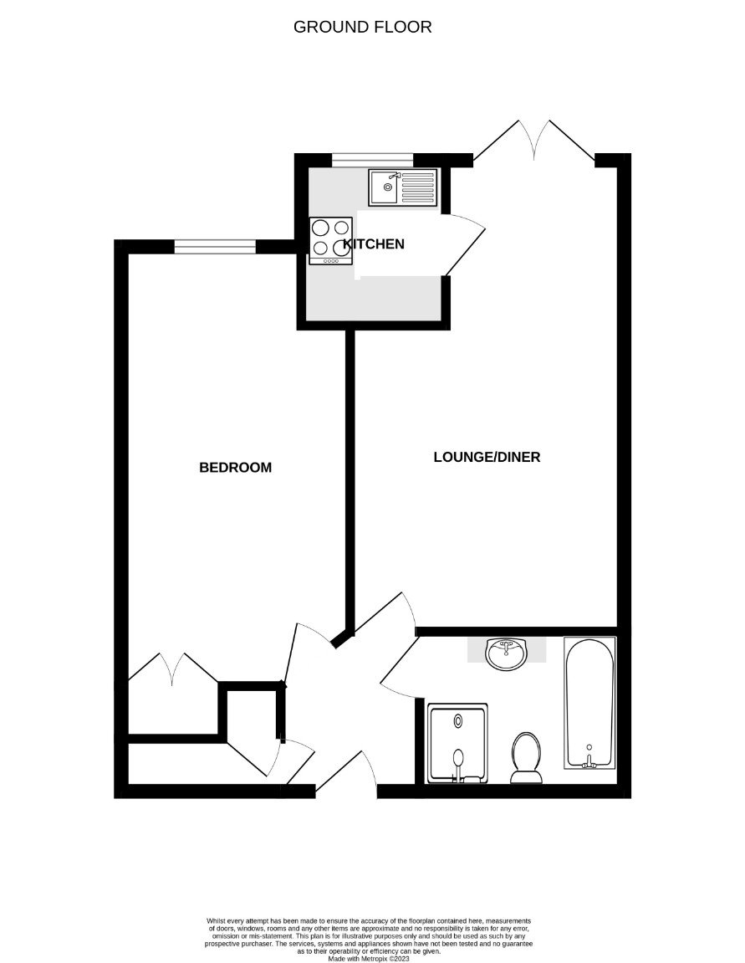
6 Pegasus Court, 88 Salterton Road, Exmouth, EX8 2NN
Pegasus Court is a modern retirement development built with quality and elegance immediately evident. The attention to detail in communal areas as well as the apartment itself is worthy of special note. The kitchen is a superb feature of the property being fully equipped, well planned and designed. A clever carousel unit in the kitchen makes the most of the space, while the modern oven, hob, microwave and fridge/freezer are all built in. The taps in the kitchen and the fitted bathroom are easy to operate and hot water is available on demand from the economic heating system. In each room sockets are placed at waist height for greater convenience, and should assistance ever be needed, there are unobtrusive Careline units which can bring immediate response, coupled with the House Manager available from approximately 9am to 5pm, Monday to Friday. The parking area is accessed via electronic gates. The communal areas are worthy of special note with a most attractive communal lounge, spacious laundry room, quality visitor suite, library and superb communal gardens. There is an age restriction on the development, and residents must be aged 60 years or over.
THE ACCOMMODATION COMPRISES: Communal secure entrance with door entry intercom system. The apartment is located on the ground floor and accessed via its own private front door with spy hole giving access to:
RECEPTION HALL: Door entry intercom with emergency care line cord; walk-in airing cupboard housing water cylinder with coat rack and light connected; door giving access to further cupboard area with electric meter, consumer unit and slatted shelving.
LOUNGE/DINING ROOM: - 5.84m x 3.38m (19'2" x 11'1") narrowing to 2.18m (7'2"). Double glazed double doors opening onto a PATIO SUN TERRACE with communal gardens beyond; electric coal effect fire housed in fire surround; television point; telephone point; wall mounted electric heater; glazed panelled door leading to:
KITCHEN: - 2.31m x 1.96m (7'7" x 6'5") A well appointed kitchen fitted with range of patterned work top surfaces with tiled surrounds; inset single drainer sink unit with mixer; inset four ring hob with extractor hood over; bade cupboards and drawer units; integrated fridge and freezer; built-in oven and microwave with cupboards above and below; wall mounted cupboards; double glazed window to rear aspect.
DOUBLE BEDROOM: - 5.46m x 2.79m (17'11" x 9'2") narrowing to 1.93m (6'4"). A spacious bedroom with double glazed window to rear aspect; built-in wardrobe with clothes rail and shelving; wall mounted electric heater; telephone point; television point.
BATHROOM/SHOWER ROOM/WC: - 2.49m x 1.98m (8'2" x 6'6") Comprising of a bath with shower attachment; wash hand basin set in display surface with cabinet beneath, fitted mirror with cupboards and display lighting over; WC; shower cubicle with shower unit, hand rail and seat; fully tiled walls; ceiling extractor fan; emergency care line cord; heated towel rail; wall moulted electric heater.
OUTSIDE: The property enjoys superb communal landscaped gardens to the rear of the building offering an array of colour with a gazebo, various seating areas and raised patio sun terrace. There is also a secure parking area with parking spaces subject to availability. TENURE AND OUTGOINGS: We understand that the property is held on 125 year lease from 2008. Service charges to be confirmed.
FLOOR PLAN:

