Slide 1
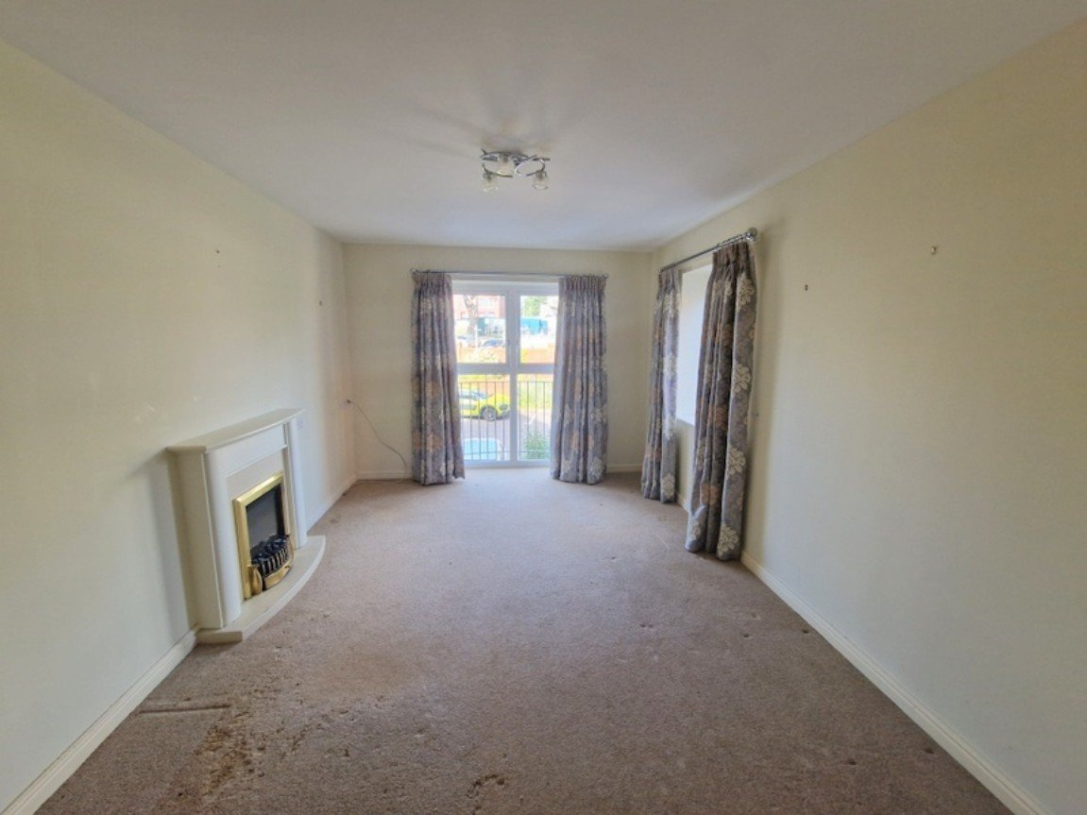
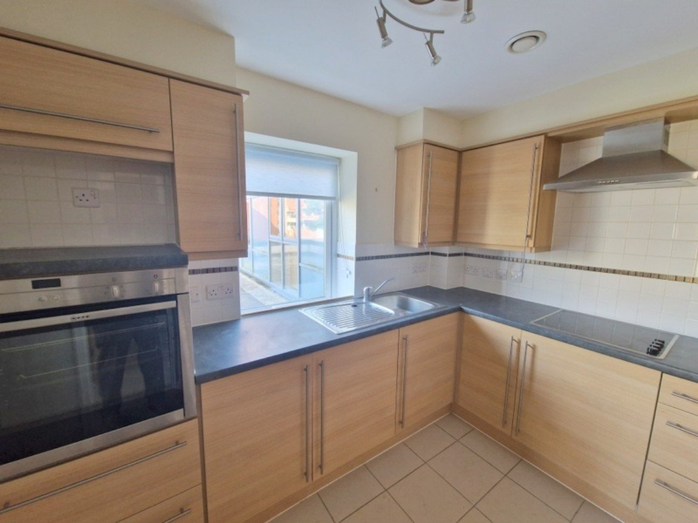
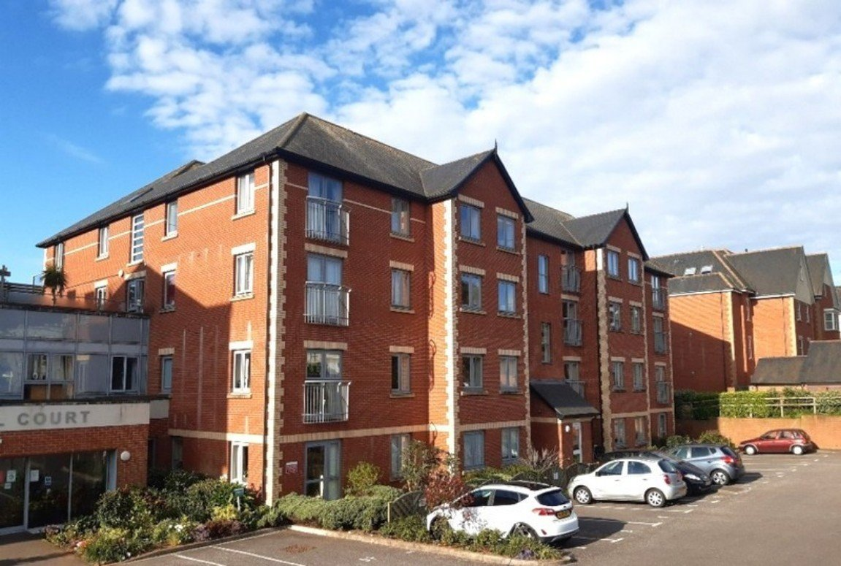
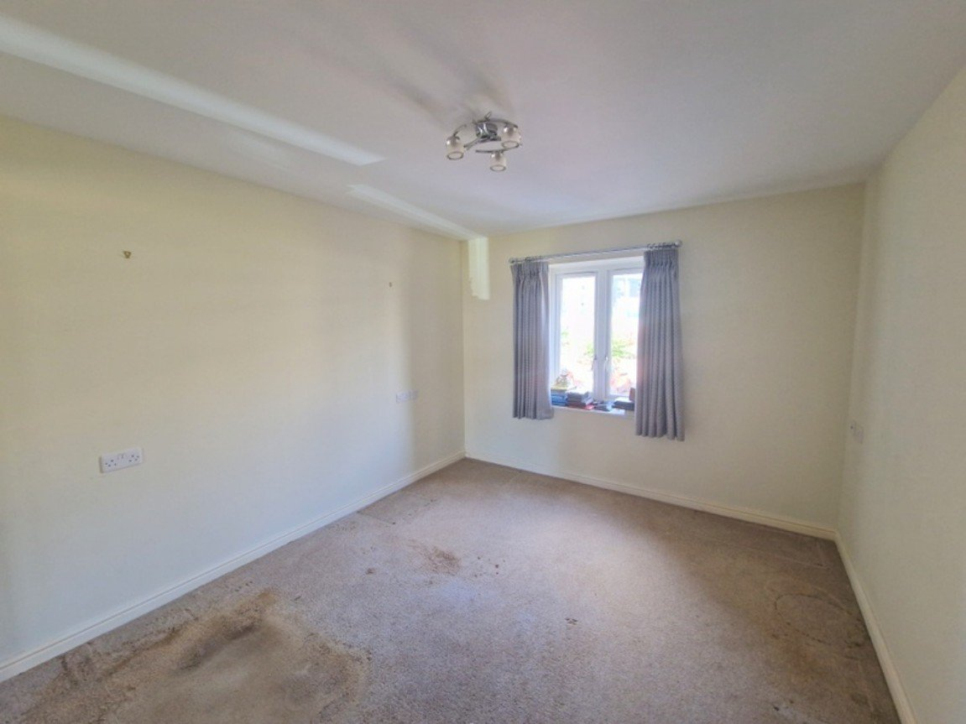
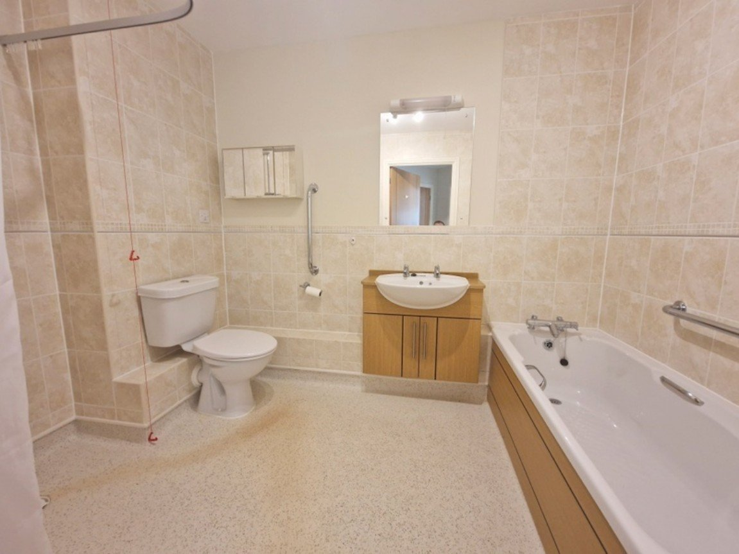
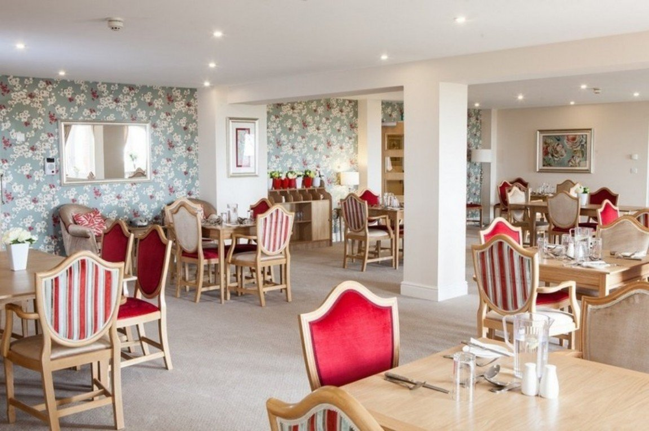
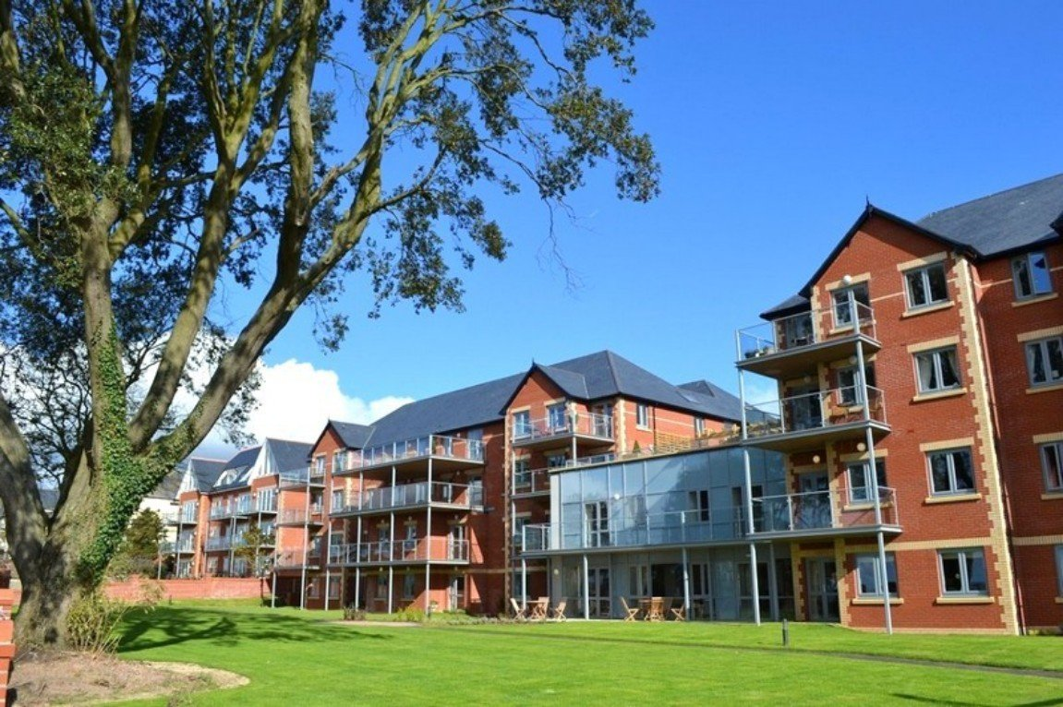
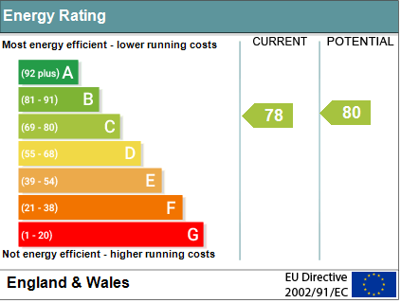
www.pennys.net
16 Roswell Court, Douglas Avenue, Exmouth, EX8 2FA
PRICE £140,000
TENURE Leasehold
A Superb McCarthy & Stone Living Plus Purpose Built One Bedroom Apartment Situated On The First Floor Of This Sought After Development Located In A Highly Desirable Area Close To Exmouth Town Centre And Sea Front
Bright & Spacious Accommodation • Reception Hall • Dual Aspect Lounge/Dining Area • Well Appointed Kitchen • Double Bedroom With Built-In Wardrobes • Spacious Bath/Wet Room/WC • Under Floor Heating • Double Glazed Windows • Excellent Communal Facilities • Secure Parking With Spaces Subject To Availability •
Pennys Estate Agents Limited for themselves and for the vendor of this property whose agents they are give notice that:- (1) These particulars do not constitute any part of an offer or a contract. (2) All statements contained in these particulars are made without responsibility on the part of Pennys Estate Agents Limited. (3) None of the statements contained in these particulars are to be relied upon as a statement or representation of fact. (4) Any intending purchaser must satisfy himself/herself by inspection or otherwise as to the correctness of each of the statements contained in these particulars. (5) The vendor does not make or give and neither do Pennys Estate Agents Limited nor any person in their employment has any authority to make or give any representation or warranty whatever in relation to this property.
PENNYS ESTATE AGENTS
2 Rolle House, Rolle Street, Exmouth, Devon, EX8 2SN
Tel: 01395 264111 EMail: help@pennys.net

Slide 2
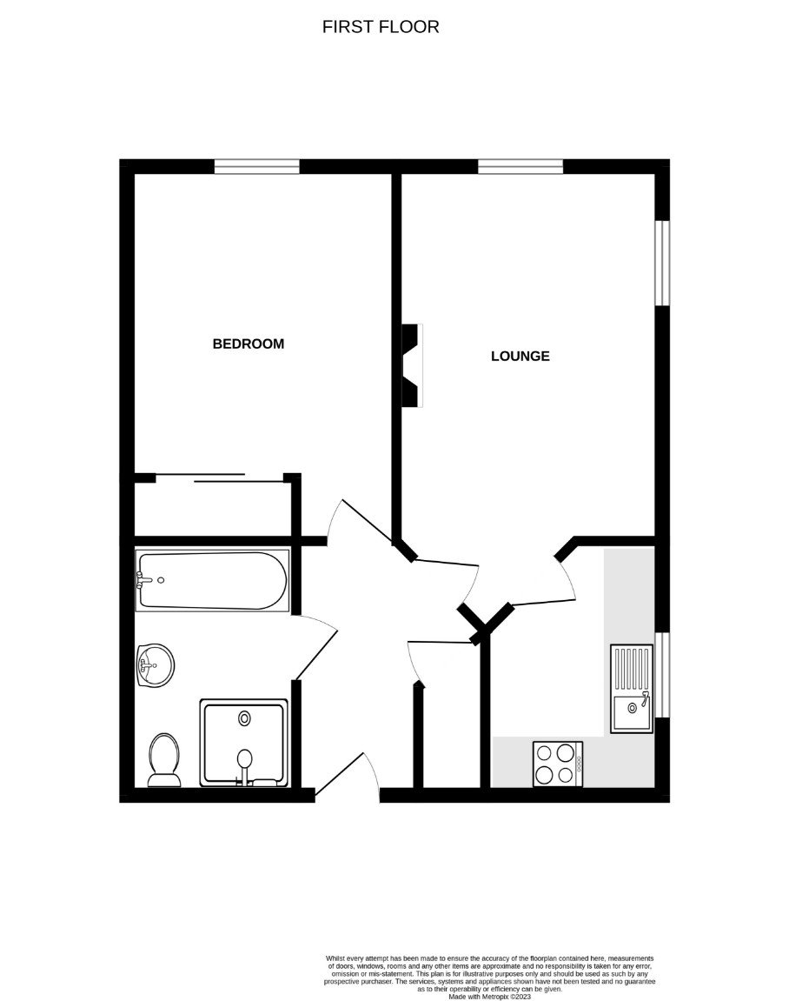
16 Roswell Court, Douglas Avenue, Exmouth, EX8 2FA
Constructed in 2013 by multi award-winning McCarthy & Stone, Roswell Court occupies an envious position with expansive sea views and provides a fantastic lifestyle living opportunity for the over 70's. A 'Retirement Living Plus' development designed for independent living with peace of mind provided by caring day-to-day support from excellent staff and an Estate Manager who oversees the smooth running of the development. Door entry security entry system to the main front door. Communal hallway and lifts giving access to all floors. Homeowners benefit from one hour of domestic assistance each week. In addition to this there are extensive domestic and care packages available to suit individual needs and budgets. All apartments are equipped with a 24-hour emergency call facility to on site staff and sophisticated intercom system providing both a visual and verbal link to the main development entrance. There is also a guest suite widely used by visiting family and friends for which a small charge per night applies. COMMUNAL FACILITIES: The development features excellent communal facilities which include a homeowner lounge, restaurant with a delicious, varied, daily table service lunch, laundry room, mobility scooter store, landscaped gardens with views to the coast. The fabulous roof terrace with furniture, planting and seating proves a very popular meeting point in favourable weather from which panoramic views in company of neighbours are enjoyed. A well maintained path leads from the development down to Exmouth cricket ground and beach. An Estate Manager, a domestic team (1 hour included in service charge, additional hours by arrangement), full wheelchair accessibility, personal care packages available from the on-site CQC registered care agency, guest suite, function room with computer and four lifts. Car parking available on site to resident permit holders also visitors parking and spaces available. THE ACCOMMODATION COMPRISES: This apartment is located on the FIRST FLOOR. Accessed via own private front door with letterbox and spy hole giving access to: RECEPTION HALL: Door entry intercom with emergency care line cord; coved ceiling; good size airing/storage cupboard with light connected, slatted shelving and housing water cylinder, electric meter and consumer unit. LOUNGE/DINING ROOM: 5.36m x 3.12m (17'7" x 10'3") narrowing to 2.31m (7'7") in the dining area. A bright and spacious dual aspect room with uPVC double glazed windows to front and side aspects; feature fire surround housing electric living flame effect fire; television point; telephone point; coved ceiling; thermostat control for under-floor heating. KITCHEN: 2.97m x 2.08m (9'9" x 6'10") A well appointed kitchen fitted with a range of patterned work top surfaces with tiled surrounds; inset single drainer sink unit with chrome mixer tap; range of base cupboards, drawer units, space and plumbing for dishwasher beneath work tops; inset four ring halogen hob with stainless steel extractor hood over with light; built-in oven with display surface over and drawer units beneath; integrated fridge and freezer; matching wall mounted cupboards with concealed lighting under; tiled flooring with under-floor heating; thermostat control; uPVC double glazed window to side aspect. BEDROOM: 4.42m x 2.08m (14'6" x 6'10") narrowing to 2.36m (7'9") With uPVC double glazed window to front aspect; built-in mirror-fronted double wardrobe with clothes rail and shelf; television point; telephone point; coved ceiling; thermostat control for under-floor heating.
BATH/WET ROOM/WC: A spacious room comprising of a bath with hand rail; wash hand basin set in display surface with cupboard beneath and fitted mirror with light/shaver socket over; shower area fitted with chrome shower unit, shower curtain and rail; WC with push button flush; attractive extensively tiled walls; ceiling extractor fan; chrome electric heated towel rail; under-floor heating. TENURE AND OUTGOINGS: We understand that the property is held on a 125 year lease from June 2012. The annual service charge we understand is currently £10,892.16 per annum (which includes water rates) for the financial year ending 31st March 2023. The annual ground rent is £510 per year which is paid in two half-yearly instalments. We recommend that any interested parties should confirm these figures before exchange of contracts.
FLOOR PLAN:

