Slide 1
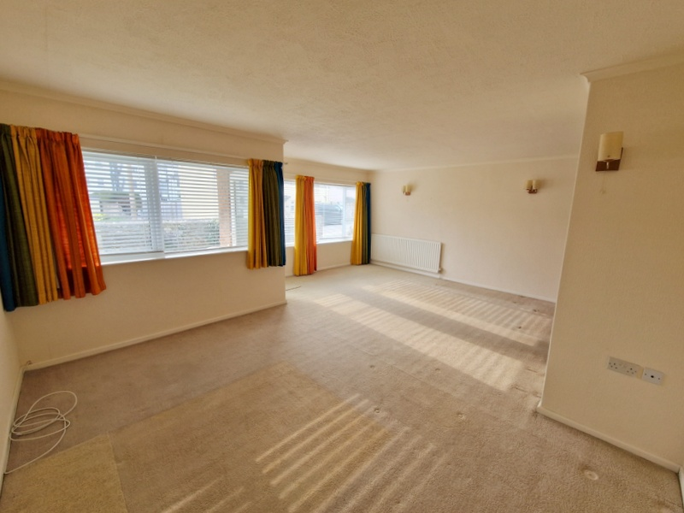
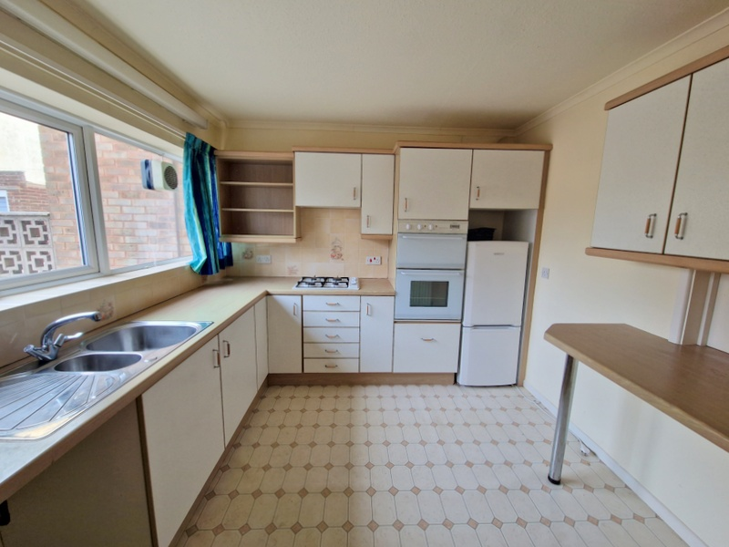
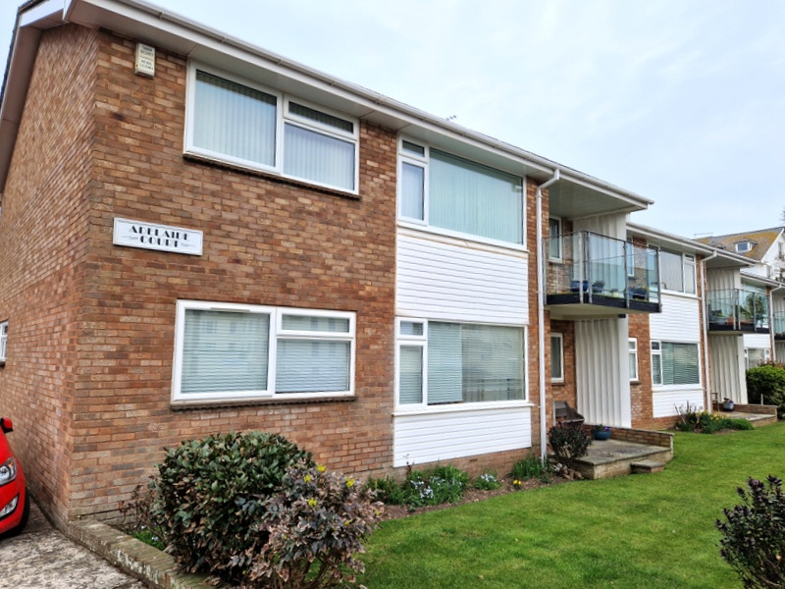
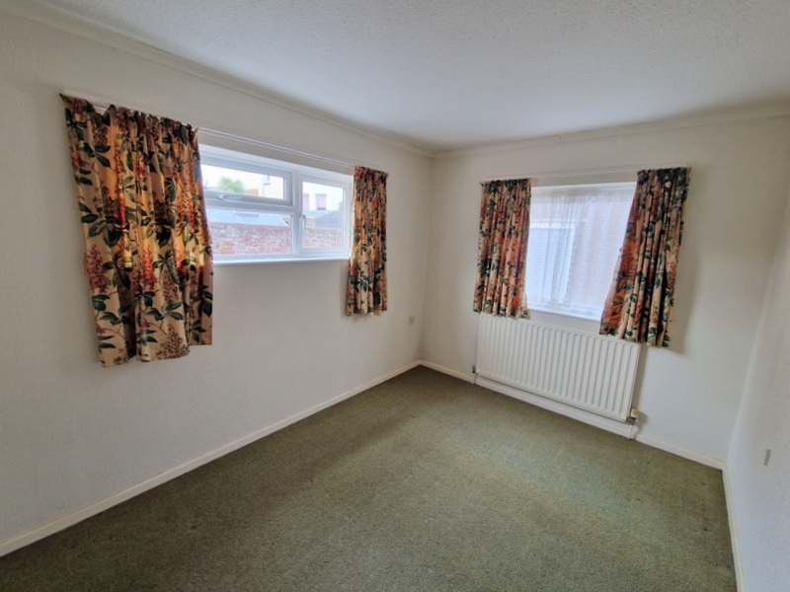
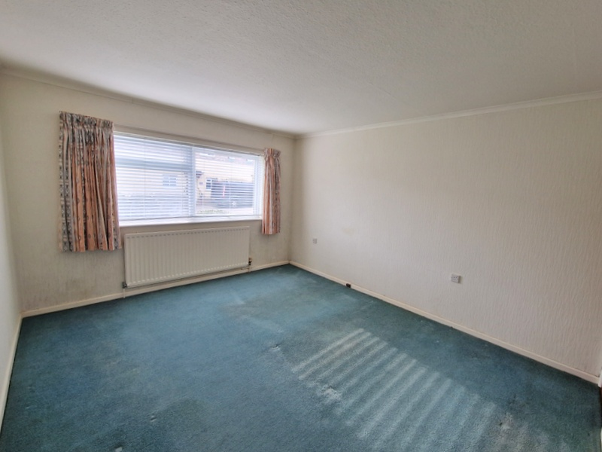
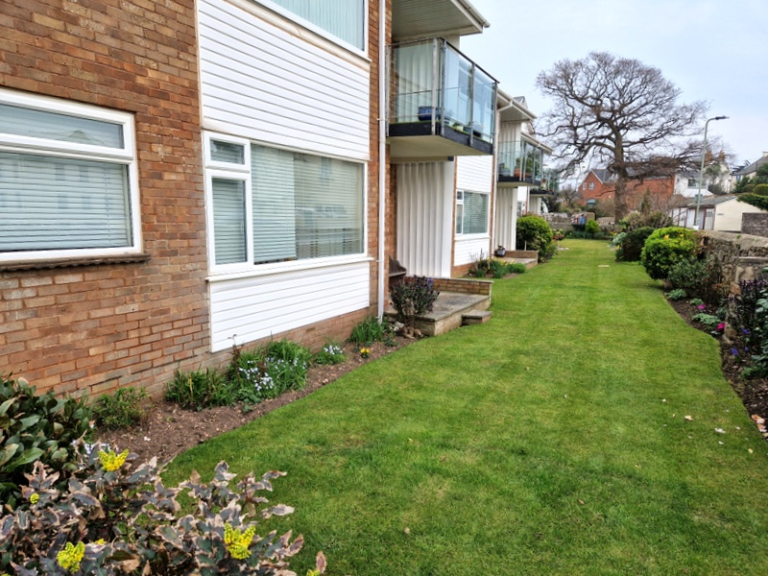
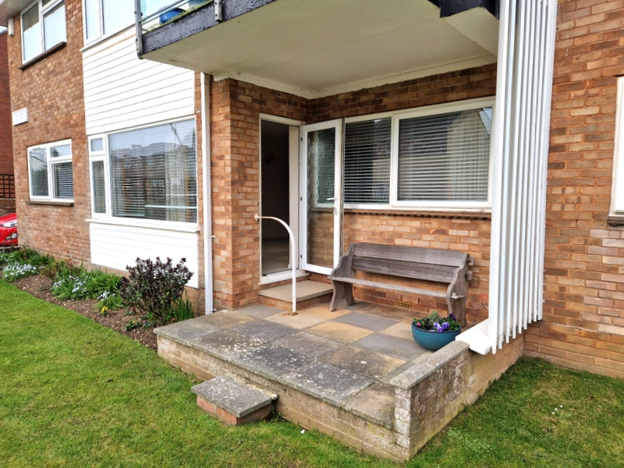
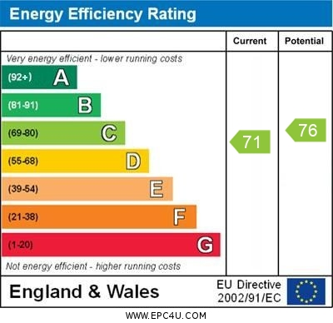
www.pennys.net
Flat 3 Adelaide Court, Louisa Place, Exmouth, EX8 2AL
GUIDE PRICE £300,000
TENURE Leasehold
A Spacious Ground Floor Purpose Built Apartment Enjoying An Enviable Location, Only A Short Distance From The Seafront And Within Walking Distance Of The Town Centre With Well Kept Communal Gardens, Garage And Communal Parking Area
Own Private Entrance * Reception Hall * Lounge/Dining Room With Access To Sun Terrace * Kitchen/Breakfast Room * Two Double Bedrooms * Bathroom * Separate Wc * Double Glazed Windows * Gas Central Heating * Some General Refurbishment Required Offered For Sale With No Ongoing Chain
Pennys Estate Agents Limited for themselves and for the vendor of this property whose agents they are give notice that:- (1) These particulars do not constitute any part of an offer or a contract. (2) All statements contained in these particulars are made without responsibility on the part of Pennys Estate Agents Limited. (3) None of the statements contained in these particulars are to be relied upon as a statement or representation of fact. (4) Any intending purchaser must satisfy himself/herself by inspection or otherwise as to the correctness of each of the statements contained in these particulars. (5) The vendor does not make or give and neither do Pennys Estate Agents Limited nor any person in their employment has any authority to make or give any representation or warranty whatever in relation to this property.
PENNYS ESTATE AGENTS
2 Rolle House, Rolle Street, Exmouth, Devon, EX8 2SN
Tel: 01395 264111 EMail: help@pennys.net

Slide 2
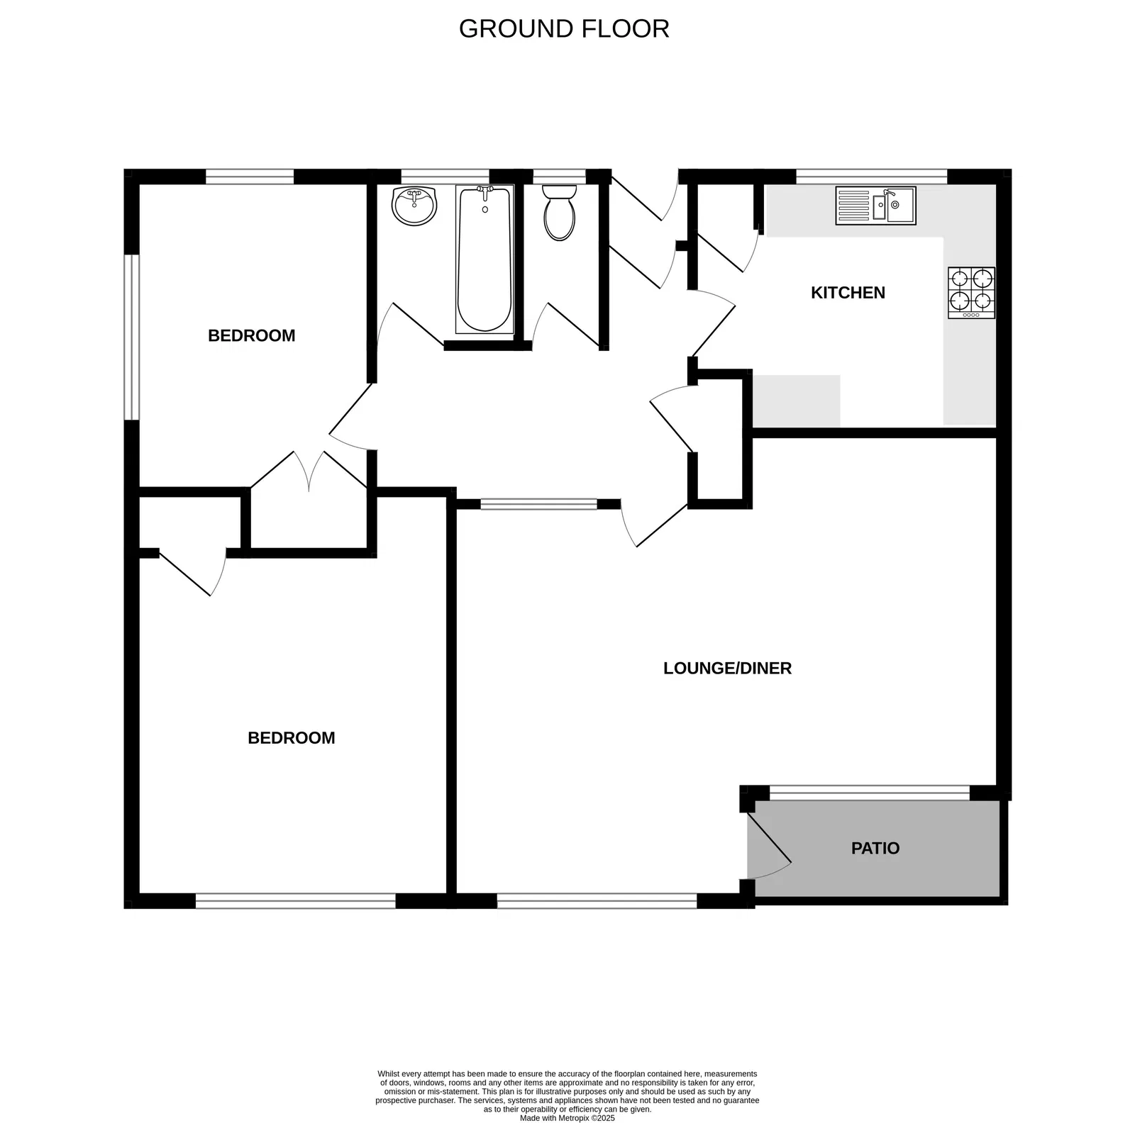
3 Adelaide Court, Louisa Place, Exmouth, EX8 2AL
THE ACCOMMODATION COMPRISES: Own private front door with patterned glass giving access to:
ENTRANCE LOBBY: With inner door leading through to:
RECEPTION HALL: Radiator, coats cupboard housing gas meter with fitted shelving, wall lighting, doors giving access to all rooms:
LOUNGE/DINING ROOM: 6.25m x 4.72m (20'6" x 15'6") narrowing to 4.09m (13'5") A bright spacious room with double glazed windows overlooking the front aspect and double glazed door with patterned glass giving access onto the communal gardens. TV point, two radiators, wall lighting, serving hatch to kitchen.
KITCHEN/BREAKFAST ROOM: 3.56m x 3.02m (11'8" x 9'11") Fitted range of wood-effect worktops with cupboards, drawer units and plumbing for automatic washing machine beneath worktop, one and a half bowl single drainer sink unit, inset four ring gas hob, built-in double oven, space for upright fridge/freezer, range of wall mounted cupboards, breakfast bar area, radiator, cupboard housing Worcester gas boiler for hot water and central heating, double glazed window.
BEDROOM 1: 4.17m plus doorway recess x 3.63m (13'8" x 11'11") A super sized main bedroom with built-in single wardrobe, radiator, double glazed window, wall lighting.
BEDROOM 2: 3.61m x 2.74m (11'10" x 9'0") A dual aspect room with two sets of double glazed windows, radiator, built-in double wardrobe fitted with chest of drawer and shelving units.
BATHROOM: 2.06m x 1.47m (6'9" x 4'10") With bath, wash hand basin, tiling to splash prone areas, radiator, double glazed window with patterned glass.
SEPARATE CLOAKROOM/WC: With WC and double glazed window with patterned glass.
OUTSIDE: The property enjoys communal gardens, parking and drying area. Outside cold water tap.
GARAGE: 5.03m x 2.69m (16'6" x 8'10") With up and over door.
.
TENURE: Service Charge: Will be sold with a newly extended 99 year lease with a peppercorn Ground Rent. Maintenance: Is a one sixth share of all outgoings – paid every 12 months
FLOOR PLAN:

