Slide 1
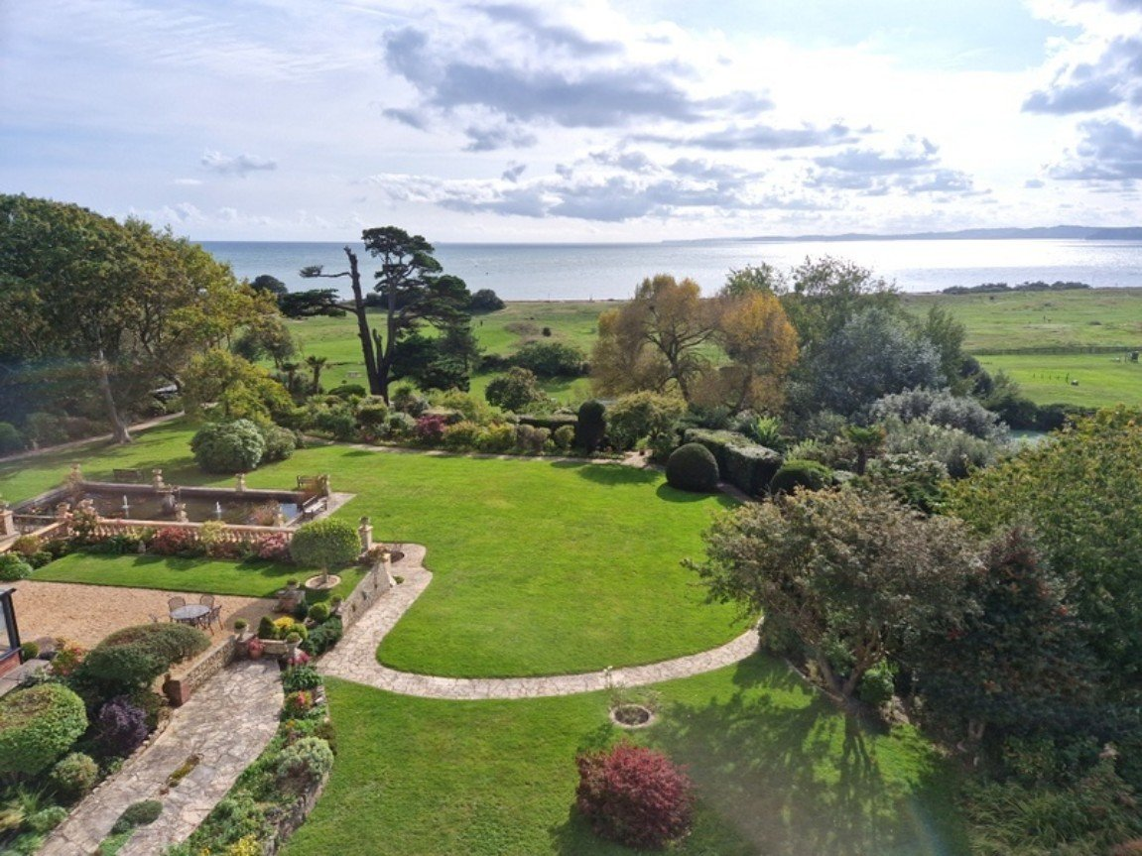
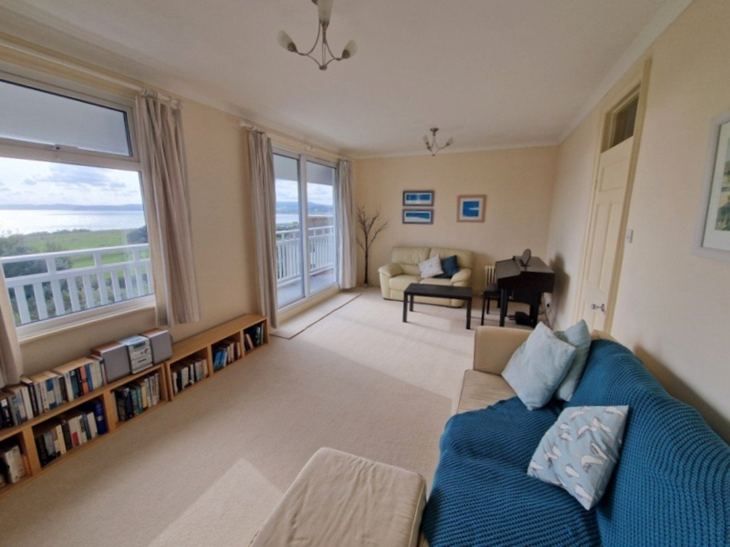
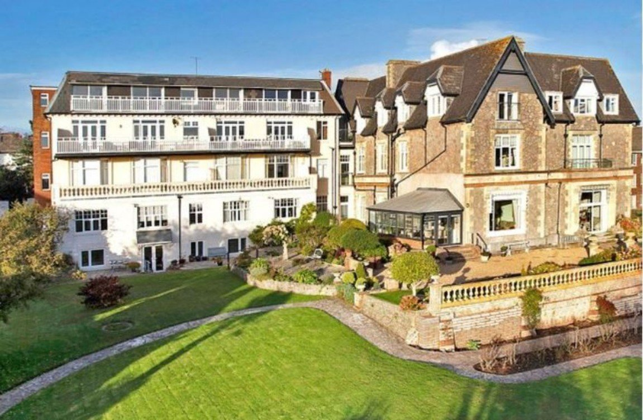
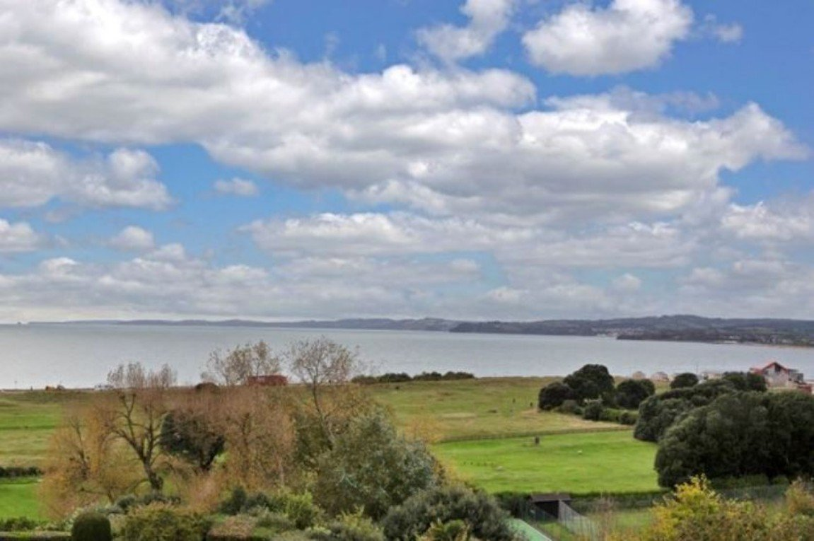
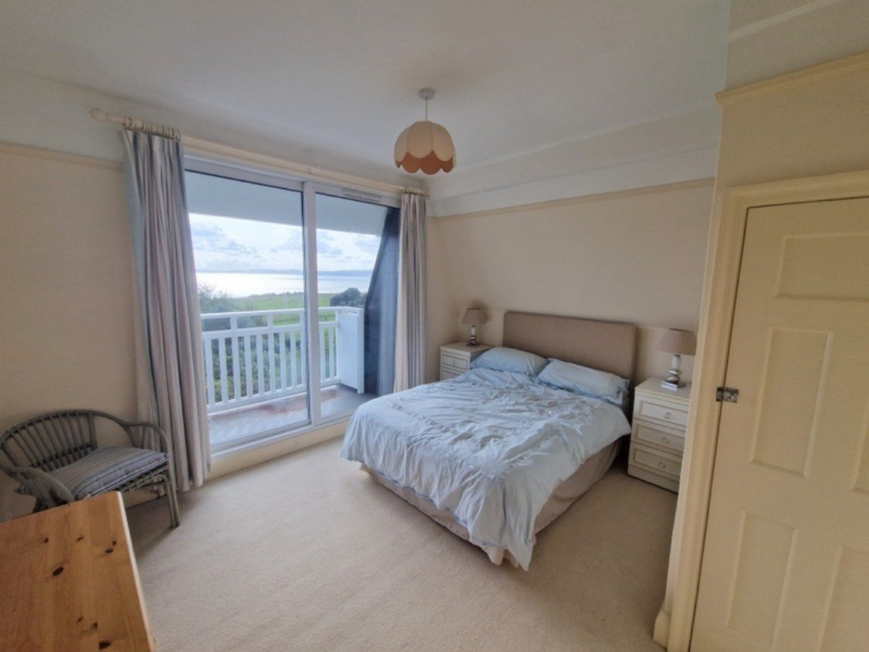
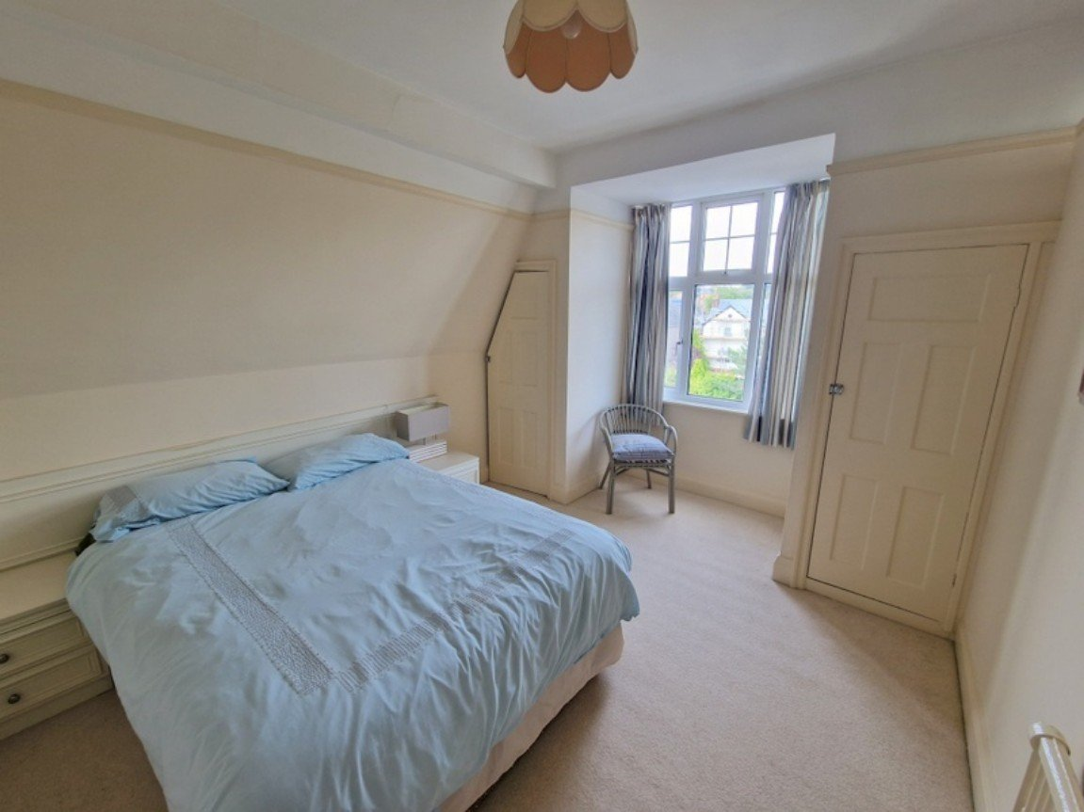
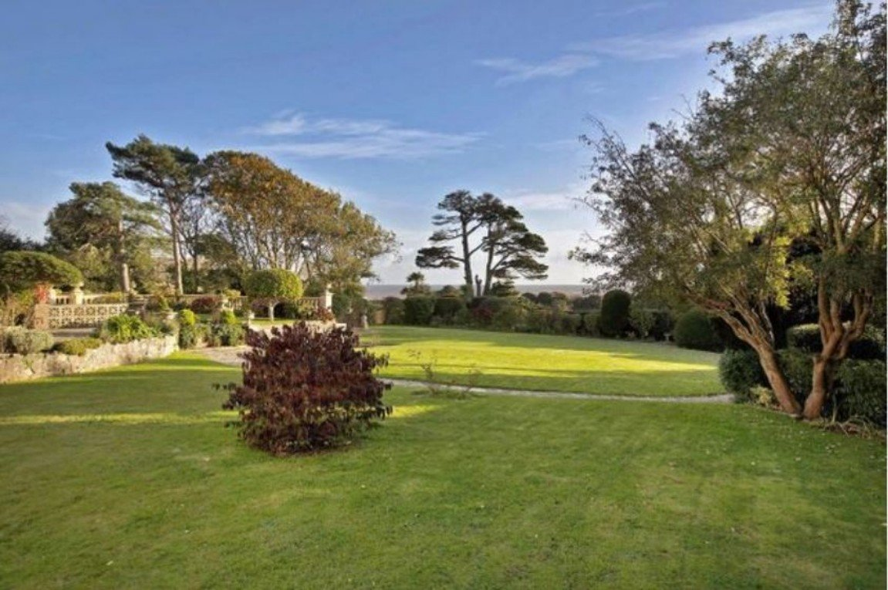
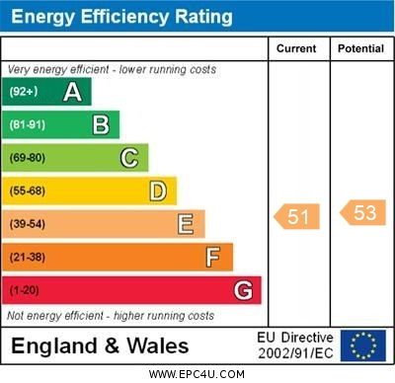
www.pennys.net
Flat 7 Maer Bay Court, 12 Douglas Avenue, Exmouth, EX8 2BX
GUIDE PRICE
OIRO £435,000
TENURE Share of Freehold
A Wonderful Top Floor Apartment Enjoying The Most Stunning Coastline Views, Picturesque Communal Gardens And Parking Space
Spacious Lounge/Dining Room • Brand New Kitchen •
Two Double Bedrooms • Shower Room/WC •
Double Glazed Windows •
Gas Central Heating • Spacious Balcony •
NO ONWARD CHAIN •
Pennys Estate Agents Limited for themselves and for the vendor of this property whose agents they are give notice that:- (1) These particulars do not constitute any part of an offer or a contract. (2) All statements contained in these particulars are made without responsibility on the part of Pennys Estate Agents Limited. (3) None of the statements contained in these particulars are to be relied upon as a statement or representation of fact. (4) Any intending purchaser must satisfy himself/herself by inspection or otherwise as to the correctness of each of the statements contained in these particulars. (5) The vendor does not make or give and neither do Pennys Estate Agents Limited nor any person in their employment has any authority to make or give any representation or warranty whatever in relation to this property.
PENNYS ESTATE AGENTS
2 Rolle House, Rolle Street, Exmouth, Devon, EX8 2SN
Tel: 01395 264111 EMail: help@pennys.net

Slide 2
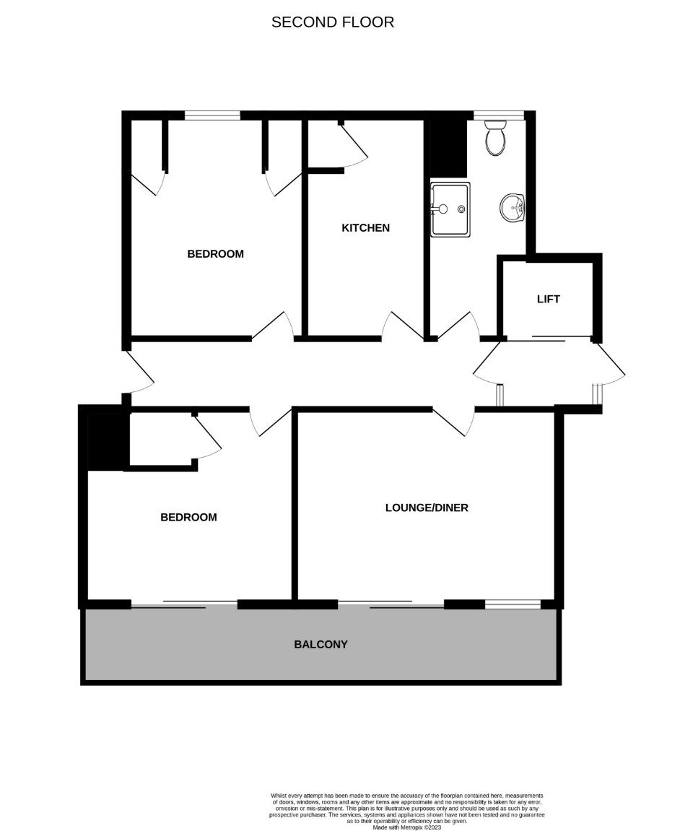
Flat 7 Maer Bay Court, 12 Douglas Avenue, Exmouth, EX8 2BX
A stunning penthouse style apartment in arguably one of Exmouth's finest locations with views of Exmouth beach, Exe estuary, Haldon Hills, Brixham to Berry Head and lighthouse. It also provides a 'birds eye' view of shipping, yachting, windsurfing races and firework displays. The beautiful residents' garden provides a variety of areas to enjoy and includes seating and a magnificent pond. It also offers direct access to Madeira Walk, providing a level walk into town and the Maer, Exmouth Beach and leisure area. THE ACCOMMODATION COMPRISES: Lift rises to TOP FLOOR; private front door to: RECEPTION HALL: Radiator; telephone point; electric consumer unit; door giving a second entrance with access to staircase which leads down to OUTSIDE; door entry phone.
LOUNGE/DINING ROOM: 5.72m x 3.51m (18'9" x 11'6") Double glazed window and sliding double glazed patio doors opening onto the BALCONY gaining stunning uninterrupted views over the Maer to the sea and coastline beyond; radiator. KITCHEN: 4.09m x 2.26m (13'5" x 7'5") To be fitted with a range of quality units; built-in storage cupboard; double glazed window to front elevation. BEDROOM ONE: 3.71m x 3.48m (12'2" x 11'5") Sliding double glazed patio doors to BALCONY with stunning coastline views; radiator; built-in wardrobe. BEDROOM TWO: 4.09m x 3.18m (13'5" x 10'5") into dormer style. Double glazed window to front elevation; radiator; picture rail; two fitted cupboards. SHOWER ROOM/WC: 3.76m x 1.73m (12'4" x 5'8") A good size shower cubicle with mira shower; pedestal wash hand basin with tiled splash back; fitted mirror with integrated light; WC with push button flush; tiled floor; under floor heating; chrome heated towel rail; recess ceiling spotlighting; double glazed window with pattern glass. OUTSIDE: Outside there are exceptionally maintained communal grounds, boasting a large pond which is home to an array of wildlife, in addition to mature trees and a multitude of colourful plants. This along with its incredible setting, ease of access to the coastline make this property a must see and an early viewing is highly recommended. There is also a gate from the communal gardens leading to Madeira Walk. The apartment also benefits from a PARKING SPACE. TENURE AND OUTGOINGS: The service charge is approximately £275.00 per calendar month per flat which includes a contribution towards the lift maintenance and also includes central heating, hot water, maintenance of boiler, cleaning, redecoration and maintenance of communal areas, gardening/landscaping and buildings insurance. The property also pays £500 twice a year into a general fund. The property benefits from a 999 year lease from 1961 and also 1/16th share of Maer Bay Freeholds (Exmouth( LTD. AGENTS NOTE: The central heating is communal and the bathroom has underfloor heating and a towel rail which is independent from communal heating.
FLOOR PLAN:

