Slide 1
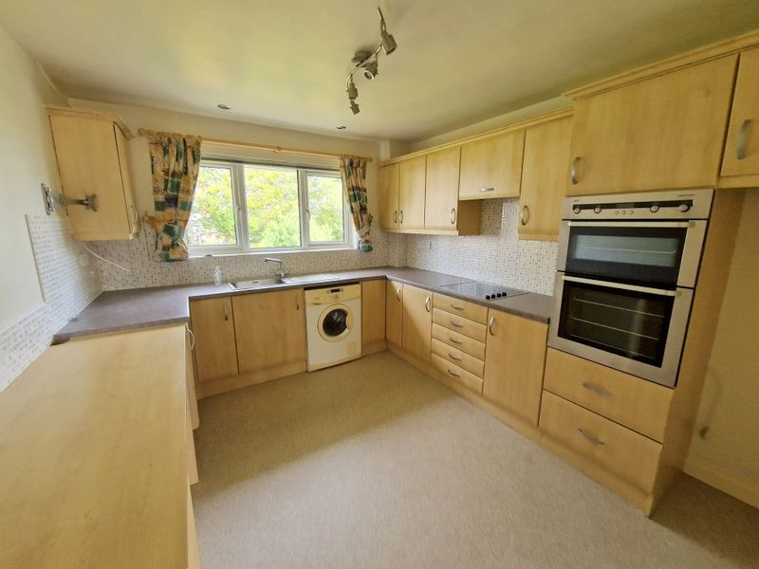
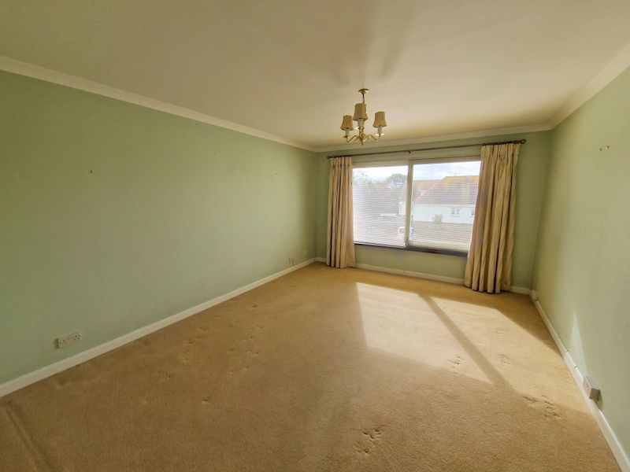
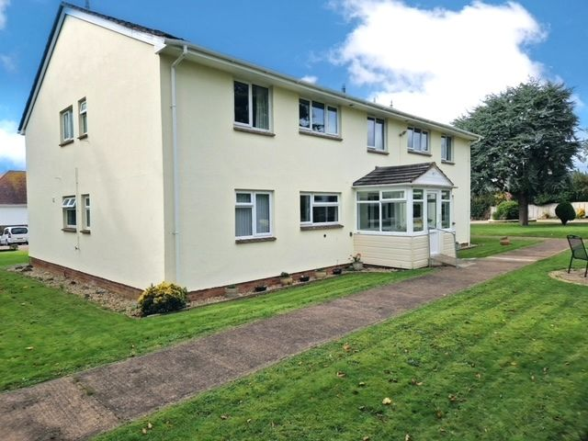
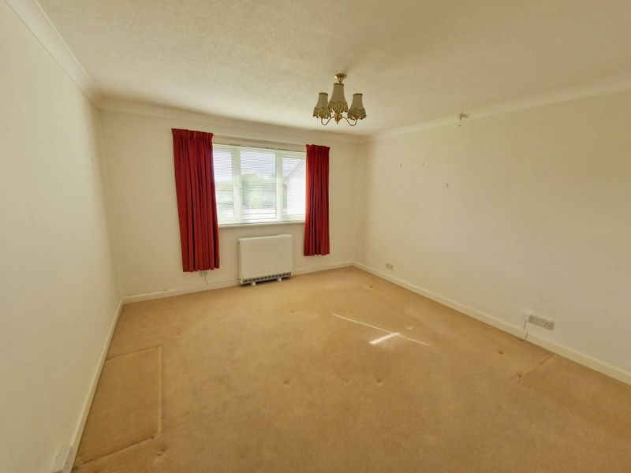
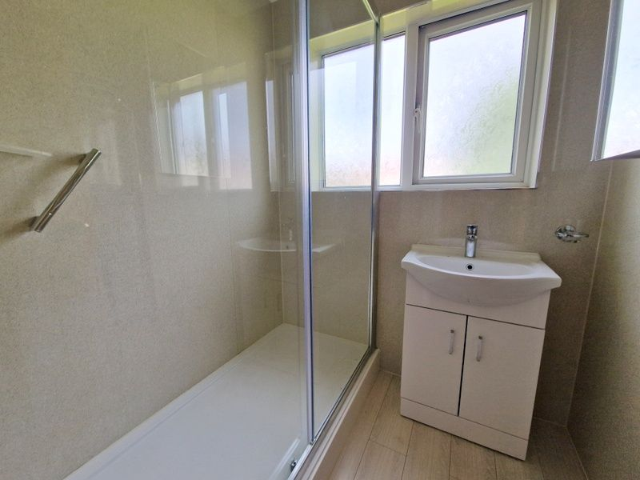
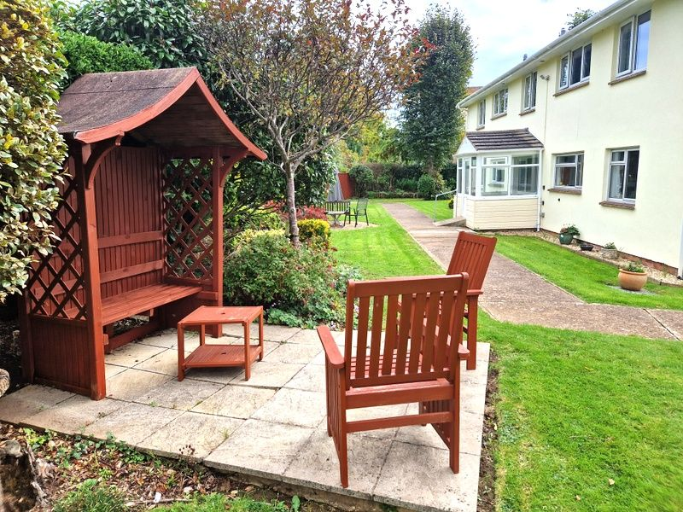
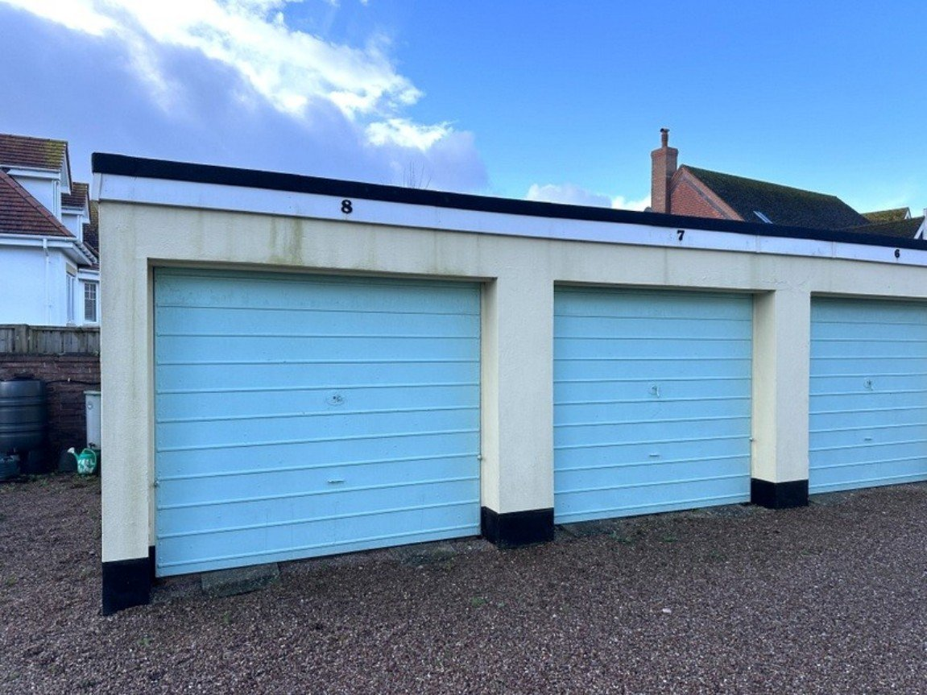
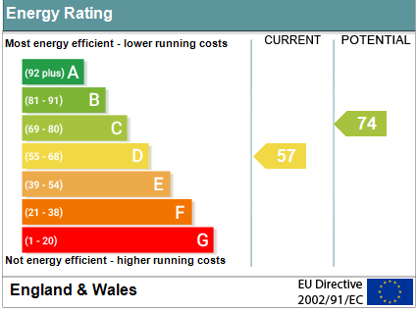
www.pennys.net
Flat 8 Pentgrove Court, 4 Stevenstone Road, Exmouth, EX8 2EP
GUIDE PRICE £214,950
TENURE Share of Freehold
A Well Presented First Floor Apartment Located In A Favoured Development In A Sought After Area Close To Bus Services With Attractive Communal Gardens, Seating, Garage And Parking
Lounge/Dining Room • Modern Kitchen/Breakfast Room •
Two Double Bedrooms • Newly Fitted Shower Room • Separate WC •
Double Glazed Window • Electric Radiator Heating •
Garage In A Block Close By • Viewing Recommended•
No Onward Chain•
Pennys Estate Agents Limited for themselves and for the vendor of this property whose agents they are give notice that:- (1) These particulars do not constitute any part of an offer or a contract. (2) All statements contained in these particulars are made without responsibility on the part of Pennys Estate Agents Limited. (3) None of the statements contained in these particulars are to be relied upon as a statement or representation of fact. (4) Any intending purchaser must satisfy himself/herself by inspection or otherwise as to the correctness of each of the statements contained in these particulars. (5) The vendor does not make or give and neither do Pennys Estate Agents Limited nor any person in their employment has any authority to make or give any representation or warranty whatever in relation to this property.
PENNYS ESTATE AGENTS
2 Rolle House, Rolle Street, Exmouth, Devon, EX8 2SN
Tel: 01395 264111 EMail: help@pennys.net

Slide 2
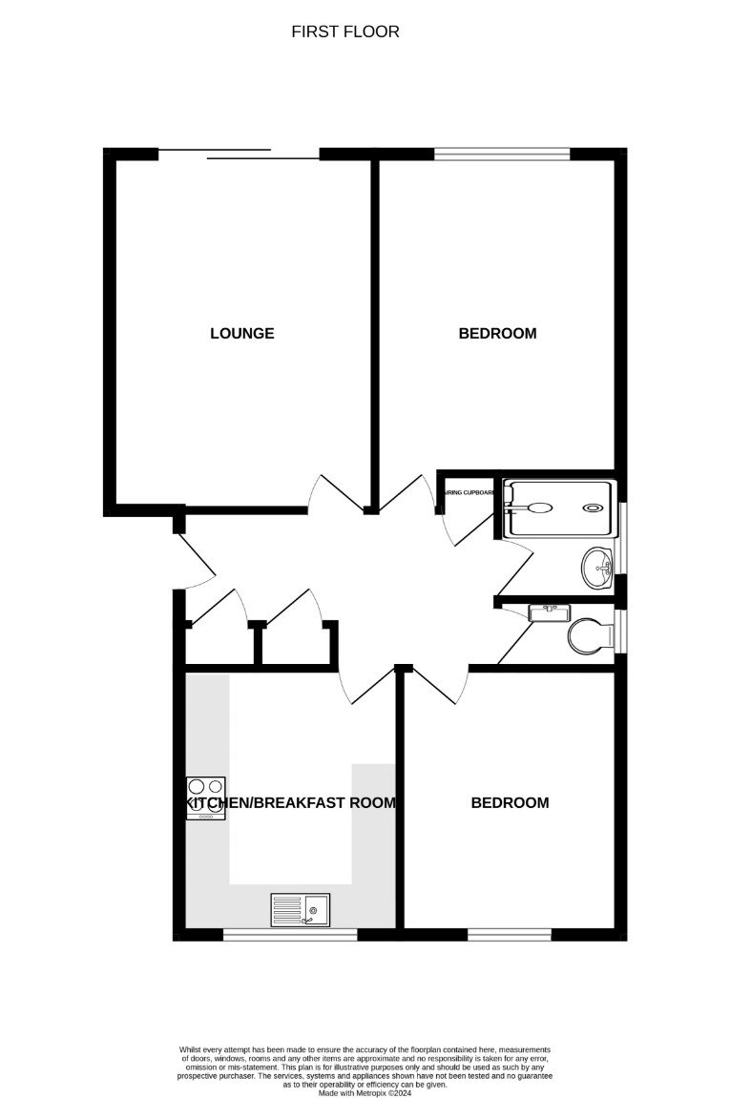
Flat 8 Pentgrove Court, 4 Stevenstone Road, Exmouth, EX8 2EP
THE ACCOMMODATION COMPRISES: Communal entrance giving access to the communal hallway. Stairs to FIRST FLOOR; own private wooden front door with obscure glass inset and letter box leading to the:
RECEPTION HALL: With coved ceiling; electric radiator; good size cupboard with shelving and housing the electric meters and electric consumer unit; adjoining cupboard with shelving and hanging rail; third cupboard housing the water cylinder; access to roof space; doors to: LOUNGE/DINING ROOM: 4.85m x 3.63m (15'11" x 11'11") A bright and spacious room with uPVC double glazed window and further sliding window to rear aspect overlooking the communal gardens; television point; telephone point; coved ceiling; electric radiator. KITCHEN/BREAKFAST ROOM: 3.61m x 3m (11'10" x 9'10") Comprising of a range of patterned worktop surfaces with tiled surrounds; range of base cupboards, drawer units and space and plumbing for an automatic washing machine beneath; inset four ring electric hob with concealed extractor hood over; space for an upright fridge freezer; matching range of wall units at eye-level; built-in stainless steel electric oven with built-in grill above; single drainer sink unit with mixer tap; extended worktop surface providing breakfast bar area; electric radiator; television point; uPVC double glazed windows to front aspect overlooking the communal gardens. BEDROOM ONE: 4.85m x 3.63m (15'11" x 11'11") (Currently being used as a Dining Room) uPVC double glazed window overlooking the well kept communal gardens to the rear aspect; electric radiator; coved ceiling. BEDROOM TWO: 3.63m x 3.02m (11'11" x 9'11") uPVC double glazed window with outlook over the communal gardens to the front of the development; coved ceiling; electric radiator; television point; range of freestanding wardrobes with hanging rails and drawer units. SHOWER ROOM: Newly fitted with a double with shower cubicle and drying area with glass splash screen and sliding door; wall mounted seat and grab rails; wall mounted electric Mira shower; attractive tiled walls; wash hand basin with chrome mixer tap displayed in vanity unit with cupboard beneath; mirror fronted medicine cabinet with light; coved ceiling; wood effect flooring; uPVC double glazed window with obscure glass. SEPARATE WC: WC in concealed cystern with push button flush; wash hand basin with mixer tap displayed in vanity unit with cupboard beneath; attractive tiled walls to splash prone areas; wood effect flooring; uPVC double glazed window with obscure glass; coved ceiling. OUTSIDE: Pentgrove Court is set in well tended and generously sized level communal gardens enjoying an array of colour and seating areas with a communal drying area and bin store. A driveway leads through to the rear of the building where there is visitors parking and a block of GARAGES of which apartment 8 benefits from a single garage. GARAGE: 5.11m x 2.57m (16'9" x 8'5") With up and over door.
TENURE AND OUTGOINGS: We understand that the apartment enjoys the benefit of 1/8th share of the freehold and has a 999 year lease from 2023. The service charges are approximately £100.00 per month. AGENTS NOTE: Please note this property has an age restriction of 50 years and over.
FLOOR PLAN:

