Slide 1
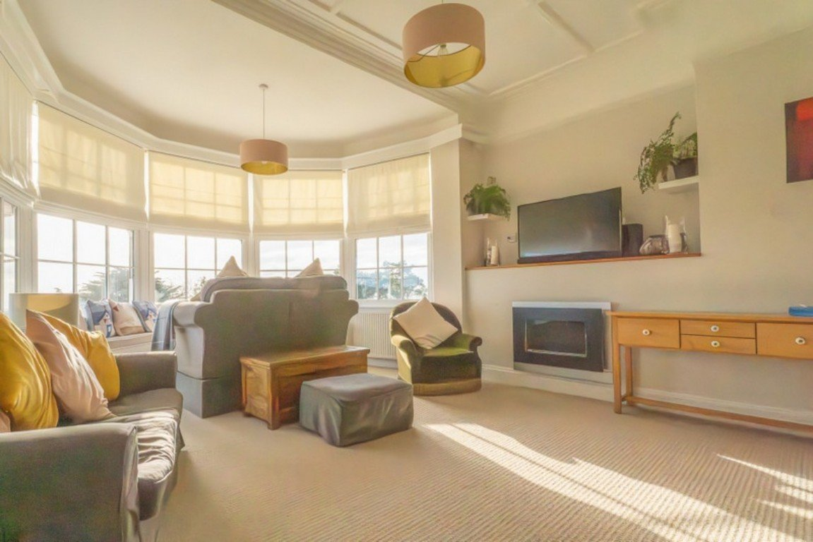
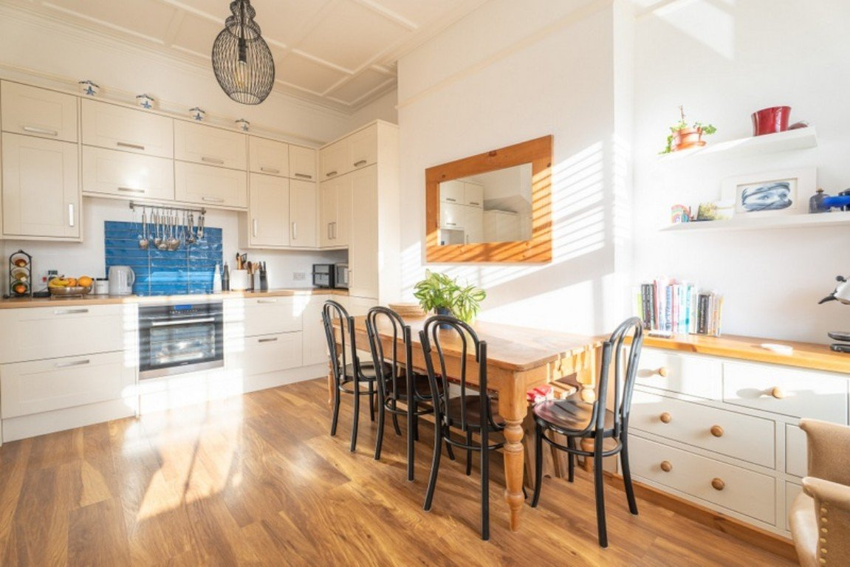
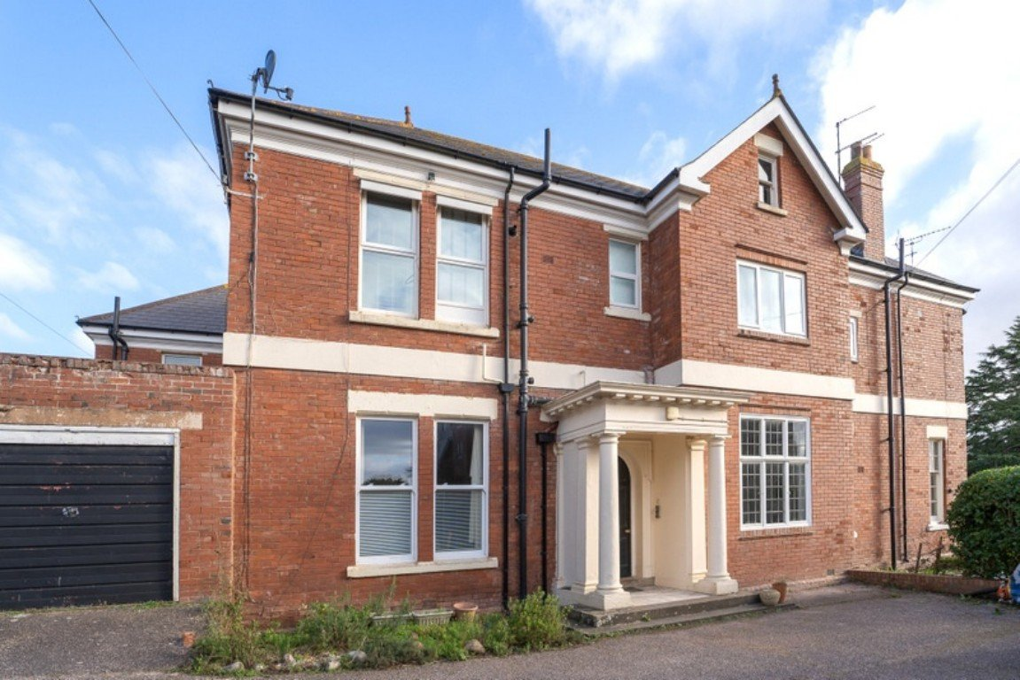
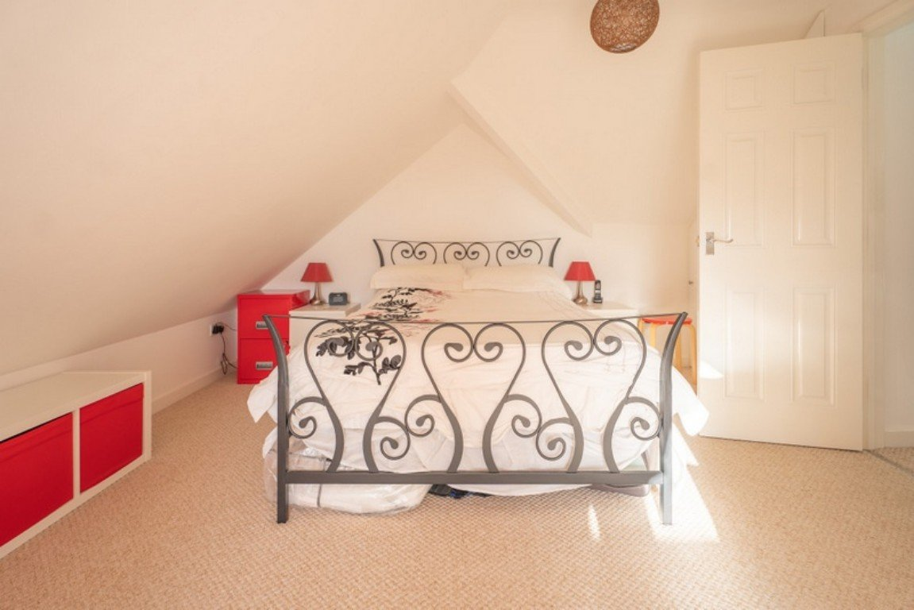
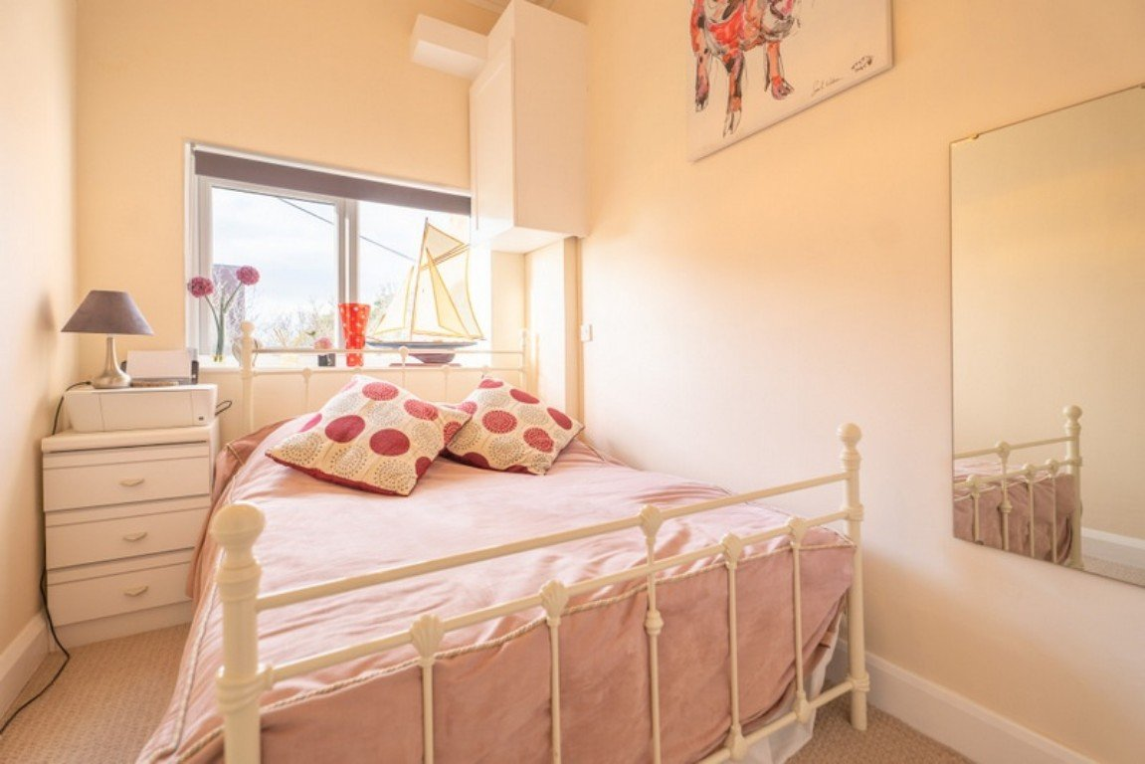
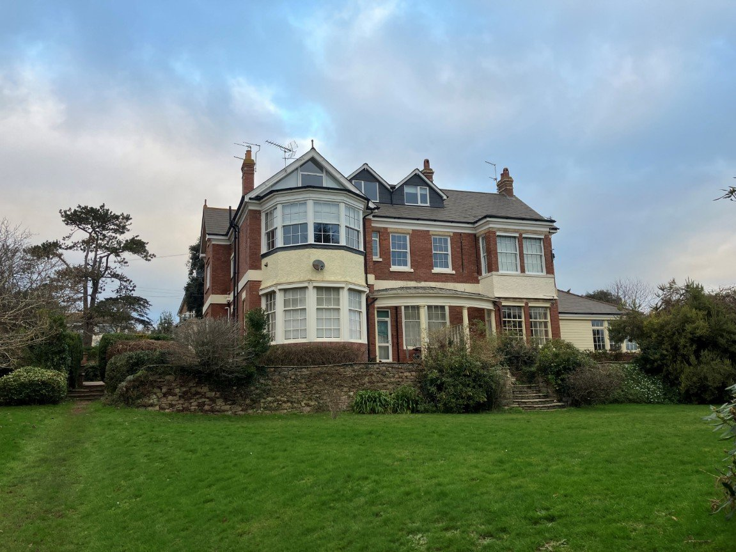
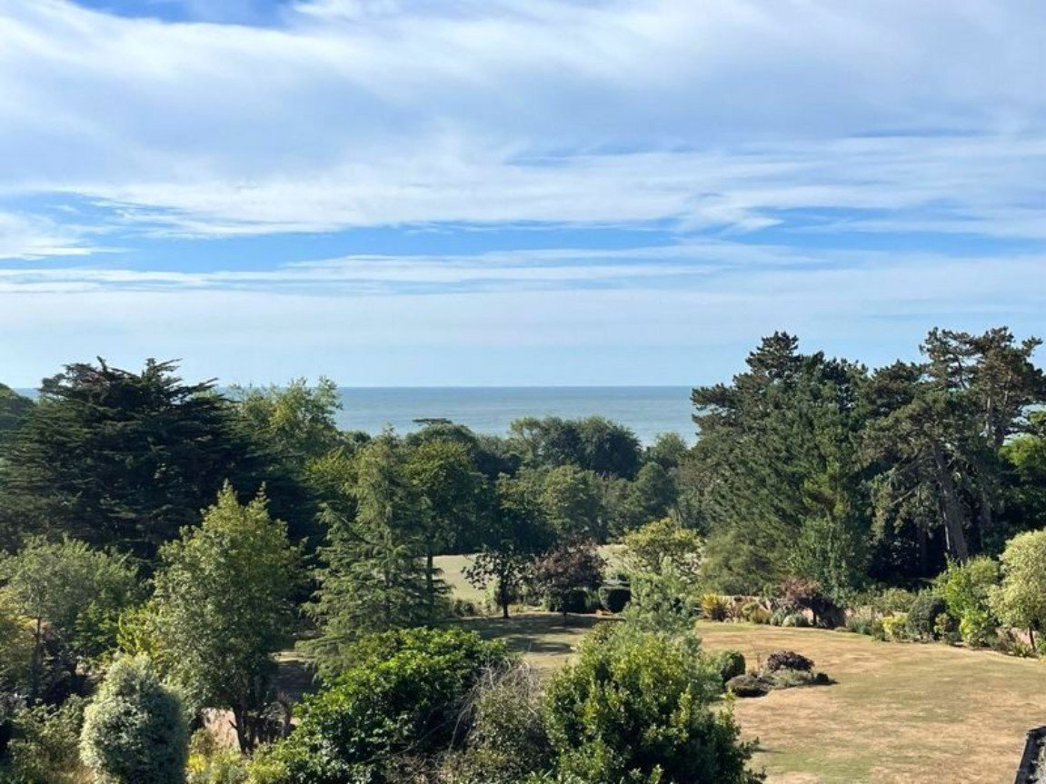
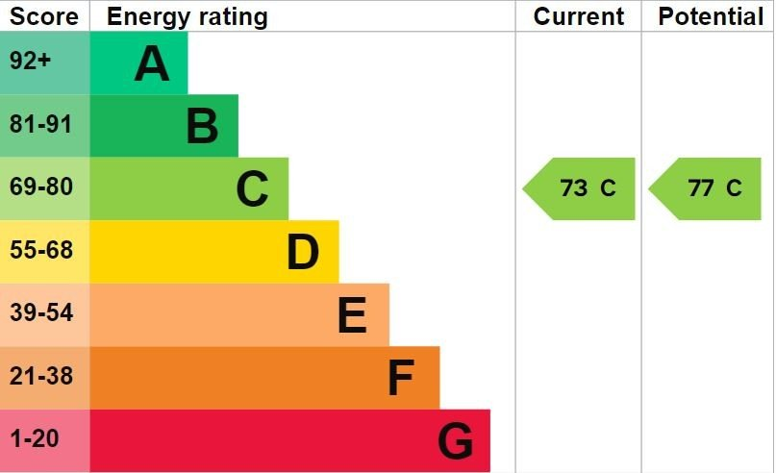
www.pennys.net
Flat 5 St Cyr, 26 Douglas Avenue, Exmouth, EX8 2HA
GUIDE PRICE £460,000
TENURE Share of Freehold
A Beautifully Presented Three Bedroom Maisonette Standing In Delightful Mature Communal Gardens In The Highly Desirable 'Avenues' Area Of Exmouth With Garage
Reception Hall • Lounge With Panoramic Sea/Coastline Views And Beyond •
Kitchen/Breakfast Room • Three Double Bedrooms • Bathroom/WC •
Shower Room/WC • uPVC Double Glazing & Gas Central Heating •
Garage • Picturesque Communal Gardens •
Viewing Highly Recommended •
Pennys Estate Agents Limited for themselves and for the vendor of this property whose agents they are give notice that:- (1) These particulars do not constitute any part of an offer or a contract. (2) All statements contained in these particulars are made without responsibility on the part of Pennys Estate Agents Limited. (3) None of the statements contained in these particulars are to be relied upon as a statement or representation of fact. (4) Any intending purchaser must satisfy himself/herself by inspection or otherwise as to the correctness of each of the statements contained in these particulars. (5) The vendor does not make or give and neither do Pennys Estate Agents Limited nor any person in their employment has any authority to make or give any representation or warranty whatever in relation to this property.
PENNYS ESTATE AGENTS
2 Rolle House, Rolle Street, Exmouth, Devon, EX8 2SN
Tel: 01395 264111 EMail: help@pennys.net

Slide 2
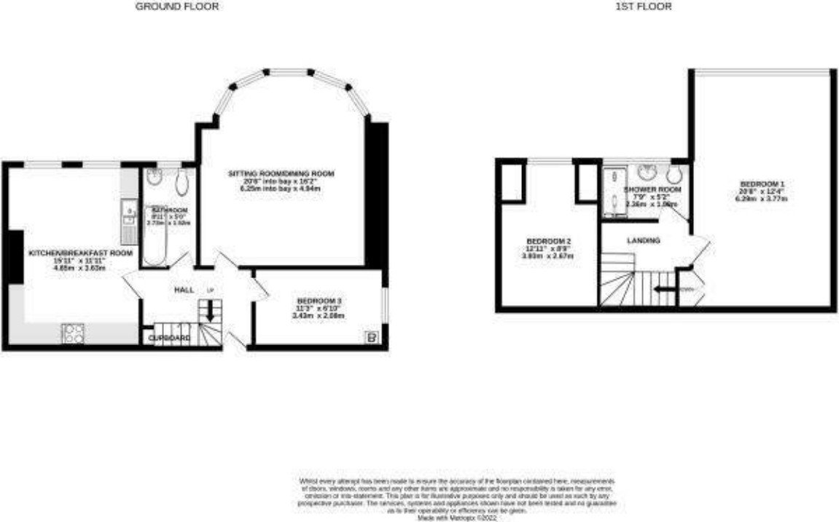
Flat 5 St Cyr, 26 Douglas Avenue, Exmouth, EX8 2HA
Pennys are delighted to offer for sale this beautifully presented three bedroom maisonette style property situated in one of Exmouth's most sought after locations in a highly desirable development with panoramic sea and coastline views. The building stands in beautifully kept communal grounds, easy access to the town centre and Exmouth seafront. The accommodation has undergone an extensive programme of refurbishment and is a must see property. THE ACCOMMODATION COMPRISES: A grand communal entrance with sweeping staircase and feature leaded atrium ceiling leads to the FIRST FLOOR; own private front door giving access to: RECEPTION HALL: With an oak staircase with glass balustrades rising to the SECOND FLOOR with understairs storage cupboard housing gas and water meters; radiator; electric consumer unit; doors to: LOUNGE/DINING ROOM: 6.25m x 4.93m (20'6" x 16'2") maximum overall measurement into bay. A bright and spacious room with feature curved bay and uPVC double glazed sash windows overlooking the beautiful communal gardens and panoramic coastline views beyond; wall mounted gas living flame effect fire with feature shelf above; ornate ceiling; picture rail; four radiators; wall lights; television point. KITCHEN/BREAKFAST ROOM: 4.85m x 3.63m (15'11" x 11'11") A stunning feature to the property and comprises of wood effect work top surfaces with attractive tiled splashbacks to splash prone areas; a range of cupboards and drawer units; space for dishwasher; space and plumbing for an automatic washing machine; space for an upright fridge freezer; built-in electric oven with four ring ceramic hob above; inset one and a half bowl sink unit with chrome mixer tap; range of wall mounted cupboards with concealed lighting; upright larder style cupboard; wood flooring; two radiators; two uPVC double glazed sash windows with stunning coastline views and beyond; ornate ceiling; picture rail. BEDROOM THREE: 3.43m x 2.08m (11'3" x 6'10") uPVC double glazed window to side aspect; built-in wardrobe with fitted range of cupboards above; cupboard housing gas boiler serving domestic hot water and gas central heating; radiator; coved ceiling. BATHROOM/WC: 2.72m x 1.52m (8'11" x 5'0") Bath with chrome mixer tap; wall mounted shower over and shower splash screen; newly fitted wall panelling; wash hand basin set in vanity unit with cupboards beneath; WC with push button flush set in vanity unit with shelf over; LED ceiling spotlighting; radiator; towel rail; uPVC double glazed window with obscure glass to rear; wood effect flooring. SECOND FLOOR LANDING: With velux window; smoke alarm; doors to: BEDROOM ONE: 6.3m x 3.76m (20'8" x 12'4") A stunning main bedroom with uPVC double glazed feature triangular window gaining panoramic sea and coastline views beyond; radiator; built-in double wardrobe. BEDROOM TWO: 3.94m x 2.67m (12'11" x 8'9") uPVC double glazed window to rear aspect gaining wonderful views over the communal gardens and sea/coastline and beyond; built-in double wardrobe; two additional storage cupboards into eaves with hanging rails; radiator.
SHOWER ROOM/WC: 2.36m x 1.57m (7'9" x 5'2") Comprising of a double width shower cubicle with glass splash screen door; wall mounted rainfall shower with detachable handheld attachment; WC with push button flush set in vanity unit; wash hand basin set in vanity unit; heated towel rail; extractor fan; shaver socket; tile effect flooring; LED ceiling spotlights; uPVC double glazed window to rear aspect gaining stunning views. GARAGE: 4.75m x 2.54m (15'7" x 8'4") With wooden doors; power and light connected; lean-to storage area to the side. Parking for motorhome/cars to the front. OUTSIDE: The property is approached via a driveway with communal parking for residents. There is a covered entrance to the communal area with steps leading down to the attractive mature communal gardens which extend to approximately an acre and benefits from many mature trees, shrubs, fruit trees and grassed areas providing an abundance of colour. There is also a raised decked area and summer house, these gardens must be seen to be fully appreciated. There is also a cellar providing further storage space for use by the residents. TENURE AND OUTGOINGS: We understand the property will be sold with a new 999 year lease on completion. The service & maintenance charges are £150.00 per month which includes buildings insurance, maintenance of gardens etc. The property also benefits from a 1/7th share of freehold with the seven flat owners being in full control of maintenance work forming the management company of St Cyr (Exmouth) LTD. Council Tax Band B.
FLOOR PLAN:

