Slide 1
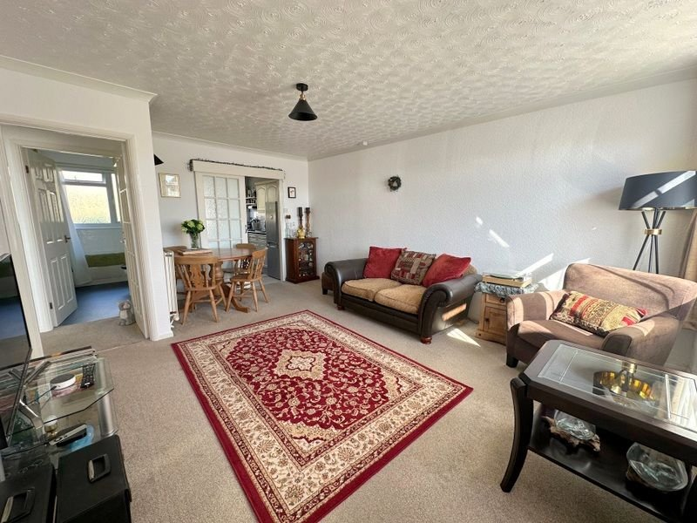
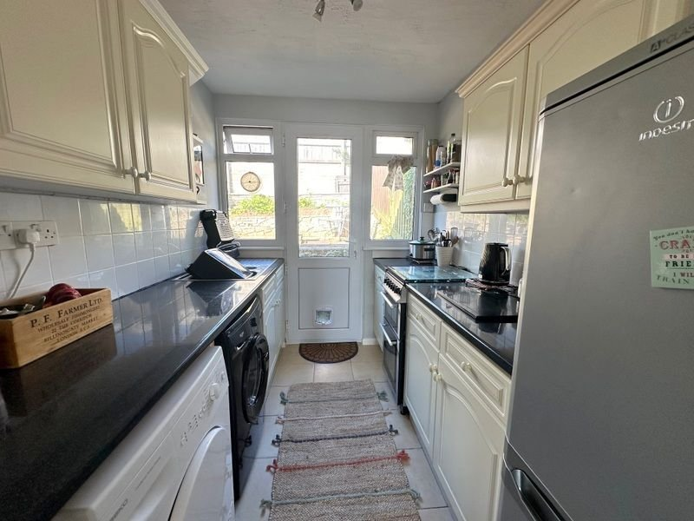
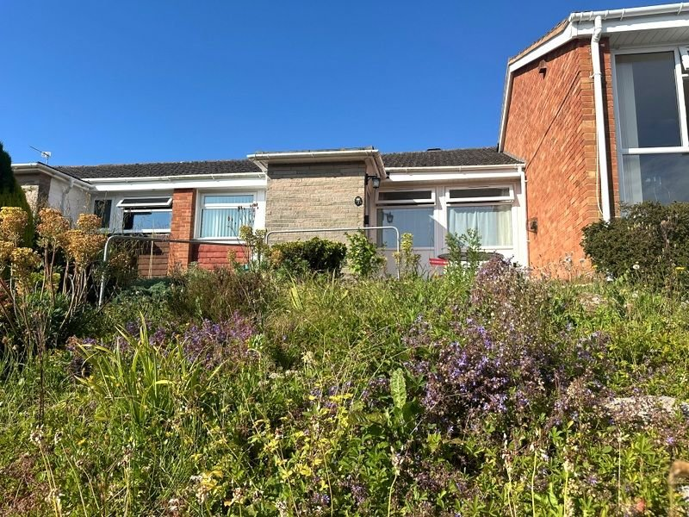
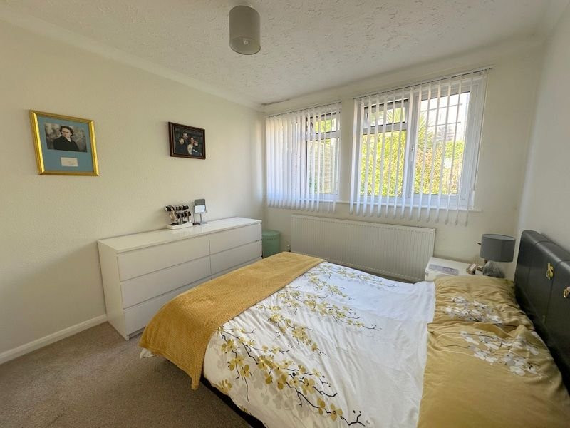
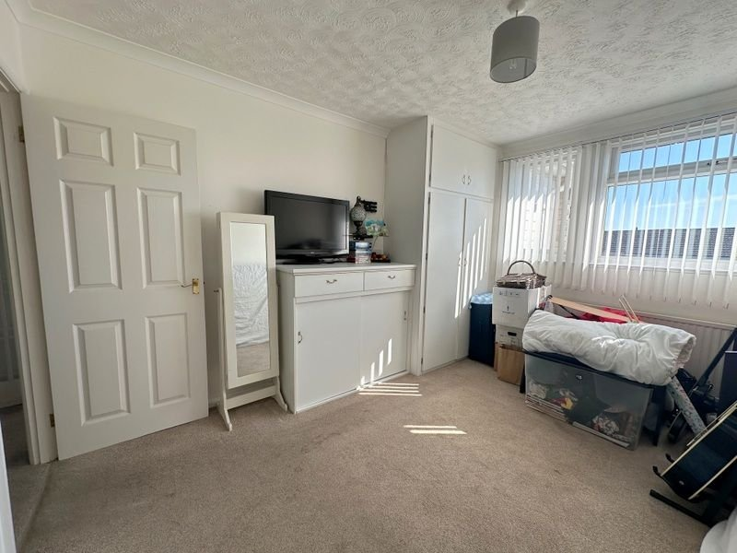
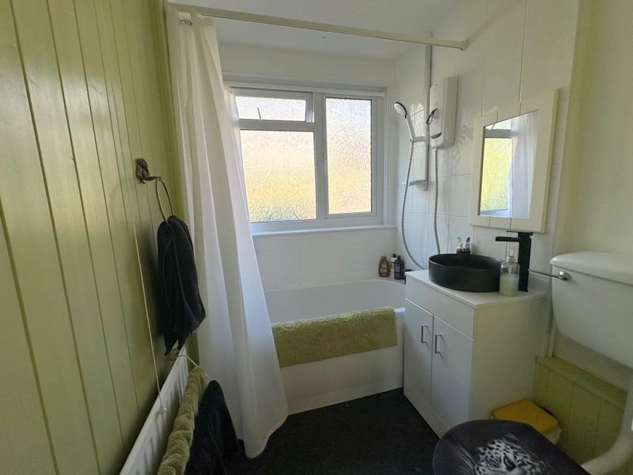
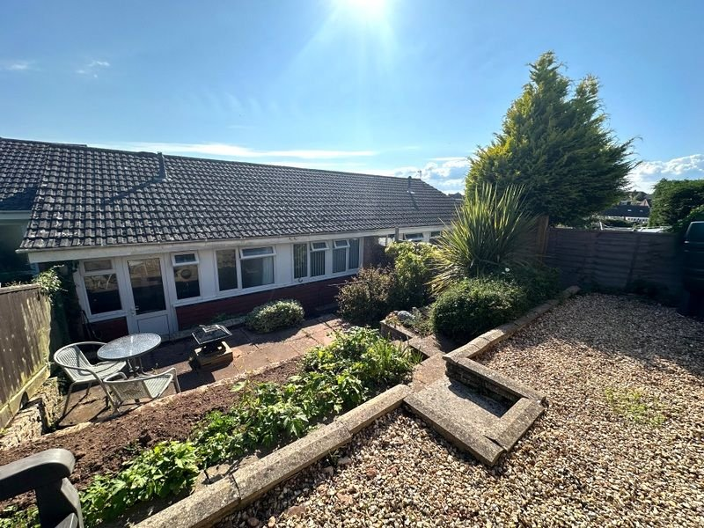
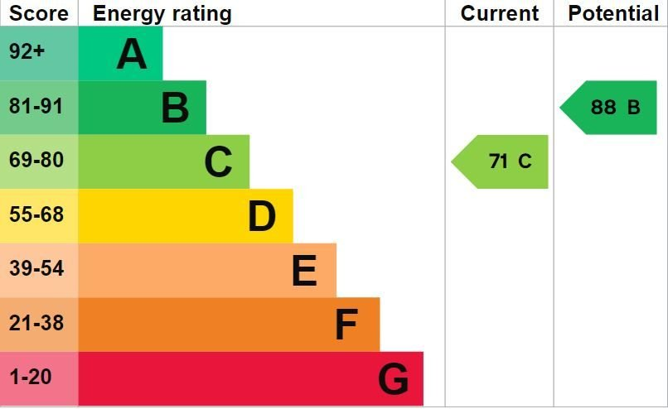
www.pennys.net
3 Travershes Close, Exmouth, EX8 3LH
GUIDE PRICE £229,950
TENURE Freehold
A Well Presented Two Double Bedroom Terraced Bungalow Situated In A Favoured Location Offered For Sale With No Onward Chain
Entrance Hall • Lounge/Dining Room • Kitchen •
Two Double Bedrooms • Bathroom/WC •
Gas Central Heating • Double Glazed Windows • Attractive Colourful Front & Rear Gardens • Viewing Highly Recommended • No Onward Chain •
Pennys Estate Agents Limited for themselves and for the vendor of this property whose agents they are give notice that:- (1) These particulars do not constitute any part of an offer or a contract. (2) All statements contained in these particulars are made without responsibility on the part of Pennys Estate Agents Limited. (3) None of the statements contained in these particulars are to be relied upon as a statement or representation of fact. (4) Any intending purchaser must satisfy himself/herself by inspection or otherwise as to the correctness of each of the statements contained in these particulars. (5) The vendor does not make or give and neither do Pennys Estate Agents Limited nor any person in their employment has any authority to make or give any representation or warranty whatever in relation to this property.
PENNYS ESTATE AGENTS
2 Rolle House, Rolle Street, Exmouth, Devon, EX8 2SN
Tel: 01395 264111 EMail: help@pennys.net

Slide 2
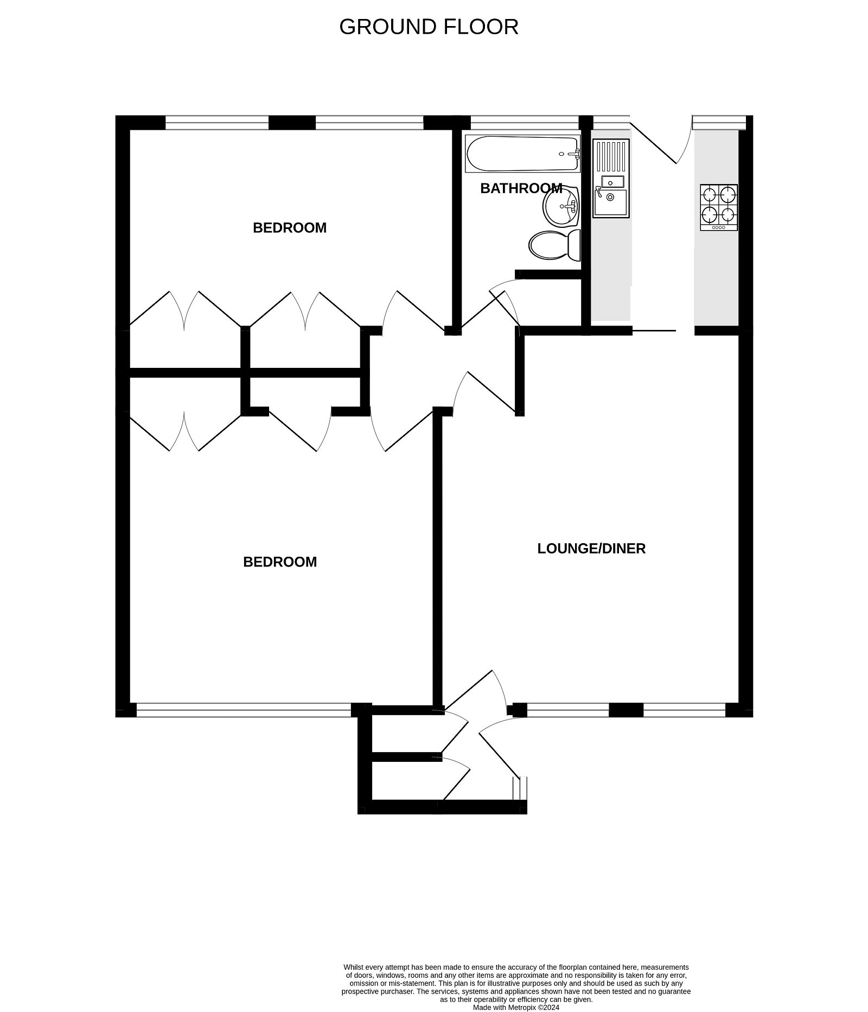
3 Travershes Close, Exmouth, EX8 3LH
THE ACCOMMODATION COMPRISES: uPVC front door with double glazed patterned window inset and matching picture window to one side, giving access to the: ENTRANCE HALL: With access to two storage cupboards - one housing the gas meter; inner glazed panelled door with patterned glass leading to: LOUNGE/DINING ROOM: 5.18m x 3.86m (17'0" x 12'8") Narrowing in the dining area to 9'5" (2.87m). A bright and spacious room with uPVC double glazed window overlooking the front aspect; television point; two radiators; coved ceiling; telephone point; additional wall lighting in the dining area; sliding glazed panelled door with patterned glass leading to the: KITCHEN: 2.69m x 2.08m (8'10" x 6'10") Fitted with a range of patterned worktop surfaces with tiled surrounds; inset one and a half bowl stainless steel single drainer sink unit with mixer tap; base cupboards; drawer units; space and plumbing for an automatic washing machine; further appliance space beneath worktop surfaces; matching wall units at eye-level; wall mounted gas boiler serving domestic hot water and gas central heating; timer control for hot water and central heating; double glazed windows overlooking rear aspect; double glazed door giving access into the rear garden. From the Lounge/Dining Room a glazed panelled door with patterned glass leads to: INNER HALLWAY: Smoke detector; coved ceiling; thermostat control for central heating; doors to: BEDROOM ONE: 3.78m x 2.95m (12'5" x 9'8") A good size room with uPVC double glazed window overlooking the front aspect; range of built-in wardrobes with clothes rail and shelving, drawer units with sliding storage space beneath and display surface over; television point; two further built-in cupboards; coved ceiling; radiator. BEDROOM TWO: 2.95m x 3.02m (9'8" x 9'11") uPVC double glazed window to rear aspect; radiator; coved ceiling; two sets of built-in wardrobes - one with fitted shelving and storage cupboard over and one with clothes rail and shelf. BATHROOM/WC: Comprising of a bath with mixer tap and Mira shower unit over, shower curtain and rail; circular wash hand basin with mixer tap set into vanity unit with cupboard beneath; WC; tile effect flooring; extractor fan; part tiled walls; uPVC double glazed window with pattern glass; access to loft hatch; airing cupboard with slatted shelving also housing water tank. OUTSIDE: The property enjoys an elevated position with a colorful tiered front garden with areas of flower and shrub beds and decorative stone garden areas. Steps and pathway give access to the bungalow with outside light and outside tap. To the rear of the property there is an attractive tiered garden offering an array of colour from flower beds, patio sun terrace areas and decorative stone garden area perfect. The rear garden is fully enclosed with timber fencing offering a degree or privacy.
FLOOR PLAN:

