Slide 1
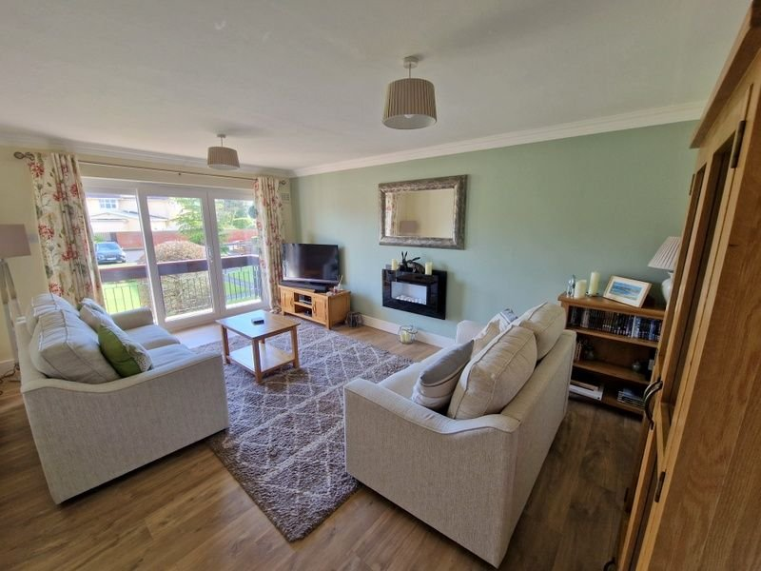
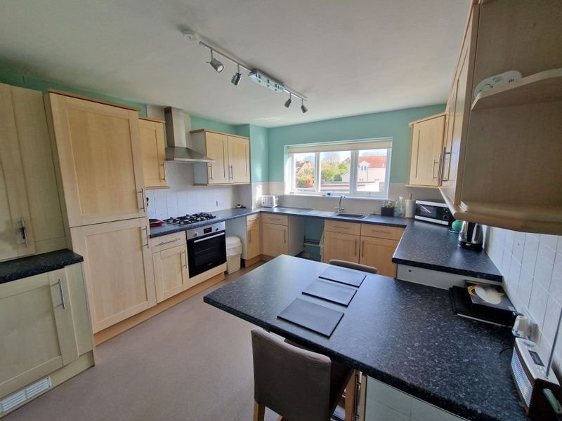
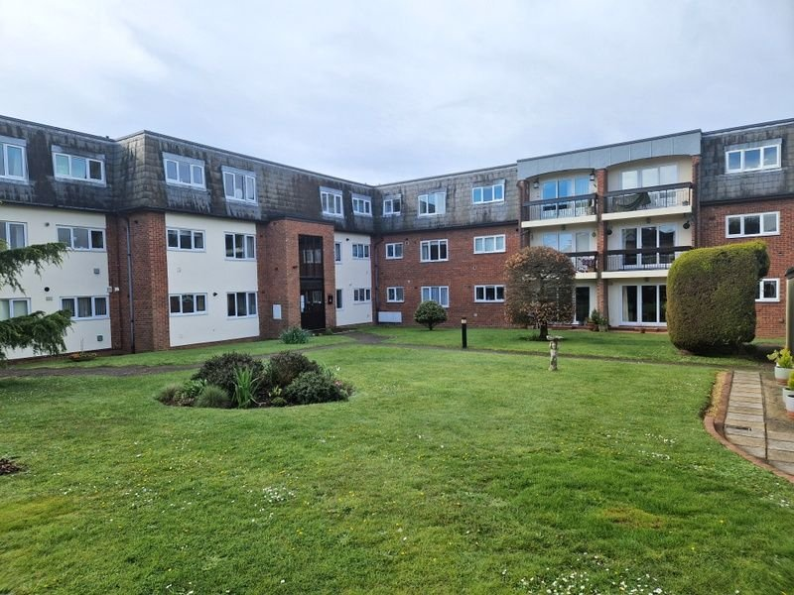
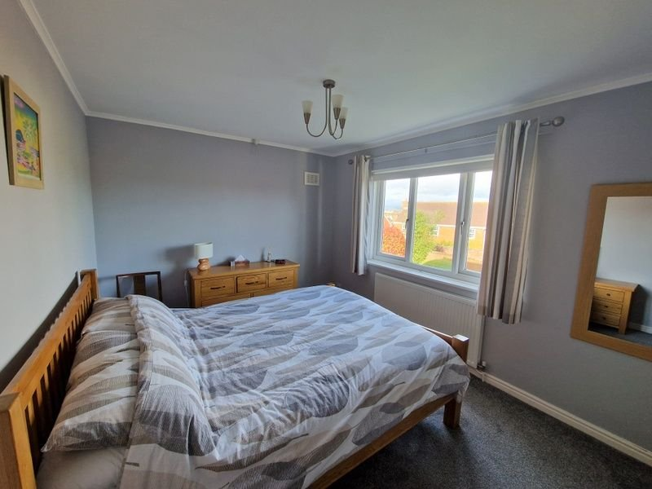
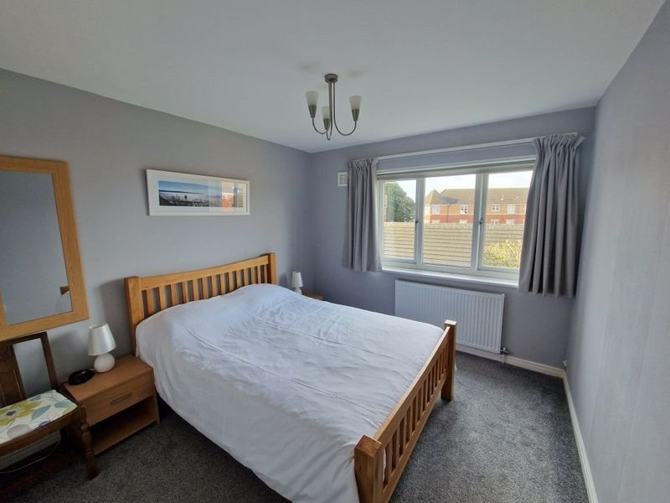
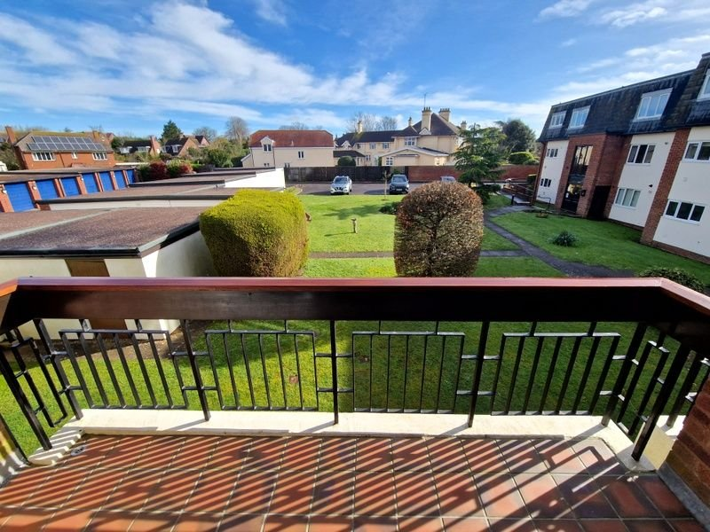
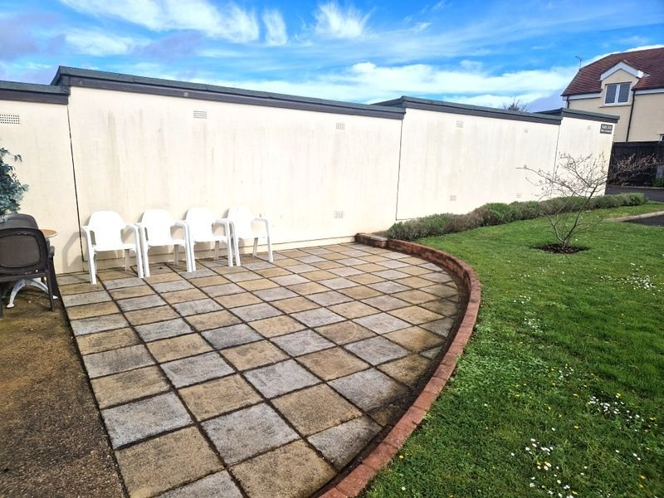
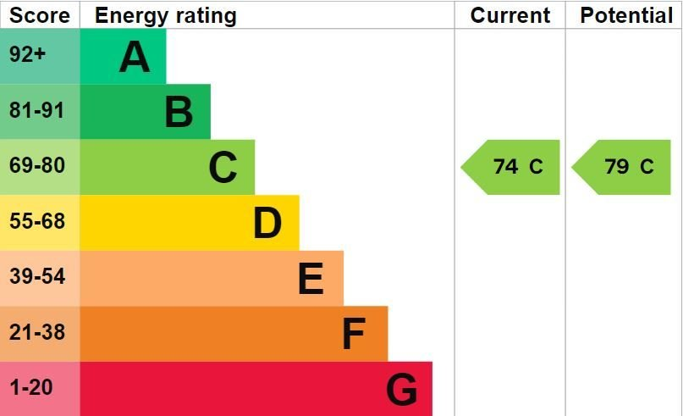
www.pennys.net
Flat 2 Meresyke, 13 Cranford Avenue, Exmouth, EX8 2HT
GUIDE PRICE £257,000
TENURE Share of Freehold
A Well Presented Purpose Built First Floor Apartment Enjoying An Avenues Location Set In Well Tended Communal Gardens And Garage
Lounge/Dining Room With Sun Balcony Off • Modern Kitchen/Breakfast Room •
Two Double Bedrooms • Bathroom/WC • Cloakroom/WC •
Gas Central Heating • Double Glazed Windows •
No Onward Chain •
Pennys Estate Agents Limited for themselves and for the vendor of this property whose agents they are give notice that:- (1) These particulars do not constitute any part of an offer or a contract. (2) All statements contained in these particulars are made without responsibility on the part of Pennys Estate Agents Limited. (3) None of the statements contained in these particulars are to be relied upon as a statement or representation of fact. (4) Any intending purchaser must satisfy himself/herself by inspection or otherwise as to the correctness of each of the statements contained in these particulars. (5) The vendor does not make or give and neither do Pennys Estate Agents Limited nor any person in their employment has any authority to make or give any representation or warranty whatever in relation to this property.
PENNYS ESTATE AGENTS
2 Rolle House, Rolle Street, Exmouth, Devon, EX8 2SN
Tel: 01395 264111 EMail: help@pennys.net

Slide 2
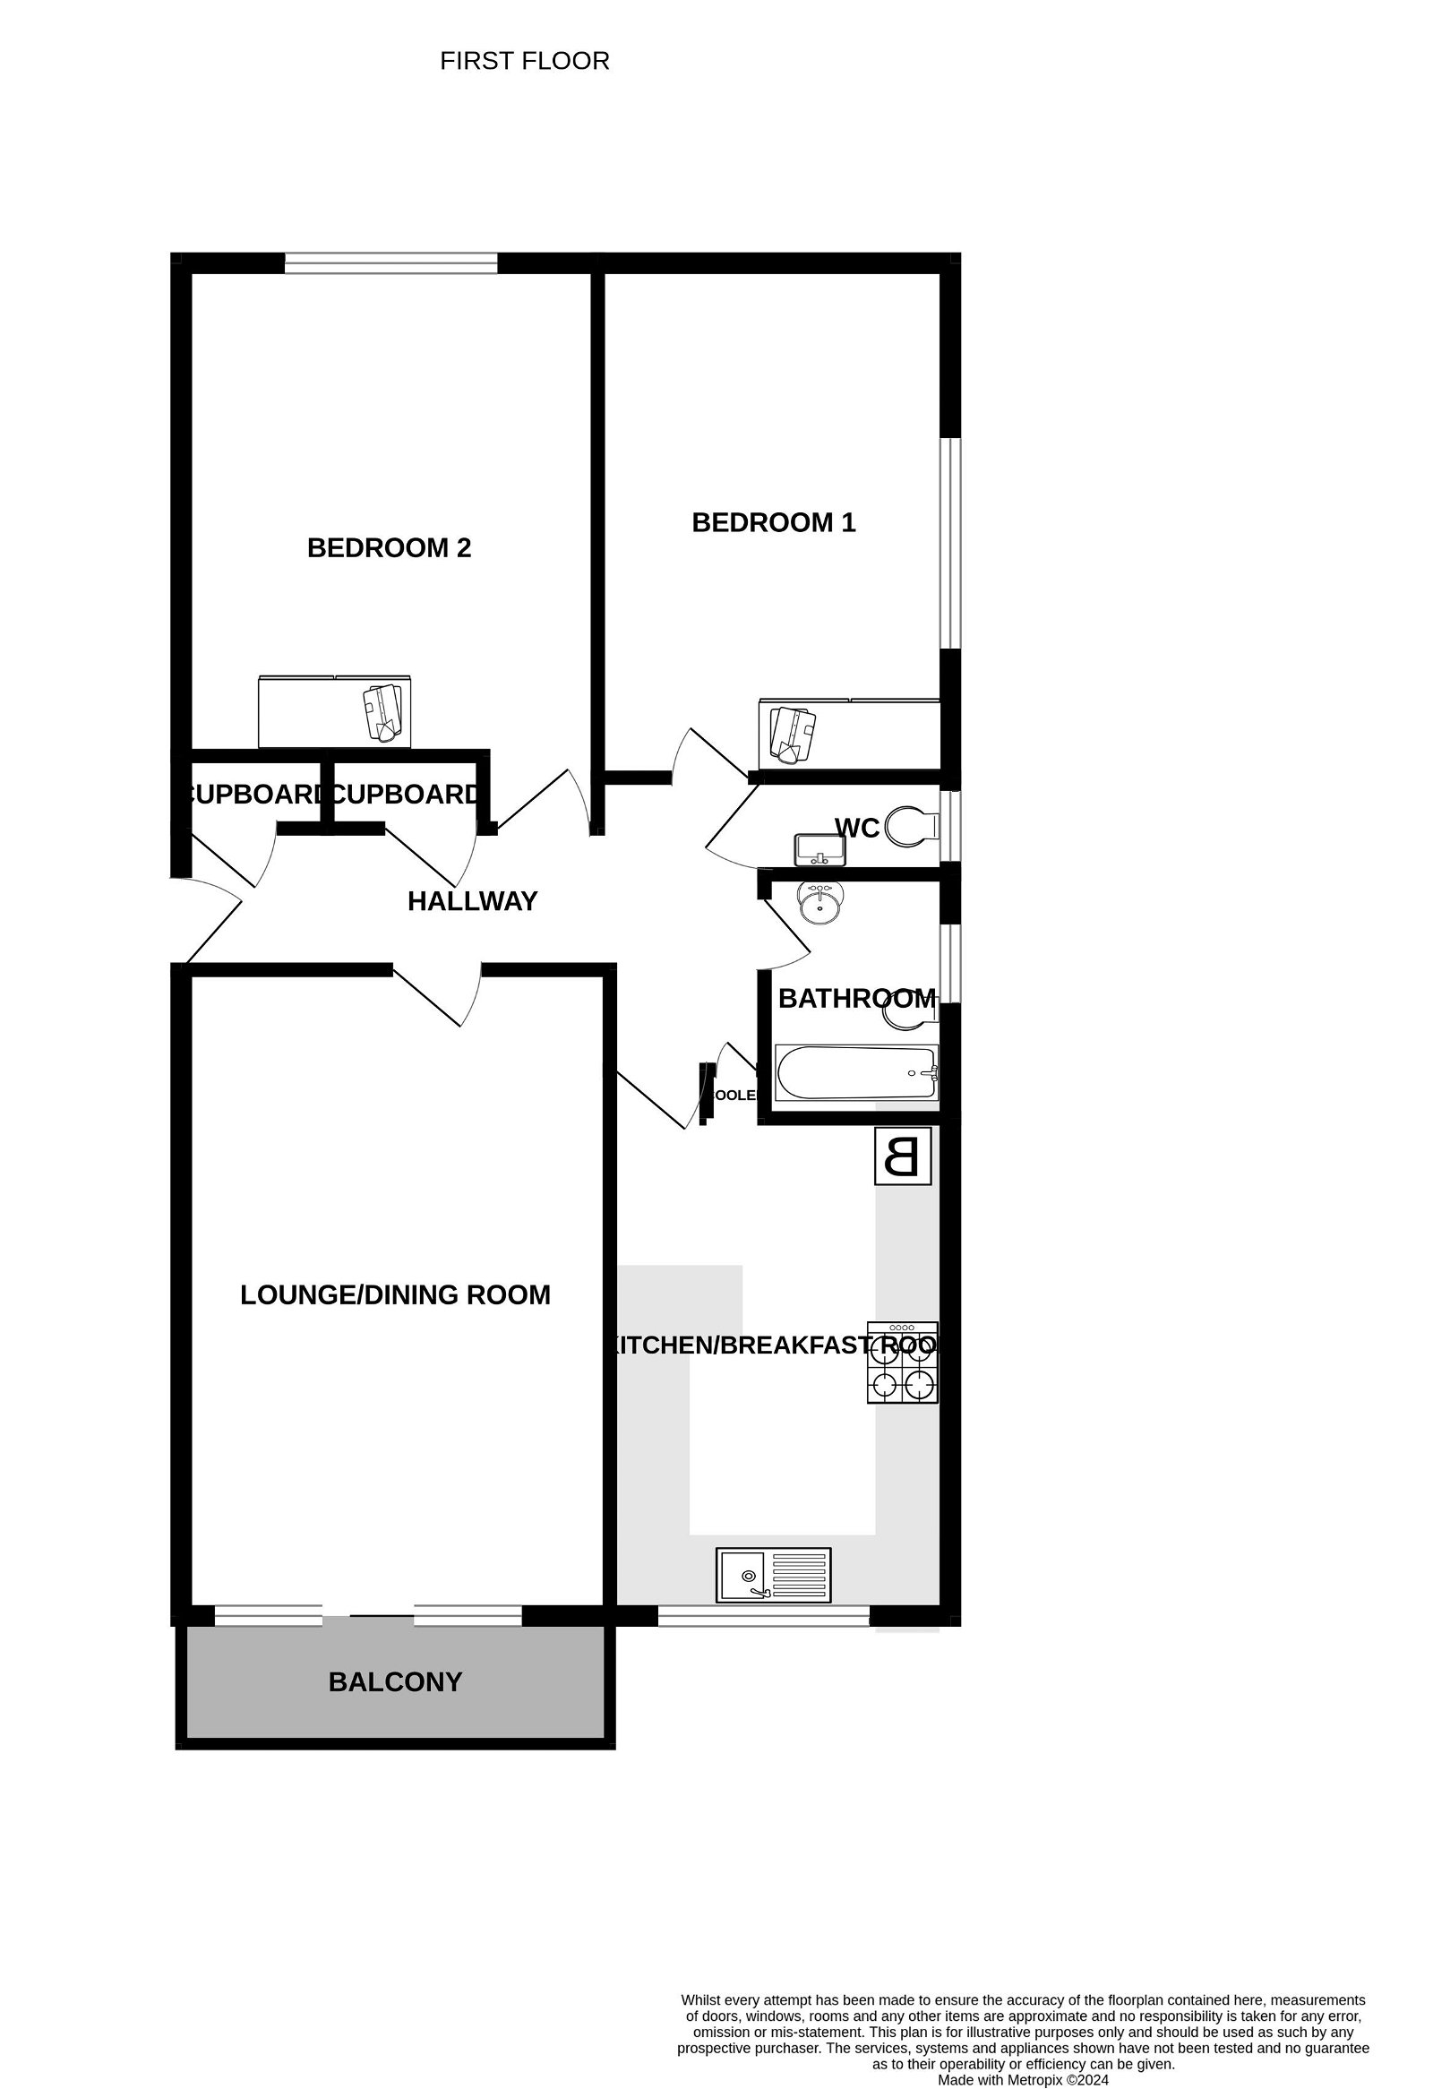
Flat 2 Meresyke, 13 Cranford Avenue, Exmouth, EX8 2HT
THE ACCOMMODATION COMPRISES: Communal entrance with door entry intercom system with staircase to FIRST FLOOR LANDING. Own front door with spy hole and letterbox to: RECEPTION HALL: Wood effect flooring; recess ceiling LED spotlighting; door entry phone; radiator; coats cupboard; adjoining cupboard housing meters and further storage cupboard; telephone access point; doors to: LOUNGE/DINING ROOM: 5.21m x 3.58m (17'1" x 11'9") A spacious bright room with triple doors (middle one sliding) SUN BALCONY which overlooks the communal gardens; television point; wall mounted pebble effect living flame electric fire; telephone point; wood effect flooring; two radiators. KITCHEN/BREAKFAST ROOM: 3.84m x 3.33m (12'7" x 10'11") A well equipped room fitted with a range of worktop surfaces extended to provide breakfast bar area with tiled surrounds; cupboards, drawer units and plumbing for an automatic washing machine and appliance space beneath worktop surfaces; inset single drainer sink unit with mixer tap; four ring gas hob with electric oven beneath and stainless steel extractor hood over; wall mounted cupboards with concealed lighting; drinks cooler in wall recess; integrated fridge freezer; boiler housed in cupboard with cupboard beneath (previously used to house tumble dryer); double glazed window; ceiling spotlighting; radiator. BEDROOM ONE: 4.22m x 2.84m (13'10" x 9'4") Built-in wardrobes; radiator; television point; double glazed window. BEDROOM TWO: 3.78m x 2.9m (12'5" x 9'6") Built-in wardrobes; radiator; double glazed window. BATHROOM/WC: 2.08m x 1.68m (6'10" x 5'6") Bath with Mira shower over, shower curtain and rail; pedestal wash hand basin; WC with push button flush; chrome heated towel rail; mirror fronted medicine cabinet; shaver socket; double glazed window with pattern glass; attractive tiling to splash prone areas. CLOAKROOM/WC: 1.8m x 0.84m (5'11" x 2'9") Space saver wash hand basin; WC; part tiled walls; double glazed window with pattern glass; radiator. OUTSIDE: Meresyke is set in well tended communal gardens with clothes drying area and refuse area. The apartment benefits from a SINGLE GARAGE with up and over door, power and light connected.
TENURE AND OUTGOINGS: The property is leasehold with 999 years from 1978 and also benefits from an equal share of the freehold. The service charge is £1800 per annum which includes buildings insurance and £60.00 per annum ground rent.
FLOOR PLAN:

