Slide 1
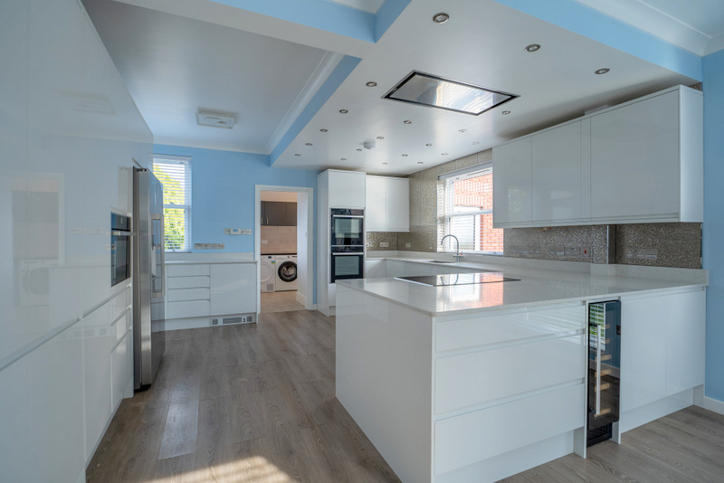
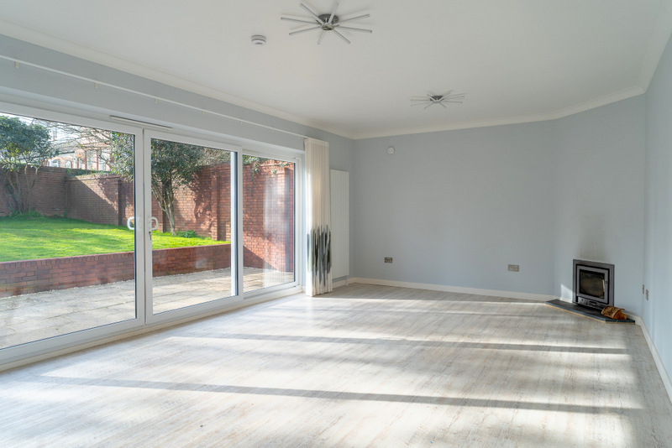
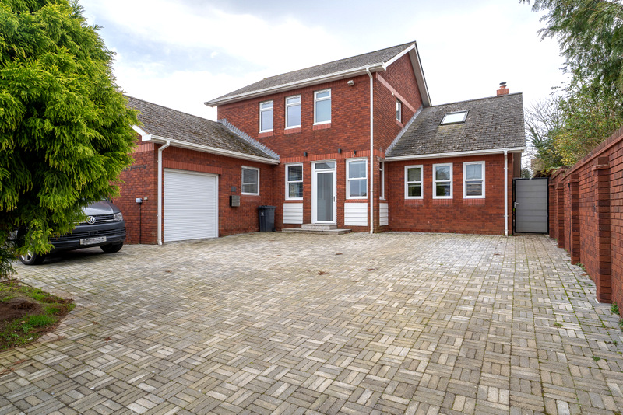
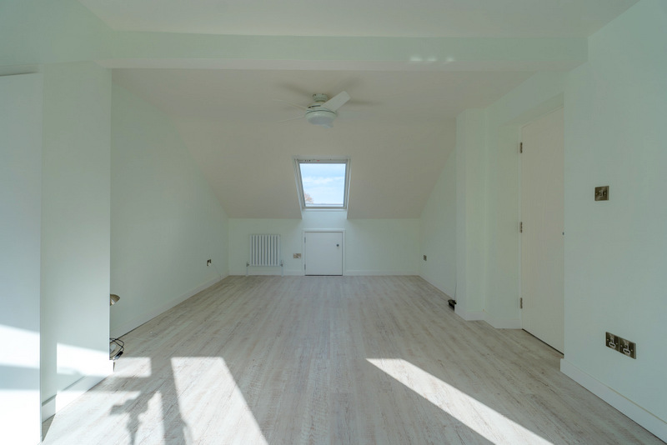
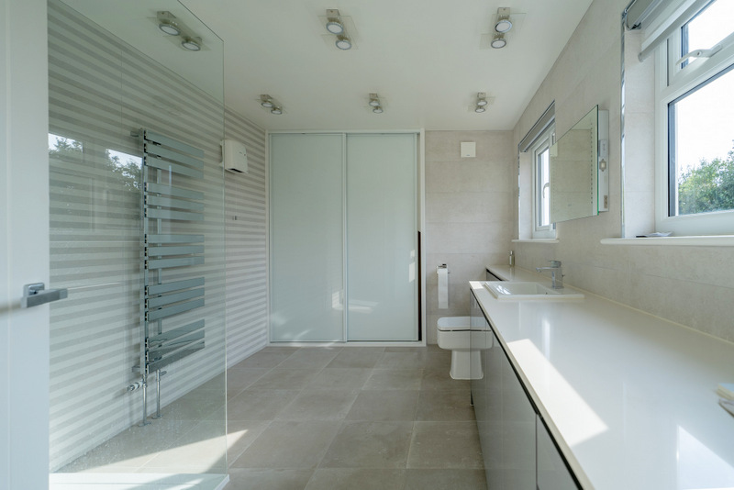
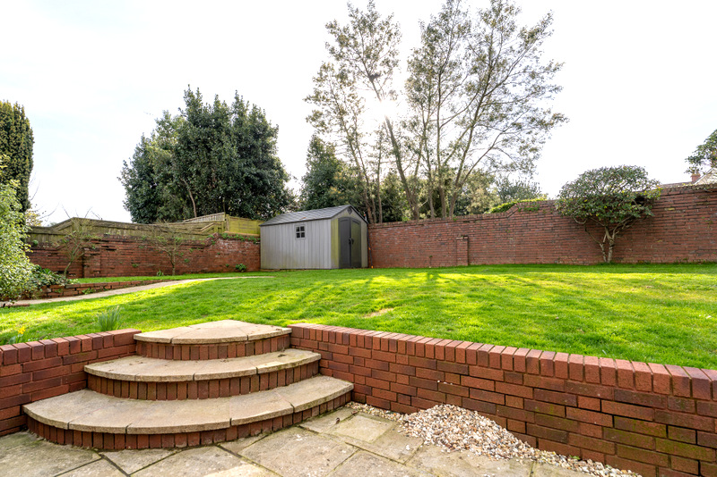
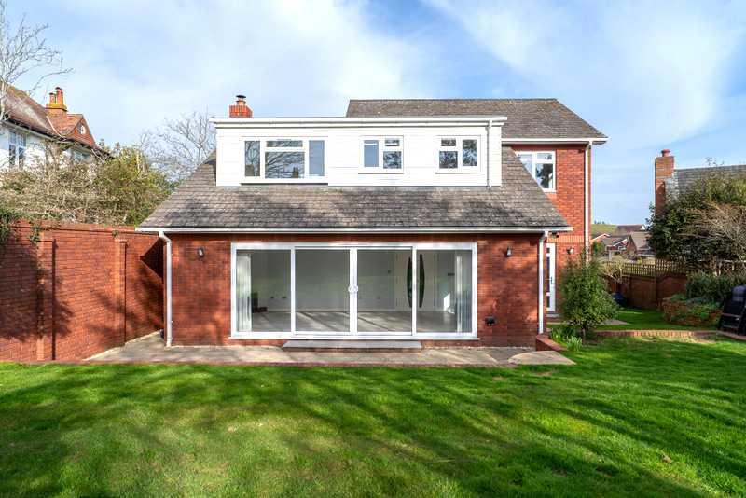
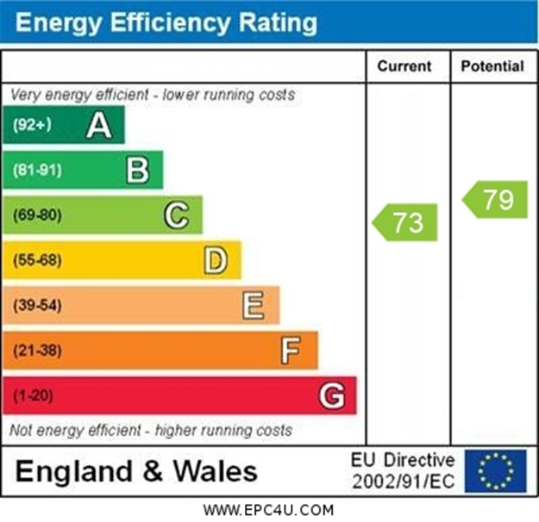
www.pennys.net
85 Douglas Avenue, Exmouth, EX8 2HG
GUIDE PRICE £880,000
TENURE Freehold
A Truly Exceptional Detached Residence, Beautifully Re-furbished And Offering Exceptional Sized Accommodation Of Approximately 2,200 Sq. Footage Set Behind Electrically Operated Gates, With Parking For Numerous Vehicles And Garage
High Quality Accommodation * Well Appointed Kitchen/Dining Room With Range Of Built-In Appliances * Utility Room And Garden Room * Large Dual Aspect Lounge With Log Burner Stove * Ground Floor Bedroom With Modern En-Suite Shower Room/Wc Galleried Landing * Three Double Bedrooms – The Main Bedroom With An Exceptional En-Suite Shower Room/Wc * Newly Fitted Bathroom Suite * Fully Enclosed Rear Garden Gas Central Heating * Double Glazing * Offered For Sale With No Ongoing Chain
Pennys Estate Agents Limited for themselves and for the vendor of this property whose agents they are give notice that:- (1) These particulars do not constitute any part of an offer or a contract. (2) All statements contained in these particulars are made without responsibility on the part of Pennys Estate Agents Limited. (3) None of the statements contained in these particulars are to be relied upon as a statement or representation of fact. (4) Any intending purchaser must satisfy himself/herself by inspection or otherwise as to the correctness of each of the statements contained in these particulars. (5) The vendor does not make or give and neither do Pennys Estate Agents Limited nor any person in their employment has any authority to make or give any representation or warranty whatever in relation to this property.
PENNYS ESTATE AGENTS
2 Rolle House, Rolle Street, Exmouth, Devon, EX8 2SN
Tel: 01395 264111 EMail: help@pennys.net

Slide 2
85 Douglas Avenue, Exmouth, EX8 2HG
Pennys are delighted to offer for sale this individually built, beautifully refurbished detached residence located in the sought after 'Avenues; area of Exmouth within reach of a parade of shops and bus services. Offered with no ongoing chain, the bright and spacious accommodation of over 2,200 sq ft offers the opportunity for those looking for a large family home or multi generation living. Outside there is a block paved driveway offering ample off-road parking for numerous cars/boat/caravan and a single garden. To the rear is an attractively presented and private garden. Viewing is strongly recommended.
THE ACCOMMODATION COMPRISES: uPVC double glazed front door with patterned glass giving access to:
ENTRANCE PORCH: 2.34m x 1.12m (7'8" x 3'8") With courtesy light, double glazed windows and matching inner double glazed door giving access to:
RECEPTION HALL: 6.22m x 2.59m (20'5" x 8'6") An impressive entrance to the property with two radiators, matching double glazed picture window, staircase rising to first floor landing with feature glass chrome balustrade, useful understairs storage cupboard, two radiators.
GROUND FLOOR CLOAKROOM/WC: Refitted with wash hand basin with splashback, cabinet beneath display surface, WC with push button flush, fitted cupboard with sliding doors, shelved cupboard with sliding doors, further shelved storage cupboard, two coat rails, upright radiator, tiled flooring, recessed ceiling spotlighting, ceiling extractor fan.
LOUNGE/DINING ROOM: 8.15m x 4.27m (26'9" x 14'0") A wonderfully sized and bright living space with two double glazed sash style windows and large sliding patio doors opening onto the rear garden, electrically assisted log burner stove housing chimney recess with slate hearth, three radiators, TV point.
KITCHEN/BREAKFAST/DINING ROOM: 7.44m x 4.42m (24'5" x 14'6") Another lovely size room stylishly fitted with range of quartz working surfaces with matching splashbacks with feature tiling over, fitted with one and a half bowl ‘Franke’ sink unit with mixer tap, filtered water position and boiling water tap, inset induction hob with remote controlled ceiling extractor over, led ceiling spotlighting in kitchen working area, built-in double oven, range of cupboards, two carousel units, integrated dishwasher beneath working surfaces, wall mounted cupboards, further range of drawer units, pull-out larder cupboards, built-in microwave oven, American style fridge/freezer, three sets of double glazed sash style windows to front and side aspects and double glazed door opening through to the rear garden, kicker fan is a Myson radiator off the central heating system. Door to:
UTILITY ROOM: 2.62m x 2.51m (8'7" x 8'3") maximum including doorway recess. Fitted with patterned worktop with inset single drainer sink unit with cupboards, washing machine and tumble dryer beneath worktops, tiled splashbacks, wall mounted cupboards over, radiator, double glazed window, floor to ceiling linen cupboard, door to:
GARDEN ROOM: 2.59m x 2.54m (8'6" x 8'4") A very useful area housing electric consumer unit, modern gas boiler for hot water and central heating, radiator, double glazed window to side aspect, double glazed door with patterned glass giving access to the rear garden and door giving direct access to the GARAGE.
GROUND FLOOR BEDROOM 4: 4.24m x 3.81m (13'11" x 12'6") A spacious double bedroom with three sets of double glazed sash style windows to front aspect, radiator, built-in wardrobes with cupboards over.
EN-SUITE BATHROOM/WC: 2.31m x 1.75m (7'7" x 5'9") Beautifully fitted with a stylish modern suite comprising; bath with shower splash screen, shower unit with remote push button control with start/stop, fixed rainfall shower head hose and two detachable shower head hoses, wash hand basin set in display surface with cupboards beneath, cupboards and WC with concealed cistern and push button flush beneath, fitted mirror over sink unit with integrated light and demist, shaver socket, fully tiled walls and tiled flooring, double glazed window with patterned glass, Dimplex electric wall heater, ceiling extractor fan.
FIRST FLOOR GALLERIED LANDING: With double glazed velux window, which lets in an abundance of light with further double glazed window to side aspect, access via loft ladder to roof space, radiator.
BEDROOM 1: 6.71m x 3.73m (22'0" x 12'3") A wonderful main bedroom suite with double glazed window to rear aspect and double glazed velux window to the front elevation, built-in wardrobes, two radiators, access to eaves storage space.
EN-SUITE SHOWER ROOM/WC: 3.73m x 2.67m (12'3" x 8'9") An extremely spacious en-suite stylishly fitted with ease of access shower cubicle with shower splash screen, fixed rainfall shower head hose and detachable shower head hose with remote push button control with start/stop, wash hand basin set in display surface with range of cupboards and drawer units, fitted mirror over sink unit with integrated light and demist (sensor light beneath, wave hand underneath to turn mirror lights on and off), WC with concealed cistern and push button flush, two sets of double glazed windows, chrome heated towel rail, Dimplex wall heater, built-in cupboard with sliding doors, electrically operated blinds with remote and charger, beautiful feature tiled walls and tiled flooring.
BEDROOM 2: 4.34m x 3.66m (14'3" x 12'0") A bright dual aspect room with double glazed windows to side and rear elevations, built-in wardrobe with cupboards over, radiator.
BEDROOM 3: 4.37m x 3.66m (14'4" x 12'0") Another fantastically sized dual aspect bedroom with three sets of double glazed windows to front and rear elevations, built-in wardrobe with cupboard over, airing cupboard with water cylinder and slatted shelving.
MAIN BATHROOM/WC: 2.54m x 1.85m (8'4" x 6'1") Recently fitted and we understand never used comprising; bath with shower splash screen with fixed rainfall shower head hose, two detachable shower head hoses and remote push button start/stop for the shower, wash hand basin set in display surface with cupboards, drawer units, WC with concealed cistern with push button flush beneath, wall mounted cupboards incorporating mirror fronted medicine cabinet with (sensor light beneath, wave hand underneath to turn mirror lights on and off), attractive fully tiled walls and tiled flooring, Dimplex wall heater.
OUTSIDE: The property is located behind an electrically controlled sliding gates which lead to a large block paved driveway and turning area providing parking for numerous vehicles, boats, caravans etc, with outside power supply, leading to a GARAGE, side gate and patio pathway leads through to the rear garden. The rear garden is fully enclosed by brick walling, looking over lovely size patio sun terrace ideal for outside entertaining with patio pathways, extensive lawned garden with raised shrub beds, lawned area side garden with patio area and pathway leading back around to the front of the property via further gate. Outside lighting and outside cold water tap.
GARAGE: 5.54m x 2.54m (18'2" x 8'4") Electrically operated roller door with remote control, fitted range of work benches, double glazed window, power and light connected, door into the main house and access to mezzanine boarded storage area with further access to more roof void storage areas.
SEPARATE FLOOR PLAN:

