Slide 1
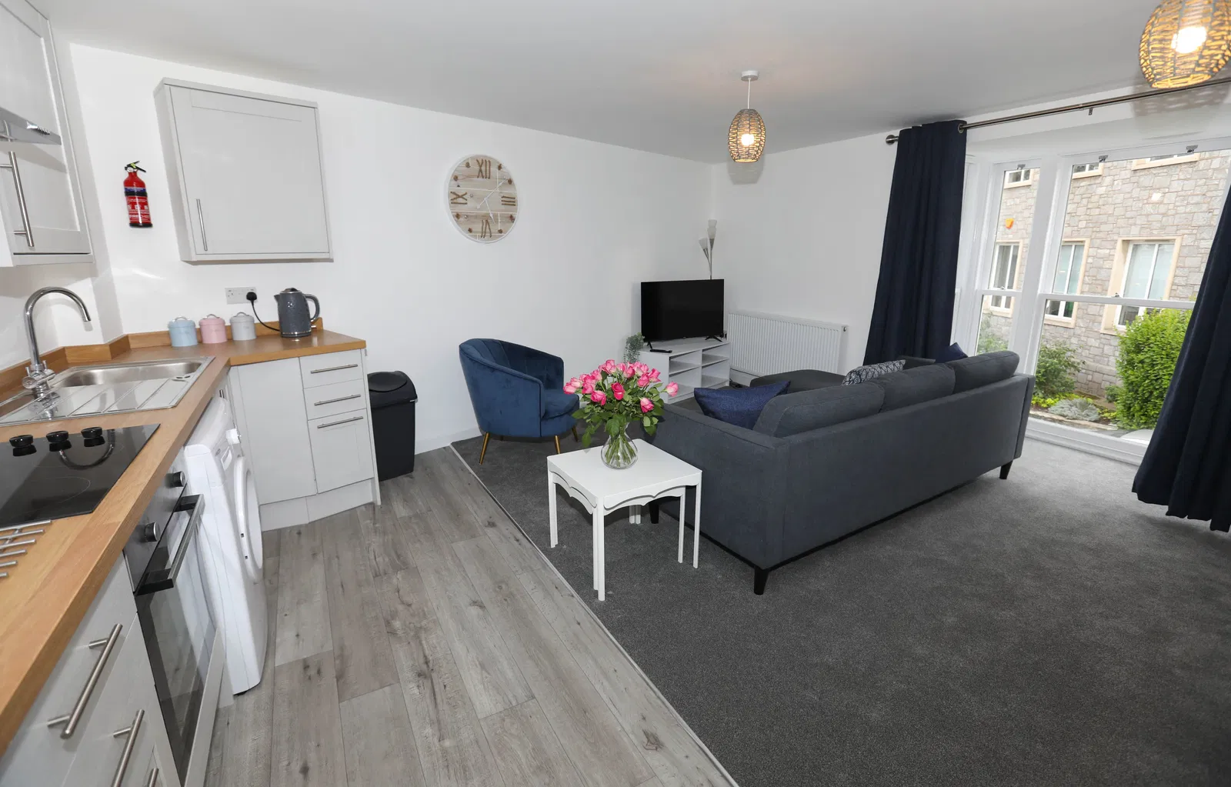
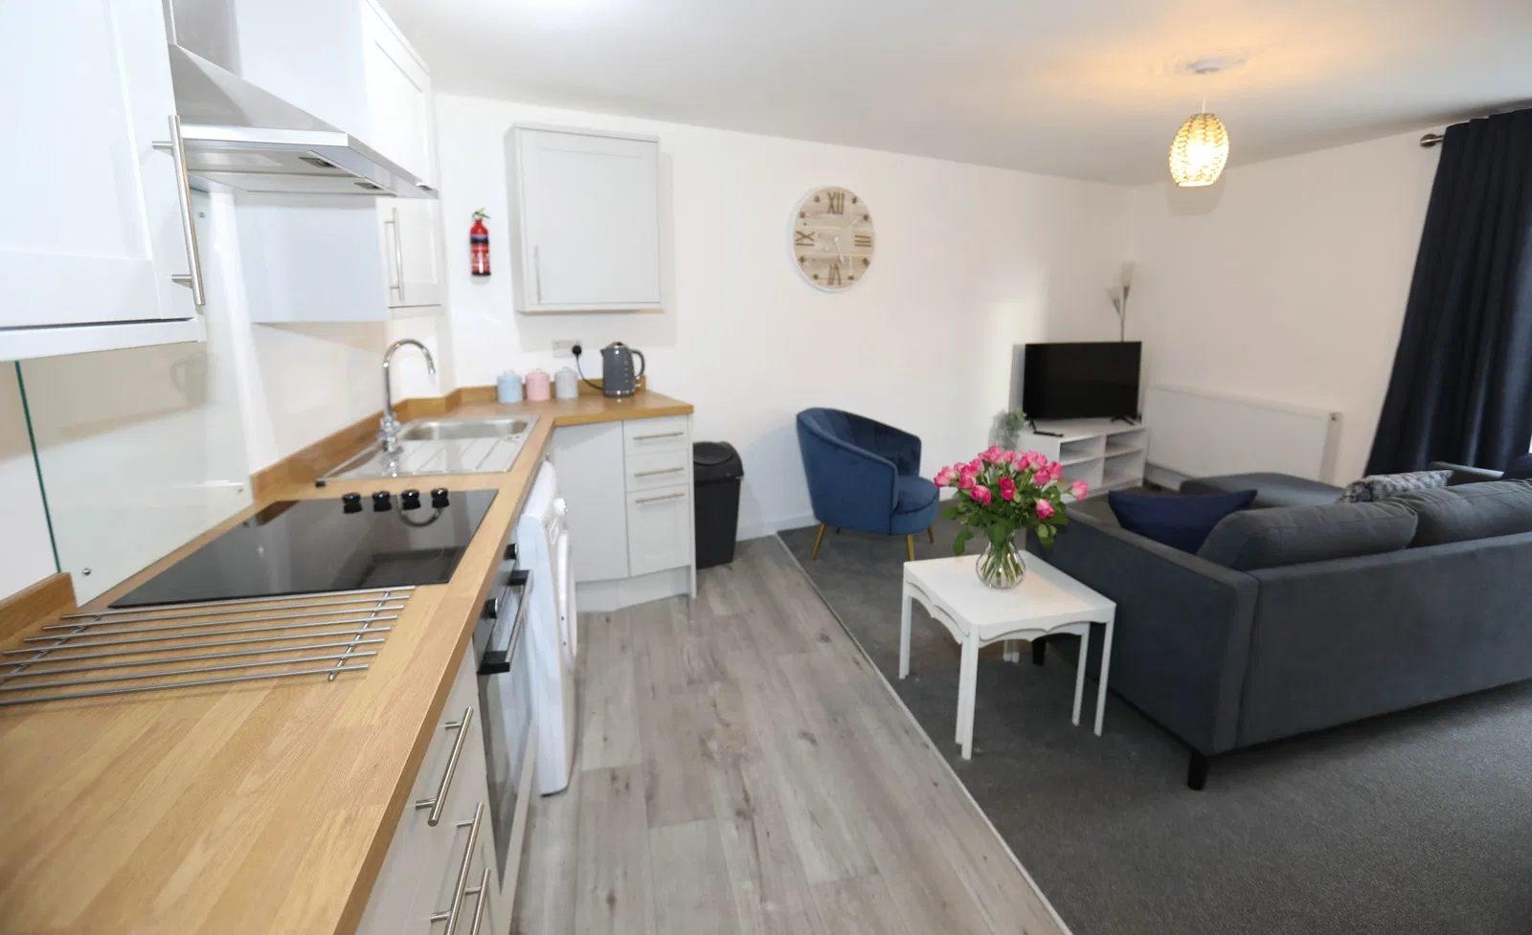
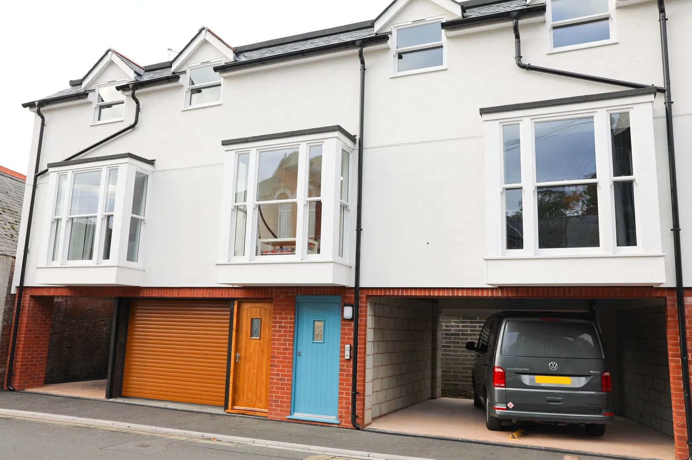
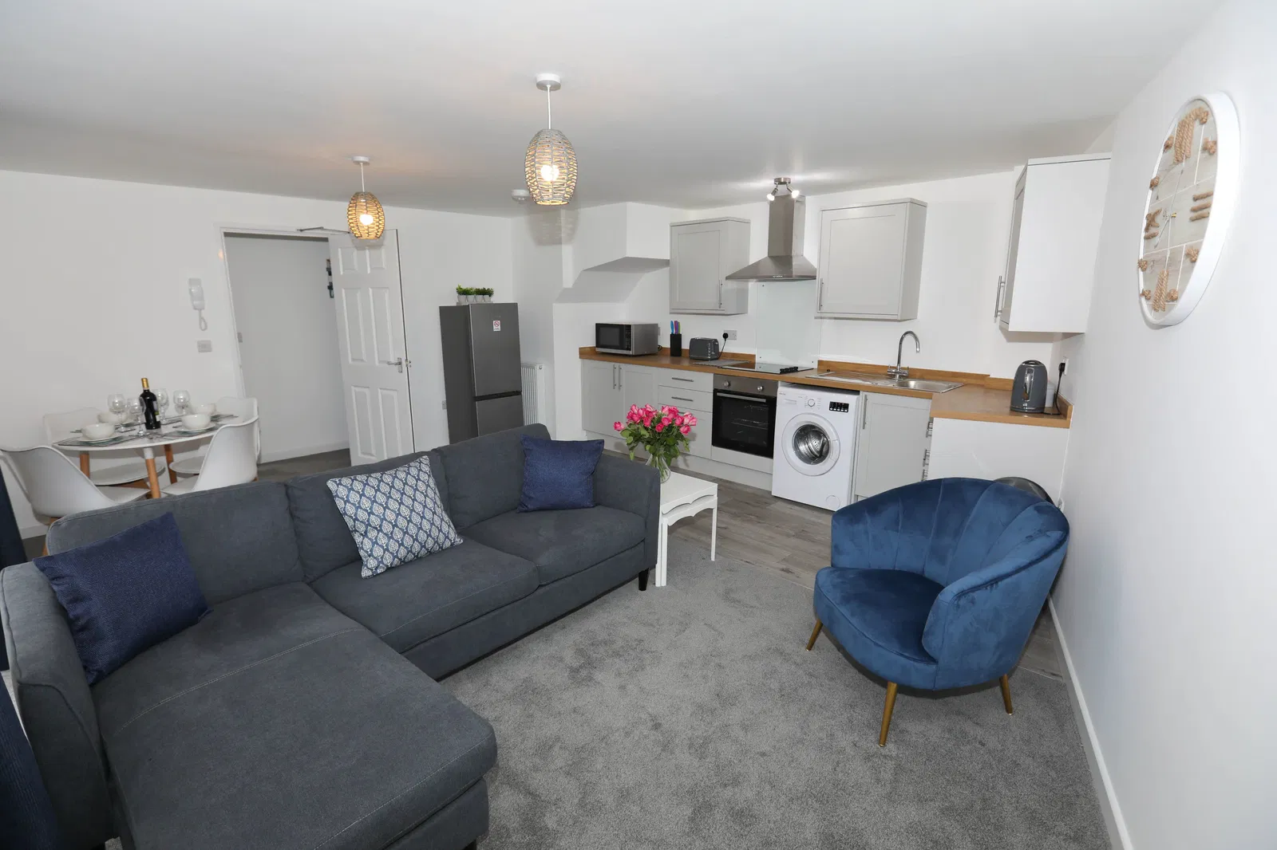
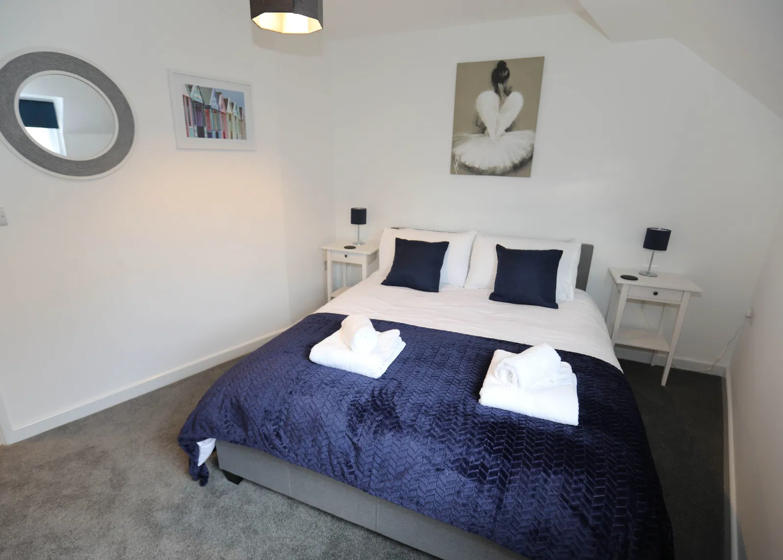
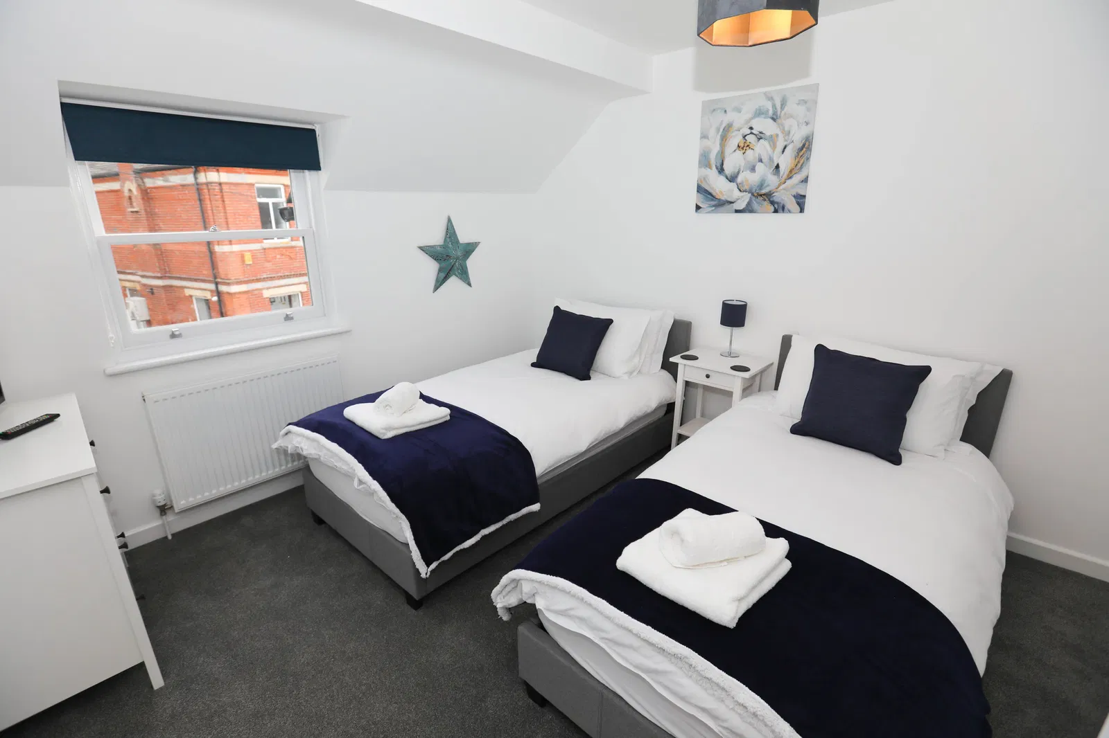
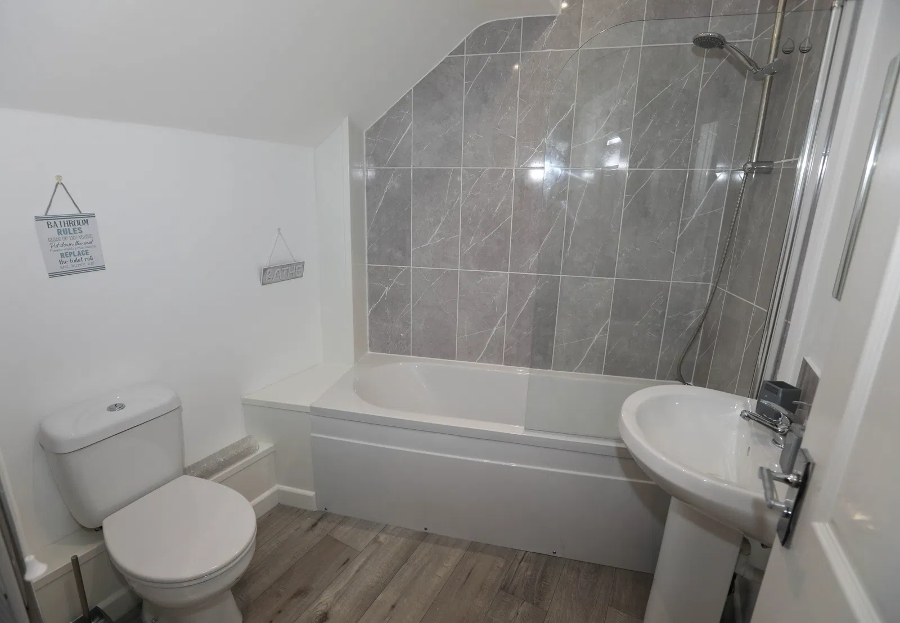
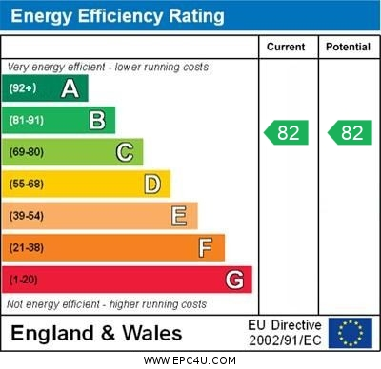
www.pennys.net
Thomas Tucker Building, Flat 6, 37 The Strand, Exmouth, EX8 1AQ
GUIDE PRICE £240,000
TENURE Shared Freehold
High Quality Maisonette Style Apartment Located Close To The Heart Of The Town Centre
Spacious High Quality Open-Plan Kitchen/Living Room * Two Double Bedrooms * Bathroom/Wc * Double Glazed Windows * Gas Central Heating Super Permanent Or Holiday Home Retreat – Currently And Successfully Run As An Airbnb * Covered Parking Space Available Subject To Separate Negotiation
Pennys Estate Agents Limited for themselves and for the vendor of this property whose agents they are give notice that:- (1) These particulars do not constitute any part of an offer or a contract. (2) All statements contained in these particulars are made without responsibility on the part of Pennys Estate Agents Limited. (3) None of the statements contained in these particulars are to be relied upon as a statement or representation of fact. (4) Any intending purchaser must satisfy himself/herself by inspection or otherwise as to the correctness of each of the statements contained in these particulars. (5) The vendor does not make or give and neither do Pennys Estate Agents Limited nor any person in their employment has any authority to make or give any representation or warranty whatever in relation to this property.
PENNYS ESTATE AGENTS
2 Rolle House, Rolle Street, Exmouth, Devon, EX8 2SN
Tel: 01395 264111 EMail: help@pennys.net

Slide 2
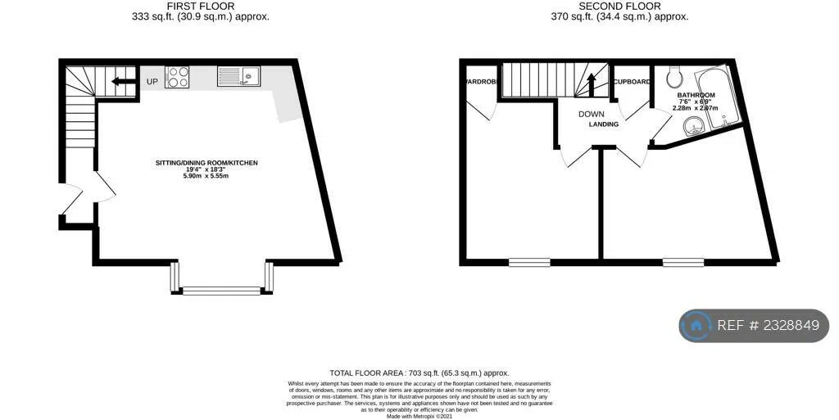
Thomas Tucker Building, Flat 6, 37 The Strand, Exmouth, EX8 1AQ
THE ACCOMMODATION COMPRISES: Communal entrance with door intercom serving two apartments with staircase rising to first floor, private front door to Reception Hall, store cupboard, staircase leading to second floor.
OPEN-PLAN KITCHEN & LIVING ROOM: 5.18m x 4.88m (17'0" x 16'0") plus double glazed bay window fitted with sash style windows and overlooking the front elevation. A bright spacious room comprising Kitchen Area fitted with wood effect worktops with matching splashbacks with inset single drainer sink unit with mixer tap with glass splashback with cupboards, drawer units, plumbing for automatic washing machine beneath work surfaces, inset four-ring hob with glass splashback and chimney style extractor hood over with light and built-in oven below, wall mounted cupboards, radiator, LIVING AREA: fitted radiator, TV point and door entry phone.
SECOND FLOOR LANDING AREA: Cupboard housing Baxi gas boiler for hot water and central heating and electric consumer unit.
BEDROOM 1: 3.66m x 2.79m (12'0" x 9'2") Double glazed sash style window to front aspect, TV point, radiator.
BEDROOM 2: 13.94m x 3.35m (12'11" x 11'0") Built-in cupboard, clothes hanging rail, radiator, double glazed sash style window to front aspect, TV point.
BATHROOM/WC: 2.01m x 1.93m (6'7" x 6'4") Comprising bath with shower attachment, pedestal wash hand basin, WC with push button flush, chrome heated towel rail, fitted wall mirror, recessed ceiling led spotlighting, ceiling extractor fan.
TENURE & OUTGOINGS: To be confirmed.
Mortgage Assistance: We are pleased to recommend Meredith Morgan Taylor, who would be pleased to help no matter which estate agent you finally buy through. For a free initial chat please contact us on to arrange an appointment. Your home may be repossessed if you do not keep up repayments on your mortgage. Meredith Morgan Taylor Ltd is an appointed representative of The Openwork Partnership, a trading style of Openwork Ltd which is authorised and regulated by the Financial Conduct Authority (FCA).
FLOOR PLAN:

