Slide 1
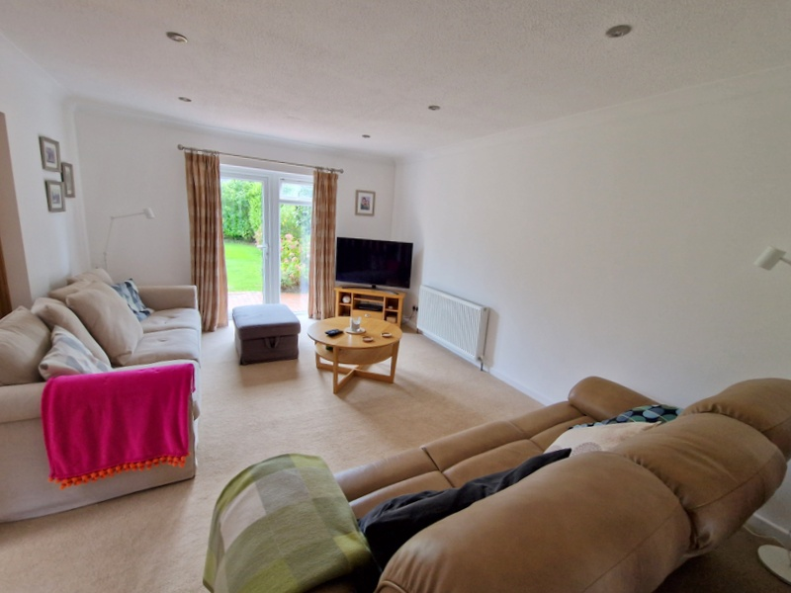
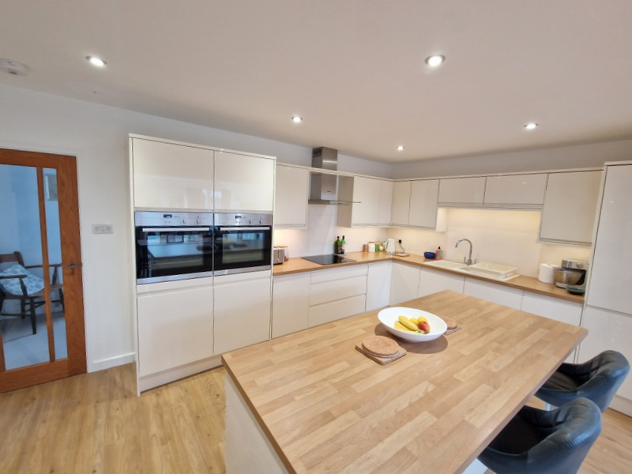
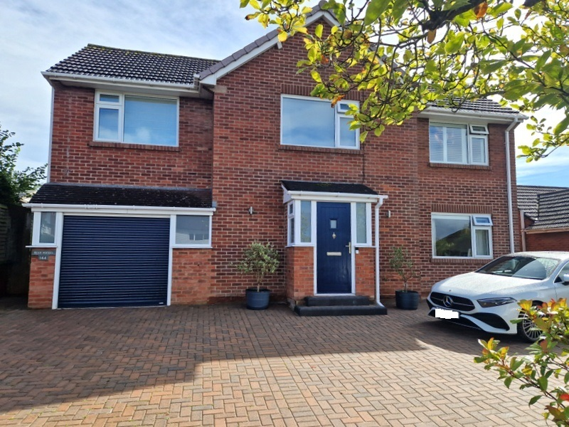
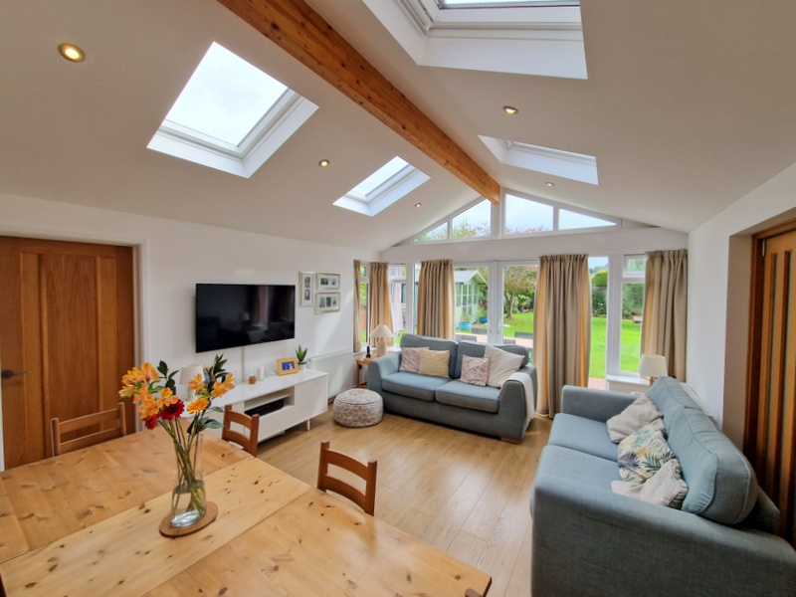
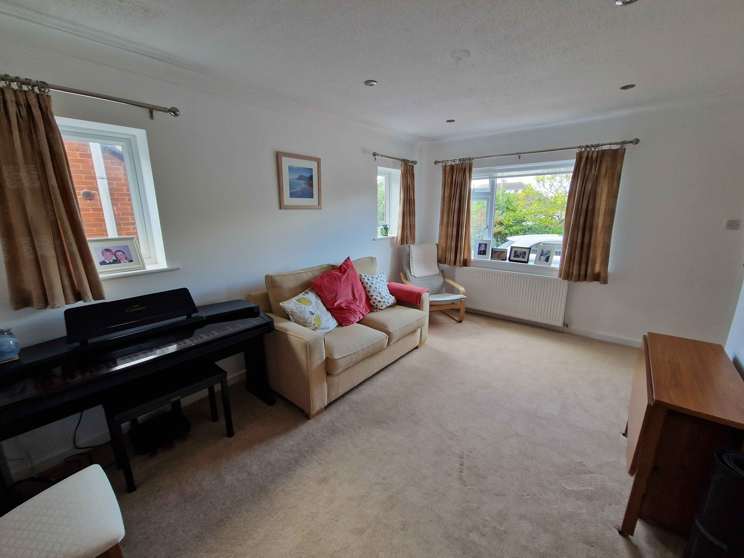
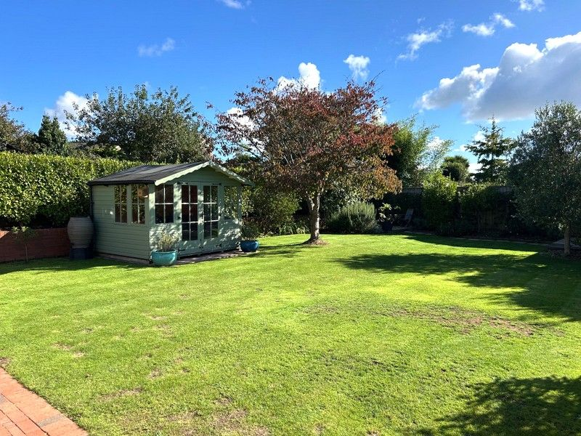
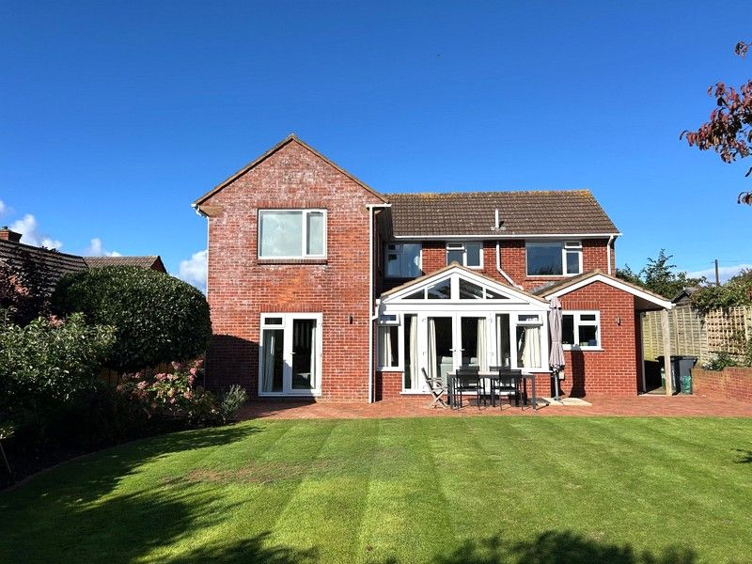
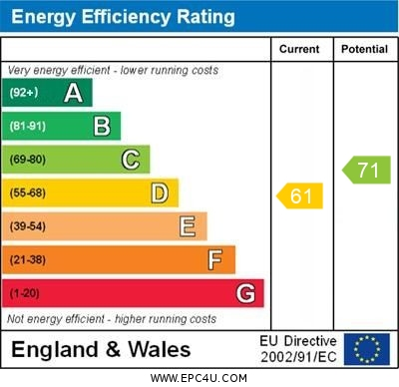
www.pennys.net
Blue Hayes,144 Hulham Road, Exmouth, EX8 4RD
GUIDE PRICE £775,000
TENURE Freehold
A Stunning Detached Family Home Which Has Been Significantly Extended And Much Improved Enjoying Ample Parking, Garage And Level Good Size Landscaped Rear Garden
Sitting Room * Attractive Lounge * Stunning Open-Plan Modern Kitchen/Breakfast/Dining/Family Room * Good Size Utility Room * Ground Floor Cloakroom/Wc * Four First Floor Bedrooms – Main Bedroom With En-Suite Stylish Shower Room/Wc * Family Bathroom Suite * Gas Central Heating * Double Glazed Windows * Viewing Highly Recommended
Pennys Estate Agents Limited for themselves and for the vendor of this property whose agents they are give notice that:- (1) These particulars do not constitute any part of an offer or a contract. (2) All statements contained in these particulars are made without responsibility on the part of Pennys Estate Agents Limited. (3) None of the statements contained in these particulars are to be relied upon as a statement or representation of fact. (4) Any intending purchaser must satisfy himself/herself by inspection or otherwise as to the correctness of each of the statements contained in these particulars. (5) The vendor does not make or give and neither do Pennys Estate Agents Limited nor any person in their employment has any authority to make or give any representation or warranty whatever in relation to this property.
PENNYS ESTATE AGENTS
2 Rolle House, Rolle Street, Exmouth, Devon, EX8 2SN
Tel: 01395 264111 EMail: help@pennys.net

Slide 2
Blue Hayes, 144 Hulham Road, Exmouth, EX8 4RD
THE ACCOMMODATION COMPRISES: Composite front door to:
RECEPTION HALL: With frosted uPVC double glazed windows, wood effect flooring in entrance area with stairs rising to first floor landing, radiator, recessed ceiling spotlighting, telephone point. Useful Understairs cupboard: 2.26m x 0.84m (7'5" x 2'9") fitted out as a small office with radiator and recessed ceiling spotlighting.
SITTING ROOM: 4.52m x 3.43m (14'10" x 11'3") A charming room with uPVC double glazed windows to front and side aspects, recessed ceiling spotlighting, radiator, bi-folding doors opening through to the main living area, which once opened provides a lovely open space.
LOUNGE: 4.85m x 3.68m (15'11" x 12'1") A charming room with uPVC double glazed door and window overlooking and opening onto the rear garden, TV point, radiator, recessed ceiling spotlighting, bi-folding doors opening through to:
KITCHEN/BREAKFAST/DINING/FAMILY ROOM: 8.38m x 5.13m (27'6" x 16'10") overall measurement. A spacious high quality room providing a superb hub to the house. The kitchen/breakfast room is fitted with a range of wood effect working tops including a central island unit with cupboards, drawer units and extended to provide a breakfast bar area. Wide range of base cupboards and drawer units, with one and a quarter bowl single drainer sink unit, induction hob set into work surfaces, splashback walls, stainless steel chimney style extractor hood with light, two built-in ovens, cupboards above and below, wall mounted cupboards with concealed lighting beneath, upright stylish radiator. The dining/family room is a bright and spacious area with vaulted style ceiling with four double glazed velux windows allowing an abundance of light with ceiling beam, plus uPVC double glazed windows and double doors overlooking and opening onto the rear garden, two radiators, TV point, feature wood flooring throughout and door to:
UTILITY ROOM: 3.53m x 2.31m (11'7" x 7'7") Fitted with patterned worktops with cupboards, drawer units, plumbing for automatic washing machine and space for tumble dryer beneath worktops, inset single drainer sink unit, tiled surrounds, wall mounted cupboard, ceiling spotlighting, ceiling extractor fan, radiator, uPVC double glazed window overlooking the rear garden, wood effect flooring, uPVC double glazed door giving access to the rear garden and door to GARAGE and access to:
GROUND FLOOR CLOAKROOM/WC: Stylish modern suite comprising vanity wash hand basin with tiled splashback, WC with concealed cistern and push button flush, radiator, recessed ceiling spotlight and ceiling extractor fan, uPVC double glazed window with patterned glass, wood effect flooring.
From the reception hall a turning staircase rises to:
FIRST FLOOR GALLERIED LANDING: With access to eaves storage space on half landing, uPVC double glazed window to front aspect. On the main landing there is a radiator, access to boarded roof space via loft ladder, airing cupboard with water cylinder and slatted shelving, adjoining linen cupboard with radiator.
BEDROOM 1: 4.27m x 3.84m (14'0" x 12'7") plus doorway 2.74m x 0.81m (9'0" x 2'8") with access to the en-suite shower room/wc. An excellent dual aspect main bedroom suite with double glazed windows to side and rear aspects enjoying an open outlook, two radiators, built-in range of wardrobes with sliding doors.
EN-SUITE SHOWER ROOM/WC: 2.49m x 1.52m (8'2" x 5'0") Stylish suite comprising double width shower cubicle with fixed rainfall shower head hose and detachable rainfall shower head hose, shower splash screen, vanity wash hand basin with fitted mirror with integrated light over, WC with concealed cistern with push button flush, ladder style chrome heated towel rail, attractive extensively tiled walls, recess ceiling spotlighting, ceiling extractor fan.
BEDROOM 2: 4.55m x 3.33m (14'11" x 10'11") A bright spacious double bedroom with uPVC double glazed windows to front and rear aspects, radiator, TV point.
BEDROOM 3: 3.07m x 2.51m (10'1" x 8'3") Another double bedroom with uPVC double glazed window to front elevation with wooden window shutters enjoying a view towards the estuary and coastline beyond, TV point, radiator, built-in single wardrobe.
BEDROOM 4: 2.62m x 2.62m (8'7" x 8'7") uPVC double glazed window to rear aspect, radiator, built-in single wardrobe.
FAMILY BATHROOM/WC: 2.31m x 2.01m (7'7" x 6'7") Modern suite comprising bath with shower unit over and shower splash screen, vanity style wash hand basin with range of cupboards beneath, WC with concealed cistern and push button flush, attractive tiling to splash prone areas, radiator, recessed ceiling spotlighting, uPVC double glazed with patterned glass, ladder style chrome heated towel rail.
OUTSIDE: The property enjoys a large block paved driveway and parking/turning area edged with well stocked shrub beds, leading to the garage. A wooden side gate and pathway, leads through to the rear garden. The rear garden is a superb feature of the property being landscaped comprising of a good size level garden with a spacious block paved terrace, ideal for outside entertaining with outside lighting, well stocked colourful flower and shrub beds. Decorative stone seating area to the rear of the garden and GARDEN SHED. Outside power. SUMMER HOUSE 2.9m x 2.31m (9'6" x 7'7") with power and light connected, with windows and glazed double doors
GARAGE: 5.79m x 2.72m (19'0" x 8'11") Electric roll up and over door, electric consumer unit, Vaillant gas boiler for hot water and central heating, fitted work surface with cupboards and drawer units beneath, gas meter, double glazed windows with patterned glass, cold water taps.
Mortgage Assistance: We are pleased to recommend Meredith Morgan Taylor, who would be pleased to help no matter which estate agent you finally buy through. For a free initial chat please contact us on to arrange an appointment. Your home may be repossessed if you do not keep up repayments on your mortgage. Meredith Morgan Taylor Ltd is an appointed representative of The Openwork Partnership, a trading style of Openwork Ltd which is authorised and regulated by the Financial Conduct Authority (FCA).
FLOOR PLAN: Insert.

