Slide 1
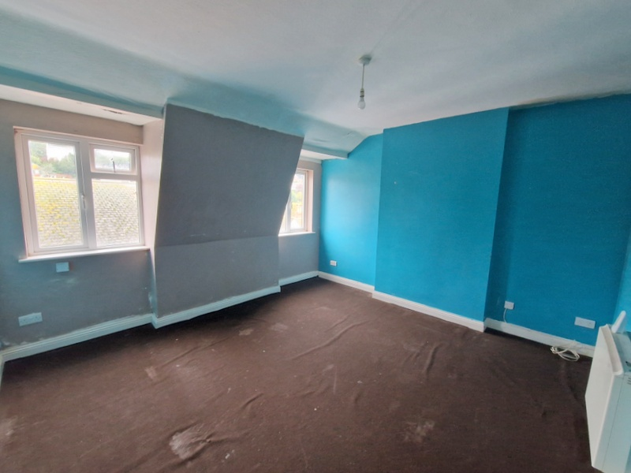
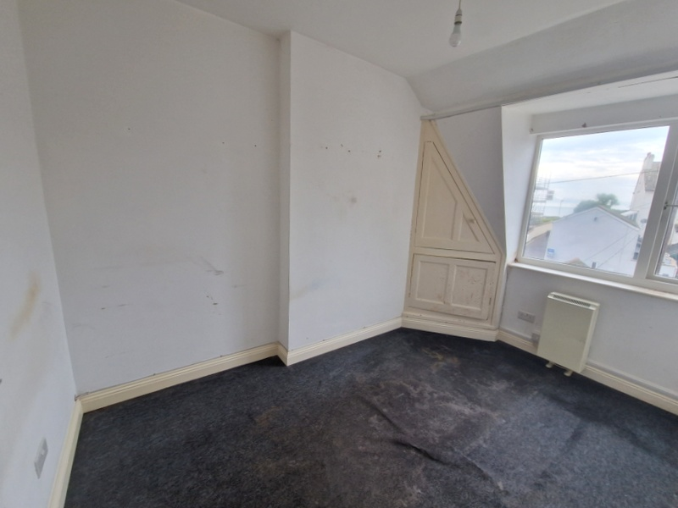

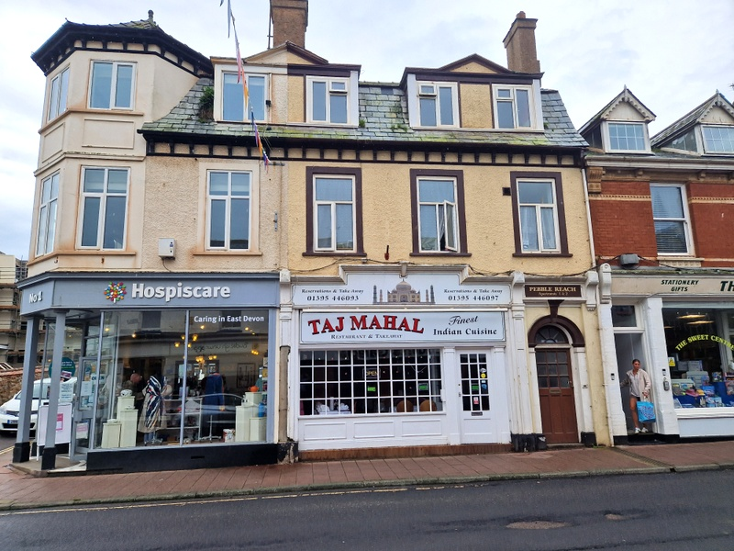
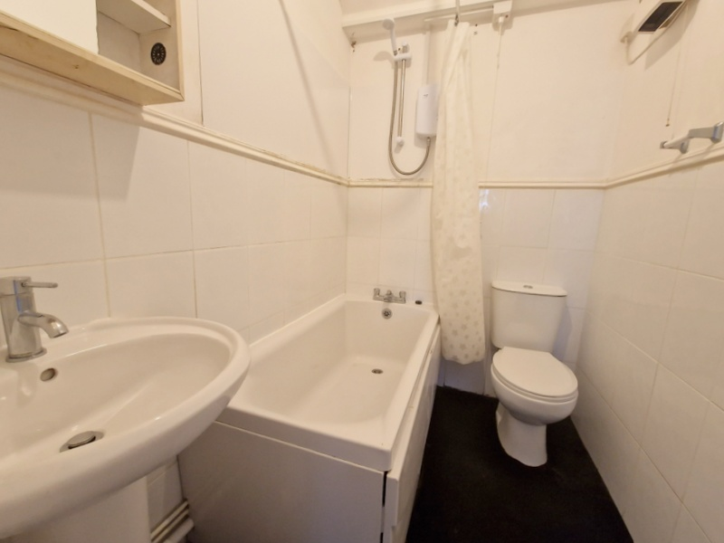
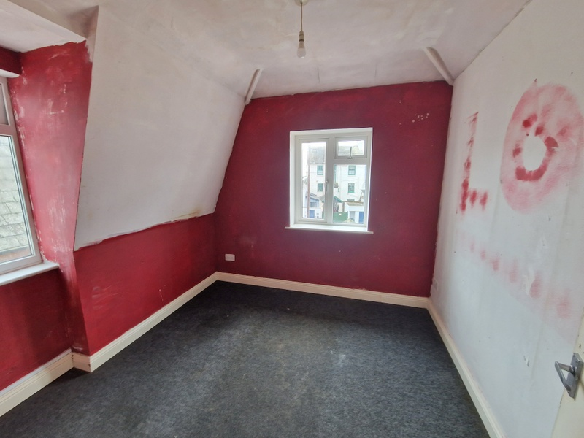
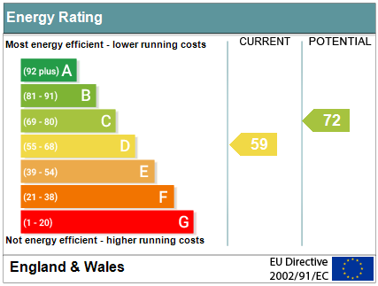

www.pennys.net
Flat 2 Pebble Reach, 1c High Street, Budleigh Salterton, EX9 6LD
GUIDE PRICE £135,000
TENURE Leasehold
An Upper Floor Two Bedroom Flat Ideally Located In Budleigh Salterton Town Centre Offering Easy Access To Amenities And Seafront
Good Size Lounge * Separate Kitchen * Two Bedrooms * Bathroom/Wc * General Refurbishment Required * No Ongoing Chain
Pennys Estate Agents Limited for themselves and for the vendor of this property whose agents they are give notice that:- (1) These particulars do not constitute any part of an offer or a contract. (2) All statements contained in these particulars are made without responsibility on the part of Pennys Estate Agents Limited. (3) None of the statements contained in these particulars are to be relied upon as a statement or representation of fact. (4) Any intending purchaser must satisfy himself/herself by inspection or otherwise as to the correctness of each of the statements contained in these particulars. (5) The vendor does not make or give and neither do Pennys Estate Agents Limited nor any person in their employment has any authority to make or give any representation or warranty whatever in relation to this property.
PENNYS ESTATE AGENTS
2 Rolle House, Rolle Street, Exmouth, Devon, EX8 2SN
Tel: 01395 264111 EMail: help@pennys.net

Slide 2
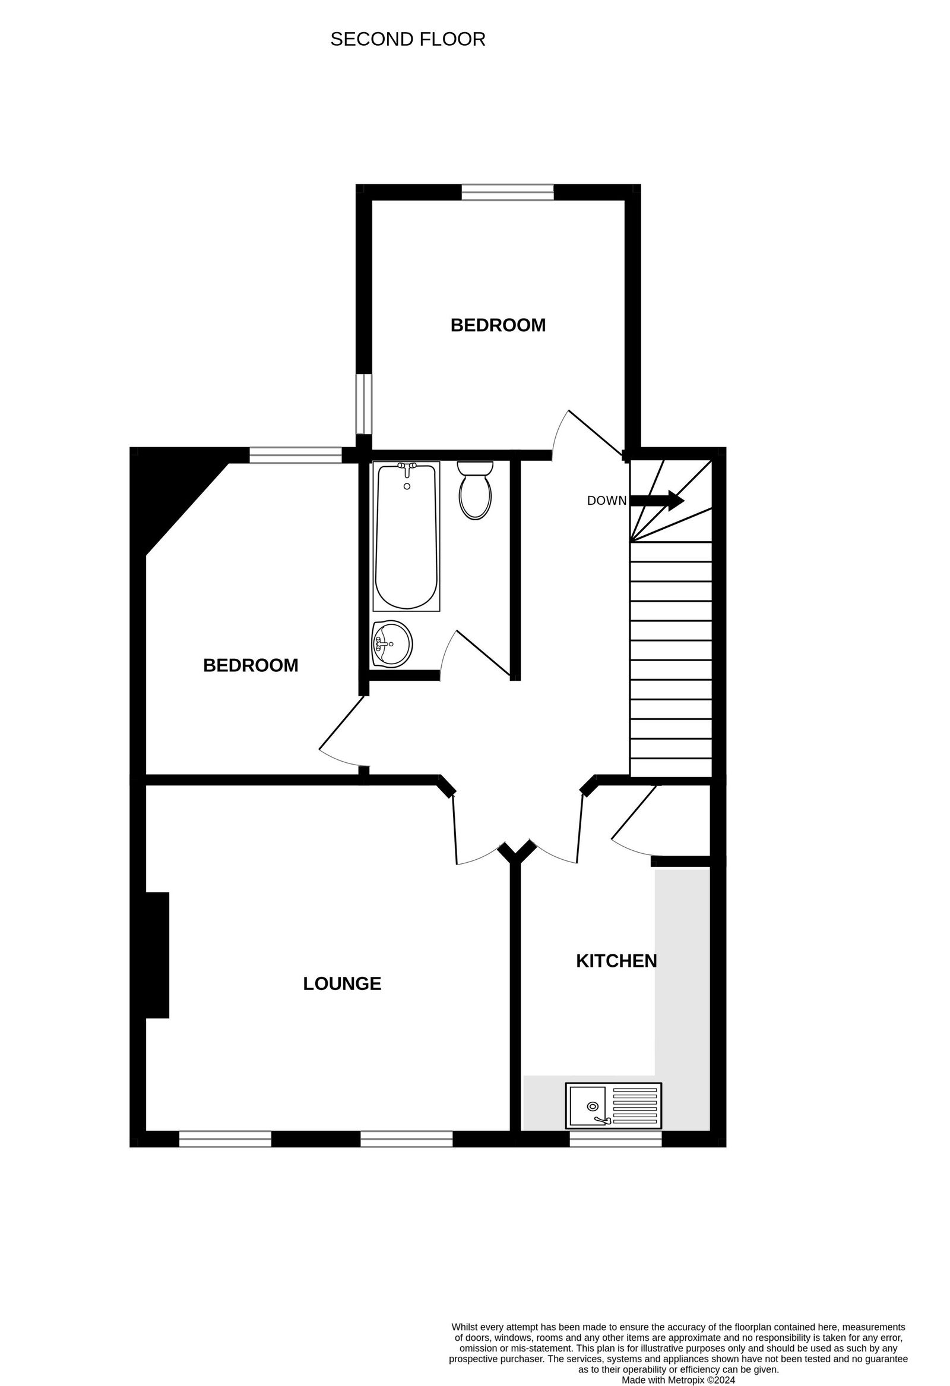
Flat 2 Pebble Reach, 1c High Street, Budleigh Salterton, EX9 6LD
THE ACCOMMODATION COMPRISES: Communal front door and staircase leading to:
FIRST FLOOR: Private front door to:
ENTRANCE HALL: With further staircase rising to:
LANDING: Access to roof space.
LOUNGE: 4.09m x 3.94m (13'5" x 12'11") Two double glazed windows to front aspect, night storage heater, telephone point, TV point.
KITCHEN: 3.86m x 2.21m (12'8" x 7'3") With worktops with cupboards, appliance spaces beneath, tiled surrounds, cupboard housing water cylinder, double glazed window to front aspect.
BEDROOM 1: 3.56m x 2.41m (11'8" x 7'11") Double glazed window to rear aspects, electric heater, cupboard housing electric meter and consumer unit.
BEDROOM 2: 3m x 2.84m (9'10" x 9'4") With double glazed window to side and rear aspects, electric wall heater.
BATHROOM/WC: 2.03m x 1.5m (6'8" x 4'11") With bath with shower unit over, shower curtain and rail, pedestal wash hand basin, WC, part tiled walls up to dado rail height, ceiling extractor fan, electric wall heater, mirror fronted medicine cabinet.
TENURE: The property is held on a 199 year lease from 2007.
Mortgage Assistance: We are pleased to recommend Meredith Morgan Taylor, who would be pleased to help no matter which estate agent you finally buy through. For a free initial chat please contact us on 01395 264111 to arrange an appointment. Your home may be repossessed if you do not keep up repayments on your mortgage. Meredith Morgan Taylor Ltd is an appointed representative of Openwork Limited, a trading style of Openwork Ltd which is authorised and regulated by the Financial Conduct Authority (FCA).
FLOOR PLAN:

