Slide 1
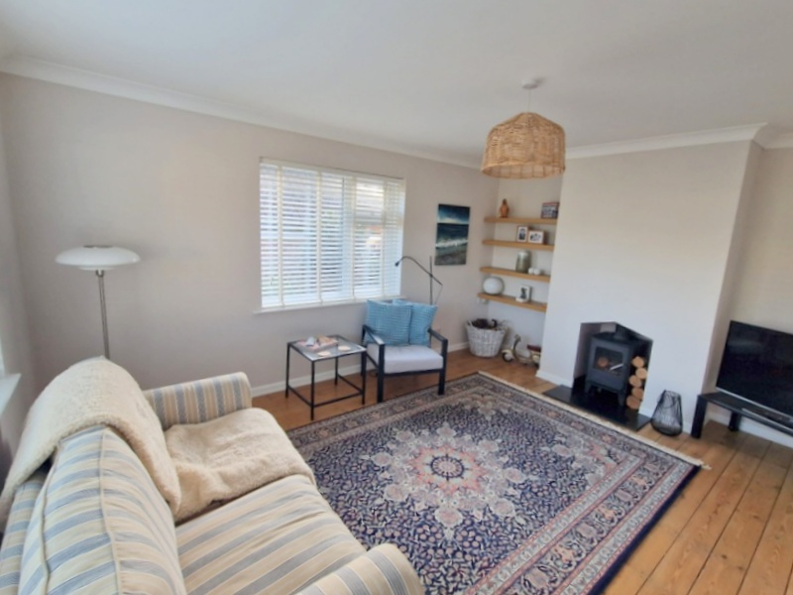
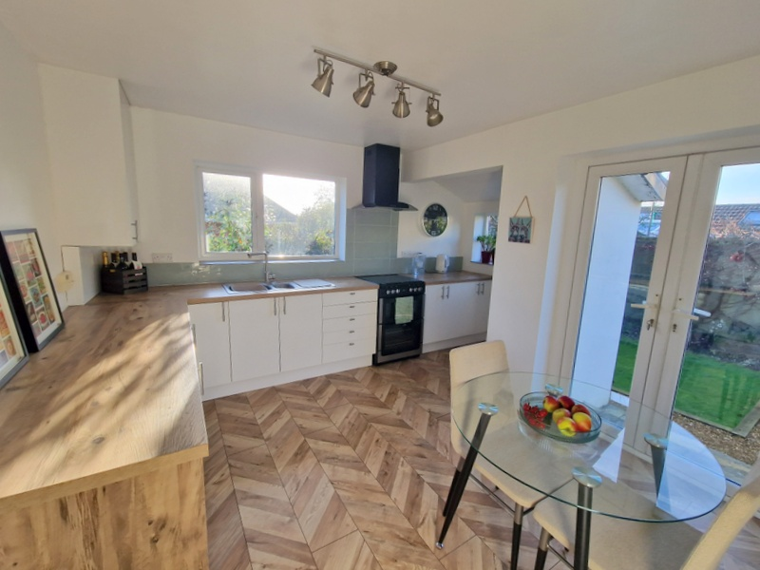

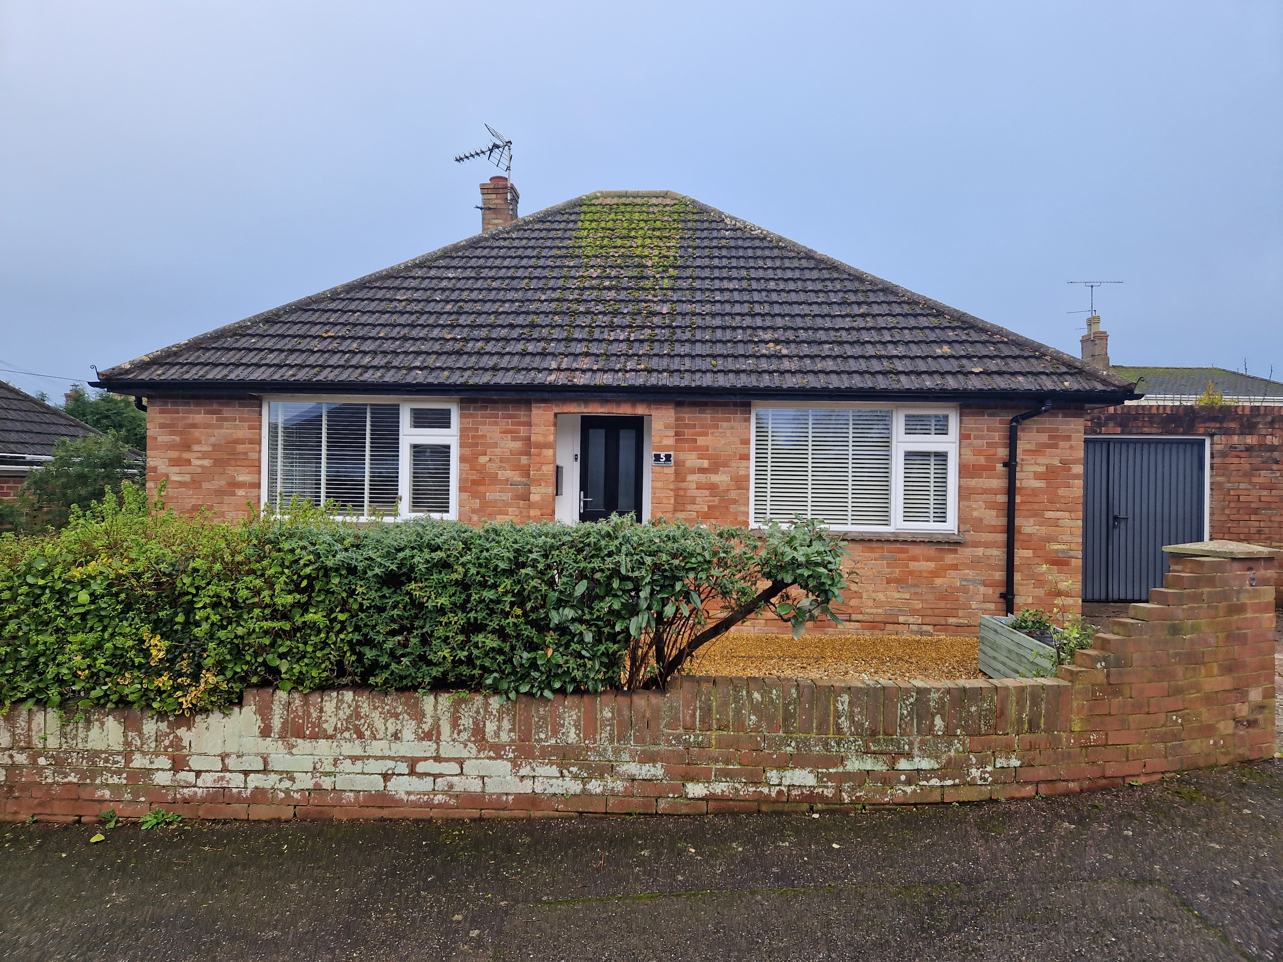
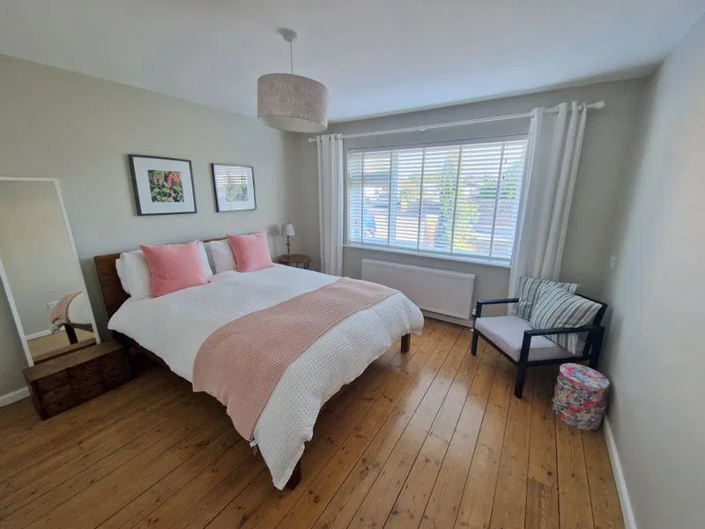
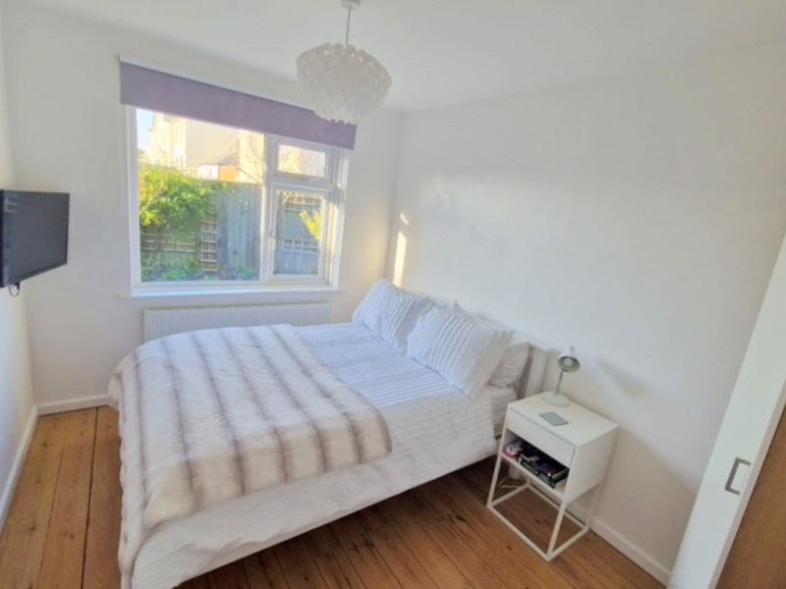
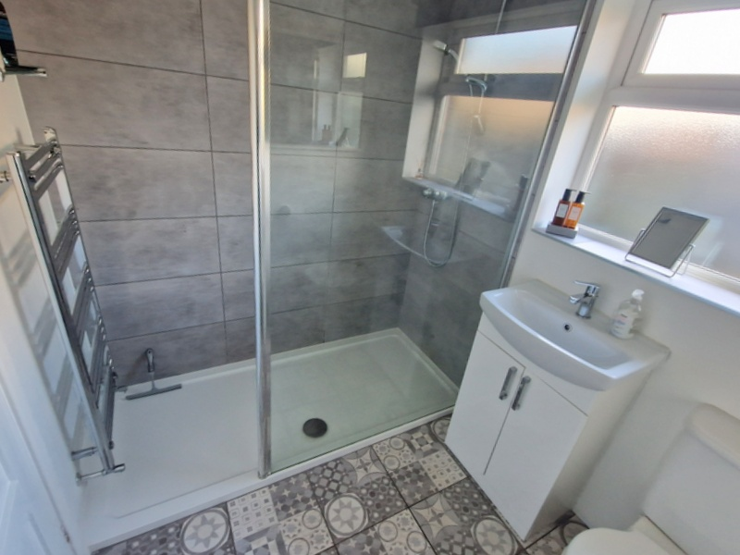
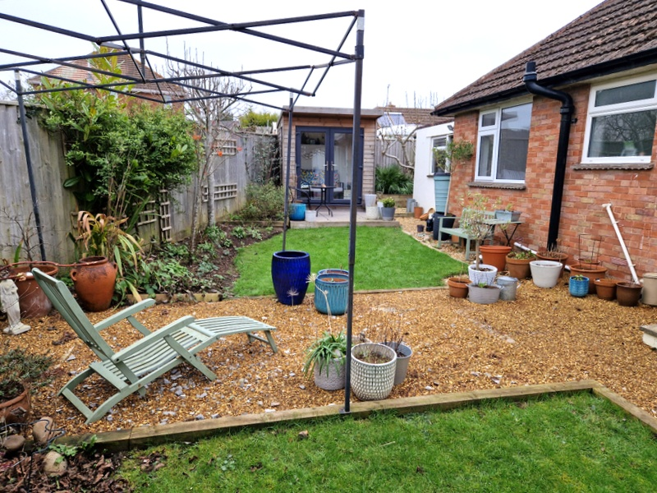
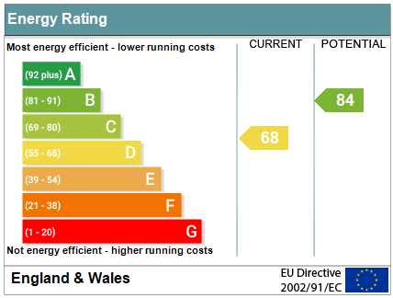

www.pennys.net
5 Orchard Close, Exmouth, EX8 3JD
GUIDE PRICE £440,000
TENURE Freehold
A Beautifully Presented Detached Bungalow Enjoying An Enviable Cul-De-Sac Location With Well Planned Level Gardens, Driveway And Garage
Dual Aspect Lounge With Wood Burner Stove * Stylish Modern Kitchen/Breakfast Room Two Double Bedrooms * Superb Modern Shower Room/Wc * Gas Central Heating * Upvc Double Glazed Windows * Beautiful Attractive Rear Garden With Insulated Garden Room Viewing Recommended
Pennys Estate Agents Limited for themselves and for the vendor of this property whose agents they are give notice that:- (1) These particulars do not constitute any part of an offer or a contract. (2) All statements contained in these particulars are made without responsibility on the part of Pennys Estate Agents Limited. (3) None of the statements contained in these particulars are to be relied upon as a statement or representation of fact. (4) Any intending purchaser must satisfy himself/herself by inspection or otherwise as to the correctness of each of the statements contained in these particulars. (5) The vendor does not make or give and neither do Pennys Estate Agents Limited nor any person in their employment has any authority to make or give any representation or warranty whatever in relation to this property.
PENNYS ESTATE AGENTS
2 Rolle House, Rolle Street, Exmouth, Devon, EX8 2SN
Tel: 01395 264111 EMail: help@pennys.net

Slide 2
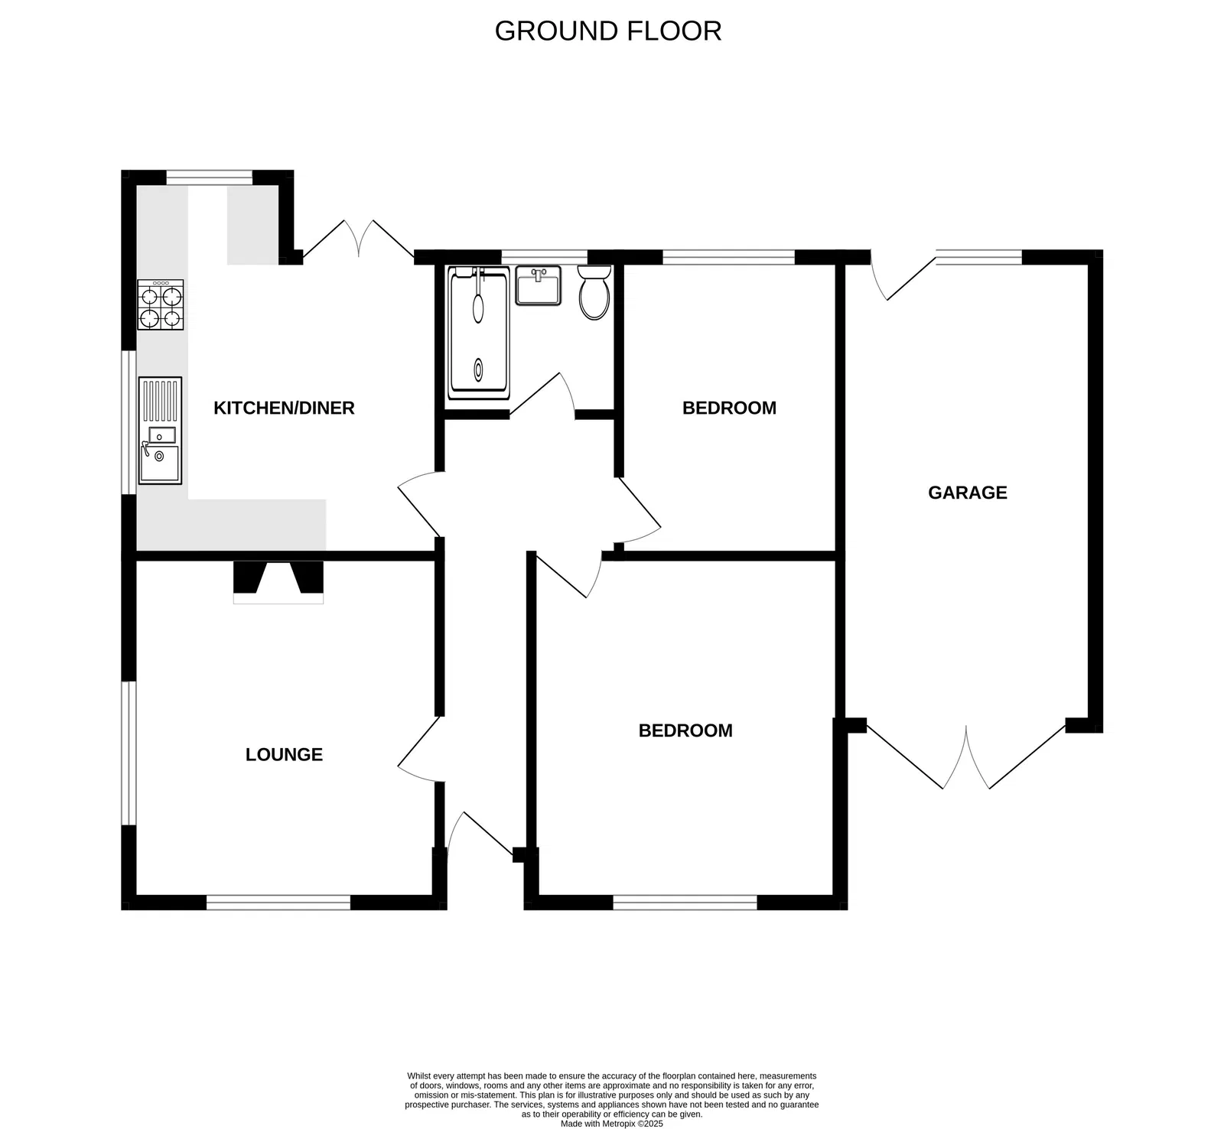
5 Orchard Close, Exmouth, EX8 3JD
THE ACCOMMODATION COMPRISES: Open entrance porch with courtesy light and tiled floor, inner composite front door giving access to:
RECEPTION HALL: A fine entrance to the property with two radiators, tiled floor, access via loft ladder to good size roof space (this could be converted to additional accommodation if required subject to the necessary planning consents).
LOUNGE: 4.55m x 3.63m (14'11" x 11'11") A charming room with strip wood flooring, chimney recess housing log wood burner stove standing on a slate hearth, uPVC double glazed windows to front and side aspects, TV point, radiator.
KITCHEN/BREAKFAST ROOM: 4.19m x 3.63m (13'9" x 11'11") maximum overall measurements. A bright and stylish room with uPVC double glazed windows to rear and side elevations and uPVC double glazed double doors opening onto the rear garden, fitted range of wood effect worktops with tiled splashbacks, inset one a quarter bowl single drainer sink unit with mixer tap, cupboards and drawer units and appliance space beneath worktops, gas cooker point with chimney style extractor hood over with light, wall mounted cupboard housing Baxi gas boiler for hot water and central heating, timer control for hot water and central heating, radiator, wood effect flooring, ceiling spotlighting.
BEDROOM 1: 4.09m x 3.61m (13'5" x 11'10") A spacious double bedroom with stripped wood flooring, radiator, five door fitted wardrobe, uPVC double glazed window to front aspect, TV point.
BEDROOM 2: 3.56m x 2.57m (11'8" x 8'5") Another good size double bedroom with stripped wood flooring, radiator, TV point and uPVC double glazed window to rear aspect.
SHOWER ROOM/WC: 2.24m x 1.8m (7'4" x 5'11") Refitted as a modern stylish shower room with ease of access large shower tray with shower splash screen and Mira shower unit, tiled cubicle with chrome heated towel rail, wash hand basin with cabinet beneath and mixer tap, WC with push button flush, tiled flooring, ceiling extractor fan, uPVC double glazed window with patterned glass, stylish upright radiator.
OUTSIDE: Quietly located towards the head of a sought after cul-de-sac off Phillipps Avenue, the property enjoys a decorative stone front garden area edged with well stocked shrub borders and raised flowerbeds, the driveway provides off road parking leading to the GARAGE. A pathway and gate give access through to the rear garden. The rear garden is level and beautifully planned and presented comprising of two areas of lawned garden with decorative stone seating area and pathways, together with a raised patio sun terrace with access to a fully insulated GARDEN ROOM/OFFICE 2.24m x 2.24m (7'4" x 7'4") having uPVC double glazed picture windows and uPVC double glazed double doors, power connected. To the side of the bungalow is a further decorative stone garden area with raised shrub beds, small decked area. Outside lighting, outside power sockets and outside cold water tap.
GARAGE: 5.18m x 3.28m (17'0" x 10'9") With metal double doors, plumbing for automatic washing machine, fitted work benches, power and light connected, uPVC double glazed window and part glazed door giving direct access to the rear garden.
FLOOR PLAN:

