Slide 1
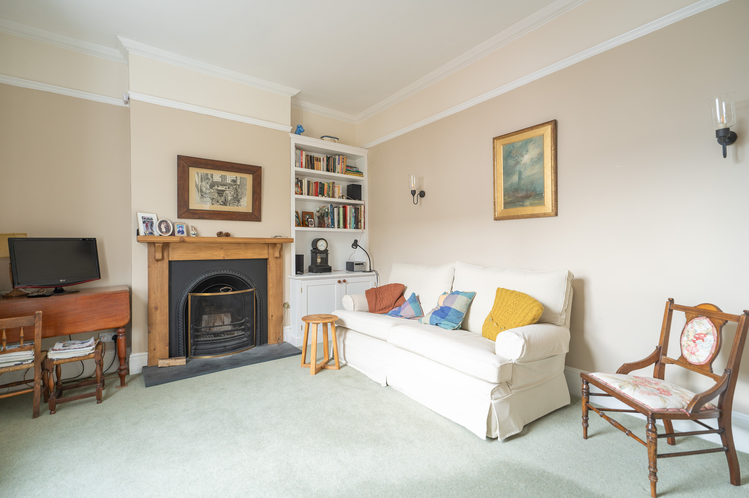
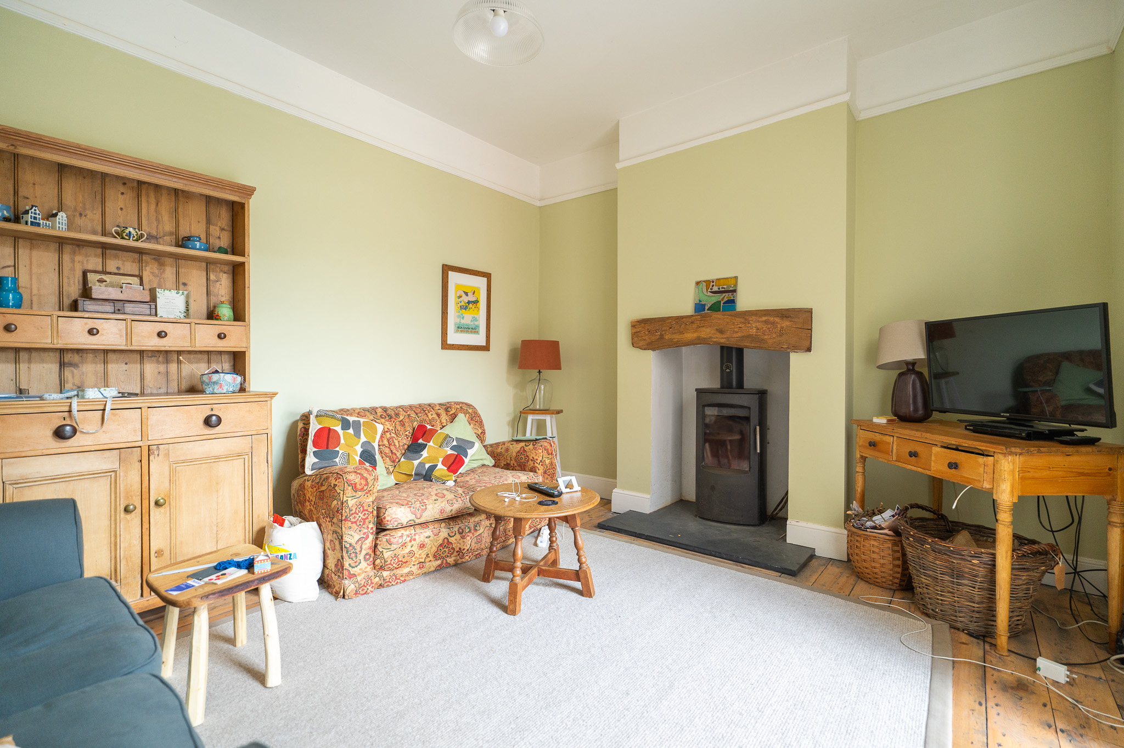
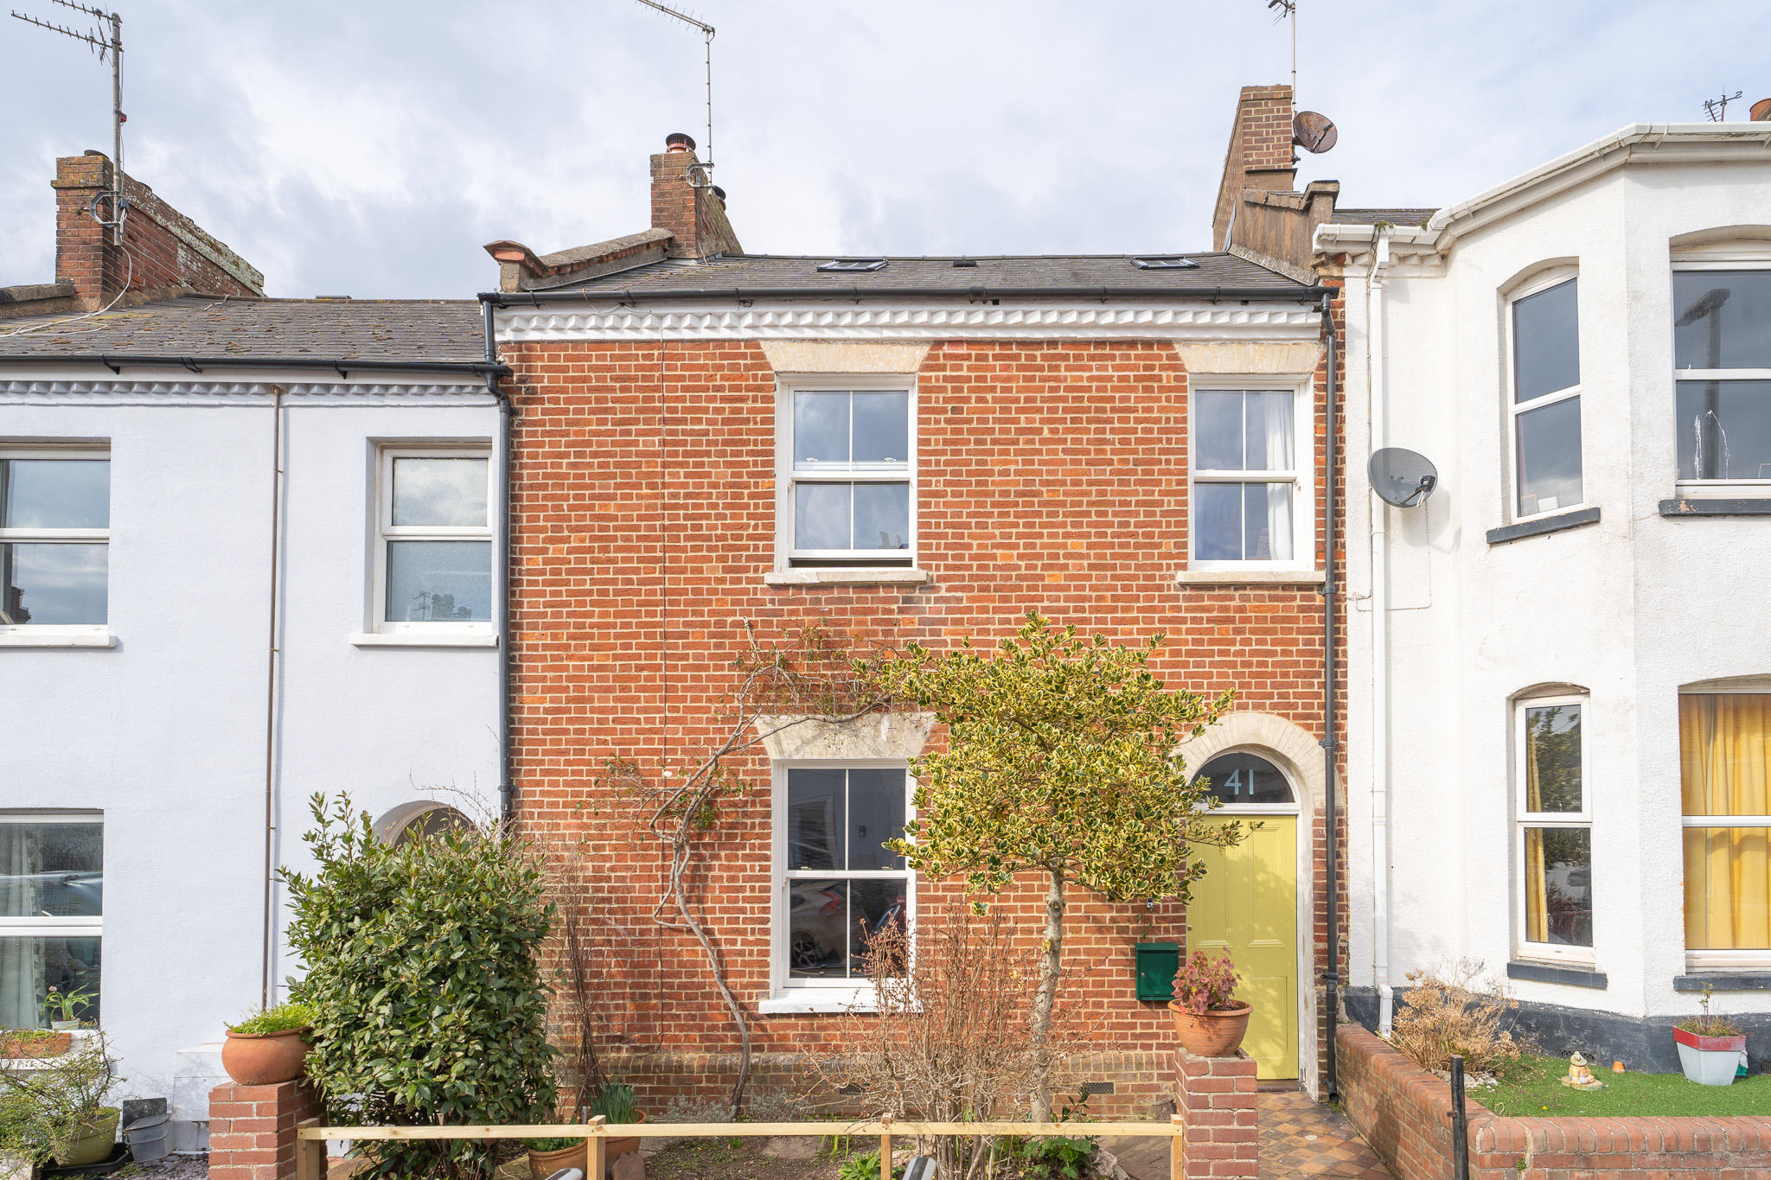
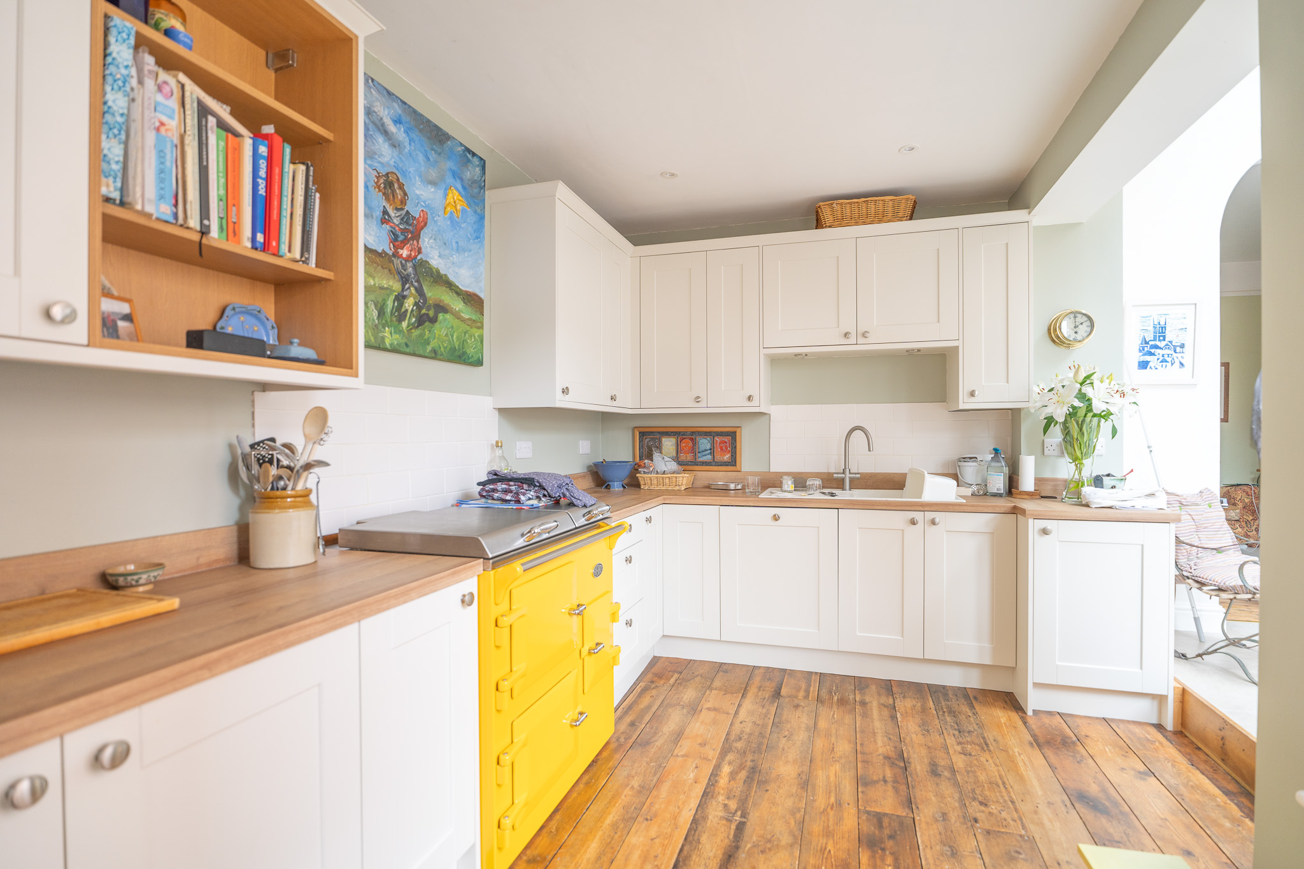
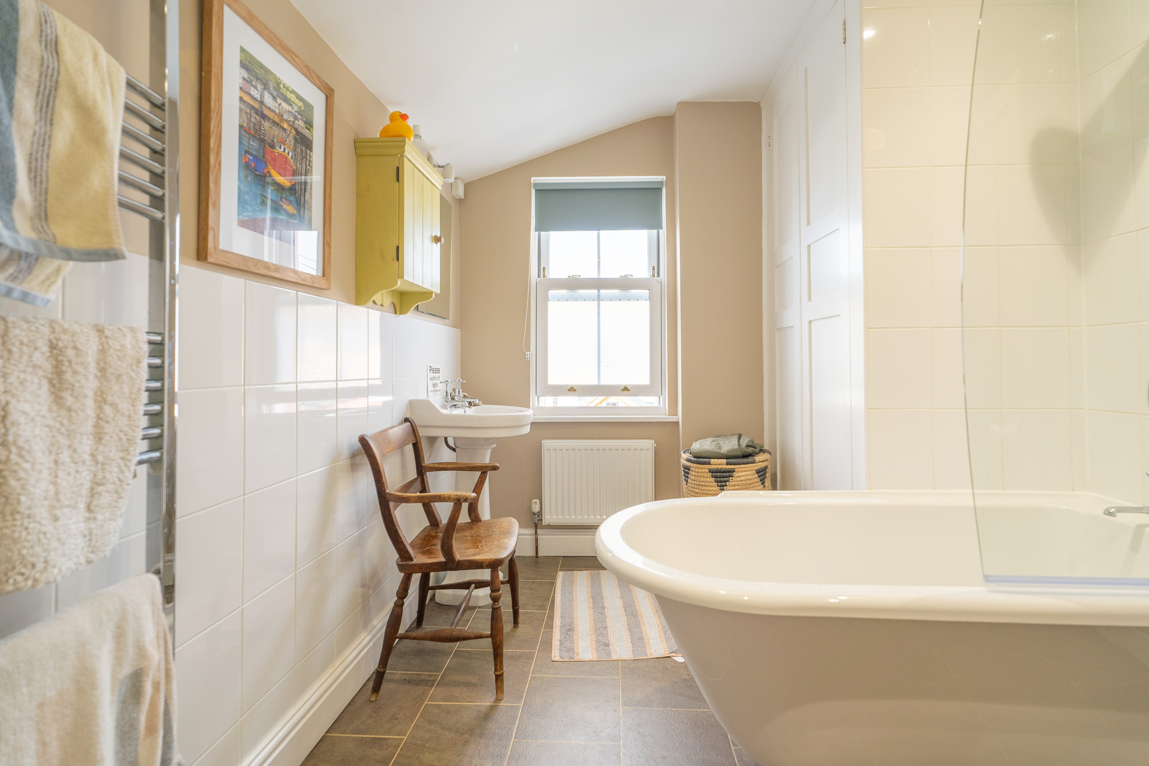
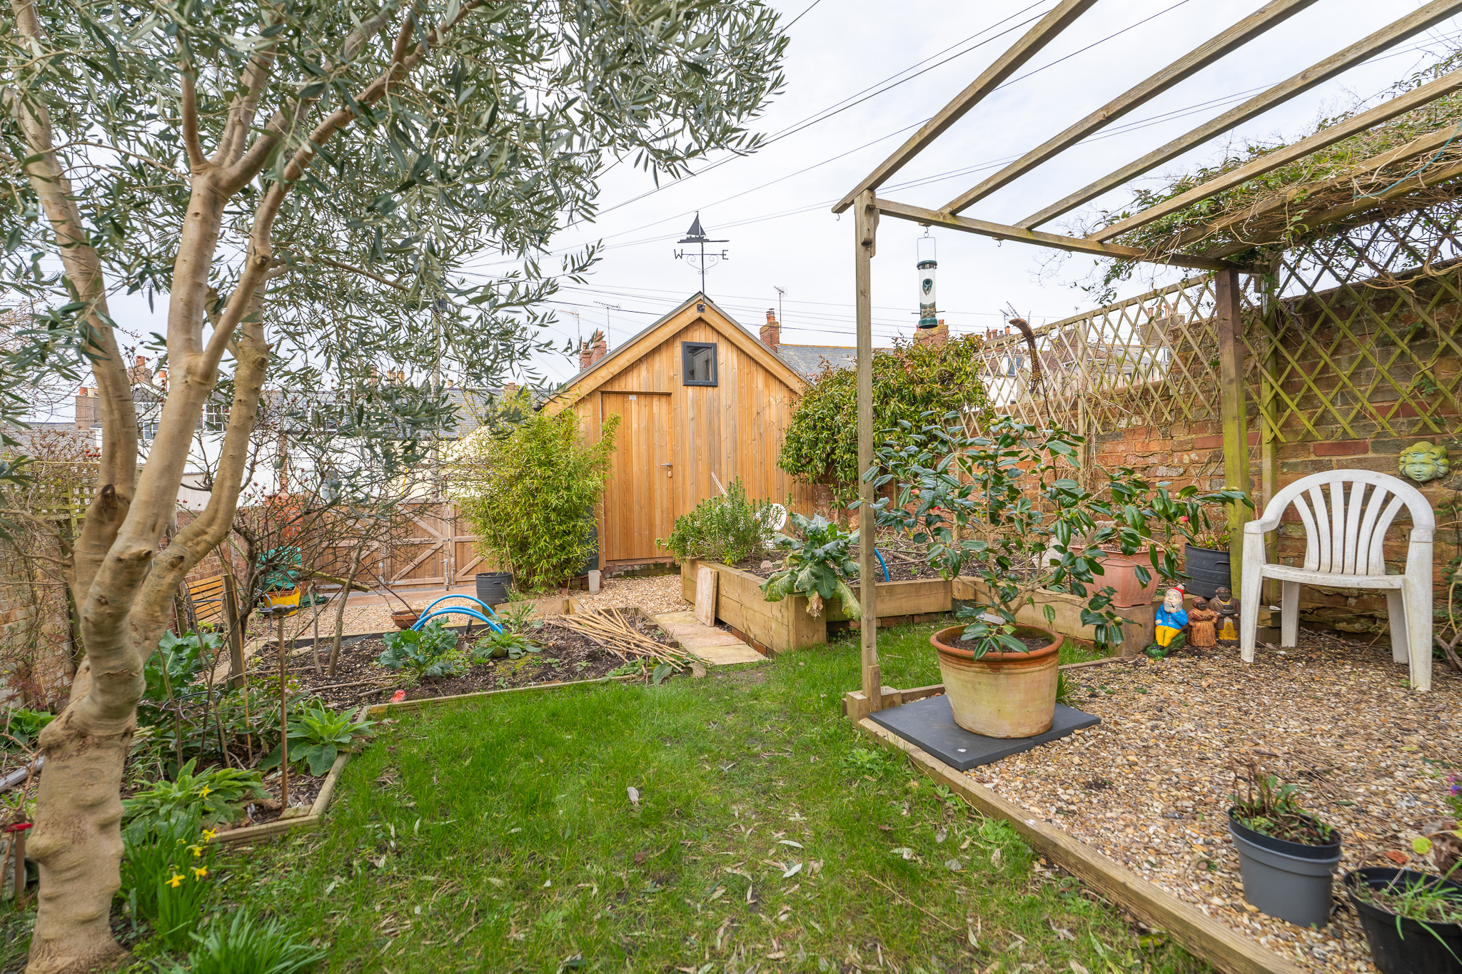
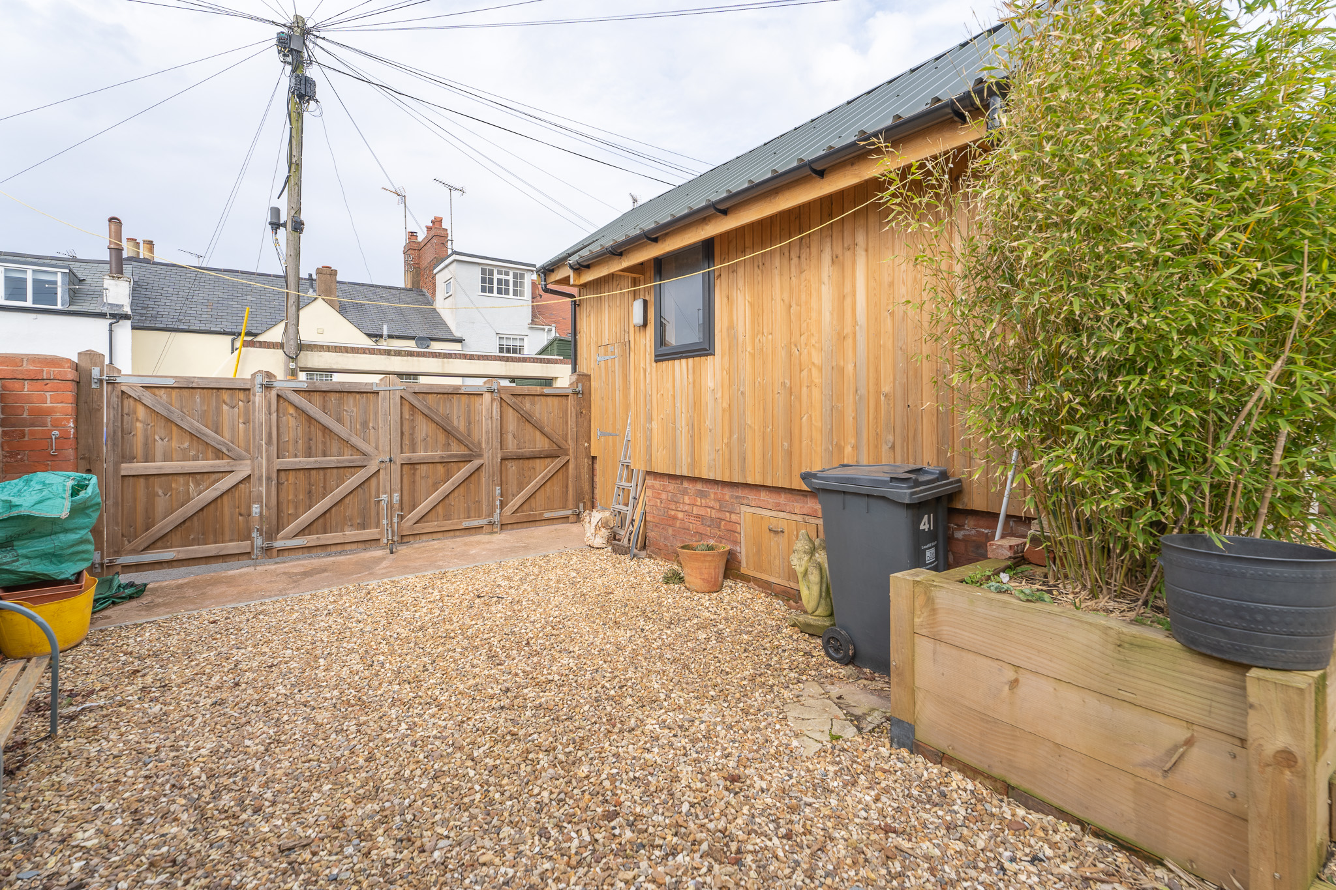
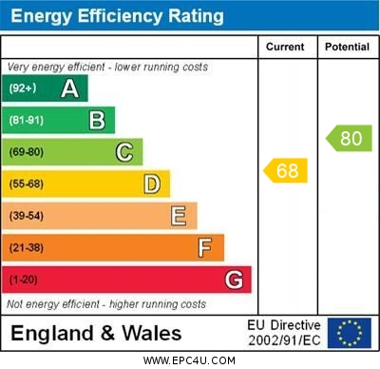
www.pennys.net
41 Raleigh Road, Exmouth, EX8 2RX
GUIDE PRICE £585,000
TENURE Freehold
A Truly Stunning Period Terrace House Tastefully Refurbished Keeping Much Inherent Character Of Its Era With Lovely Rear Garden, Off Road Parking And Architect Designed Workshop
Entrance Vestibule * Reception Hall * Lounge * Sitting Room * Breakfast Area * Modern Kitchen * Dining Room * Garden Room * Ground Floor Utility Area/Wc * Three First Floor Bedrooms * Spacious First Floor Bathroom Suite * Second Floor Bedroom And Bathroom/Wc * Double Glazed Sash Style Windows * Gas Central Heating * Viewing Strongly Recommended
Pennys Estate Agents Limited for themselves and for the vendor of this property whose agents they are give notice that:- (1) These particulars do not constitute any part of an offer or a contract. (2) All statements contained in these particulars are made without responsibility on the part of Pennys Estate Agents Limited. (3) None of the statements contained in these particulars are to be relied upon as a statement or representation of fact. (4) Any intending purchaser must satisfy himself/herself by inspection or otherwise as to the correctness of each of the statements contained in these particulars. (5) The vendor does not make or give and neither do Pennys Estate Agents Limited nor any person in their employment has any authority to make or give any representation or warranty whatever in relation to this property.
PENNYS ESTATE AGENTS
2 Rolle House, Rolle Street, Exmouth, Devon, EX8 2SN
Tel: 01395 264111 EMail: help@pennys.net

Slide 2
41 Raleigh Road, Exmouth, EX8 2RX
THE ACCOMMODATION COMPRISES: Solid wood front door with feature arched window over to:
ENTRANCE VESTIBULE: Solid wood flooring, dado rail, inner solid wood door with patterned glass to:
RECEPTION HALL: Radiator, part tongue and groove walling to dado rail height, picture rail, stairs rising to first floor landing with useful understairs storage cupboard beneath, cupboard housing electric meter.
LOUNGE: 4.77m x 3.47m (15’8" x 11’5") A charming room with wooden fire surround housing open fireplace with slate hearth, bespoke design dresser style unit in wall recess, radiator, picture rail, TV point, double glazed sash style window to front aspect with wooden window shutters.
FAMILY ROOM: 4.29m x 3.52m (14’1" x 11’7") Stripped wood flooring, radiator, wood burning stove housed in chimney recess standing on a slate hearth with oak beam over, TV point, picture rail, archway through to:
BREAKFAST ROOM: 2.38m x 2.20m (7’10" x 7’3") Double glazed double doors opening onto the rear garden, vaulted style ceiling with double glazed velux window allowing an abundance of light, radiator, opening through to:
KITCHEN: 4.50m x 2.44m (14’9" x 8') A modern kitchen with fitted range of wood-effect worktops with matching splashbacks, with range of cupboards and drawer units, integrated dishwasher beneath worktops, inset Blanco single drainer sink unit with mixer tap with tiled splashback and display lighting over sink area, range of wall mounted cupboards incorporating a microwave oven, solid wood flooring, radiator, secondary glazed sash window, radiator, recessed ceiling spotlighting, space for upright fridge/freezer, opening to:
DINING ROOM: 3.70m x 2.44m (12’2" x 8') With wood-effect flooring, radiator, uPVC double glazed window overlooking the garden, double glazed velux window again allowing an abundance of light into the room, double glazed double doors opening to:
CONSERVATORY: 3.28m x 2.44m (10’9" x 8') A useful area with double glazed windows and double glazed double doors opening onto the rear garden, wood-effect flooring, wall light.
From the breakfast area door to:
GROUND FLOOR UTILITY/WC: 2.24m x 0.94m (7'4" x 3'1") With plumbing for automatic washing machine under display surface and shelving, wash hand basin, WC with push button flush, electric heated towel rail, extensively tiled walls and tiled flooring, recessed ceiling led lighting, double glazed window with patterned glass.
FIRST FLOOR LANDING: Picture rail, picture window to rear aspect, staircase rising to second floor with useful understairs recess and cupboard, walk-in store cupboard with power, telephone point, window, coat rail.
BEDROOM 1: 3.99m x 3.47m (13’1" x 11'5") into wall recess, one of which is fitted with a built-in shelved storage cupboard. Feature ornate fireplace with tiled hearth, radiator, picture rail, stripped wood flooring, double glazed sash window to rear aspect.
BEDROOM 2: 4.27m x 3.50m (14' x 11'6") into wall recesses. With feature ornate fireplace, radiator, double glazed sash window to front aspect, picture.
BEDROOM 3: 2.36m x 1.83m (7’9" x 6'") Picture rail, radiator, double glazed sash window to front aspect.
BATHROOM/WC: 3.52m x 2.44m (11’7" x 8’) A spacious room fitted with claw foot bath with tiling to splash prone area, shower splash screen and shower unit over, pedestal wash hand basin, WC, chrome heated towel rail, further tiling to splash prone areas, linen cupboard, radiator, double glazed sash window to rear aspect, recessed ceiling spotlighting.
SECOND FLOOR LANDING AREA: Double glazed velux window, access to eaves storage space.
BEDROOM 4: 4.06m x 3.62m (13’4" x 11’11") A wonderful bedroom suite with two double glazed sash style windows to rear aspect enjoying views over the town to estuary and coastline in the distance, radiator, part sloping ceiling with double glazed velux window to front aspect, access to eaves storage space, radiator.
BATHROOM/WC: 1.98m x 1.7m (6'6" x 5'7") Bath with shower splash screen and shower unit over set in a tiled surround, pedestal wash basin with tiled splashback, WC with push button flush, radiator, double glazed sash style window to rear aspect, again enjoying lovely views across the town to the estuary, recessed ceiling spotlighting, chrome heated towel rail.
OUTSIDE: To the front of the property is an attractive garden enclosure. The rear garden is a lovely feature of the property and is a good size being so close to the town centre, enjoying a patio sun terrace, outside cold water tap, decorative stone seating area with pergola over, lawned area of garden, two raised vegetable plots, decorative stone pathway leading to the rear of the garden to a decorative stone PARKING AREA, accessed via wooden folding gates into wide service lane, architect designed WORKSHOP/GARDEN OFFICE: 3.15m x 2.74m (10'4" x 9'0") with high vaulted style ceiling, power and light connected, double glazed windows, fitted cupboards, fully insulated. There is also a water pipe and internet cable, which are not connected, making this a very useful garden office.
STOREROOM: 2.44m x 2.13m (8'0" x 7'0") Very useful area with high ceiling, there is a boarded storage area, electric consumer unit with wiring in place to fit solar panels if required. Outside garden lighting.
FLOOR PLAN: Separate insert.

