Slide 1
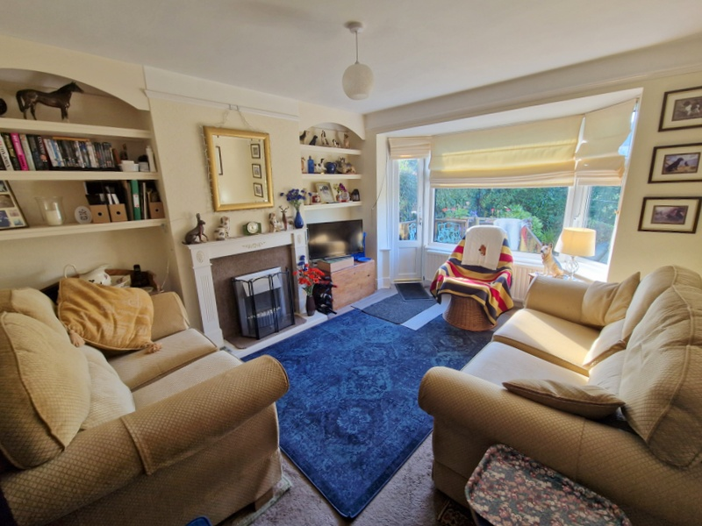
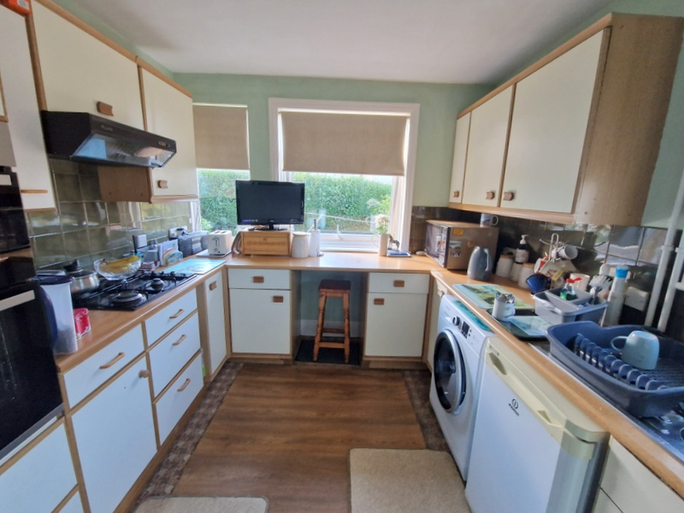
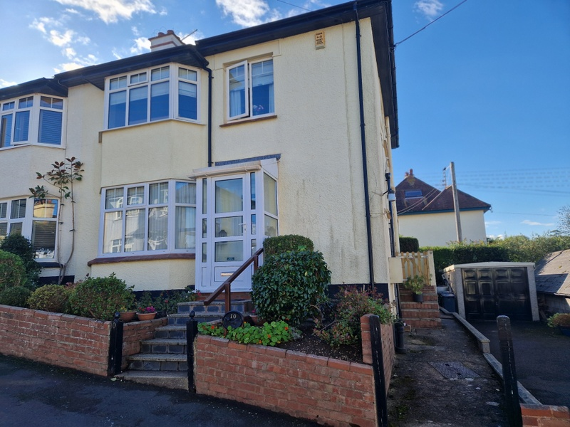
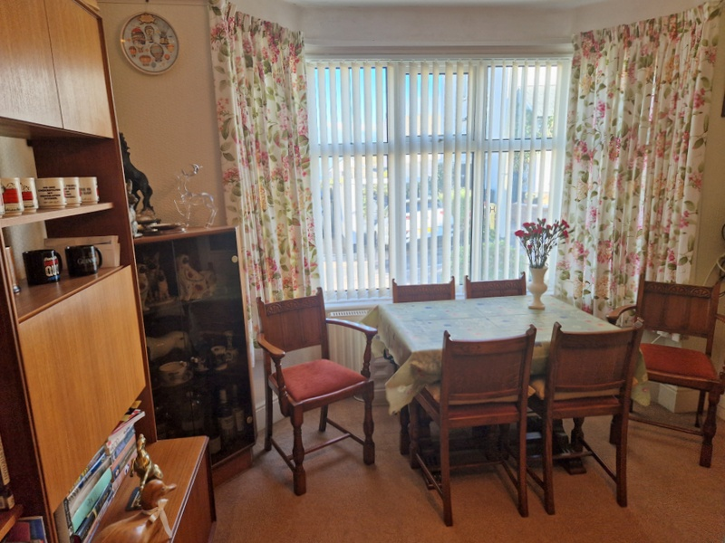
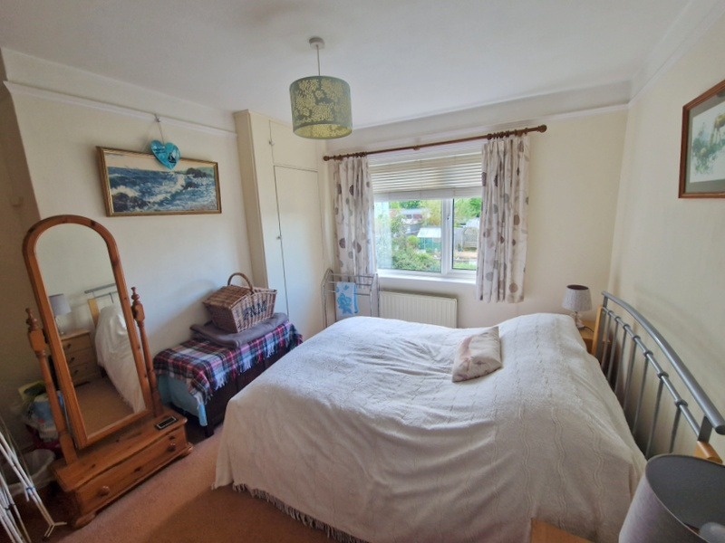
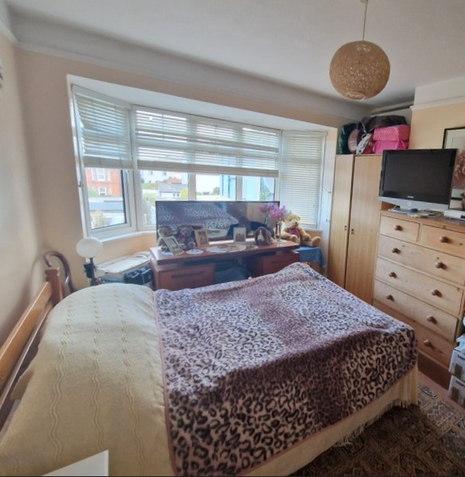
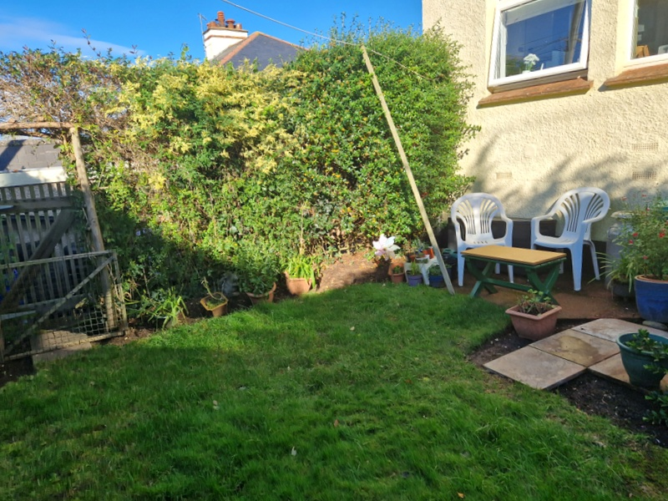
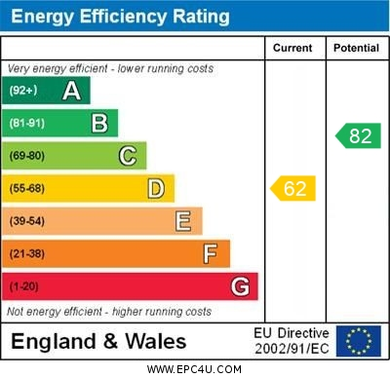
www.pennys.net
10 Redhills, Budleigh Salterton, EX9 6JW
GUIDE PRICE £485,000
TENURE Freehold
A 1930’s Semi Detached House Enjoying A Cul-De-Sac Location Just A Short Distance From Both The Town Centre And Seafront
Entrance Porch And Reception Hall * Dining Room * Lounge * Kitchen Ground Floor Shower Room/Wc * Three First Floor Bedrooms * Private Rear Garden * Driveway And Garage * Double Glazed Windows * Gas Central Heating * Viewing Recommended
Pennys Estate Agents Limited for themselves and for the vendor of this property whose agents they are give notice that:- (1) These particulars do not constitute any part of an offer or a contract. (2) All statements contained in these particulars are made without responsibility on the part of Pennys Estate Agents Limited. (3) None of the statements contained in these particulars are to be relied upon as a statement or representation of fact. (4) Any intending purchaser must satisfy himself/herself by inspection or otherwise as to the correctness of each of the statements contained in these particulars. (5) The vendor does not make or give and neither do Pennys Estate Agents Limited nor any person in their employment has any authority to make or give any representation or warranty whatever in relation to this property.
PENNYS ESTATE AGENTS
2 Rolle House, Rolle Street, Exmouth, Devon, EX8 2SN
Tel: 01395 264111 EMail: help@pennys.net

Slide 2
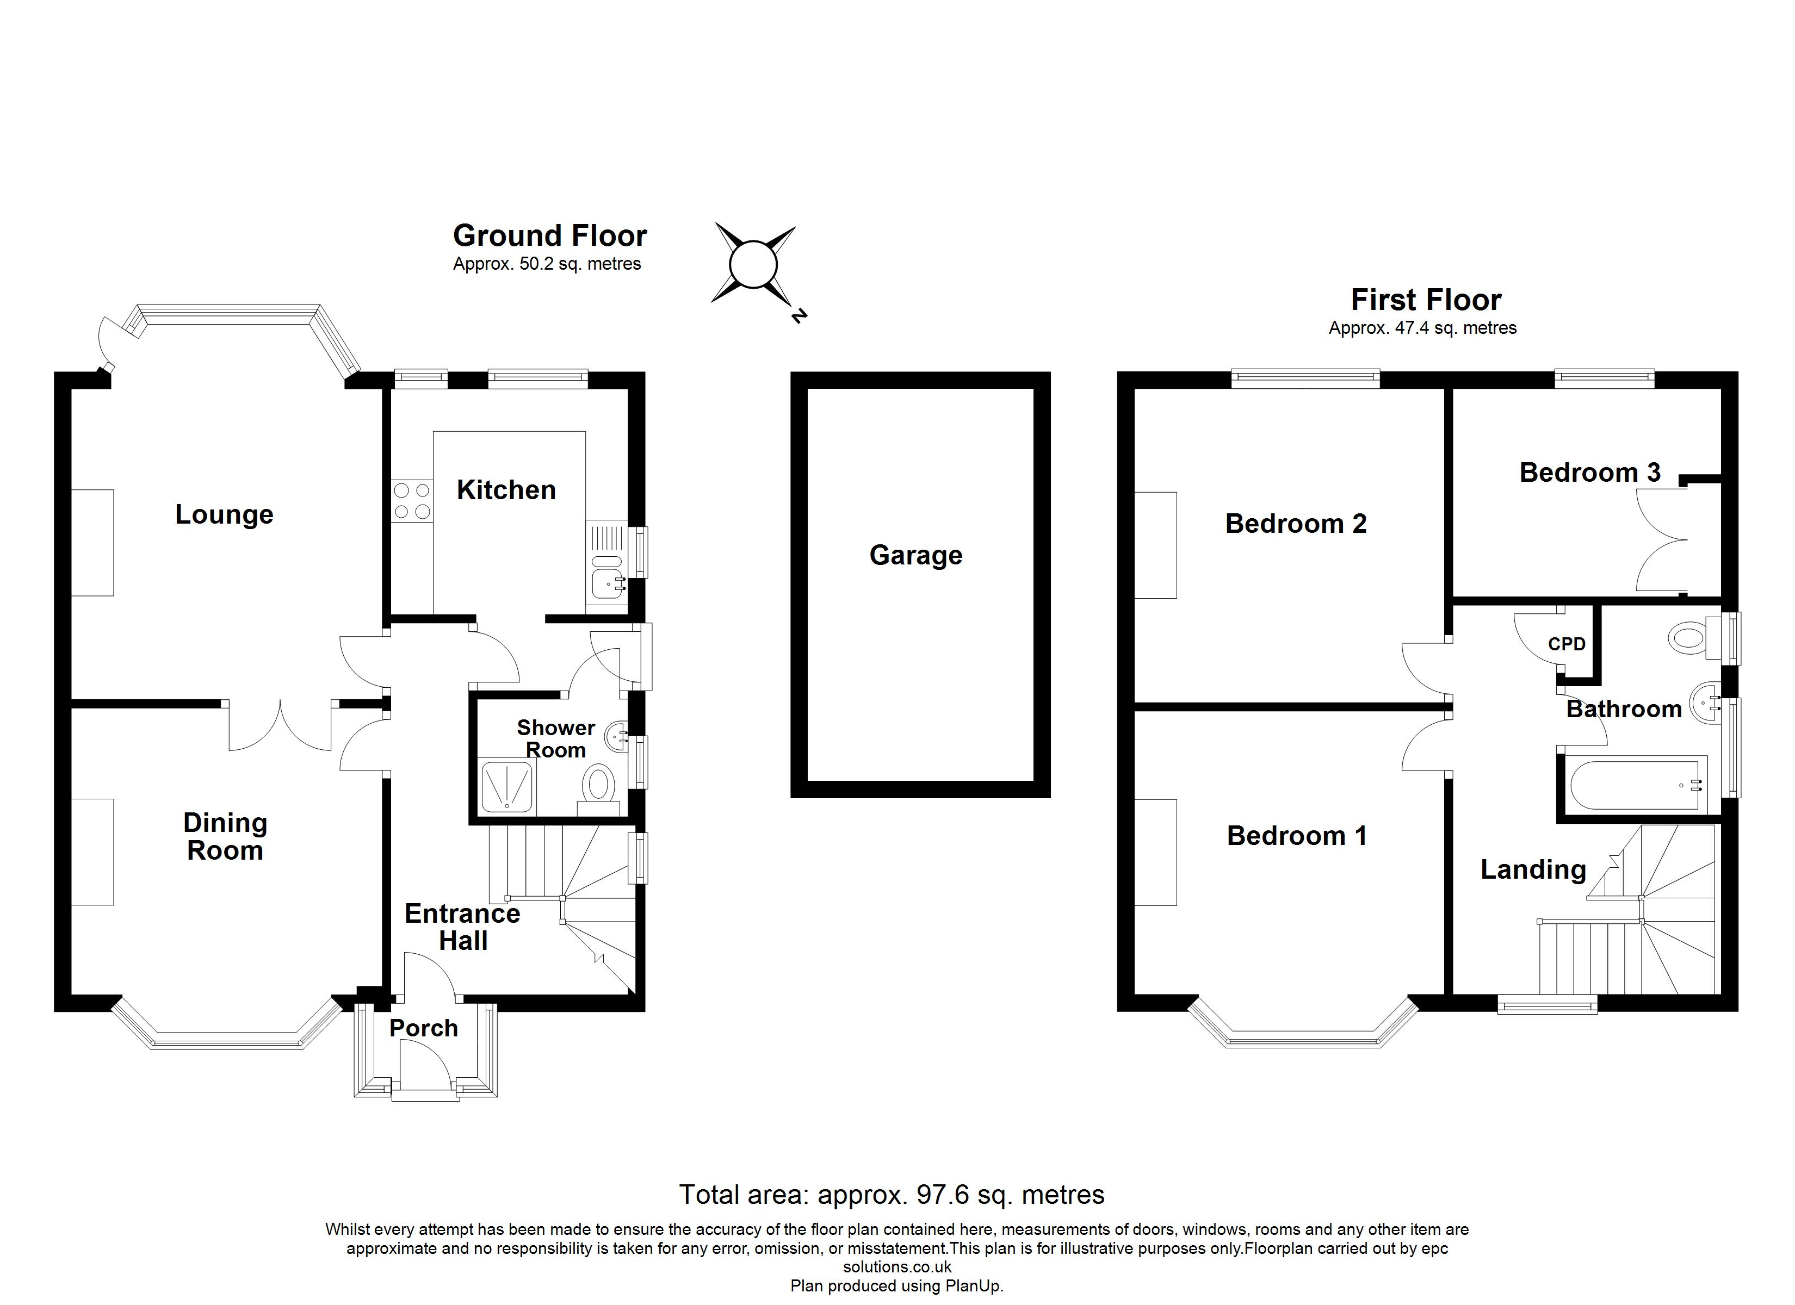
10 Redhills, Budleigh Salterton, Exmouth, EX9 6JW
Budleigh Salterton is a tranquil and unspoilt Regency town by the sea which has managed to retain much of its classic beauty and original charm, situated on the Jurassic coastline of East Devon and designated as a World Heritage site. The beautiful two-mile beach, with very clean and safe bathing water is framed by the picturesque sandstone cliffs and allows panoramic views across Lyme Bay. Nearby is the Otter Estuary, which has been designated an area of Outstanding Natural Beauty and has an abundance of wildlife to explore. Budleigh Salterton has much to offer, having an impressive variety of interesting shops with a wide choice of individually run family businesses, restaurants and cafes. There is also a primary school, doctor’s surgery, dentists and a library, all within close proximity of the property. East Devon Golf Club, Budleigh Cricket Club plus the Croquet and Tennis Club are renowned sporting venues. Budleigh Salterton has access to numerous local bus routes, whilst communications from Exeter are excellent and include the M5 motorway, a mainline rail link to London (Paddington & Waterloo).
THE ACCOMMODATION COMPRISES: uPVC front door giving access to:
ENTRANCE PORCH: Tiled floor, double glazed windows and inner double glazed door with patterned glass to:
RECEPTION HALL: Turning staircase rising to first floor with useful understairs cupboard beneath, radiator, double glazed window on half landing to side aspect, fitted shelving in wall recess, panelled doors giving access to:
DINING ROOM: 4.22m x 3.66m (13'10" x 12'0") maximum measurement into double glazed window overlooking the front aspect. Fitted dresser style units in walled recess, wooden fire surround, TV point, radiator, picture rails, glazed panelled double doors to:
LOUNGE: 3.96m x 3.66m (13'0" x 12'0") into the bay. A charming room with fire surround and electric point for freestanding electric fire, uPVC double glazed window with slim double glazed door giving access to the rear garden, TV point, radiator, picture rail, fitted shelving in wall recess.
From the reception hall there is a side lobby area with double glazed door with patterned glass to outside and door to:
GROUND FLOOR SHOWER ROOM/WC: 1.78m x 1.27m (5'10" x 4'2") With shower cubicle, wash hand basin, WC, boiler for hot water and central heating, radiator, double glazed window with patterned glass.
KITCHEN: 2.79m x 2.72m (9'2" x 8'11") Fitted with a range of wood effect worktops with cupboards, drawer units, plumbing for automatic washing machine and appliance space, small breakfast bar area with space for breakfast bar stool beneath work surface, tiled surrounds, inset four-ring gas hob with extractor hood over, built-in oven and grill with drawer units and cupboards above and below, wall mounted cupboards, TV point, double glazed windows to side and rear aspects.
FIRST FLOOR LANDING: Double glazed window to front aspect, radiator, access to roof space, fitted storage cupboard.
BEDROOM 1: 4.01m x 3.35m (13'2" x 11'0") maximum overall measurement into wall recesses. Double glazed bay window to front aspect enjoying some distant sea views, TV point, radiator, picture rails.
BEDROOM 2: 3.66m x 3.35m (12'0" x 11'0") to wall recess. Double glazed window to rear aspect, radiator, built-in wardrobe, TV point, picture rail.
BEDROOM 3: 2.74m x 2.44m (9'0" x 8'0") Double glazed window to rear aspect, radiator picture rails, built-in cupboard housing water cylinder and immersion switch.
BATHROOM/WC: 2.49m x 2.03m (8'2" x 6'8") narrowing to 1.57m (5'2") Comprising bath with shower unit over, shower curtain rail, pedestal wash hand basin, WC, tiling to splashback areas, radiator, light shaver socket, two sets of double glazed windows with patterned glass.
OUTSIDE: To the front of the property is an attractive garden enclosure with well stocked flower and shrub beds, with a few steps rising to the property, outside lighting, alongside the property is a driveway providing parking for a couple of cars leading to a detached GARAGE. A side path and gate gives access through an enclosed rear garden which enjoys a raised decked sun terrace adjoining the rear of the property, lawned area of garden edged with shrub beds, mature hedging which offers a high degree of privacy and seclusion.
DETACHED GARAGE: 4.47m x 2.54m (14'8" x 8'4") With up and over door, power and light connected, two side windows.
Mortgage Assistance: We are pleased to recommend Meredith Morgan Taylor, who would be pleased to help no matter which estate agent you finally buy through. For a free initial chat please contact us on to arrange an appointment. Your home may be repossessed if you do not keep up repayments on your mortgage. Meredith Morgan Taylor Ltd is an appointed representative of The Openwork Partnership, a trading style of Openwork Ltd which is authorised and regulated by the Financial Conduct Authority (FCA).
FLOOR PLAN:

