Slide 1
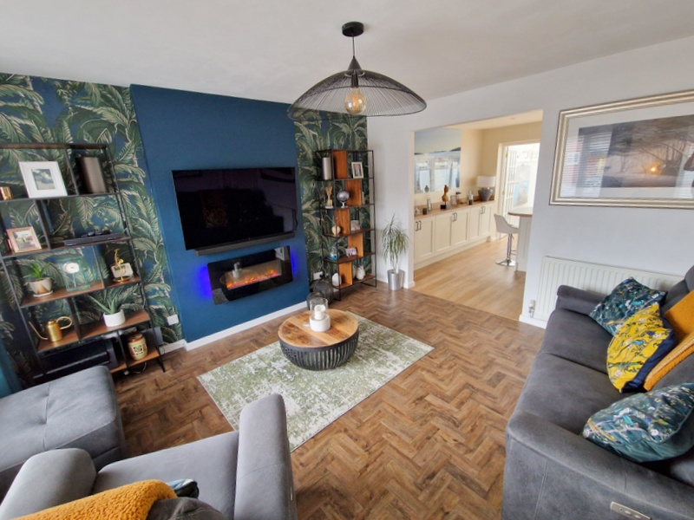
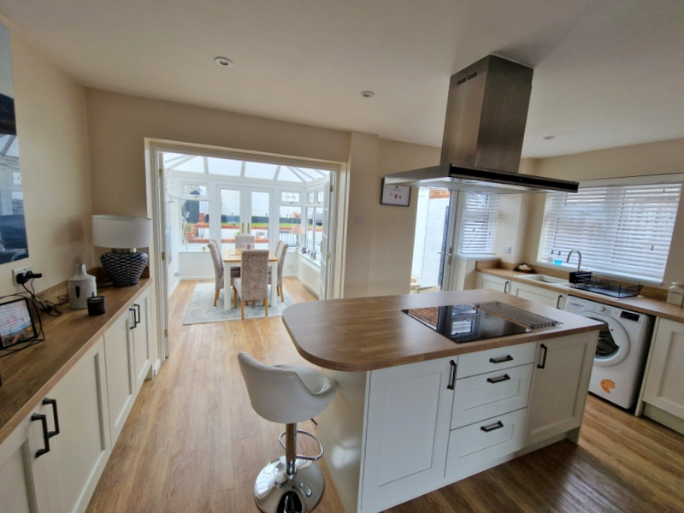
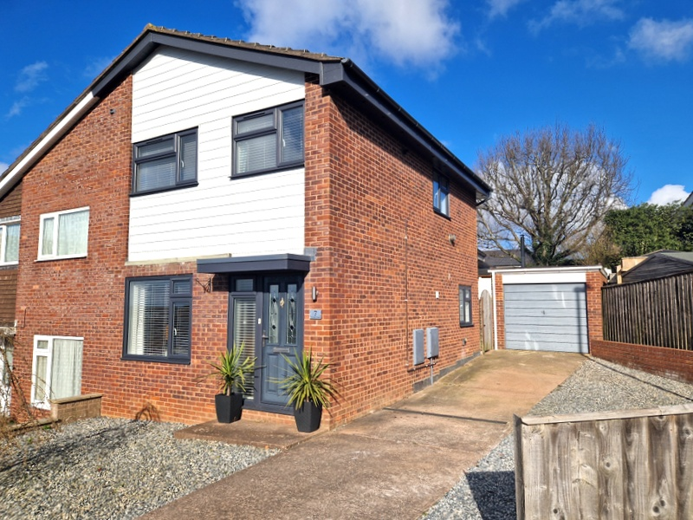
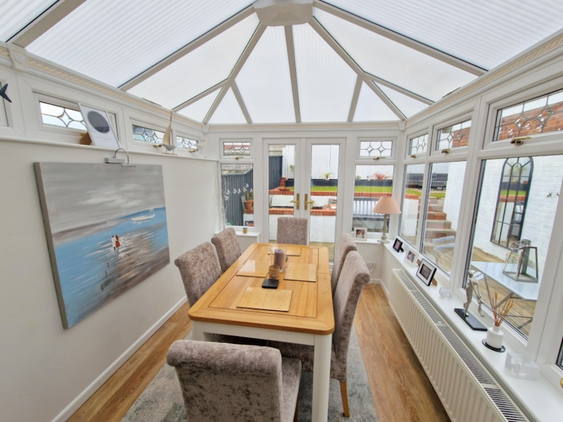
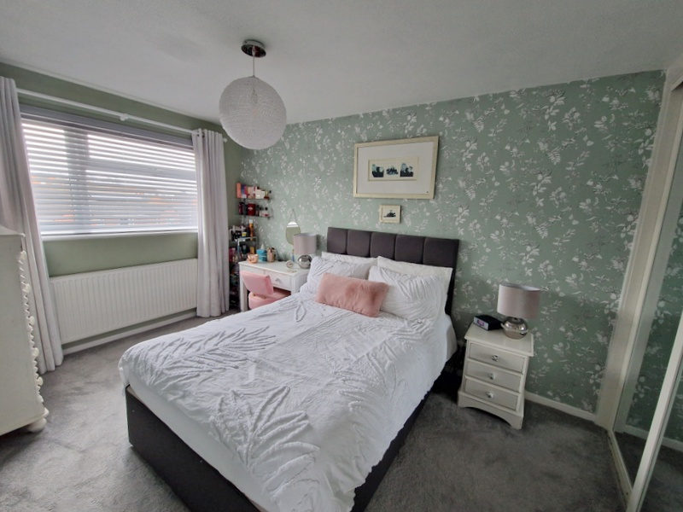
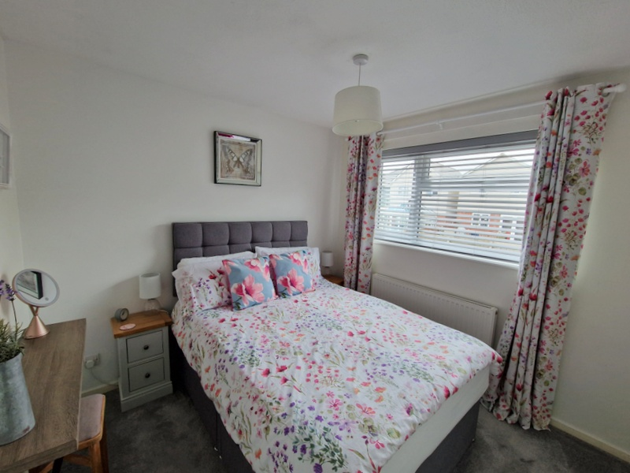
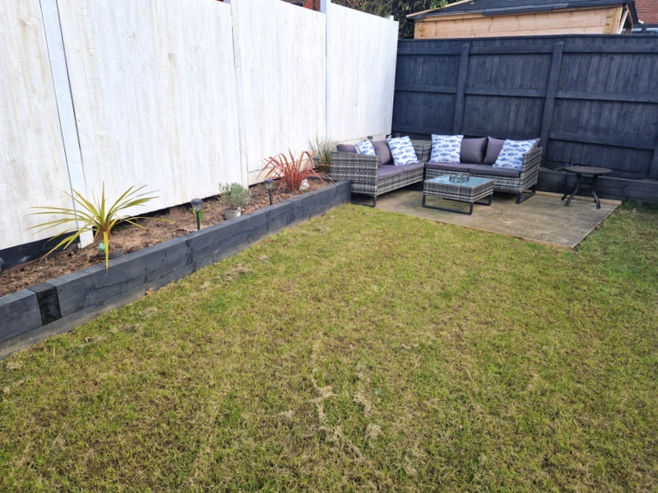
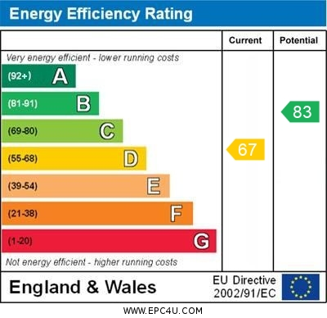
www.pennys.net
7 Marcom Close, Exmouth, EX8 5PW
GUIDE PRICE £345,000
TENURE Freehold
A Beautifully Presented And Much Improved Semi Detached House With Lovely Coastal Views Enjoying Landscaped Gardens, Ample Parking, Garage
Attractive Lounge * Stunning Open-Plan Kitchen/Breakfast Room Conservatory Extension * Three Bedrooms * Recently Fitted Bathroom Suite Gas Central Heating * Double Glazed Windows * Viewing Recommended
Pennys Estate Agents Limited for themselves and for the vendor of this property whose agents they are give notice that:- (1) These particulars do not constitute any part of an offer or a contract. (2) All statements contained in these particulars are made without responsibility on the part of Pennys Estate Agents Limited. (3) None of the statements contained in these particulars are to be relied upon as a statement or representation of fact. (4) Any intending purchaser must satisfy himself/herself by inspection or otherwise as to the correctness of each of the statements contained in these particulars. (5) The vendor does not make or give and neither do Pennys Estate Agents Limited nor any person in their employment has any authority to make or give any representation or warranty whatever in relation to this property.
PENNYS ESTATE AGENTS
2 Rolle House, Rolle Street, Exmouth, Devon, EX8 2SN
Tel: 01395 264111 EMail: help@pennys.net

Slide 2
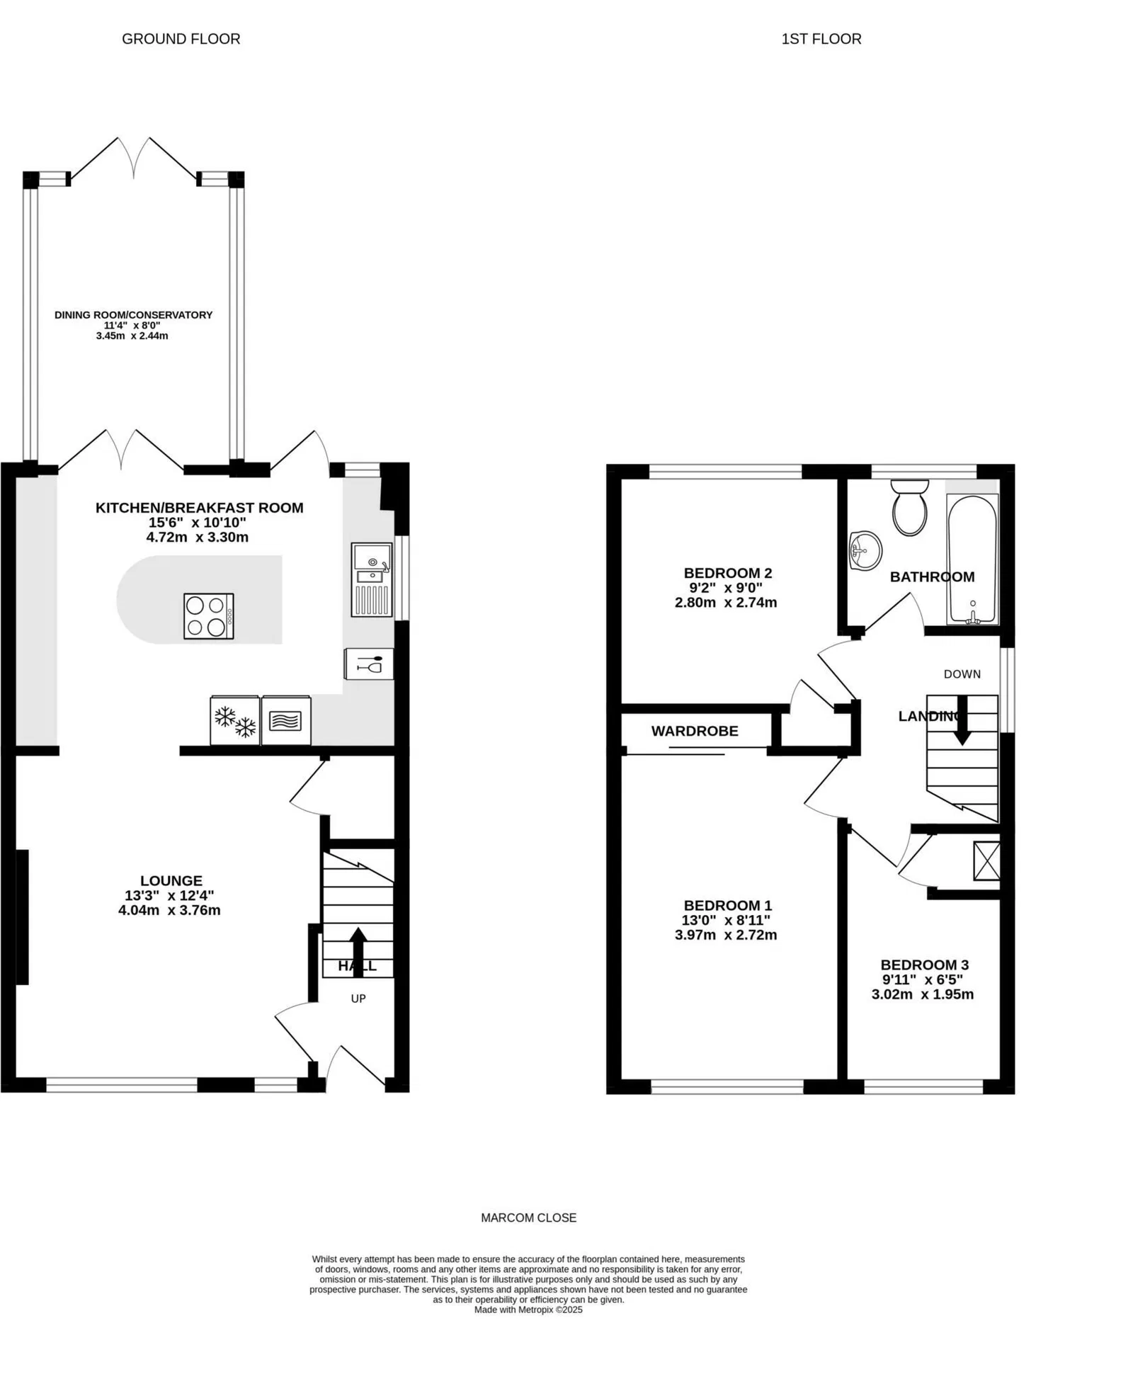
7 Marcom Close, Exmouth, EX8 5PW
THE ACCOMMODATION COMPRISES: Entrance canopy with composite front door giving access to:
ENTRANCE HALL: Radiator, stairs rising to first floor landing, glazed panelled door to:
LOUNGE: 4.06m x 3.84m (13'4" x 12'7") A bright room with uPVC double glazed window to front aspect with further double glazed picture window, wall mounted living flame electric fire, TV point, good size understairs storage cupboard, radiator, opening through to:
KITCHEN/BREAKFAST ROOM: 4.72m x 3.33m (15'6" x 10'11") A stunning room with fitted range of wood-effect worktops with matching splashback, central island breakfast unit with range of cupboards and drawer units beneath, inset induction hob with stainless steel extractor hood over with light, further range of cupboards and drawer units, plumbing for automatic washing machine and integrated dishwasher beneath worktops, carousel unit, refuse pull-out cupboard, built-in double oven, integrated fridge and freezer, wall mounted cupboards, recessed ceiling led spotlighting, double glazed windows to side and rear aspects, double glazed door giving access to the rear garden, glazed panelled double doors to:
CONSERVATORY EXTENSION: 3.45m x 2.44m (11'4" x 8'0") A fine addition to the accommodation with radiator, spotlighting, double glazed windows overlooking the rear garden, double glazed double doors opening onto outside.
FIRST FLOOR LANDING: uPVC double glazed window to side aspect.
BEDROOM 1: 3.96m x 2.77m (13'0" x 9'1") Lovely main bedroom, uPVC double glazed window to front aspect gaining views towards the estuary and coastline beyond, newly fitted built-in double wardrobe with mirror fronted sliding doors, clothes rail and shelf, TV point, radiator.
BEDROOM 2: 2.77m x 2.74m (9'1" x 9'0") uPVC double glazed window to rear aspect, radiator, TV point, built-in linen cupboard with clothes rail – a large very useful linen/airing cupboard with radiator and slatted shelving, good size access to part boarded roof space via loft ladder.
BEDROOM 3: 3.02m x 1.96m (9'11" x 6'5") overall measurement. uPVC double glazed window to front aspect, again gaining lovely views to the coastline beyond, radiator, built-in wardrobe over stairwell recess with clothes and shelf, also houses a modern gas boiler for hot water and central heating.
BATHROOM/WC: 1.88m x 1.85m (6'2" x 6'1") Stylish recently fitted suite comprising of bath with handgrips, shower unit over with fixed rainfall shower head hose and detachable shower head hose, shower curtain and rail, wash hand basin, WC with push button flush, extensively attractively tiled walls, uPVC double glazed window with patterned glass.
OUTSIDE: The property is located towards the head of a sought-after cul-de-sac and enjoys a decorative stone front garden with driveway and off-road parking together with additional decorative stone garden providing another parking area. Outside cold water tap. The driveway gives access to a single GARAGE. A side gate gives access to the newly landscaped rear garden which has been attractively planned with ease of maintenance in mind comprising of a decked sun terrace with raised water feature with a few steps leading up to a level area of lawned garden, further seating area which is positioned ideally to take full advantage of the lovely views towards the estuary and coastline beyond. Outside lighting.
GARAGE: 5.46m x 2.74m (17'11" x 9'0") Up and over door, power and light connected. uPVC door giving direct access into the garden. The garage has a part partitioned wall to separate the garage door area to a utility area, double glazed window overlooking the rear garden.
FLOOR PLAN:

