Slide 1
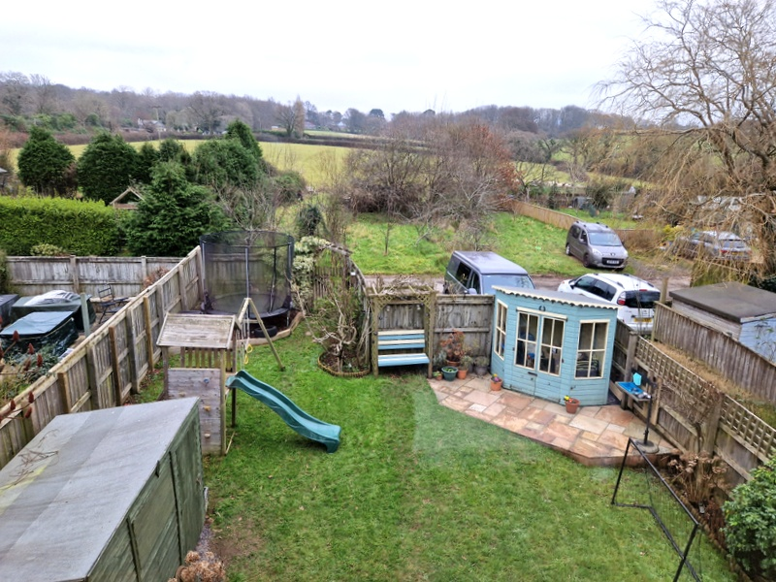
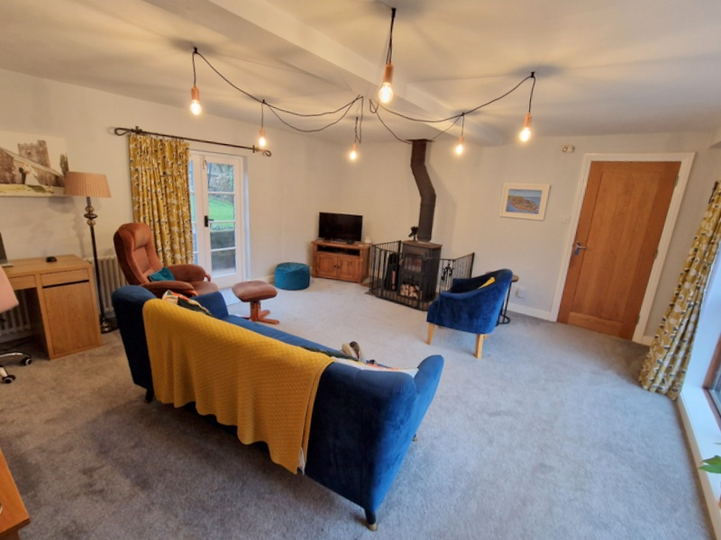
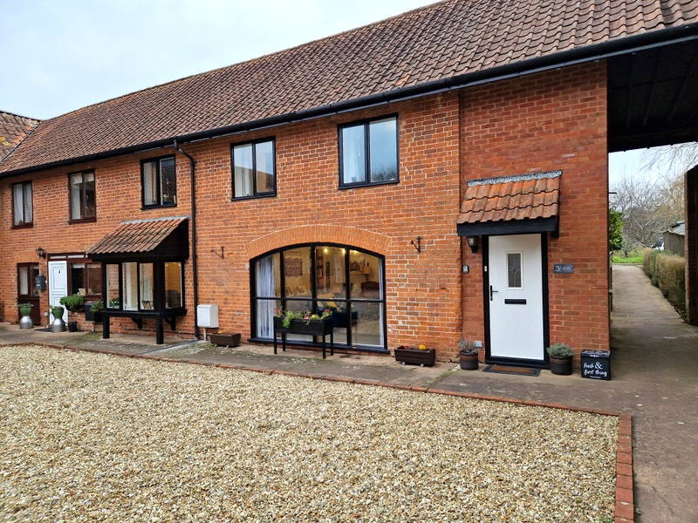
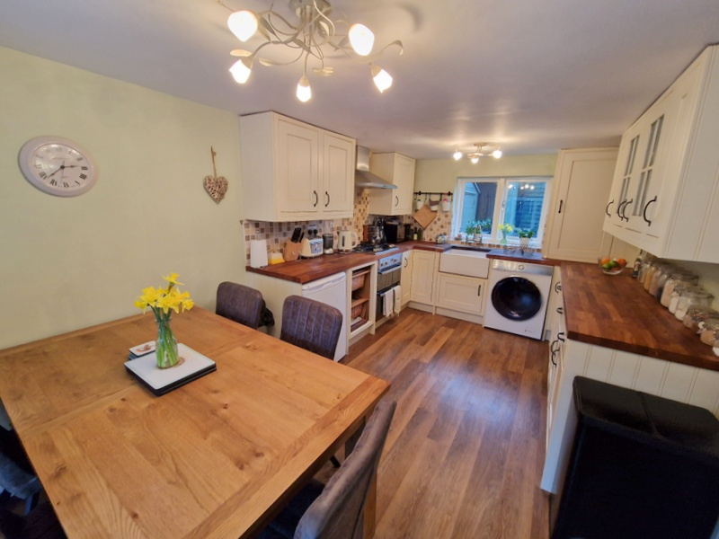
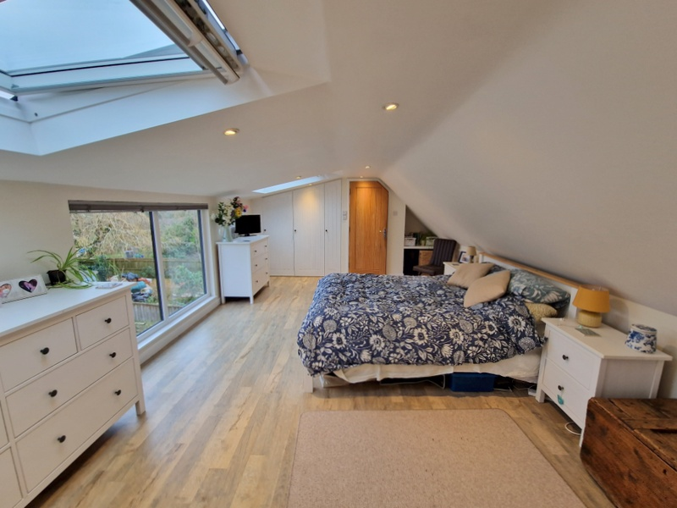
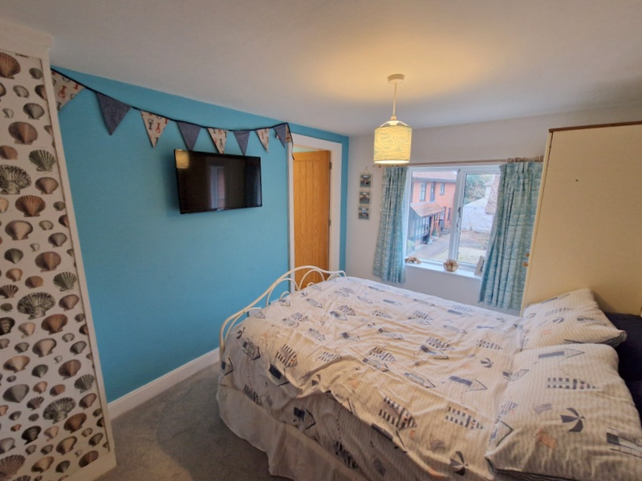
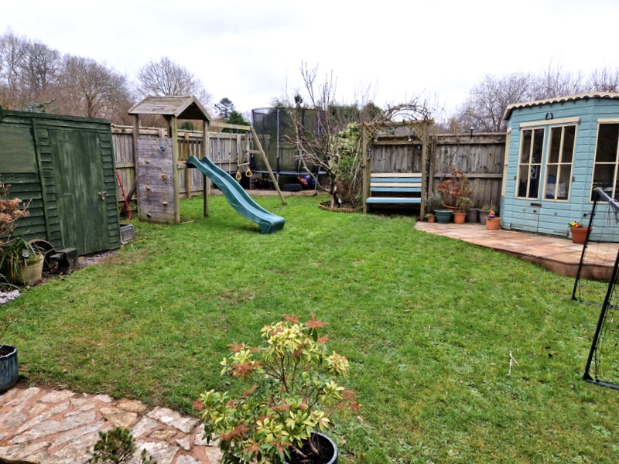
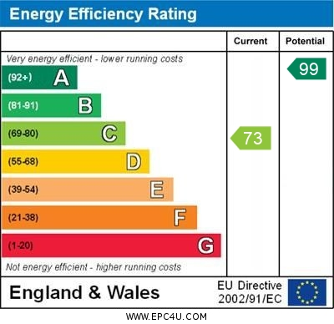
www.pennys.net
3 Withycombe Barton Mews, Exmouth, EX8 5EG
GUIDE PRICE £514,500
TENURE Freehold
A Beautifully Presented Barn Conversion Forming Part Of A Sought-After Mews Style Development In A Wonderful Semi-Rural Location On The Outskirts Of Exmouth
Reception Hall * Ground Floor Cloakroom/Wc * Spacious Lounge * Farmhouse Style Kitchen/Dining Room * Three First Floor Bedrooms – One With En-Suite Shower Room/Wc * Main Modern Bathroom Suite * Second Floor Master Bedroom Suite With En-Suite Shower Room/Wc * Gas Central Heating * Double Glazed Windows * Lovely Gardens * Parking For Two Cars * Viewing Recommended
Pennys Estate Agents Limited for themselves and for the vendor of this property whose agents they are give notice that:- (1) These particulars do not constitute any part of an offer or a contract. (2) All statements contained in these particulars are made without responsibility on the part of Pennys Estate Agents Limited. (3) None of the statements contained in these particulars are to be relied upon as a statement or representation of fact. (4) Any intending purchaser must satisfy himself/herself by inspection or otherwise as to the correctness of each of the statements contained in these particulars. (5) The vendor does not make or give and neither do Pennys Estate Agents Limited nor any person in their employment has any authority to make or give any representation or warranty whatever in relation to this property.
PENNYS ESTATE AGENTS
2 Rolle House, Rolle Street, Exmouth, Devon, EX8 2SN
Tel: 01395 264111 EMail: help@pennys.net

Slide 2
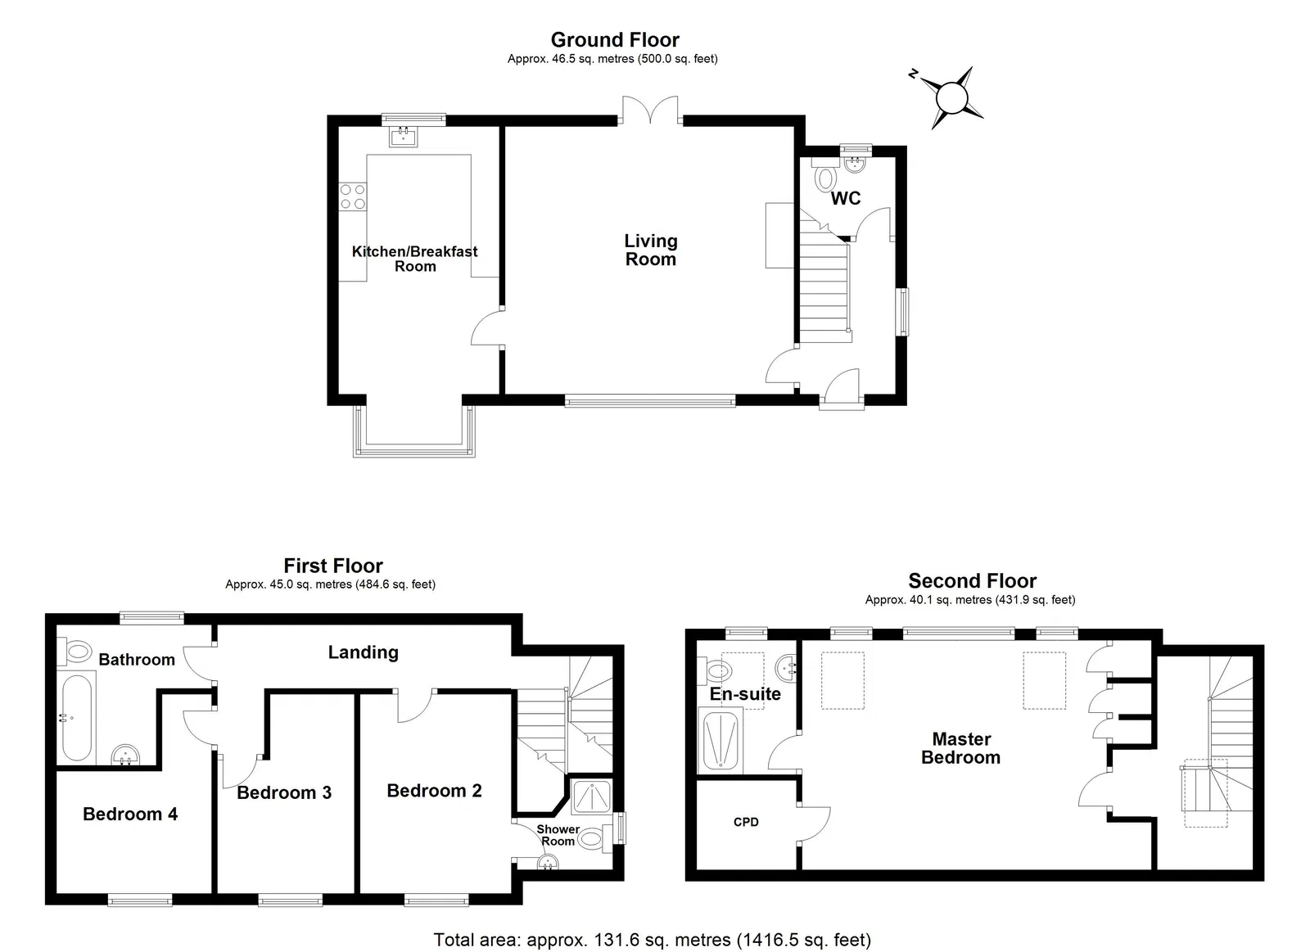
3 Withycombe Barton Mews, Exmouth, EX8 5EG
Withycombe Barton Mews is a stylish barn conversion situated in an excellent semi rural position on the outskirts of Exmouth, offering a unique lifestyle opportunity within the town and boasting lovely views over surrounding countryside. Outside, the property enjoys its own good size gardens and parking bay for two cars, viewing is strongly recommended.
THE ACCOMMODATION COMPRISES: Entrance canopy with composite front door giving access to:
RECEPTION HALL: Wood effect flooring, radiator, sealed unit double glazed window to side aspect, staircase rising to first floor, telephone point, electric consumer unit.
GROUND FLOOR CLOAKROOM/WC: Fitted with space saver wash hand basin with tiled splashback, cabinet beneath, WC with push button flush with display surface, window with patterned glass.
SITTING ROOM: 5.16m x 4.75m (16'11" x 15'7") A charming room which includes a ‘work from home/study’ area, with log burner stove standing on tiled hearth, antique style radiator, TV point, feature large arch sealed unit double glazed window overlooking the courtyard and glazed panelled double doors opening onto the property’s private garden.
KITCHEN/DINING ROOM: 4.72m x 2.82m (15'6" x 9'3") Enjoying a farmhouse style kitchen with solid wood worktops with Belfast style sink with integrated double drainers with mixer tap, cupboards, drawer units, wine rack, plumbing for automatic washing machine beneath, four-ring gas hob with built-in oven below and extractor hood, tiled surrounds, wall mounted cupboards – one housing the Vaillant gas boiler for hot water and central heating, incorporating two glass fronted display units, square bay window with deep window sill overlooking the courtyard, stylish upright radiator, sealed unit double glazed window overlooking the property’s private gardens.
FIRST FLOOR LANDING: Radiator, turning staircase rising to second floor with useful storage cupboard beneath.
BEDROOM 2: 3.51m x 2.67m (11'6" x 8'9") Radiator, sealed unit double glazed window overlooking the courtyard garden, TV point, antique style radiator.
EN-SUITE SHOWER ROOM/WC: Stylishly fitted with shower cubicle with shower unit and sliding shower splash screen doors, vanity style wash hand basin with tiled splashback, WC with push button flush, radiator, window with patterned glass.
BEDROOM 3: 3.4m x 2.31m (11'2" x 7'7") maximum overall measurement. Sealed unit double glazed window overlooking the courtyard, antique style radiator.
BEDROOM 4: 3.48m x 2.84m (11'5" x 9'4") maximum overall measurement. Sealed unit double glazed window overlooking the courtyard, antique style radiator, fitted shelving.
FAMILY BATHROOM/WC: 3.05m x 2.44m (10'0" x 8'0") maximum overall measurement. Modern suite comprising whirlpool bath with Mira shower unit with rainfall shower head hose and detachable shower head hose, vanity style wash hand basin with tiled splashback, fitted mirror, integrated light and shaver socket over, WC with push button flush, fitted shelved wall cabinet with storage cupboards beneath, antique style radiator, chrome heated towel rail, underfloor heating, sealed unit double glazed window overlooking the private gardens.
SECOND FLOOR LANDING AREA: With OFFICE SPACE, exposed ceiling beam, double glazed velux window, recessed ceiling spotlighting, door to the main bedroom suite:
MASTER BEDROOM: 6.1m x 3.91m (20'0" x 12'10") A truly stunning bedroom with large uPVC double glazed picture windows enjoying outlook over the gardens to farmland beyond with two additional double glazed electrically operated velux windows allowing an abundance of light, built-in bespoke wardrobes, large cupboard for storage with fitted shelves, access to eaves storage space, stylish upright radiator, recessed ceiling spotlighting, TV point.
EN-SUITE SHOWER ROOM/WC: 2.36m x 1.88m (7'9" x 6'2") Beautifully fitted with stylish suite comprising ease of access shower cubicle with shower unit and shower splash screen, vanity style wash hand basin with tiled splashback and fitted mirror with integrated light and shaver socket, WC with push button flush, uPVC double glazed window with patterned glass, additional double glazed velux window, chrome heated towel rail.
OUTSIDE: Forming part of a select Mews style development the property benefits from a parking bay to the front offering parking for two cars. Pedestrian gate gives access to the property’s own good size garden which has been beautifully planned and presented comprising of lawned gardens edged with shrub beds, three TIMBER GARDEN STORES, patio sun terrace with SUMMER HOUSE. In the centre of the barns there is a communal decorative stone courtyard garden.
FLOOR PLAN:

