Slide 1
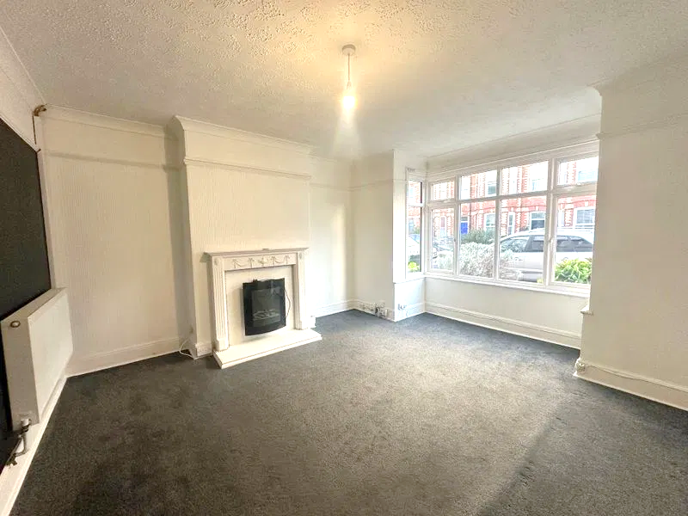
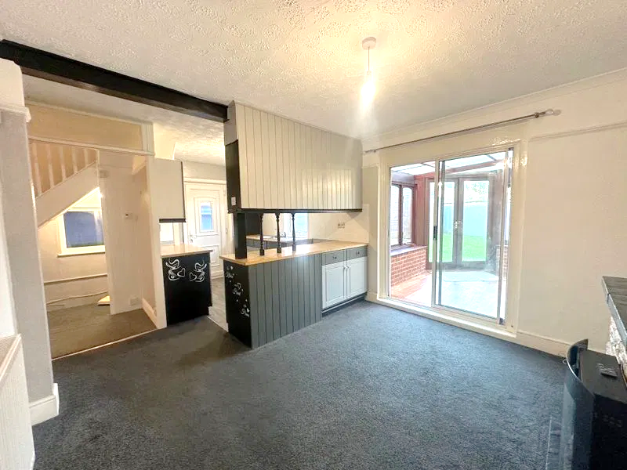
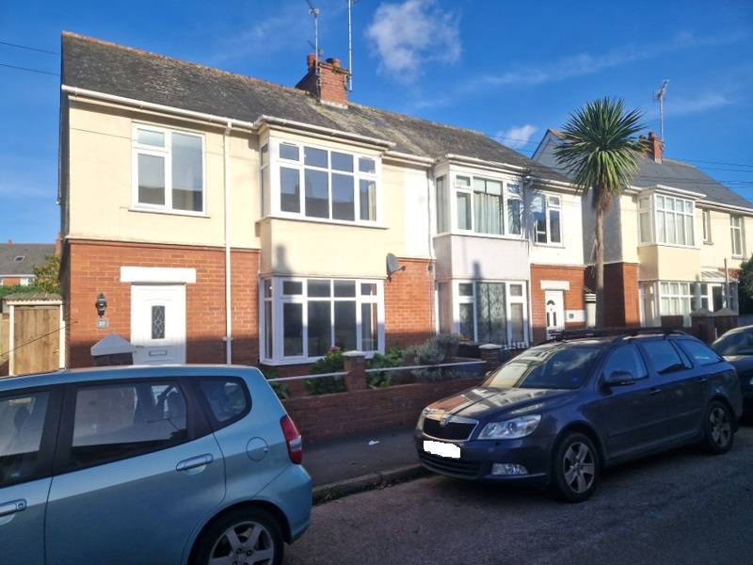
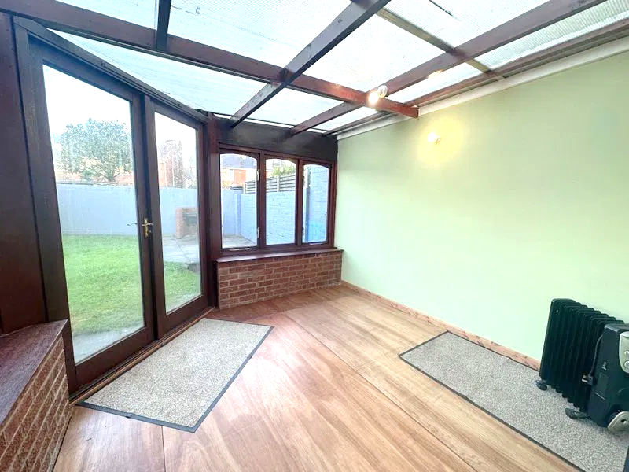
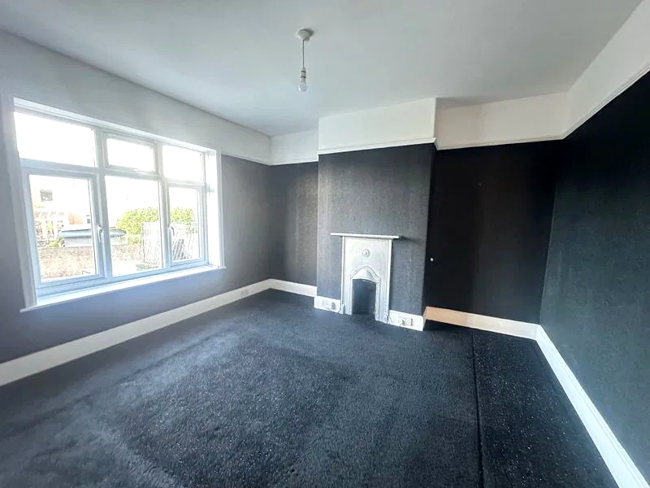
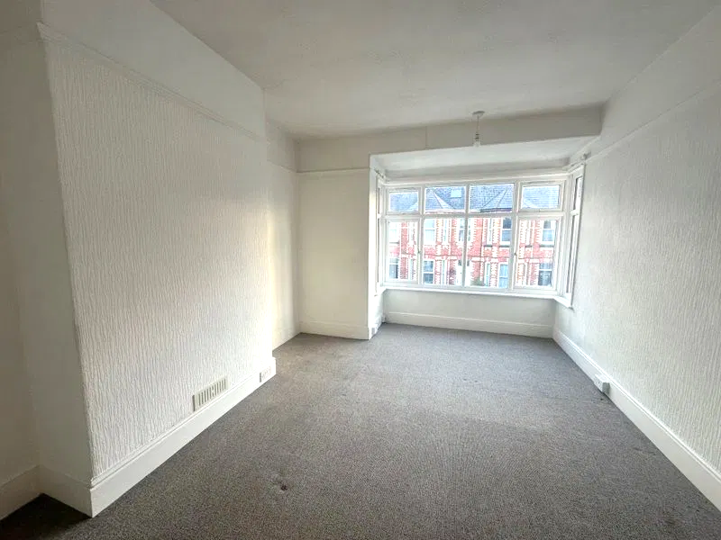
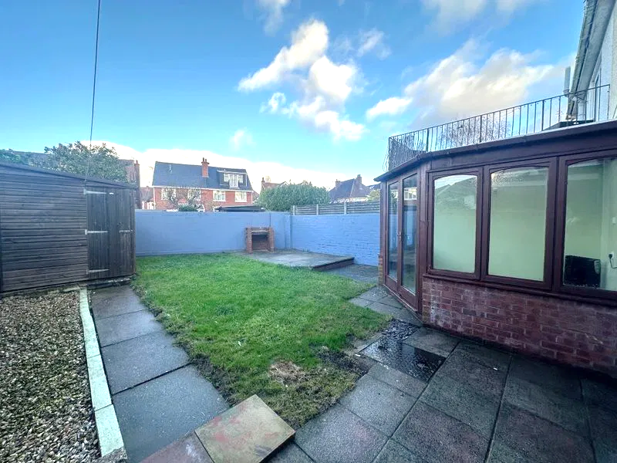
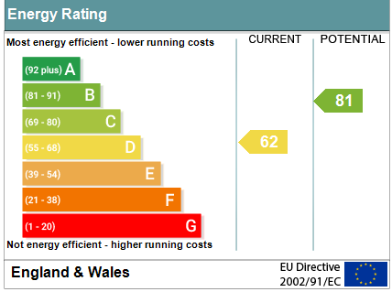
www.pennys.net
27 Park Road, Exmouth, EX8 1TL
GUIDE PRICE £315,000
TENURE Freehold
An Older Style Semi Detached House Enjoying An Enviable Location Close To Schools, Phear Park, Shops, Town Centre And Railway Station
Entrance Vestibule & Reception Hall * Square Bay Lounge * Open-Plan Kitchen/Dining Room * Sun Room * Three First Floor Good Size Bedrooms * Modern Bathroom/Wc With Bath And Shower Cubicle * Upvc Double Glazed Windows * Gas Central Heating Via Modern Boiler* Super Family Home * No Ongoing Chain
Pennys Estate Agents Limited for themselves and for the vendor of this property whose agents they are give notice that:- (1) These particulars do not constitute any part of an offer or a contract. (2) All statements contained in these particulars are made without responsibility on the part of Pennys Estate Agents Limited. (3) None of the statements contained in these particulars are to be relied upon as a statement or representation of fact. (4) Any intending purchaser must satisfy himself/herself by inspection or otherwise as to the correctness of each of the statements contained in these particulars. (5) The vendor does not make or give and neither do Pennys Estate Agents Limited nor any person in their employment has any authority to make or give any representation or warranty whatever in relation to this property.
PENNYS ESTATE AGENTS
2 Rolle House, Rolle Street, Exmouth, Devon, EX8 2SN
Tel: 01395 264111 EMail: help@pennys.net

Slide 2
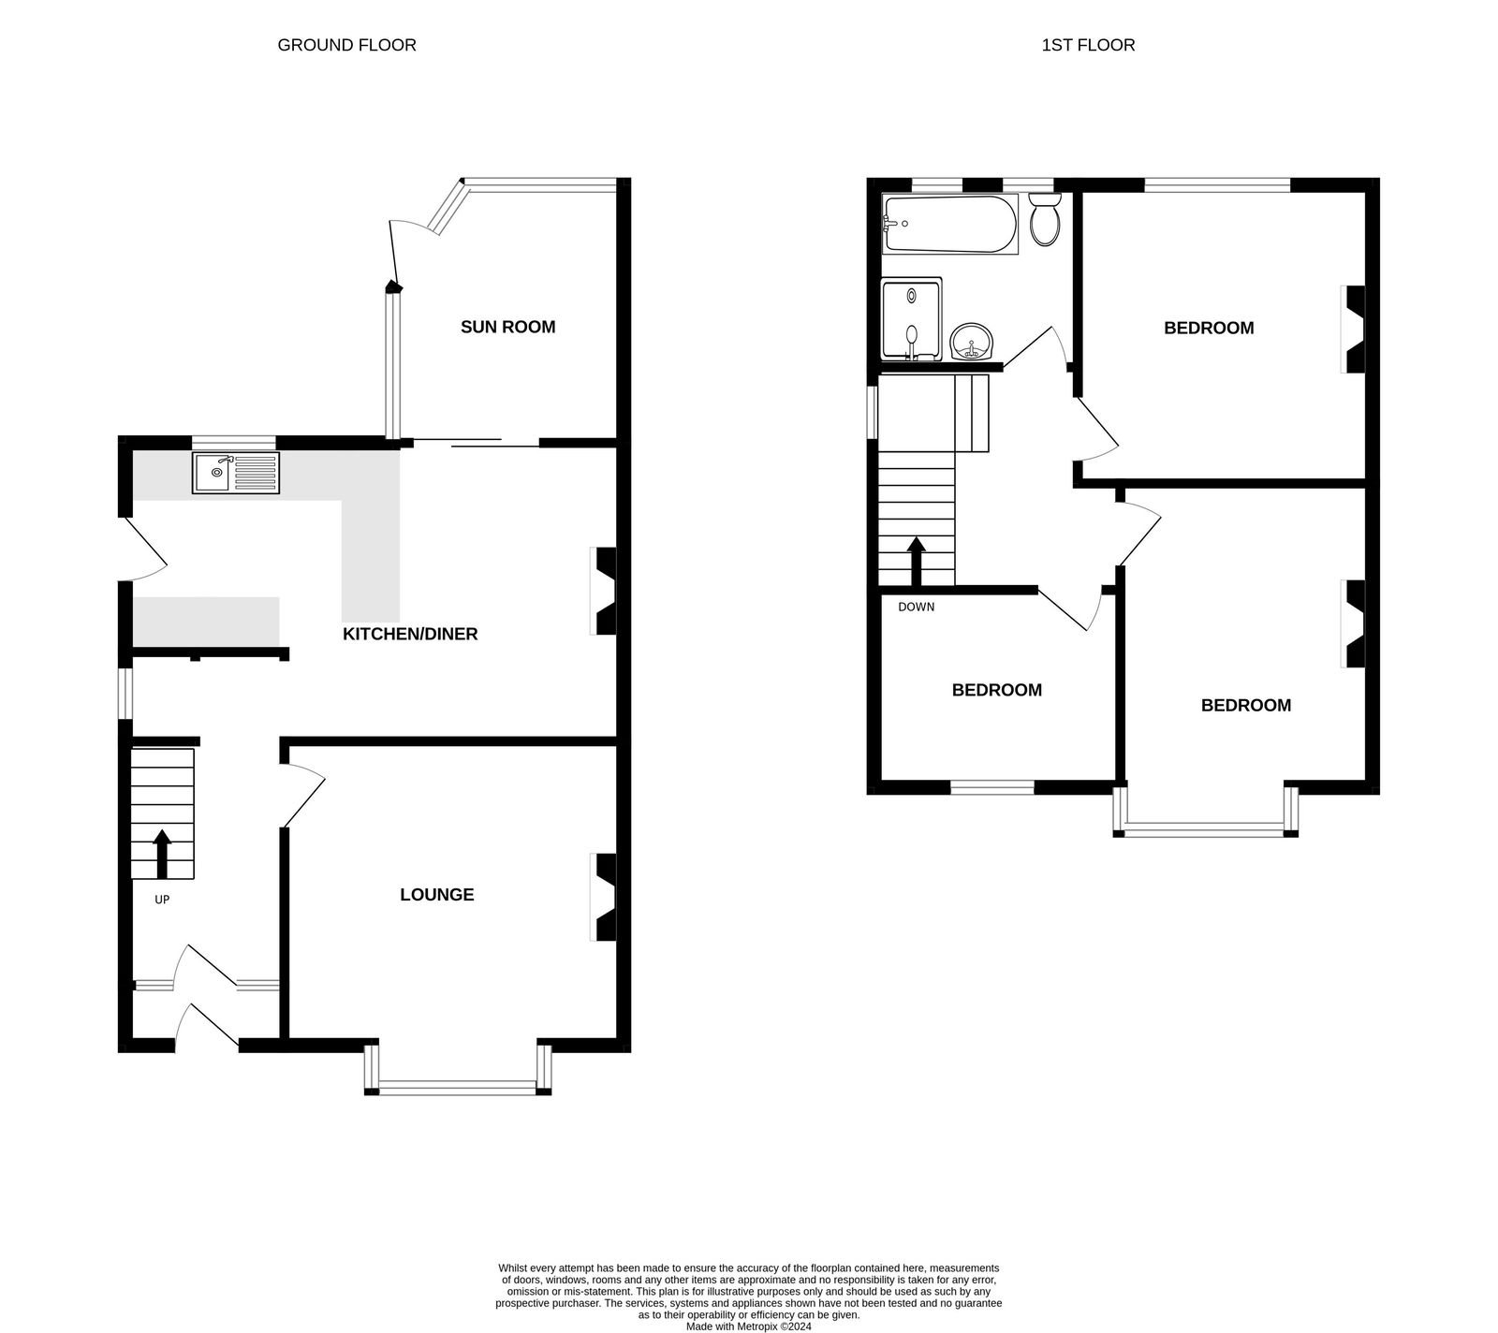
27 Park Road, Exmouth, EX8 1TL
THE ACCOMMODATION COMPRISES: uPVC double glazed front door with double glazed patterned window inset to:
ENTRANCE VESTIBULE: Inner solid wood door with patterned window inset, picture window side screens leading to:
RECEPTION HALL: Radiator, picture rail, stairs rising to FIRST FLOOR LANDING, with useful understairs recess with light, uPVC double glazed window, power socket.
LOUNGE: 4.39m x 4.04m (14'5" x 13'3") maximum into uPVC double glazed square bay window which overlooks the front aspect, radiator, TV points, wooden fire surround housing electric living flame fire with remote control, coved ceiling.
OPEN-PLAN KITCHEN/DINING ROOM: 6.05m x 3.66m (19'10" x 12'0") narrowing to 2.51m (8'3") Kitchen fitted with wood effect worktops with inset single drainer sink unit with cupboards and drawer units beneath work surfaces, wall mounted cupboards, gas and electric cooker points, tiled surrounds, modern Worcester gas boiler for hot water and central heating, uPVC double glazed door with pattern window inset to outside. DINING AREA: Radiator, picture rail, stone fireplace with hearth housing electric living flame fire, sliding double glazed patio doors to:
SUN ROOM: 2.87m x 2.84m (9'5" x 9'4") With wood laminate flooring, windows and double doors opening onto the rear garden, power and light connected.
FIRST FLOOR LANDING: With uPVC double glazed picture window with patterned glass, access to roof space via loft ladder which is boarded, spacious and provides space for conversion, subject to the necessary consents.
BEDROOM 1: 4.42m x 3.1m (14'6" x 10'2") measurement into uPVC double glazed square bay window to front aspect, radiator, picture rail.
BEDROOM 2: 3.58m x 3.48m (11'9" x 11'5") Good size double bedroom with feature fire surround, picture rail, radiator, uPVC double glazed window to rear aspect.
BEDROOM 3: 2.74m x 2.29m (9'0" x 7'6") Good size third bedroom, radiator, uPVC double glazed window to front aspect, picture rail.
BATHROOM/WC: 2.36m x 1.98m (7'9" x 6'6") Comprising bath, good size shower cubicle with sliding shower splash screen doors, shower unit, splash back walls, pedestal wash hand basin with mirror fronted medicine cabinet over, chrome heated towel rail with Dimplex wall heater, two uPVC double glazed windows with patterned glass, extractor fan, extensively tiled walls.
OUTSIDE: To the front of the property is a decorative stone garden area with pedestrian gate and path leading to the property, covered side pathway providing useful storage area leads through to the rear garden which is fully enclosed with patio sun terrace with brick barbeque area, substantial TIMBER GARDEN SHED with power and light connected, lawned garden and decorative stone garden area.
Mortgage Assistance: We are pleased to recommend Meredith Morgan Taylor, who would be pleased to help no matter which estate agent you finally buy through. For a free initial chat please contact us on to arrange an appointment. Your home may be repossessed if you do not keep up repayments on your mortgage. Meredith Morgan Taylor Ltd is an appointed representative of The Openwork Partnership, a trading style of Openwork Ltd which is authorised and regulated by the Financial Conduct Authority (FCA).
FLOOR PLAN:

