Slide 1
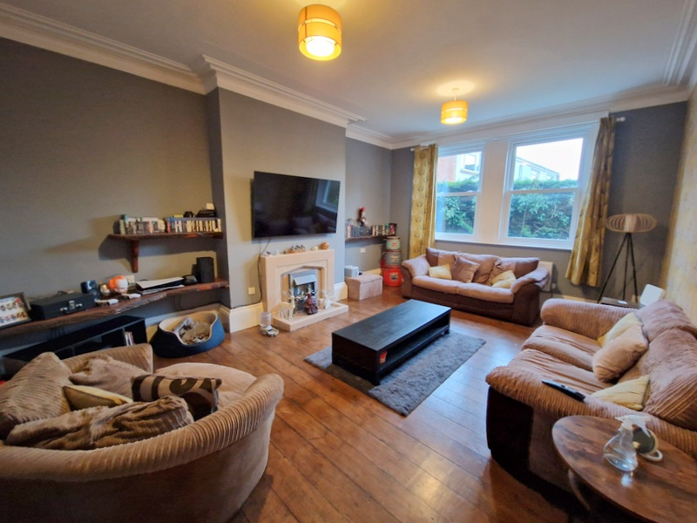
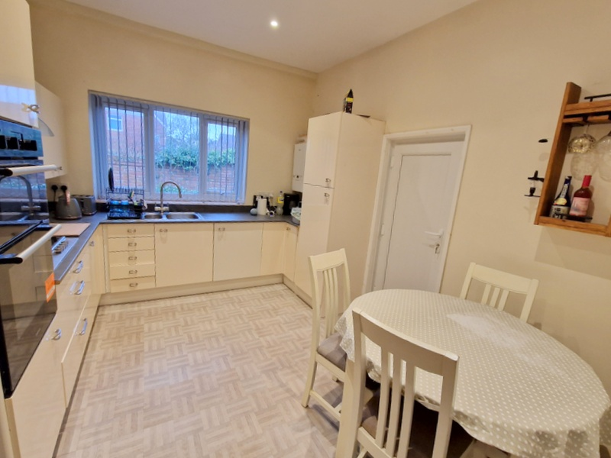
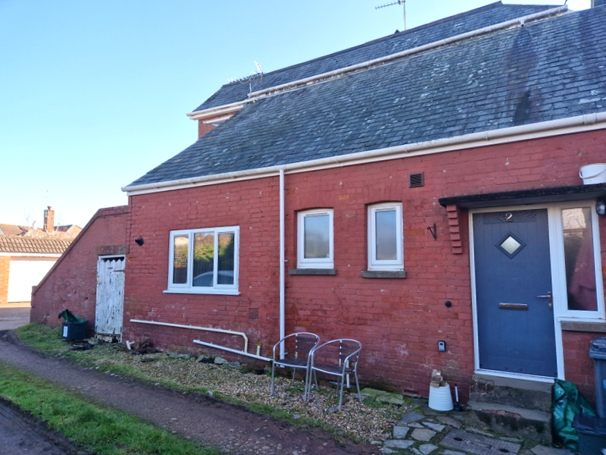
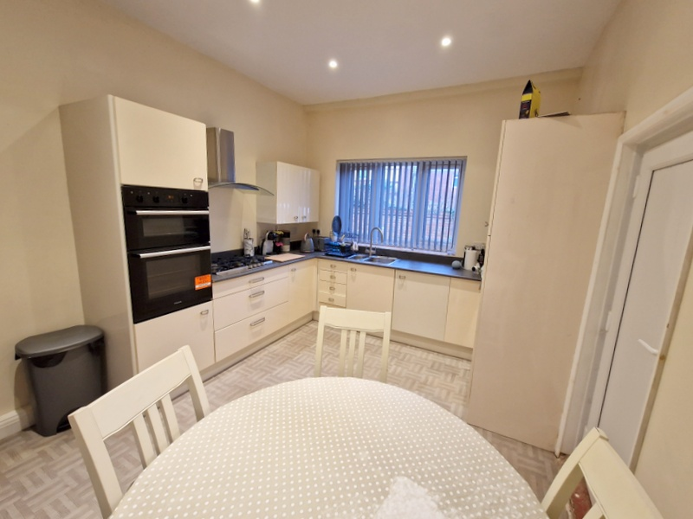
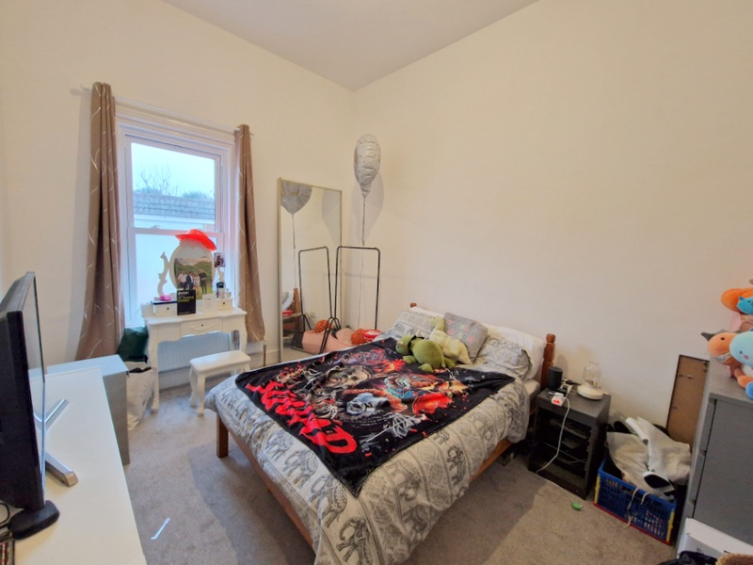
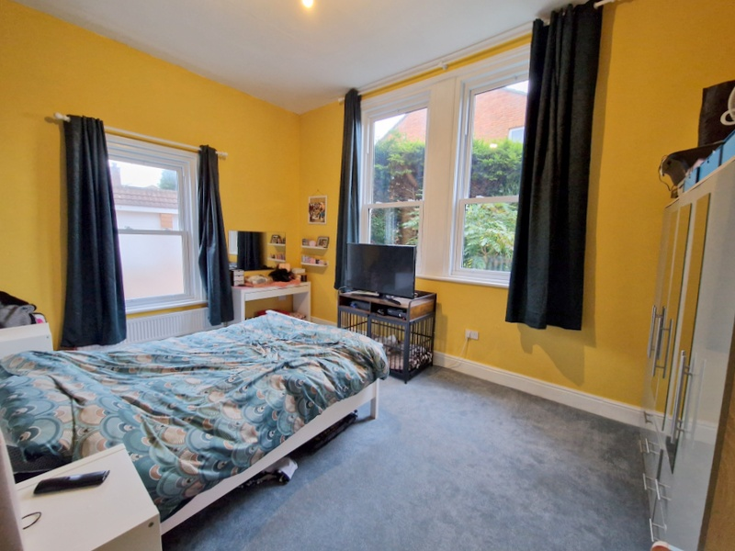
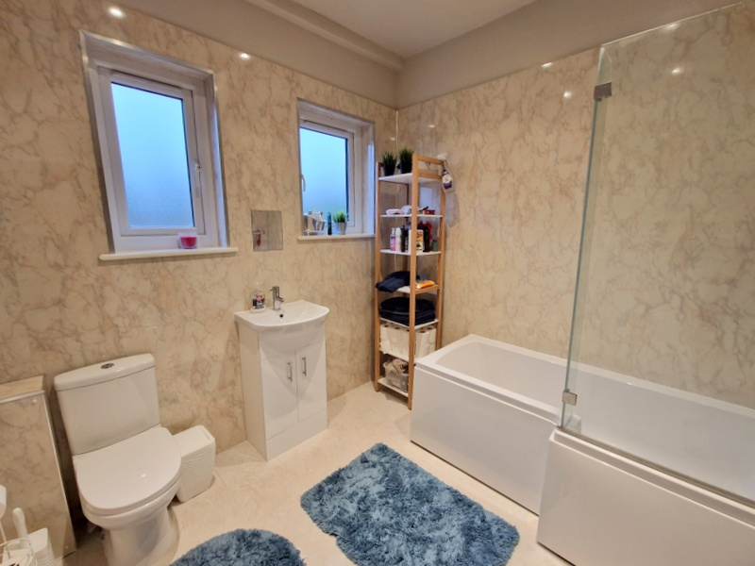
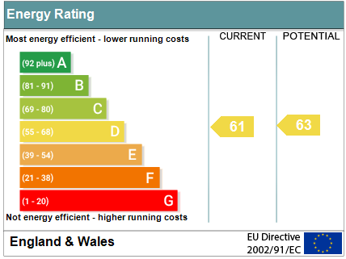
www.pennys.net
Flat 2 Warberry Lodge, 11 Cyprus Road, Exmouth, EX8 2DZ
GUIDE PRICE £250,000
TENURE Leasehold
An Extremely Spacious Ground Floor Apartment Enjoying An Enviable Location Only A Short Distance From The Seafront And Town Centre Offering Elegant And Spacious Accommodation
Modernised And Refurbished Accommodation * Spacious And Airy Rooms Own Private Entrance * Spacious Reception Hall * Lounge/Dining Room With Stripped Wood Flooring * Two Large Double Bedrooms * Modern Kitchen And Bathroom Suite * Gas Central Heating Via Modern Boiler * Rewired * Modern Upvc Double Glazed Windows * Viewing Recommended
Pennys Estate Agents Limited for themselves and for the vendor of this property whose agents they are give notice that:- (1) These particulars do not constitute any part of an offer or a contract. (2) All statements contained in these particulars are made without responsibility on the part of Pennys Estate Agents Limited. (3) None of the statements contained in these particulars are to be relied upon as a statement or representation of fact. (4) Any intending purchaser must satisfy himself/herself by inspection or otherwise as to the correctness of each of the statements contained in these particulars. (5) The vendor does not make or give and neither do Pennys Estate Agents Limited nor any person in their employment has any authority to make or give any representation or warranty whatever in relation to this property.
PENNYS ESTATE AGENTS
2 Rolle House, Rolle Street, Exmouth, Devon, EX8 2SN
Tel: 01395 264111 EMail: help@pennys.net

Slide 2
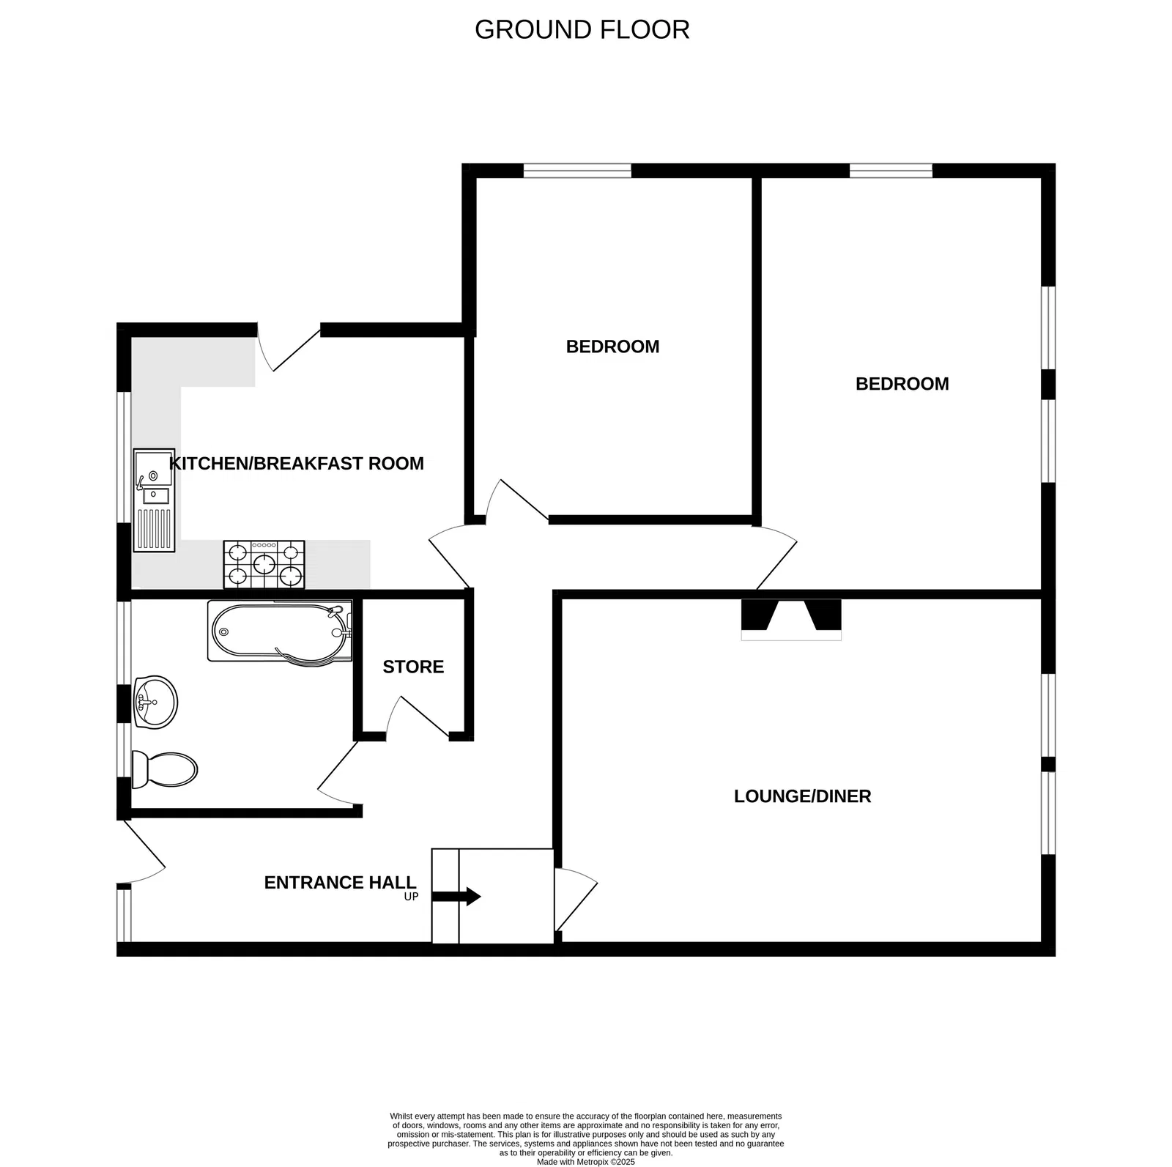
Flat 2 Warberry Lodge, 11 Cyprus Road, Exmouth, EX8 2DZ
THE ACCOMMODATION COMPRISES: Own private composite front door giving access to:
RECEPTION HALL: A fine and spacious entrance to the apartment with two radiators, uPVC double glazed window with patterned glass, electric meter and consumer unit, door to walk-in storage cupboard with light.
LOUNGE/DINING ROOM: 5.79m x 4.29m (19'0" x 14'1") A spacious and elegant room with stripped wood flooring, tiled fireplace with matching hearth housing electric living flame fire, TV point, two sets of double glazed sash style windows to side aspect, radiator, cornice ceiling, fitted shelving in recess.
KITCHEN/BREAKFAST ROOM: 4.22m x 3.2m (13'10" x 10'6") Spacious room stylishly fitted with a range of working surfaces with inset one and a half bowl single drainer sink unit with mixer tap with matching splashback, range of cupboards and drawer units beneath worktops, integrated fridge and freezer, wall mounted cupboards, five-ring gas hob with stainless steel chimney style extractor hood over, built-in oven and grill with cupboards above and below, recessed ceiling led spotlighting, modern gas boiler for hot water and central heating, radiator, uPVC double glazed window to front aspect and uPVC door to:
UTILITIES CUPBOARD: Plumbing for automatic washing machine, space for tumble dryer, light and uPVC double glazed window with patterned glass.
BEDROOM 1: 5.18m into wall recess x 3.61m (17'0" x 11'10") An extremely spacious dual aspect room with three sets of uPVC double glazed sash style windows to the side snd rear aspects, radiator TV point.
BEDROOM 2: 4.14m x 3.1m (13'7" x 10'2") uPVC sash style window to side aspect, TV point, radiator.
BATHROOM/WC: 2.62m x 2.49m (8'7" x 8'2") Stylishly fitted comprising bath with shower unit over, vanity style wash hand basin, WC with push button flush, splashback walls to bath, wash hand basin and toilet area walls, chrome heated towel rail, recessed led ceiling spotlighting, extractor fan, two sets of uPVC double glazed windows with patterned glass.
OUTSIDE: No gardens to maintain.
TENURE & OUTGOINGS: Lease: 189 years dated from December 1980 [145 years remaining]. The building itself is managed by the residents of Warberry Lodge. Service Charge: Approximately £1,200 per annum. Ground Rent: £25 per annum.
FLOOR PLAN:

